Slide 1



LIFE/work balance
We have started a #LIFEworkbalance campaign and we need your help to complete our LIFE/work balance survey.
We hope to publish the results soon, so please give 15 minutes of your time to help us get a true picture of school life.
Want to be a part of this campaign? Take the survey on our website and share it with your colleagues!
© Classroom Secrets Limited 2019

Slide 2
Year 4 – Autumn Block 4 – Multiplication and Division – 6 Times Table and Division Facts
About This Resource:
This PowerPoint has been designed to support your teaching of this small step. It includes a starter activity and an example of each question from the Varied Fluency and Reasoning and Problem Solving resources also provided in this pack. You can choose to work through all examples provided or a selection of them depending on the needs of your class.
National Curriculum Objectives:
Mathematics Year 4: (4N1) Count in multiples of 6, 7, 9, 25 and 1,000
Mathematics Year 4: (4C6a) Recall multiplication division facts for multiplication tables up to 12 × 12 Mathematics Year 4: (4c6b) Use place value, known and derived facts to multiply and divide mentally, including: multiplying by 0 and 1; dividing by 1; multiplying together three numbers
More Year 4 Multiplication and Division resources.
Did you like this resource? Don’t forget to review it on our website.
© Classroom Secrets Limited 2018

Slide 3
Year 4 – Autumn Block 4 – Multiplication and Division
Step 8: 6 Times Table and Division Facts
© Classroom Secrets Limited 2018

Slide 4
Introduction
Use the 6 times table to complete the multiplication wheel.
x 8
x 9
x 10
6
x 12
x 6
x 5
x 2
x 4
© Classroom Secrets Limited 2018

Slide 5
Introduction
Use the 6 times table to complete the multiplication wheel.
48
54
60
x 8
x 9
72
x 10
6
x 12
x 6
x 5
36
30
x 2
x 4
12
24
© Classroom Secrets Limited 2018

Slide 6
Varied Fluency 1
Complete the statements below.
6 | x |  | = | 360
540 | ÷ |  | = | 90
80 | x | 6 | =
300 | ÷ | 60 | =
© Classroom Secrets Limited 2018

Slide 7
Varied Fluency 1
Complete the statements below.
6 | x | 60 | = | 360
540 | ÷ | 6 | = | 90
80 | x | 6 | = | 480
300 | ÷ | 60 | = | 5
© Classroom Secrets Limited 2018

Slide 8
Varied Fluency 2
Match the calculations to their answers.
480
6 x 8
408
80 x 6
4,080
48
800 x 6
4,800
© Classroom Secrets Limited 2018

Slide 9
Varied Fluency 2
Match the calculations to their answers.
480
6 x 8
408
80 x 6
4,080
48
800 x 6
4,800
© Classroom Secrets Limited 2018

Slide 10
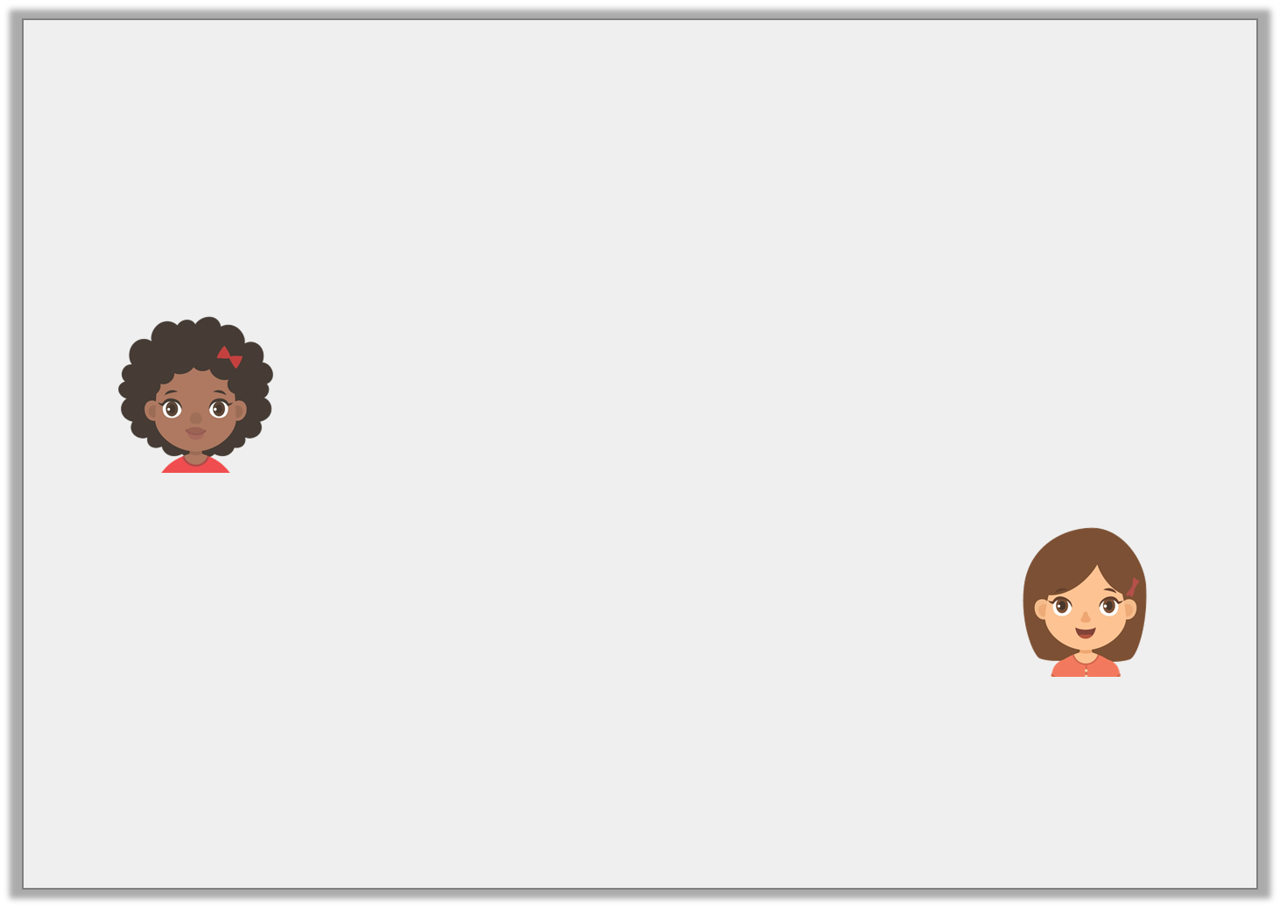
Varied Fluency 3
Annabelle buys 60 hair pins everyday for 7 seven days. Nina bought 540 hair pins over 6 days. Complete the calculation for each child.
 | x |  | =
Annabelle
 | ÷ |  | =
Nina
© Classroom Secrets Limited 2018

Slide 11
Varied Fluency 3
Annabelle buys 60 hair pins everyday for 7 seven days. Nina bought 540 hair pins over 6 days. Complete the calculation for each child.
60 | x | 7 | = | 420
Annabelle
540 | ÷ | 6 | = | 90
Nina
© Classroom Secrets Limited 2018

Slide 12
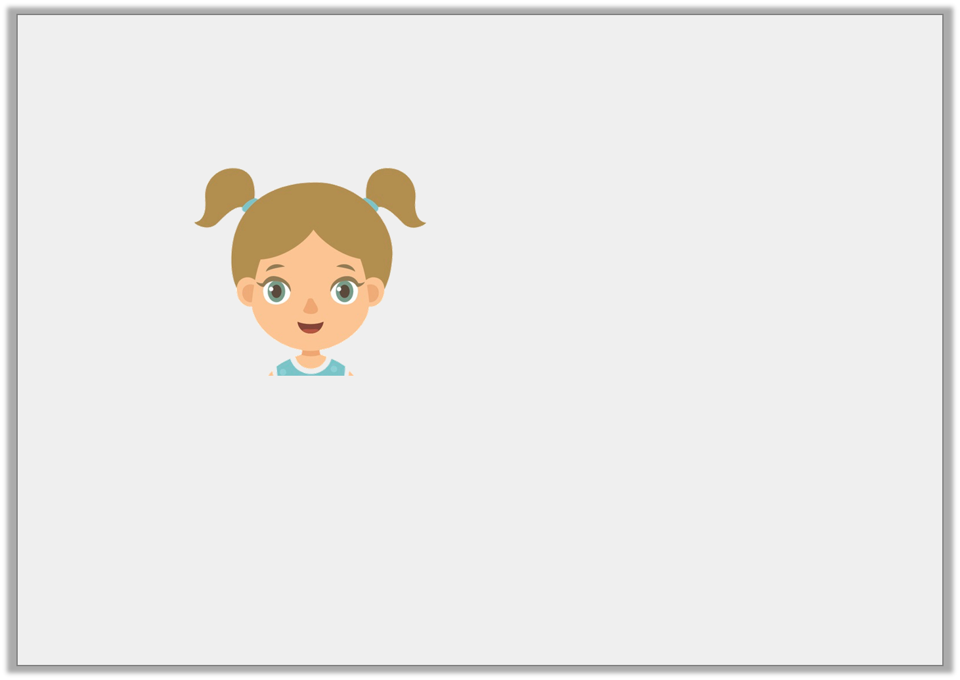
Reasoning 1
Michelle is calculating 720 ÷ 60.
Is Michelle correct? Explain your answer.
Eleven lots of 60 makes 720.
© Classroom Secrets Limited 2018

Slide 13
Reasoning 1
Michelle is calculating 720 ÷ 60.
Is Michelle correct? Explain your answer.
No, Michelle is incorrect because…
Eleven lots of 60 makes 720.
© Classroom Secrets Limited 2018

Slide 14
Reasoning 1
Michelle is calculating 720 ÷ 60.
Is Michelle correct? Explain your answer.
No, Michelle is incorrect because eleven lots of 60 = 660. 12 lots of 60 = 720.
Eleven lots of 60 makes 720.
© Classroom Secrets Limited 2018

Slide 15
Reasoning 2
Qasim needs 360 wristbands for his concert. Wristbands are sold in packets of 30.
The wholesale shop has 10 packets of wristbands.
Qasim buys all the packets available at the shop.
Has he bought enough wristbands for his concert? Prove it.
© Classroom Secrets Limited 2018

Slide 16
Reasoning 2
Qasim needs 360 wristbands for his concert. Wristbands are sold in packets of 30.
The wholesale shop has 10 packets of wristbands.
Qasim buys all the packets available at the shop.
Has he bought enough wristbands for his concert? Prove it.
No, Qasim has not bought enough wristbands because…
© Classroom Secrets Limited 2018

Slide 17
Reasoning 2
Qasim needs 360 wristbands for his concert. Wristbands are sold in packets of 30.
The wholesale shop has 10 packets of wristbands.
Qasim buys all the packets available at the shop.
Has he bought enough wristbands for his concert? Prove it.
No, Qasim has not bought enough wristbands because
30 x 10 = 300. He needs to buy 2 more packets.
© Classroom Secrets Limited 2018

Slide 18
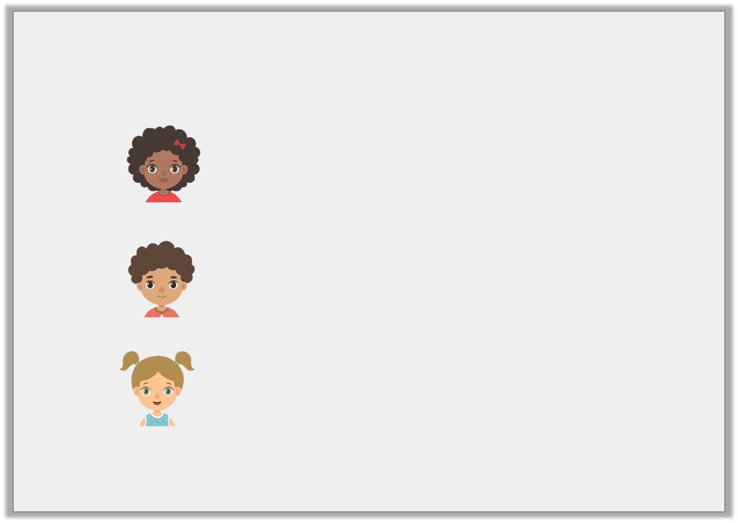
Problem Solving 1
Match the children below to the correct multiples of 6.
My number is less than 30 x 12 and has a digit sum of 6.
Martha
My number is greater than 120 but less than 60 x 4.
Callum
My number is the sum of Martha and Callum’s numbers and has a digit sum of 6.
Bella
180
540
240
420
© Classroom Secrets Limited 2018

Slide 19
Problem Solving 1
Match the children below to the correct multiples of 6.
My number is less than 30 x 12 and has a digit sum of 6.
240
Martha
My number is greater than 120 but less than 60 x 4.
180
Callum
My number is the sum of Martha and Callum’s numbers and has a digit sum of 6.
420
Bella
540
© Classroom Secrets Limited 2018

