Slide 1


Y3-4 Solving Word Problems
Addition and Subtraction
Commissioned by The PiXL Club Ltd.
October 2019
This resource is strictly for the use of member schools for as long as they remain members of The PiXL Club. It may not be copied, sold nor transferred to a third party or used by the school after membership ceases. Until such time it may be freely used within the member school.
All opinions and contributions are those of the authors. The contents of this resource are not connected with nor endorsed by any other company, organisation or institution.
PiXL Club Ltd endeavour to trace and contact copyright owners. If there are any inadvertent omissions or errors in the acknowledgements or usage, this is unintended and PiXL will remedy these on written notification
© Copyright The PiXL Club Limited, 2019

Slide 2
Teacher guidance
Typically, pupils lack confidence tackling word problems, mainly because they involve several steps and a large amount of information to process. Barriers to successfully answering these may, of course, be the mathematical concepts being assessed, but the amount of reading, the challenging vocabulary, as well as identifying the correct operation/s to perform, is not to be underestimated.
This therapy begins by explaining a suggested teaching strategy for these question types. The intention of this strategy is to develop pupil confidence in tackling such questions through high-quality modelling. Using the teach, model and apply format, it will take pupils through this strategy with two modelled questions. Pupils will then have the opportunity to apply this independently.
The guidance notes under each slide explain each stage. It is assumed that Stage One, the teaching of the mathematical skill/concept involved, has been already taught.

Slide 3

The PiXL approach to solving word problems
Unlock the language
Unlock the numbers
Embed vocabulary
Number-free zones
Answer-free zones
Full problem
Teach the mathematical concept/skill being tested within the question
Stage 1 | Stage 2 | Stage 3 | Stage 4 | Stage 5

Slide 4
Model Question 1

Slide 5
Stage 2 - Vocabulary
Ben picked 86 apples from his cousin’s apple tree. He gave 32 apples to his cousin and kept the rest. How many apples did Ben keep?

Slide 6

Stage 2 - Vocabulary
Synonym: _____________________
Antonym: _____________________
My definition: ____________________
_________________________________
_________________________________
Used in context: ___________________
_________________________________
______________________________
Word:
keep
Picture:

Slide 7
Stage 3 – Number Free Zone
Ben picked 86 apples from his cousin’s apple tree. He gave 32 apples to his cousin and kept the rest. How many apples did Ben keep?
1. Vocabulary - Write a definition for the following words:
a) cousin b) rest
2. Retrieval – What did the cousin get given?
3. Inference – What is the question asking you to do? Summarise the problem.

Slide 8
Stage 4 – Answer Free Zone
Ben picked 86 apples from his cousin’s apple tree. He gave 32 apples to his cousin and kept the rest. How many apples did Ben keep?
Answer: 54 apples

Slide 9
Thinking Talk
Ben picked 86 apples from his cousin’s apple tree. He gave 32 apples to his cousin and kept the rest. How many apples did Ben keep?
I will subtract 32 from 86.
Firstly, I need to begin with 86 because that is the total number of apples.
86
- 32
54
Ben gives apples away which means he is going to have less apples, so I need to subtract.
Answer: 54 apples

Slide 10
Thinking Talk
Ben picked 86 apples from his cousin’s apple tree. He gave 32 apples to his cousin and kept the rest. How many apples did Ben keep?
I could also show this as a bar model.
86 apples
Cousin 32 | Left ?
Answer: 54 apples

Slide 11
Stage 5 – Your Turn
Alex collected 92 conkers from the woods. He gave 26 conkers to his brother. How many conkers has Alex got now?
Answer: 66 conkers

Slide 12
Model Question 2

Slide 13
Stage 2 - Vocabulary
Sarah went out for lunch. She bought a sandwich costing £1.95, a drink priced at 60p and a snack bar for 24p. Sarah has £4. How much change does Sarah get?

Slide 14
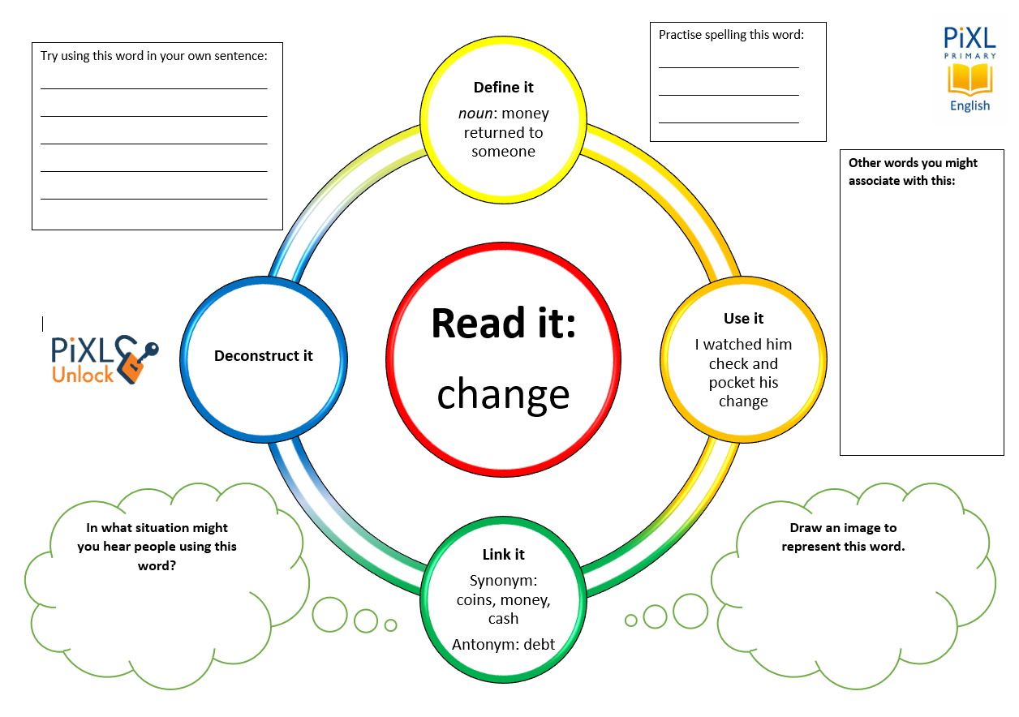
Stage 2 - Vocabulary
change
price
bought
costing

Slide 15
Stage 3 – Number Free Zone
Sarah went out for lunch. She bought a sandwich costing £1.95, a drink priced at 60p and a snack bar for 24p. Sarah has £4. How much change does Sarah receive?
1. Vocabulary - Write a definition for the following words:
a) bought b) snack
2. Retrieval – How many items does Sarah buy?
3. Inference – What is the question asking you to do? Summarise the problem.

Slide 16
Stage 4 - Answer Free Zone
Sarah went out for lunch. She bought a sandwich costing £1.95, a drink priced at 60p and a snack bar for 24p. Sarah has £4. How much change does Sarah receive?
Answer: £1.21

Slide 17
Thinking Talk
Sarah went out for lunch. She bought a sandwich costing £1.95, a drink priced at 60p and a snack bar for 24p. Sarah has £4. How much change does Sarah receive?
Firstly, I need to find out how much Sarah spent altogether.
To do this accurately, I must convert the pence to pounds so it is the same unit as the sandwich.
To do this I will have to add the cost of the sandwich, the drink and the snack bar together.
£1.95 + 60p + 24p
60p = £0.60
24p = £0.24
Answer: £1.21

Slide 18
Thinking Talk
Sarah went out for lunch. She bought a sandwich costing £1.95, a drink priced at 60p and a snack bar for 24p. Sarah has £4. How much change does Sarah receive?
So, the calculation would be
£1.95
£0.60
+ £0.24
£2.79
To find the change, I need to find the difference between £4 and £2.29. I will use a number line for this.
So, Sarah receives £1.21 change.
+0.21
+1.00
Answer: £1.21
2.79
3.00
4.00

Slide 19
Stage 5 – Your Turn
Tommy bought himself a few snacks while out shopping. He bought a sandwich for £1.45, a drink costing 95p and a packet of fruit priced at 58p. Tommy has £5. How much does Tommy have left?
Answer: £2.02

Slide 20
Next Steps
To consolidate the language aspects of these problems, a suggestion is that the number free zone questions could form part of a guided reading session. Use Slide 7 as a model. A template can also be found in the Whole School Reading resources on inference (Slide 3).
Once pupils have developed greater confidence in tackling these word problems, they will then need to develop strategies when working independently. A suggestion is on the following slides.

Slide 21
Your Turn
Alfie, Seb and Lucy made cupcakes to sell at the school coffee morning. They made 70 cupcakes altogether. Alfie sold 13 cakes, Seb sold 31 cakes and Lucy sold 16 cakes. How many cupcakes were left?
Adam is 1.13m tall. Helen is 22cm shorter than Adam. How tall is Helen? Write your answer in metres.

Slide 22

Solving word problems – steps to success
Take Two – read the question twice, once to get a general idea of context and vocabulary; the second to understand exactly what is being asked.
Underline/highlight key information (or eliminate information from your enquiries - like a detective!)
Give us a clue – look for key words to guide you to the operation needed, e.g. altogether suggests addition, share suggests division etc.
Summarise – in your head, summarise the question back to yourself, e.g. So, I’ve got to add the cost of 3 adults to the cost of a child, then subtract that from £50.00.

Slide 23

Solving word problems – steps to success
5. Estimate – round the numbers to give a rough idea of what the answer should be and jot it down.
6. Calculate – make sure you align digits carefully.
8. Read the question back – have you answered it?
9. Look at your original estimate – does your answer seem reasonable?

Slide 24
Apply
Further Number and Answer Free Zone questions can be found on PrimaryWise in the relevant year-group areas.
These can be used to provide continued support in developing both the confidence to tackle, and strategies to solve, these problems.

