Slide 1


Y3-4 Solving Word Problems
Fractions
Commissioned by The PiXL Club Ltd.
October 2019
This resource is strictly for the use of member schools for as long as they remain members of The PiXL Club. It may not be copied, sold nor transferred to a third party or used by the school after membership ceases. Until such time it may be freely used within the member school.
All opinions and contributions are those of the authors. The contents of this resource are not connected with nor endorsed by any other company, organisation or institution.
PiXL Club Ltd endeavour to trace and contact copyright owners. If there are any inadvertent omissions or errors in the acknowledgements or usage, this is unintended and PiXL will remedy these on written notification.
© Copyright The PiXL Club Limited, 2019

Slide 2
Teacher guidance
Typically, pupils lack confidence tackling word problems, mainly because they involve several steps and a large amount of information to process. Barriers to successfully answering these may, of course, be the mathematical concepts being assessed, but the amount of reading, the challenging vocabulary, as well as identifying the correct operation/s to perform, is not to be underestimated.
This therapy begins by explaining a suggested teaching strategy for these question types. The intention of this strategy is to develop pupil confidence in tackling such questions through high-quality modelling. Using the teach, model and apply format, it will take pupils through this strategy with two modelled questions. Pupils will then have the opportunity to apply this independently.
The guidance notes under each slide explain each stage. It is assumed that Stage One, the teaching of the mathematical skill/concept involved, has been already taught.

Slide 3

The PiXL approach to solving word problems
Unlock the language
Unlock the numbers
Embed vocabulary
Number-free zones
Answer-free zones
Full problem
Teach the mathematical concept/skill being tested within the question
Stage 1 | Stage 2 | Stage 3 | Stage 4 | Stage 5

Slide 4
Model Question 1

Slide 5
Stage 2 - Vocabulary
Paula has a banana loaf cake that she cuts into 6 pieces. Paula eats 1 piece and Tom eats 2 pieces. What fraction of the banana loaf cake have Paula and Tom eaten together?

Slide 6

Stage 2 - Vocabulary
Synonym: _____________________
Antonym: _____________________
My definition: ____________________
_________________________________
_________________________________
Used in context: ___________________
_________________________________
______________________________
Word:
piece
Picture:

Slide 7
Stage 3 – Number Free Zone
Paula has a banana loaf cake that she cuts into 6 pieces. Paula eats 1 piece and Tom eats 2 pieces. What fraction of the banana loaf cake have Paula and Tom eaten together?
1. Vocabulary - Write a definition for the following words:
a) fraction b) together
2. Retrieval – Who has eaten some banana loaf cake?
3. Inference – What is the question asking you to do? Summarise the problem.

Slide 8
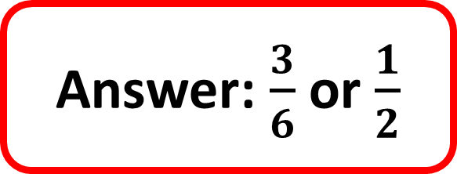
Stage 4 – Answer Free Zone
Paula has a banana loaf that she cuts into 6 equal pieces. Paula eats 1 piece and Tom eats 2 pieces. What fraction of the banana loaf have Paula and Tom eaten altogether?
Answer: $\frac{3}{6}$ or $\frac{1}{2}$

Slide 9
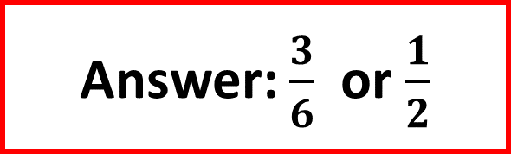
Thinking Talk
Paula has a banana loaf that she cuts into 6 equal pieces. Paula eats 1 piece and Tom eats 2 pieces. What fraction of the banana loaf have Paula and Tom eaten altogether?
Firstly, draw a bar to show the whole banana loaf.
Next, split it into 6 equal pieces.
Answer: $\frac{3}{6}$ or $\frac{1}{2}$

Slide 10
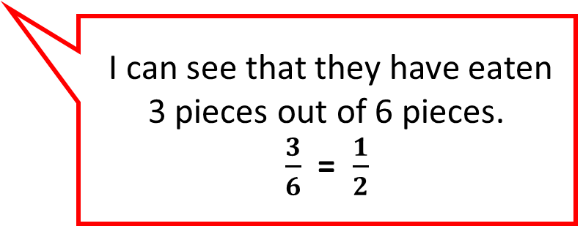

Thinking Talk
Paula has a banana loaf that she cuts into 6 equal pieces. Paula eats 1 piece and Tom eats 2 pieces. What fraction of the banana loaf have Paula and Tom eaten altogether?
Label the piece that Paula ate and the pieces that Tom ate.
P
T
T
I can see that they have eaten 3 pieces out of 6 pieces.
$\frac{3}{6}$ = $\frac{1}{2}$
Answer: $\frac{3}{6}$ or $\frac{1}{2}$

Slide 11
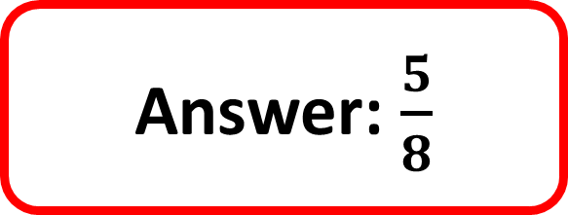
Stage 5 – Your Turn
Seb is designing a tile made up of 8 equal squares. He shades 2 squares purple and 3 squares green. What fraction of the tile is shaded altogether?
Answer: $\frac{5}{8}$

Slide 12
Model Question 2

Slide 13
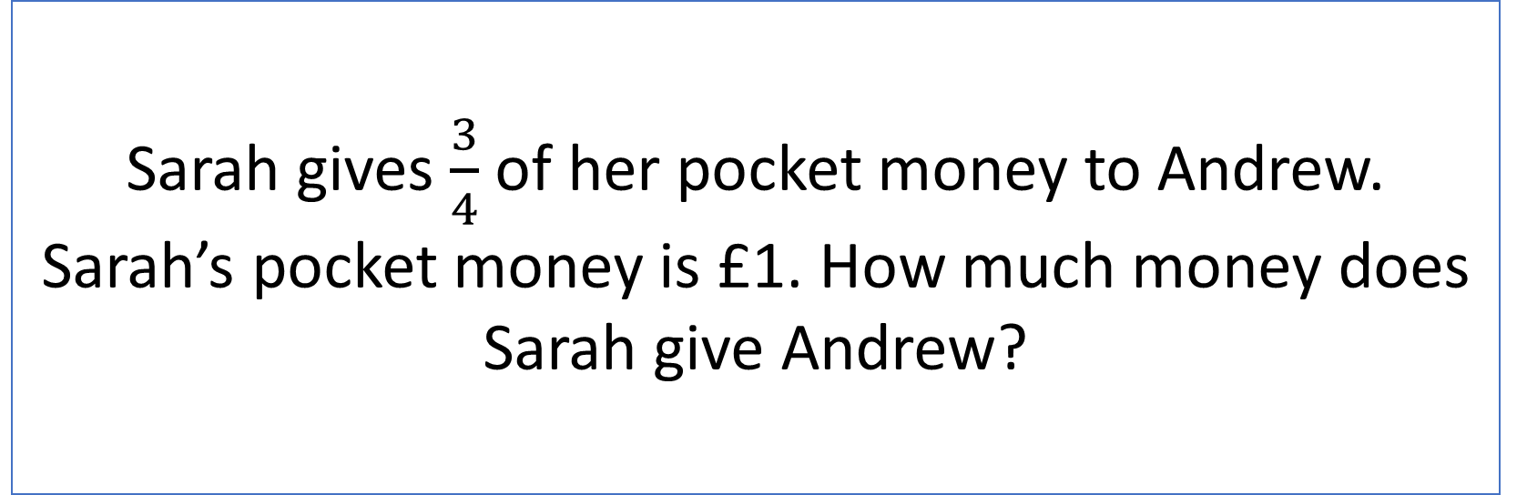
Stage 2 - Vocabulary
Sarah gives $\frac{3}{4}$ of her pocket money to Andrew. Sarah’s pocket money is £1. How much money does Sarah give Andrew?

Slide 14
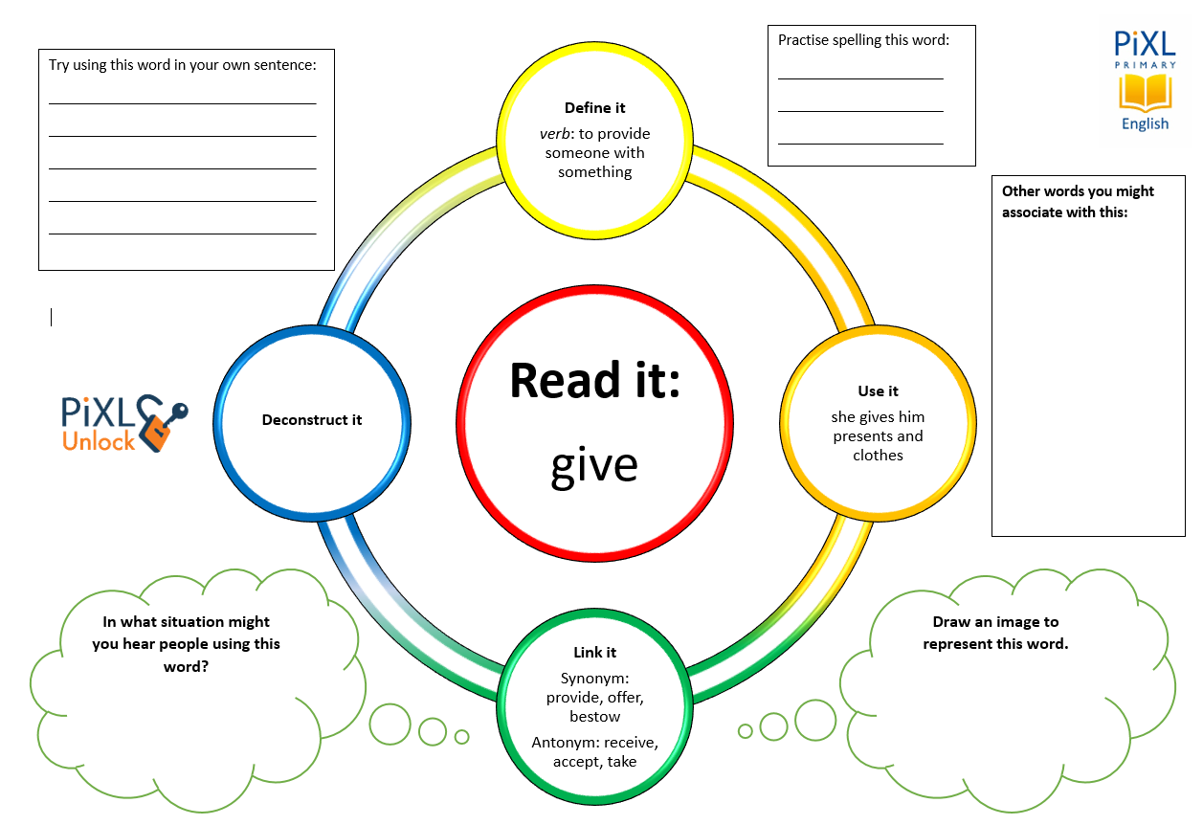
Stage 2 - Vocabulary
pocket money

Slide 15
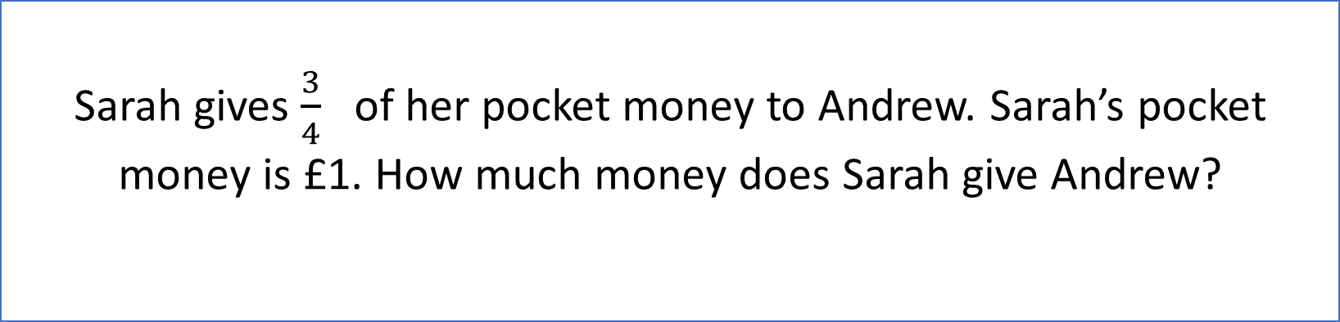
Stage 3 – Number Free Zone
Sarah gives $\frac{3}{4}$ of her pocket money to Andrew. Sarah’s pocket money is £1. How much money does Sarah give Andrew?
1. Vocabulary - What does how much tell you about the type of answer?
2. Retrieval – Where does Andrew get his money from?
3. Inference – What is the question asking you to do? Summarise the problem.

Slide 16
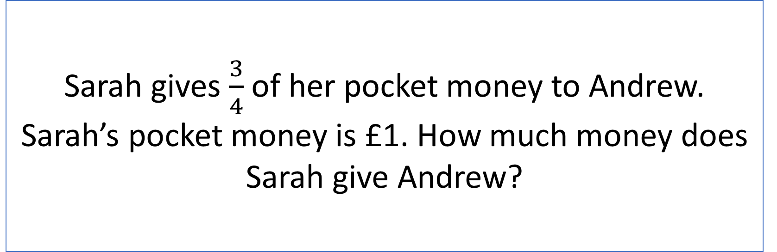
Stage 4 - Answer Free Zone
Sarah gives $\frac{3}{4}$of her pocket money to Andrew. Sarah’s pocket money is £1. How much money does Sarah give Andrew?
Answer: 75p

Slide 17
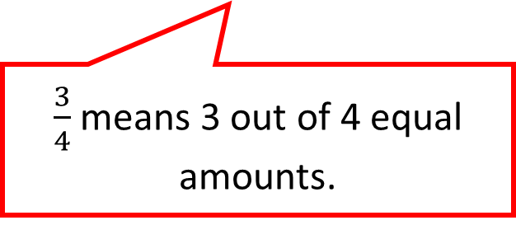
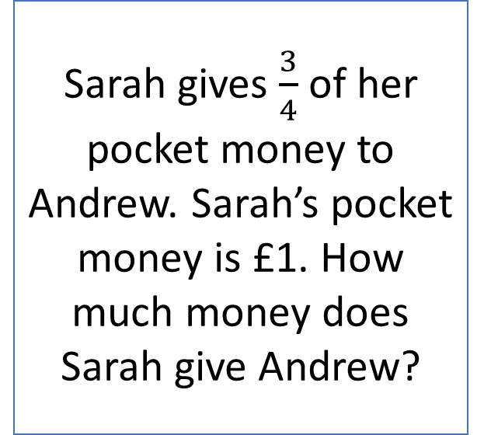
Thinking Talk
Sarah gives $\frac{3}{4}$ of her pocket money to Andrew. Sarah’s pocket money is £1. How much money does Sarah give Andrew?
Firstly, I need to convert pounds into pence so I can find a fraction of it.
$\frac{3}{4}$ means 3 out of 4 equal amounts.
There are 100p in £1.
100 ÷ 4 = 25
100p
Answer: 75p

Slide 18


Thinking Talk
Sarah gives $\frac{3}{4}$ of her pocket money to Andrew. Sarah’s pocket money is £1. How much money does Sarah give Andrew?
100 ÷ 4 = 25
100p
25
25
25
25
$\frac{3}{4}$ is 3 x 25 = 75p
Answer: 75p

Slide 19
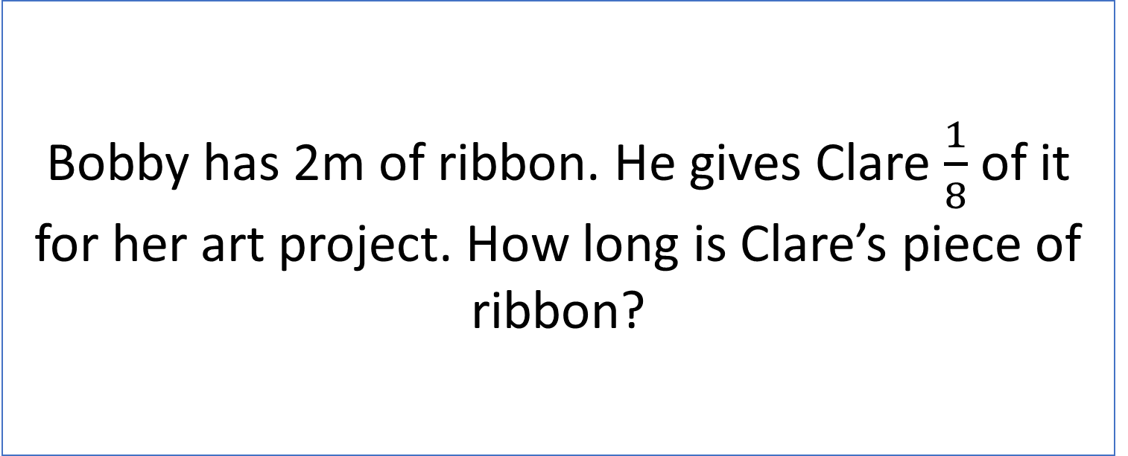
Stage 5 – Your Turn
Bobby has 2m of ribbon. He gives Clare $\frac{1}{8}$ of it for her art project. How long is Clare’s piece of ribbon?
Answer: 25cm

Slide 20
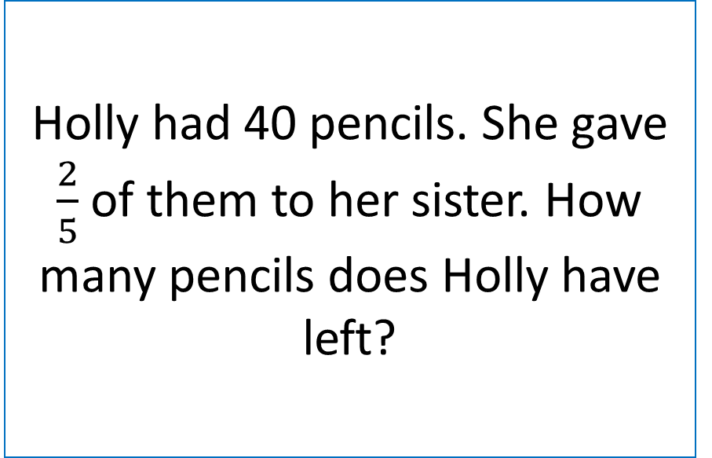
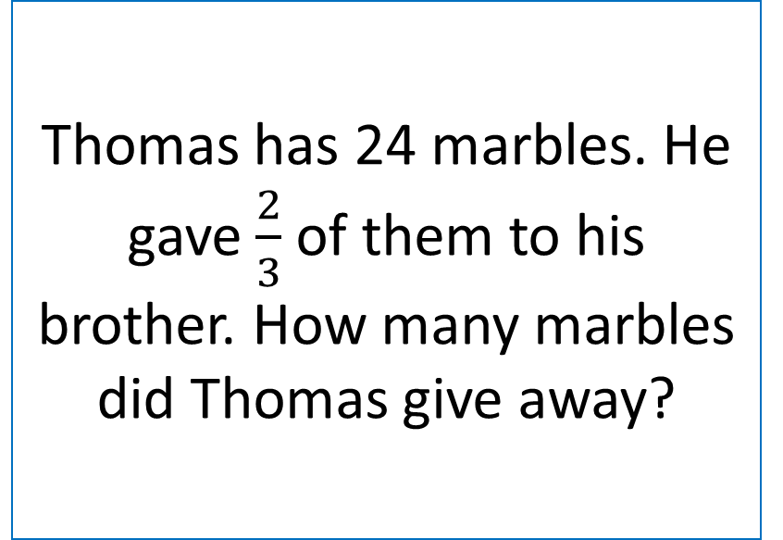
Your Turn
Thomas has 24 marbles. He gave $\frac{2}{3}$ of them to his brother. How many marbles
did Thomas give away?
Holly had 40 pencils. She gave $\frac{2}{5}$ of them to her sister. How many pencils does Holly have left?

Slide 21
Next Steps
To consolidate the language aspects of these problems, a suggestion is that the number free zone questions could form part of a guided reading session. Use Slide 7 as a model. A template can also be found in the Whole School Reading resources on inference (Slide 3).
Once pupils have developed greater confidence in tackling these word problems, they will then need to develop strategies when working independently. A suggestion is on the following slides.

Slide 22

Solving word problems – steps to success
Take Two – read the question twice, once to get a general idea of context and vocabulary; the second to understand exactly what is being asked.
Underline/highlight key information (or eliminate information from your enquiries - like a detective!)
Give us a clue – look for key words to guide you to the operation needed, e.g. altogether suggests addition, share suggests division etc.
Summarise – in your head, summarise the question back to yourself, e.g. So, I’ve got to add the cost of 3 adults to the cost of a child, then subtract that from £50.00.

Slide 23

Solving word problems – steps to success
5. Estimate – round the numbers to give a rough idea of what the answer should be and jot it down.
6. Calculate – make sure you align digits carefully.
8. Read the question back – have you answered it?
9. Look at your original estimate – does your answer seem reasonable?

Slide 24
Apply
Further Number and Answer Free Zone questions can be found on PrimaryWise in the relevant year group areas. These can be used to provide continued support in developing both the confidence to tackle, and strategies to solve, these problems.

