Slide 1


Y3-4 Solving Word Problems
Measurement
Commissioned by The PiXL Club Ltd.
October 2019
This resource is strictly for the use of member schools for as long as they remain members of The PiXL Club. It may not be copied, sold nor transferred to a third party or used by the school after membership ceases. Until such time it may be freely used within the member school.
All opinions and contributions are those of the authors. The contents of this resource are not connected with nor endorsed by any other company, organisation or institution.
PiXL Club Ltd endeavour to trace and contact copyright owners. If there are any inadvertent omissions or errors in the acknowledgements or usage, this is unintended and PiXL will remedy these on written notification.
© Copyright The PiXL Club Limited, 2019

Slide 2
Teacher guidance
Typically, pupils lack confidence tackling word problems, mainly because they involve several steps and a large amount of information to process. Barriers to successfully answering these may, of course, be the mathematical concepts being assessed, but the amount of reading, the challenging vocabulary, as well as identifying the correct operation/s to perform, is not to be underestimated.
This therapy begins by explaining a suggested teaching strategy for these question types. The intention of this strategy is to develop pupil confidence in tackling such questions through high-quality modelling. Using the teach, model and apply format, it will take pupils through this strategy with two modelled questions. Pupils will then have the opportunity to apply this independently.
The guidance notes under each slide explain each stage. It is assumed that Stage One, the teaching of the mathematical skill/concept involved, has been already taught.

Slide 3

The PiXL approach to solving word problems
Unlock the language
Unlock the numbers
Embed vocabulary
Number-free zones
Answer-free zones
Full problem
Teach the mathematical concept/skill being tested within the question
Stage 1 | Stage 2 | Stage 3 | Stage 4 | Stage 5

Slide 4
Model Question 1

Slide 5
Stage 2 - Vocabulary
Becky has two shapes. Her square has sides that measure 6cm. Her equilateral triangle has sides 7cm long. Which shape has the longest perimeter and by how many centimetres?

Slide 6

Stage 2 - Vocabulary
Synonym: _____________________
Antonym: _____________________
My definition: ____________________
_________________________________
_________________________________
Used in context: ___________________
_________________________________
______________________________
Word:
longest
Picture:

Slide 7
Stage 3 – Number Free Zone
Becky has two shapes. Her square has sides that measure 6cm. Her equilateral triangle has sides 7cm long. Which shape has the longest perimeter and by how many centimetres?
1. Vocabulary - Write a definition for the following words:
a) perimeter b) longest
2. Retrieval – How many shapes does Becky have?
3. Inference – What is the question asking you to do? Summarise the problem.

Slide 8
Stage 4 – Answer Free Zone
Becky has two shapes. Her square has sides that measure 6cm. Her equilateral triangle has sides 7cm long. Which shape has the longest perimeter and by how many centimetres?
Answer: Square by 3cm

Slide 9
Thinking Talk
Becky has two shapes. Her square has sides that measure 6cm. Her equilateral triangle has sides 7cm long. Which shape has the longest perimeter and by how many centimetres?
A square has 4 sides so to find the perimeter I need to calculate
6cm + 6cm + 6cm + 6cm
or 6 x 4.
Firstly, I need to remind myself what perimeter is.
Perimeter = the distance around the outside of a shape.
The perimeter of the square is therefore 24cm.
Answer: Square by 3cm

Slide 10
Thinking Talk
Becky has two shapes. Her square has sides that measure 6cm. Her equilateral triangle has sides 7cm long. Which shape has the longest perimeter and by how many centimetres?
An equilateral triangle has 3 equal sides.
The perimeter of the square is 24cm.
The perimeter of the triangle is 21cm.
To find the perimeter of the triangle I need to calculate
7cm + 7cm + 7cm
7 x 3 = 21cm
So, the difference between the two perimeters is
24 – 21 = 3cm
Answer: Square by 3cm.

Slide 11
Stage 5 – Your Turn
Each side of a square measures 8cm. A rectangle has a length measuring 4cm and a width of 7cm. Which shape has the smallest area and by how much?
Answer: Rectangle

Slide 12
Model Question 2

Slide 13
Stage 2 - Vocabulary
Allan takes 3 parcels to the post office. Parcel 1 weighs 87g. Parcel 2 weighs 132g. Parcel 3 weighs the same as Parcel 1 and Parcel 2 combined. How much does Parcel 3 weigh?

Slide 14
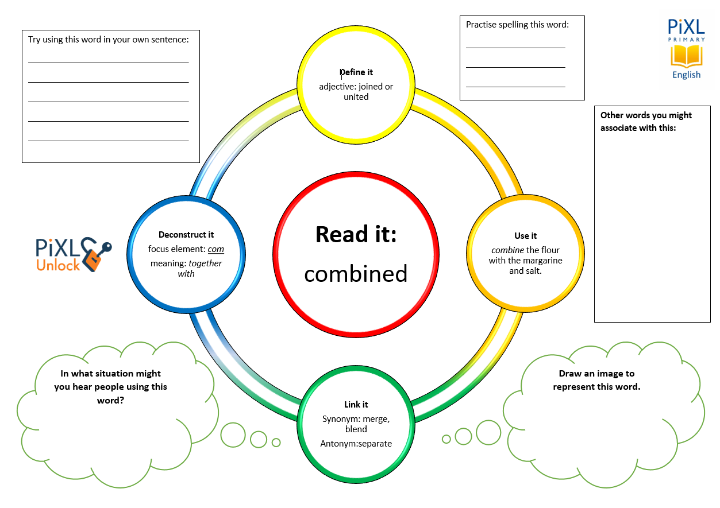
Stage 2 - Vocabulary
combined
weigh
parcel
same

Slide 15
Stage 3 – Number Free Zone
Allan takes 3 parcels to the post office. Parcel 1 weighs 87g. Parcel 2 weighs 132g. Parcel 3 weighs the same as Parcel 1 and Parcel 2 combined. How much does Parcel 3 weigh?
1. Vocabulary - Write a definition for the following words:
a) parcel b) weigh
2. Retrieval – How many parcels are there?
3. Inference – What is the question asking you to do? Summarise the problem.

Slide 16
Stage 4 - Answer Free Zone
Allan takes 3 parcels to the post office. Parcel 1 weighs 87g. Parcel 2 weighs 132g. Parcel 3 weighs the same as Parcel 1 and Parcel 2 combined. How much does Parcel 3 weigh?
Answer: 219g

Slide 17
Thinking Talk
Allan takes 3 parcels to the post office. Parcel 1 weighs 87g. Parcel 2 weighs 132g. Parcel 3 weighs the same as Parcel 1 and Parcel 2 combined. How much does Parcel 3 weigh?
Firstly, I need to note that this is a measurement problem in the context of weight – grams.
Combined means put together so, in the context of mathematics that means addition.
My answer therefore needs to be in grams.
87g + 132g = 219g
Answer: 219g

Slide 18
Thinking Talk
Allan takes 3 parcels to the post office. Parcel 1 weighs 87g. Parcel 2 weighs 132g. Parcel 3 weighs the same as Parcel 1 and Parcel 2 combined. How much does Parcel 3 weigh?
I could also show this as a bar model.
Parcel 3 ?
Parcel 1 87g
Parcel 2 132g
Answer: 219g

Slide 19
Stage 5 – Your Turn
A bottle of squash holds 500ml. Aaron pours 127ml into a glass, 98ml into a cup and some into a beaker. The beaker holds the same amount of squash as the glass and the cup combined. How much squash is in the beaker?
Answer: 225ml

Slide 20
Your Turn
Bobby has 3 pieces of border for a display board in the classroom. One piece measures 86cm, the second piece is 103cm long. The third piece measures the same as the first and second combined. How long is the third piece of border?
Alice takes 3 parcels to the post office. Parcel 1 weighs 109g. Parcel 2 weighs 127g. Parcel 3 weighs the same as Parcel 1 and Parcel 2 combined. How much do all three parcels weigh together?

Slide 21

Solving word problems – steps to success
Take Two – read the question twice, once to get a general idea of context and vocabulary; the second to understand exactly what is being asked.
Underline/highlight key information (or eliminate information from your enquiries - like a detective!)
Give us a clue – look for key words to guide you to the operation needed, e.g. altogether suggests addition, share suggests division etc.
Summarise – in your head, summarise the question back to yourself, e.g. So, I’ve got to add the cost of 3 adults to the cost of a child, then subtract that from £50.00.

Slide 22

Solving word problems – steps to success
5. Estimate – round the numbers to give a rough idea of what the answer should be and jot it down.
6. Calculate – make sure you align digits carefully.
8. Read the question back – have you answered it?
9. Look at your original estimate – does your answer seem reasonable?

Slide 23
Next Steps
To consolidate the language aspects of these problems, a suggestion is that the number free zone questions could form part of a guided reading session. Use Slide 7 as a model. A template can also be found in the Whole School Reading resources on inference (Slide 3).
Once pupils have developed greater confidence in tackling these word problems, they will then need to develop strategies when working independently. A suggestion is on the following slides.

Slide 24
Apply
Further Number and Answer Free Zone questions can be found on PrimaryWise in the relevant year-group areas. These can be used to provide continued support in developing both the confidence to tackle, and strategies to solve, these problems.

