Slide 1


Y3-4 Solving Word Problems
Multiplication and Division
Commissioned by The PiXL Club Ltd.
October 2019
This resource is strictly for the use of member schools for as long as they remain members of The PiXL Club. It may not be copied, sold nor transferred to a third party or used by the school after membership ceases. Until such time it may be freely used within the member school.
All opinions and contributions are those of the authors. The contents of this resource are not connected with nor endorsed by any other company, organisation or institution.
PiXL Club Ltd endeavour to trace and contact copyright owners. If there are any inadvertent omissions or errors in the acknowledgements or usage, this is unintended and PiXL will remedy these on written notification.
© Copyright The PiXL Club Limited, 2019

Slide 2
Teacher guidance
Typically, pupils lack confidence tackling word problems, mainly because they involve several steps and a large amount of information to process. Barriers to successfully answering these may, of course, be the mathematical concepts being assessed, but the amount of reading, the challenging vocabulary, as well as identifying the correct operation/s to perform, is not to be underestimated.
This therapy begins by explaining a suggested teaching strategy for these question types. The intention of this strategy is to develop pupil confidence in tackling such questions through high-quality modelling. Using the teach, model and apply format, it will take pupils through this strategy with two modelled questions. Pupils will then have the opportunity to apply this independently.
The guidance notes under each slide explain each stage. It is assumed that Stage One, the teaching of the mathematical skill/concept involved, has been already taught.

Slide 3

The PiXL approach to solving word problems
Unlock the language
Unlock the numbers
Embed vocabulary
Number-free zones
Answer-free zones
Full problem
Teach the mathematical concept/skill being tested within the question
Stage 1 | Stage 2 | Stage 3 | Stage 4 | Stage 5

Slide 4
Model Question 1

Slide 5
Stage 2 - Vocabulary
The school sports coach wants to buy some more tennis balls. A large box contains 24 tennis balls. If the sports coach orders 4 boxes, how many tennis balls will he get?

Slide 6

Stage 2 - Vocabulary
Synonym: _____________________
Antonym: _____________________
My definition: ____________________
_________________________________
_________________________________
Used in context: ___________________
_________________________________
______________________________
Word:
contain
Picture:

Slide 7
Stage 3 – Number Free Zone
The school sports coach wants to buy some more tennis balls. A large box contains 24 tennis balls. If the sports coach orders 4 boxes, how many tennis balls will he get?
1. Vocabulary: Write a definition for the following words:
a) large b) order
2. Retrieval – Who ordered the tennis balls?
3. Inference – What is the question asking you to do? Summarise the problem.

Slide 8
Stage 4 – Answer Free Zone
The school sports coach wants to buy some more tennis balls. A large box contains 24 tennis balls. If the sports coach orders 4 boxes, how many tennis balls will he get?
Answer: 96 tennis balls

Slide 9
Thinking Talk
The school sports coach wants to buy some more tennis balls. A large box contains 24 tennis balls. If the sports coach orders 4 boxes, how many tennis balls will he get?
Firstly, I know that one box of tennis balls contains 24.
I could double 24 and double it again.
24 x 2 = 48
48 x 2 = 96
I need 4 boxes so that is 4 groups of 24.
24 x 4 = ?
Or I could use partitioning:
20 x 4 = 80
4 x 4 = 16
And add them together.
Answer: 96 tennis balls

Slide 10
Thinking Talk
The school sports coach wants to buy some more tennis balls. A large box contains 24 tennis balls. If the sports coach orders 4 boxes, how many tennis balls will he get?
I could also show this as a bar model.
?
24
24
24
24
Answer: 96 tennis balls

Slide 11
Stage 5 – Your Turn
The school sports coach wants to buy some more bean bags. A large box contains 18 bean bags. If the sports coach orders 8 boxes, how many bean bags will she get?
Answer: 144 bean bags

Slide 12
Model Question 2

Slide 13
Stage 2 - Vocabulary
Jacob has 87 books and wants to put them on his bookshelf. The bookshelf has 3 shelves. If Jacob shares the books equally between the shelves, how many books will be on each shelf?

Slide 14
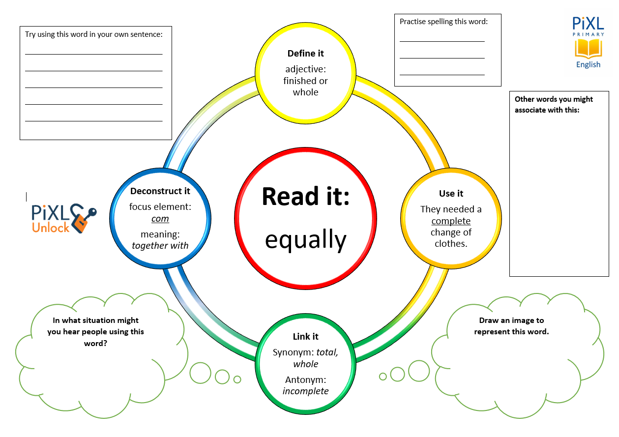
Stage 2 - Vocabulary
equally
shelves
shares

Slide 15
Stage 3 – Number Free Zone
Jacob has 87 books and wants to put them on his bookshelf. The bookshelf has 3 shelves. If Jacob shares the books equally between the shelves, how many books will be on each shelf?
1. Vocabulary - Write a definition for the following words:
a) bookshelf b) between
2. Retrieval – Where are the books going to be placed?
3. Inference – What is the question asking you to do? Summarise the problem.

Slide 16
Stage 4 - Answer Free Zone
Jacob has 87 books and wants to put them on his bookshelf. The bookshelf has 3 shelves. If Jacob shares the books equally between the shelves, how many books will be on each shelf?
Answer: 29 books

Slide 17
Thinking Talk
Jacob has 87 books and wants to put them on his bookshelf. The bookshelf has 3 shelves. If Jacob shares the books equally between the shelves, how many books will be on each shelf?
Firstly, I would draw a picture of the three shelves as a bar model.
87
Answer: 29 books

Slide 18
Thinking Talk
Jacob has 87 books and wants to put them on his bookshelf. The bookshelf has 3 shelves. If Jacob shares the books equally between the shelves, how many books will be on each shelf?
From the bar, I can see that the calculation I need to do is
87 ÷ 3
3 x 20 = 60
3 x 9 = 27
87
3 groups of 29 make 87, so there would be 29 books on each shelf.
87
Answer: 29 books

Slide 19
Stage 5 – Your Turn
Ella has 96 toys and wants to put them in her 4 toy boxes. If Ella shares the toys equally between the boxes, how many toys will be in each box?
Answer: 24 toys

Slide 20
Your Turn
A baker bakes bread rolls.
A tray holds 16 rolls. If the baker bakes enough rolls to fill 8 trays, how many bread rolls will he have altogether?
A baker has baked 120 bread rolls and wants to lay them out on trays. He has 3 trays. If Jacob shares the rolls equally between the trays, how many bread rolls will be on each tray?

Slide 21
Next Steps
To consolidate the language aspects of these problems, a suggestion is that the number free zone questions could form part of a guided reading session. Use Slide 7 as a model. A template can also be found in the Whole School Reading resources on inference (Slide 3).
Once pupils have developed greater confidence in tackling these word problems, they will then need to develop strategies when working independently. A suggestion is on the following slides.

Slide 22

Solving word problems – steps to success
Take Two – read the question twice, once to get a general idea of context and vocabulary; the second to understand exactly what is being asked.
Underline/highlight key information (or eliminate information from your enquiries - like a detective!)
Give us a clue – look for key words to guide you to the operation needed, e.g. altogether suggests addition, share suggests division etc.
Summarise – in your head, summarise the question back to yourself, e.g. So, I’ve got to add the cost of 3 adults to the cost of a child, then subtract that from £50.00.

Slide 23

Solving word problems – steps to success
5. Estimate – round the numbers to give a rough idea of what the answer should be and jot it down.
6. Calculate – make sure you align digits carefully.
8. Read the question back – have you answered it?
9. Look at your original estimate – does your answer seem reasonable?

Slide 24
Apply
Further Number and Answer Free Zone questions can be found on PrimaryWise in the relevant year-group areas.
These can be used to provide continued support in developing both the confidence to tackle, and strategies to solve, these problems.

