Slide 1


Y5-6 Problem types
Number Problems
Commissioned by The PiXL Club Ltd.
October 2019
This resource is strictly for the use of member schools for as long as they remain members of The PiXL Club. It may not be copied, sold nor transferred to a third party or used by the school after membership ceases. Until such time it may be freely used within the member school.
All opinions and contributions are those of the authors. The contents of this resource are not connected with nor endorsed by any other company, organisation or institution.
PiXL Club Ltd endeavour to trace and contact copyright owners. If there are any inadvertent omissions or errors in the acknowledgements or usage, this is unintended and PiXL will remedy these on written notification.
© Copyright The PiXL Club Limited, 2019

Slide 2
Teacher guidance
Typically, pupils find number problems tricky. However, most pupils can access these questions. The key to solving number problems is ensuring pupils understand how to use the inverse calculation. This involves pupils being able to manipulate numbers and requires them to see numbers in multiple representations.
This therapy begins by explaining a suggested teaching strategy for developing a systematic approach and it is particularly important that this stage is modelled carefully so that pupils can hear the ‘thinking out loud’ that takes place when solving such a problem. Using the teach, model and apply format, it will take pupils through this strategy with two modelled questions. Pupils will then have opportunities to apply this independently.
It is assumed that the teaching of the mathematical skill/concept involved, has been already taught.

Slide 3


LORIC
Our Primary Edge attributes help us to become better learners and today is no exception. Before you start this activity, here are some ideas for how you will need your Raj Resilience skills today:
Command Words:
try, keep going, persevere.
Reading through the whole problem and checking your answers.

Slide 4

Today, you will be solving number puzzles where you may need to work out one answer before you can work out the other answer so you will need to persevere.
Raj Resilience

Slide 5

Vocabulary
Synonym: _____________________
Antonym: _____________________
My definition: ____________________
_________________________________
_________________________________
Used in context: ___________________
_________________________________
______________________________
Word:
product
Picture:
Notes:
Select one or two words to embed using the PiXL Unlock 5-phase approach. This example is from the PiXL Vocabulary Shorts. Once the vocabulary has been explored, return to the problem.

Slide 6
Model Question 1

Slide 7

When completing a pyramid, each number above the base is made up from the product of the two supporting it. Complete the missing numbers.
Talk to your partner.
What is the question asking you to do?
280
10
4

Slide 8
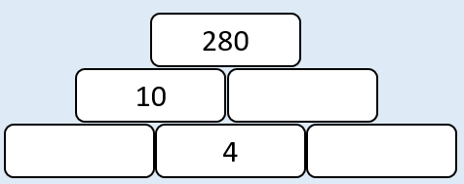
Solving Number Problems
When completing a pyramid, each number above the base is made up from the product of the two supporting it. Complete the missing numbers.
This problem tells us to multiply the two numbers that are next to each other and then place the answer in the box above. We do not have two numbers next to each other to multiply, so we will need to use the inverse.

Slide 9
Solving Number Problems
When completing a pyramid, each number above the base is made up from the product of the two supporting it. Complete the missing numbers.
With these problems, we can’t always work from left to right or from top to bottom. We need to look at what information we have and use this to help us with where to start.
I can see that we have two pieces of information for the middle right box, so we can start there.

Slide 10
Solving Number Problems
When completing a pyramid, each number above the base is made up from the product of the two supporting it. Complete the missing numbers.
10 x ____ = 280
If I divide 280 by 10, I will work out the missing number.
280 ÷ 10 = 28
The number missing in the middle box must be 28.

Slide 11
Solving Number Problems
When completing a pyramid, each number above the base is made up from the product of the two supporting it. Complete the missing numbers.
Now I can work on the bottom left box.
_____ x 4 = 10
Again, if I use the inverse and find 10 divided by 4, I will find the answer.
10 ÷ 4 = 2.5
28
Notes:
Use your calculation policy, if appropriate, to model 10 ÷ 4, or remind the children to half and half again.

Slide 12
Solving Number Problems
When completing a pyramid, each number above the base is made up from the product of the two supporting it. Complete the missing numbers.
Finally, I can work out the bottom right box.
4 x ____ = 28
My knowledge of times tables tells me that
4 x 7 = 28
I can complete the pyramid!
28
2.5

Slide 13
Solving Number Problems
When completing a pyramid, each number above the base is made up from the product of the two supporting it. Complete the missing numbers.
Talk to your partner.
How did we solve this problem?
28
2.5
7

Slide 14
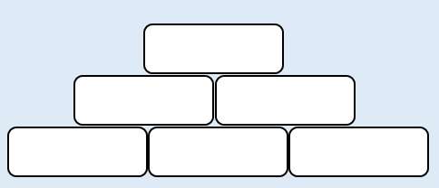
Your Turn
When completing a pyramid, each number above the base is made up from the product of the two supporting it. Complete the missing numbers.
You will need to work out one answer before you can work out the next.
96
4
8

Slide 15
Your Turn
When completing a pyramid, each number above the base is made up from the sum of the two supporting it. Complete the missing numbers.
Watch out – this one has a slightly different instruction.
512
349
176
Notes:
This problem is there to identify if the children can use the inverse of addition and subtraction.

Slide 16
Model Question 2

Slide 17
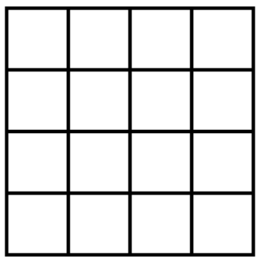
Solving Number Problems
In this Magic Square, the sum of every row, column and diagonal is 34. Complete the missing numbers.
Talk to your partner.
What is the question asking you to do?
13
12
2
7
5
4
15
1

Slide 18
Solving Number Problems
We need to make each total 34.
To begin, we can start with the far right column as it has one missing number.
12 + 7 + ____ + 1 = 34
12 + 7 + 1 = 20
34 – 20 = 14
Let’s fill this in.
In this Magic Square, the sum of every row, column and diagonal is 34. Complete the missing numbers.
13
12
2
7
5
4
15
1

Slide 19
Solving Number Problems
In this Magic Square, the sum of every row, column and diagonal is 34. Complete the missing numbers.
Next, we can look at one of our diagonal lines which also has only one number missing.
13 + ____ + 4 + 1 = 34
13 + 4 + 1 = 18
34 – 18 = 16
Let’s fill this in.
13
12
2
7
5
4
14
15
1

Slide 20
Solving Number Problems
In order to solve this, we need to keep looking at the rows, columns or diagonals which have only one number missing. I can see that the second row has just one number missing.
2 + 16 + ___ + 7 = 34
2 + 16 + 7 = 25
34 – 25 = 9
In this Magic Square, the sum of every row, column and diagonal is 34. Complete the missing numbers.
13
12
2
16
7
5
4
14
15
1

Slide 21
Solving Number Problems
In this Magic Square, the sum of every row, column and diagonal is 34. Complete the missing numbers.
Now we can complete the third column.
____ + 9 + 4 + 15 = 34
9 + 4 + 15 = 28
34 – 28 = 6
13
12
2
16
9
7
5
4
14
15
1

Slide 22
Solving Number Problems
In this Magic Square, the sum of every row, column and diagonal is 34. Complete the missing numbers.
Now we can complete the top row.
13 + ___ + 6 + 12 = 34
13 + 6 + 12 = 31
34 – 31 = 3
13
6
12
2
16
9
7
5
4
14
15
1

Slide 23
Solving Number Problems
In this Magic Square, the sum of every row, column and diagonal is 34. Complete the missing numbers.
Now we can complete the third row.
___ + 5 + 4 + 14 = 34
5 + 4 + 14 = 23
34 – 23 = 11
13
3
6
12
2
16
9
7
5
4
14
15
1

Slide 24
Solving Number Problems
Finally, we can complete both the 1st and 2nd columns.
13 + 2 + 11 + ____ = 34
13 + 2 + 11 = 26
34 – 26 = 8
And
3 + 16 + 5 + ____ = 34
3 + 16 + 5 = 24
34 – 24 = 10
In this Magic Square, the sum of every row, column and diagonal is 34. Complete the missing numbers.
13
3
6
12
2
16
9
7
11
5
4
14
15
1

Slide 25
Solving Number Problems
In this Magic Square, the sum of every row, column and diagonal is 34. Complete the missing numbers.
Talk to your partner. How did we solve this problem?
13
3
6
12
2
16
9
7
11
5
4
14
14
10
15
1

Slide 26
Your Turn
1
7
In this Magic Square, the sum of every row, column and diagonal is 34. Complete the missing numbers.
15
9
6
3
5
2

Slide 27
Your Turn
1
9
In this Magic Square, the sum of every row, column and diagonal is 34. Complete the missing numbers.
15
2
13
14
4
5

