Slide 1

Online Safety – Starter tasks linked to progression of skills
Project Evolve – Discussion points

Slide 2
EYFS
For further resources to enrich these topics please log in to Project Evolve and follow the link below. Full lesson plans are available which are resourced as well.
https://projectevolve.co.uk/toolkit/resources/years/early-years-7/

Slide 3
EYFS- Self image and identity
I can recognise, online or offline, that anyone can say ‘no’ - ‘please stop’ - ‘I’ll tell’ - ‘I’ll ask’ to somebody who makes them feel sad, uncomfortable, embarrassed or upset.
Questions To Ask
What do you like to do online? What do you not like to do?
What can you do if something makes you feel sad/ embarrassed or upset online?
Who can help you if something ever worries or upsets you online?
What are the different ways you can tell someone ‘no’? What about ‘please stop’? ‘I’ll tell’? ‘I’ll ask’?
If you say to someone…‘no’ / ‘please stop’ / ‘I’ll tell’ / ‘I’ll ask’…what does that mean?
What should you do if you say ‘no’ / ‘please stop’ / ‘I’ll tell’ / ‘I’ll ask’ but the person continues to upset you?

Slide 4
EYFS - Online Relationships
I can recognise some ways in which the internet can be used to communicate
Questions To Ask
Who is someone you know really well?
What does communicate mean?
What other words can we use for “communicate”?
How do we communicate without using the internet?
When you communicate, what might you be talking about?
What things do you like to do that involve people you know eg friends and family?
What examples of technology do you know? What ways could you use technology or the internet to communicate with someone you know?
What is the difference when you communicate with someone using technology and not using it?
How can we use technology to:
sing together
talk together
video together?

Slide 5
EYFS - Online Reputation
I can identify ways that I can put information on the internet.
Questions To Ask
What does the word information mean?
What types of information do you know?
Is it easier to share things in different ways? eg Show someone where you have been? Share your favourite song with someone? Show your friend your drawing? Show a picture of your brother/sister?
Information helps us communicate.
What does communicate mean?
We use the word online? What does that mean?
Do you go online?
When do you go online?
What do you like doing online?
What’s the opposite of online?
Offline
Real life?
Together in the same space? Is there a big difference?

Slide 6
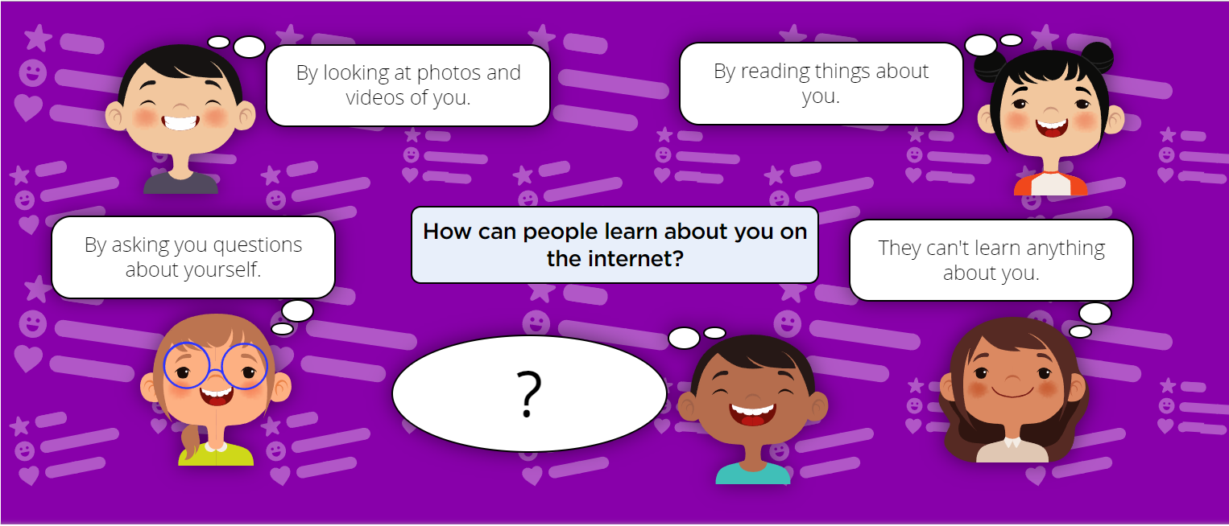
EYFS - Privacy and Security

Slide 7
EYFS - Online Bullying
I can describe ways that some people can be unkind online.
What does being unkind mean?
How might someone be unkind face-to-face?
How might someone be unkind online or using a device?
Have you ever been unkind online?
Have you ever had someone be unkind to you (or someone else) online?
How do you feel when someone is unkind to you?
How might someone else feel if people were being unkind to them?

Slide 8
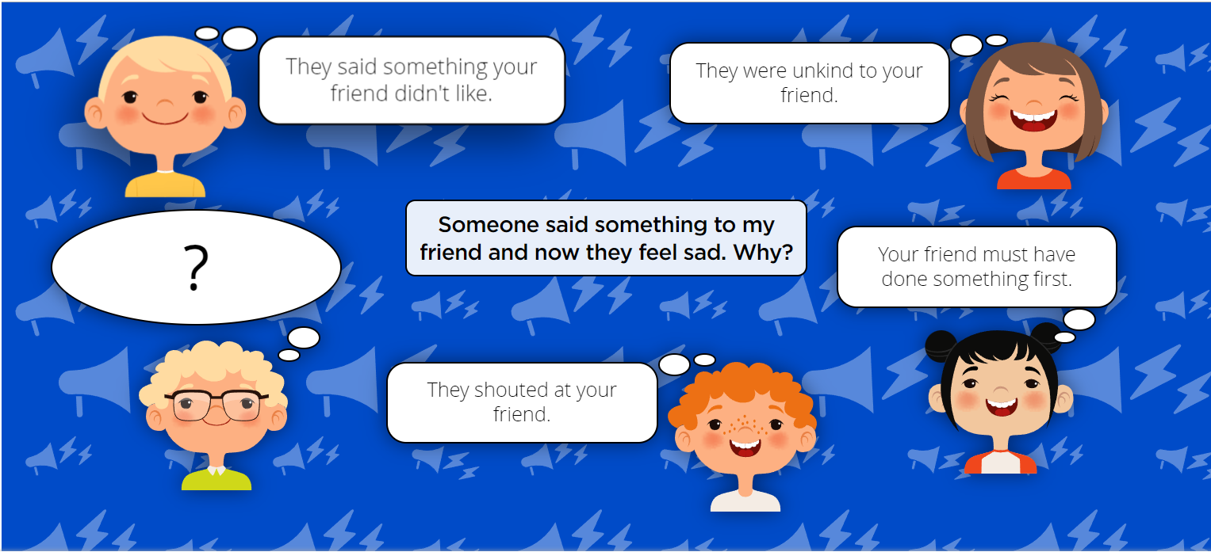
EYFS - Online Bullying

Slide 9
EYFS – Manging Online Information
I can talk about how I can use the internet to find things out.
I can identify devices I could use to access information on the internet.
How can a child get the answer to a question?
Who could they ask?
Is there any other way to get answer to a question?
What is the difference between asking a question to a person, and asking 'the internet'?
Would you get the same answer?
Does the internet have 'all the answers'?
What sort of devices can we use to get the internet? For example, you might have a tablet.
What other devices can we use?

Slide 10
EYFS – Manging Online Information
I can identify devices I could use to access information on the internet.
How can a child get the answer to a question?
Who could they ask?
Is there any other way to get answer to a question?
What is the difference between asking a question to a person, and asking 'the internet'?
Would you get the same answer?
Does the internet have 'all the answers'?
What sort of devices can we use to get the internet? For example, you might have a tablet.
What other devices can we use?

Slide 11
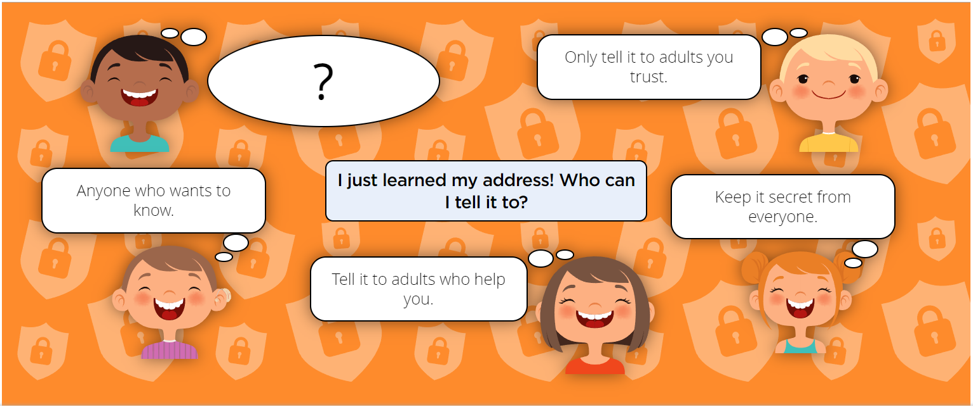
EYFS - Managing Online Information

Slide 12
Health, Wellbeing and lifestyle
I can identify rules that help keep us safe and healthy in and beyond the home when using technology
What device(s) do you like to use at home/school?
What do you like to do on your device(s)?
What things make you happy when you use technology?
What things make you unhappy/angry/sad when you use technology?
Do you have any rules at home/school for using technology? What are they?
Who helps you to stay safe?
Who decides the rules for how you use technology?
Why do you think we have these rules?

Slide 13
Health, Wellbeing and lifestyle
I can give some simple examples of these rules
What device(s) do you like to use at home/school?
What do you like to do on your device(s)?
What things make you happy when you use technology?
What things make you unhappy/angry/sad when you use technology?
Last time we talked about some of the rules for using technology and the internet. Can you remember any of them?
Why do you think we have rules for using technology and the internet?
Do you have any rules at home/school for using technology? What are they?
Who decides the rules for how you use technology?
Why do you think we have these rules?
What happens if you follow the rules (e.g. rewards)?
What happens if you don’t follow the rules (e.g. sanctions)?
Are the rules you have fair or unfair? Why?
Can you think of any rules for being safe/healthy when using technology?

Slide 14
Privacy and Security
I can identify some simple examples of my personal information (e.g. name, address, birthday, age, location).
When is it OK to share personal information?
What is personal information?
Is it ever OK to share personal information with an adult?
What people do you trust with your information?

Slide 15
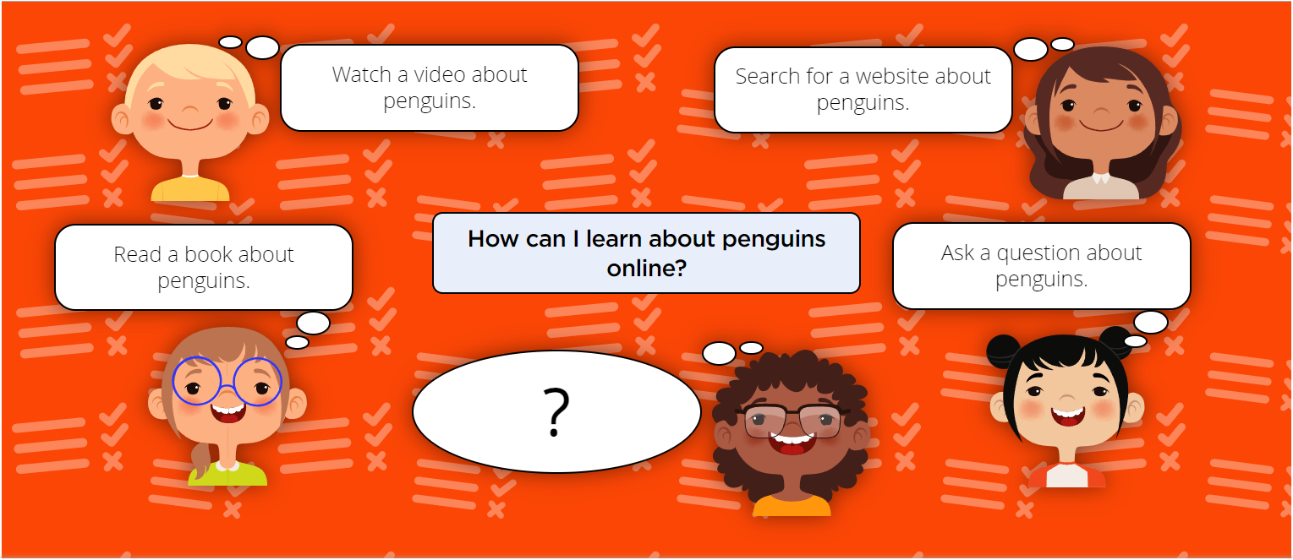
EYFS – Privacy and security

Slide 16
Copyright and ownership
I know that work I create belongs to me.
What things ‘belong’ to you at home? (e.g. toys, bedroom, other belongings)
What things ‘belong’ to you at school? (e.g. clothing/uniform, peg, tray, seat/space, etc.)
Do some things belong to more than one person? (e.g. your house, your classroom/school, objects, etc.)
If you draw a picture, who does it belong to? Why? (e.g. ‘because I made it’)
If you draw a picture on the computer/tablet/interactive whiteboard, who does it belong to?
If I give a copy of my digital picture to my friend, do I still own it?
How could we help other people know that things are ours? (e.g. ‘put our name on them’ - clothes as a good example)

Slide 17
Copyright and ownership
I can name my work so that others know it belongs to me.
What do we call each of you so we know who everyone is?
How do you know that your work is yours?
What does your teacher call you when they want your attention?
Why are names important?

Slide 18
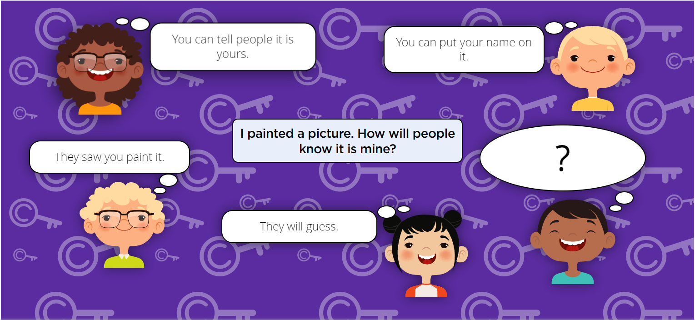
EYFS - Copyright and ownership

