Slide 1

Online Safety – Starter tasks linked to progression of skills
Project Evolve – Discussion points

Slide 2
YEAR 1
For further resources to enrich these topics please log in to Project Evolve and follow the link below. Full lesson plans are available which are resourced as well.
https://projectevolve.co.uk/toolkit/resources/years/year-one/

Slide 3
Self image and identity
I can recognise that there may be people online who could make someone feel sad, embarrassed or upset.
If something happens that makes me feel sad, worried, uncomfortable or frightened I can give examples of when and how to speak to an adult I can trust and how they can help.
Questions To Ask
What do you like to do online? What do you not like to do?
What can you do if something makes you feel sad/ embarrassed or upset online?
Is it OK to have mixed emotions? E.g. this person makes me laugh but sometimes their jokes hurt my feelings.
Who can help you if something ever worries or upsets you online?
When might someone ask an adult for help online? E.g. when during an online chat or playing a game etc.

Slide 4
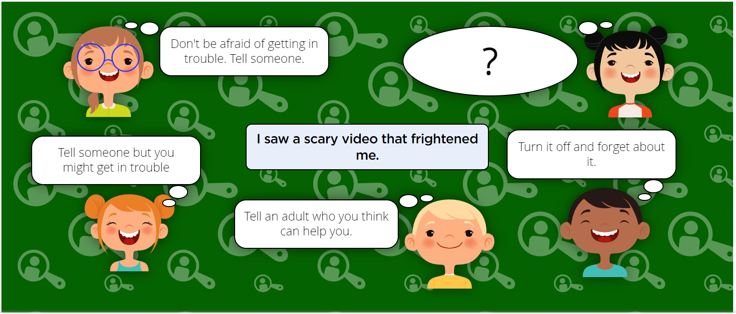

Slide 5
Online Relationships
I can give examples of when I should ask permission to do something online and explain why this is important.
Questions To Ask
What does it mean to ‘ask permission’?
What do you have to ask permission to do offline? (e.g. go outside to play, have a snack or a drink, etc.)
Who do you have to ask for permission?
What do you have to ask permission to do with technology or the internet? (e.g. watch cartoons, play a game, video chat with family or friends.)
Can you think of any times you might have to ask permission before you do something that is about another person? (e.g. upload/take a photo of them, send a message about someone else.)
Why is it important to ask permission?
What might happen if you don’t ask permission?
How might someone feel if you did something without asking their permission?

Slide 6
Online Relationships
I can use the internet with adult support to communicate with people I know (e.g. video call apps or services).
Questions To Ask
Who might be a person that you know well?
Who might be an adult that could help you?
Why might you need to use the internet or technology to communicate with someone you know?
How is communicating in this way different?
Why might it be different/better than talking face to face? How?
Why might you need some help from an adult?

Slide 7
Online Relationships
I can explain why it is important to be considerate and kind to people online and to respect their choices.
Questions To Ask
What does being considerate mean?
What other words can you think of for being considerate?
How would it make you feel if someone was unkind to you?
If you were being unkind how would it make others feel?
Do people like others who are being unkind? Are they likely to play/chat with them? Why?
What things can you do online to try to be considerate towards others?
What would you do if someone was unkind to you online?
How would it make you feel if you saw somebody being unkind to one of your friends online? What are some of the things you could do?

Slide 8
Online Relationships
I can explain why things one person finds funny or sad online may not always be seen in the same way by others.
Questions To Ask
Who likes ..... (insert an obviously popular food) Fries? Burgers? Ice Cream? Who doesn't?
Who likes ...(insert a more controversial food) Sprouts? Spinach? Liqourice Allsorts? Marmite?
Think about jokes. Does everyone like the same jokes?
Why do you think one person might like a thing when someone else doesn't? Reasons?
What do you like to do when you go online?
Do you go to the same sites all the time?
If you do go to different sites, why? Bored? need a change? Not interesting?
Do you use the same online sites as your friends? All the time?
Are there sites or games that you really like but your friends don't use or like?
Do you think everybody likes the same things online?
Why do you think people like different things?
Can you name some things you like online that your friends like? Don't like?
Have you ever laughed/been upset at something that you have seen online?
Have your friends ever shown you something that they like that has made you laugh/be sad? What about the other way around?
Do different people think about things in different ways? Can you give an example?

Slide 9
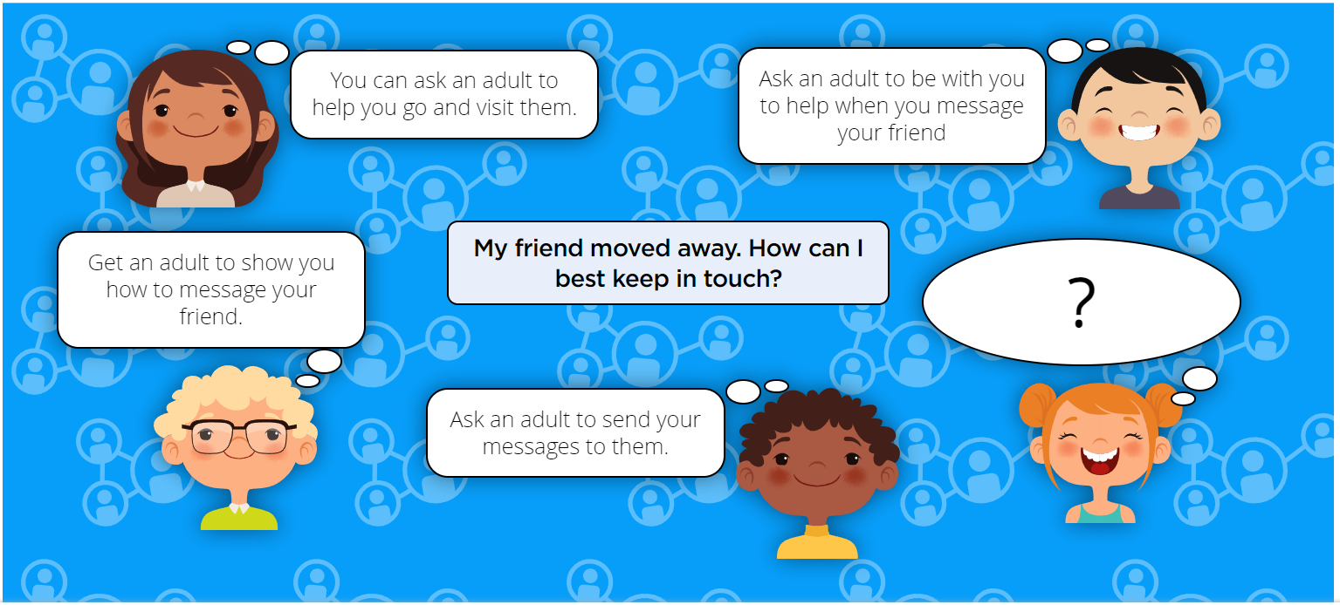

Slide 10
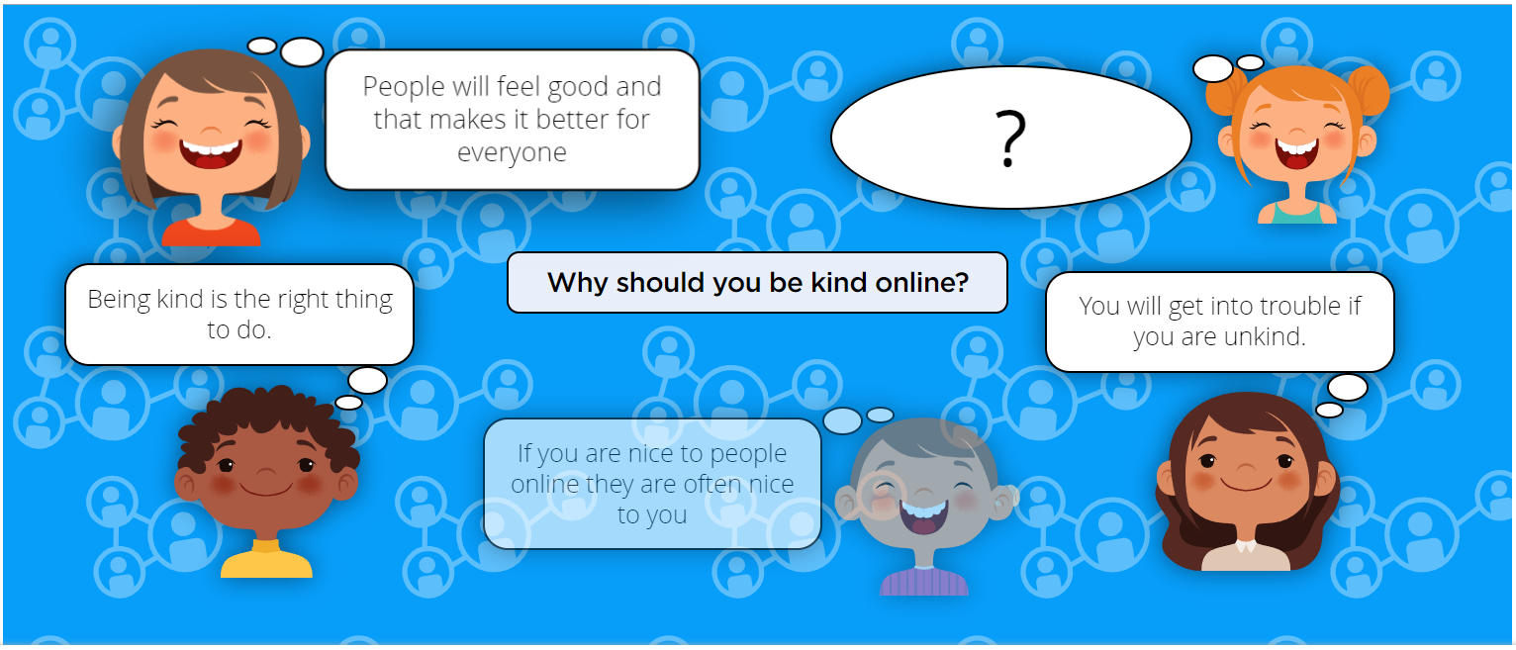

Slide 11
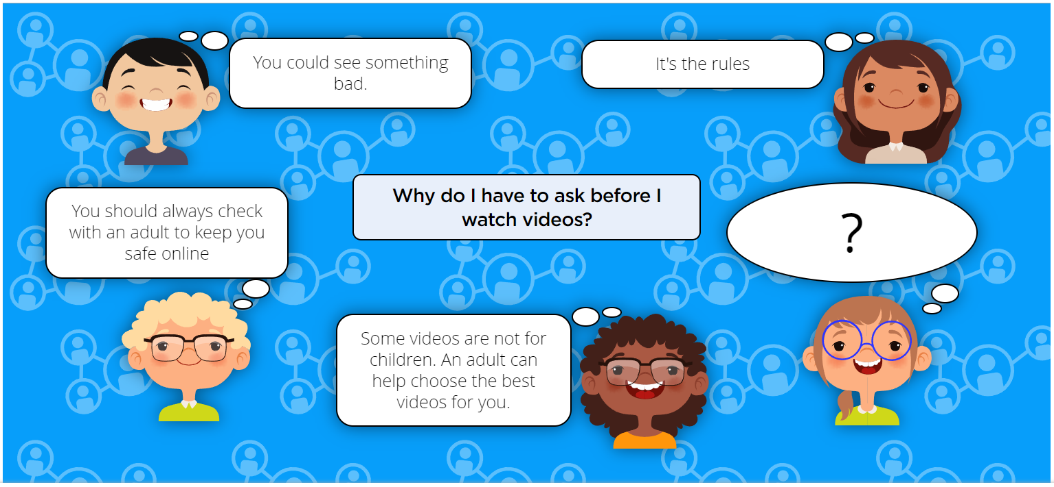

Slide 12
Online Reputation
I can recognise that information can stay online and could be copied.
Questions To Ask
What different kinds of information can be put online?
Have you shared information online?
Has anyone else shared your information online? Have you parents or carers put pictures or videos of you online?
Facebook
Instagram
Snapchat
TikTok
How long does information stay online for?
Can anyone put information online?
Can you copy information off the internet?
Does think include photographs and videos?
What should we do to stop people copying our information?
parental controls
being careful about what we share

Slide 13
Online Reputation
I can describe what information I should not put online without asking a trusted adult first.
Questions To Ask
What do we mean by ‘personal information’?
name
school
phone number
email address
Is it ok to share personal information?
Is a password personal information?
Are there some kinds of information that I can share online?
If I am unsure if I should share something online who should I ask?
What information shouldnt I share online?
What do we mean by ‘trusted adult’?
How can information be shared or seen?
text
pictures
videos
memes

Slide 14
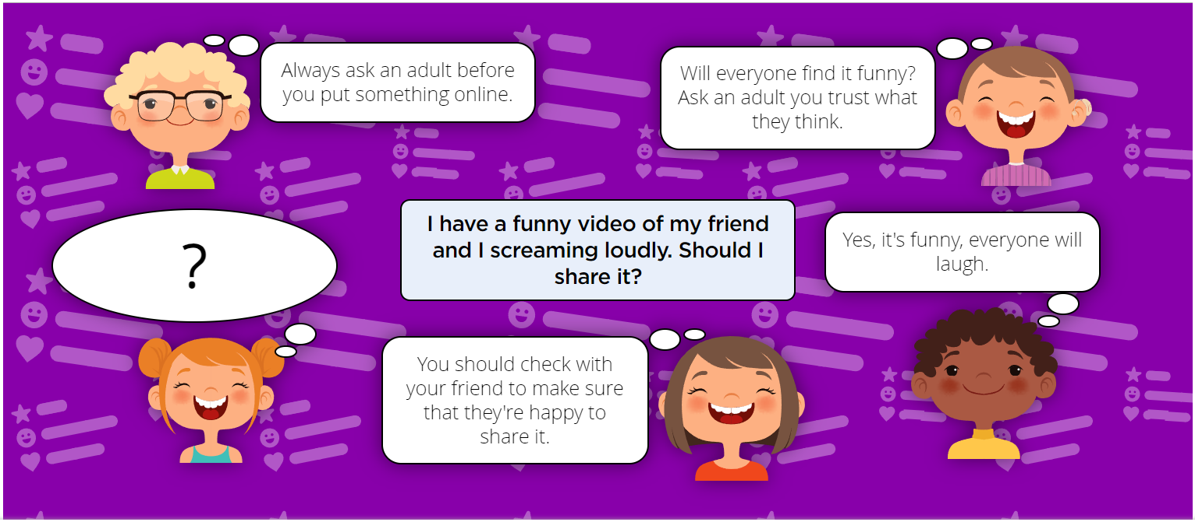

Slide 15
Online Bullying
I can describe how to behave online in ways that do not upset others and can give examples.
Questions To Ask
Have you ever upset someone online/offline?
How did they feel?
How did it make you feel?
Have you ever accidentally upset someone online/offline?
Has anything or anyone online made you upset?
How did you feel?
What did you do next?
What behaviours might upset someone online?
What behaviours might make someone feel good online?
Is there anything you might do online that neither causes upset nor makes people feel better?
What does it mean to be 'positive' online?

Slide 16
Manging Online Information
I can give simple examples of how to find information using digital technologies, e.g. search engines, voice activated searching.
Questions To Ask
What devices can we use to get on the internet?
Have you used your fingers to 'swipe' on a tablet?
Have you used a keyboard and mouse (or seen a grownup use these) on a computer?
Have you ever talked to a device (such as Alexa, Google, Siri or Cortana)?
Which way is easiest? Does it matter what you're trying to do?

Slide 17
Manging Online Information
I know / understand that we can encounter a range of things online including things we like and don’t like as well as things which are real or make believe / a joke.
Questions To Ask
I know that we can encounter a range of things online including things we like and don't like.
I know that we can encounter things online which are real or make believe / a joke.
I know I can get help if I see content that makes me feel sad, uncomfortable, worried or frightened.
I know how to get help from a trusted adult.

Slide 18
Manging Online Information
I know how to get help from a trusted adult if we see content that makes us feel sad, uncomfortable, worried or frightened.
Questions To Ask
Why does the internet have lots of information?
Who puts it there?
Why do people put information on the internet?
Is 'information' always true?
What can we do if we see something online that makes us upset?

Slide 19
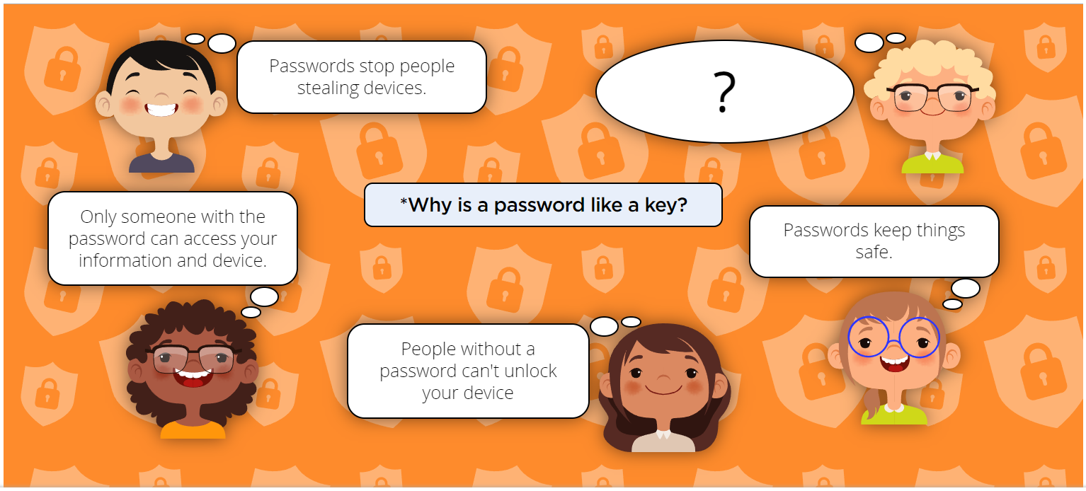

Slide 20
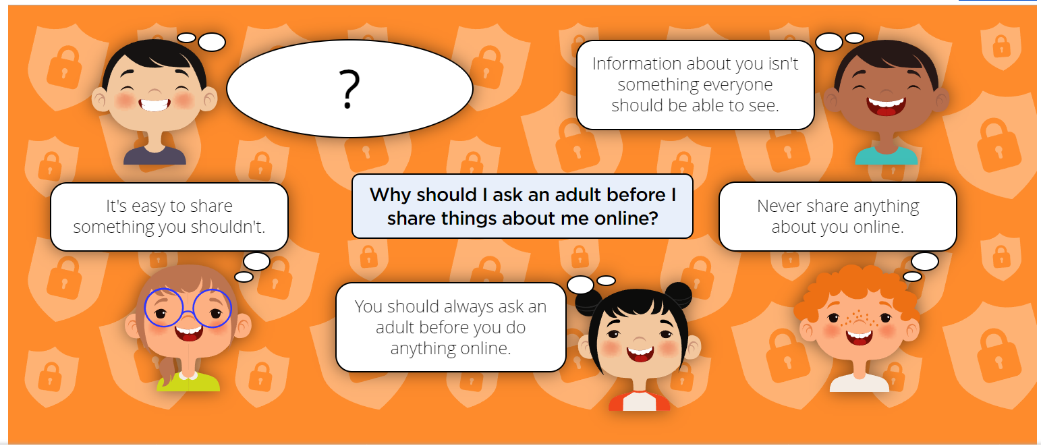

Slide 21
Health, Wellbeing and lifestyle
I can explain rules to keep myself safe when using technology both in and beyond the home.
Questions To Ask
What things do you do most at home when you are using technology online?
What do you enjoy most? Why?
What things make you unhappy/angry/sad/annoyed when you use technology?
Do you have any rules at home for using technology? What are they?
Do you have any rules at school for using technology? What are they?
Why do you think we have these rules?
What happens if you follow the rules (e.g. rewards)?
What happens if you don’t follow the rules (e.g. sanctions)?
Which rules do you think keep you safe?
Which rules do you think help you to look after your body and brain?

Slide 22
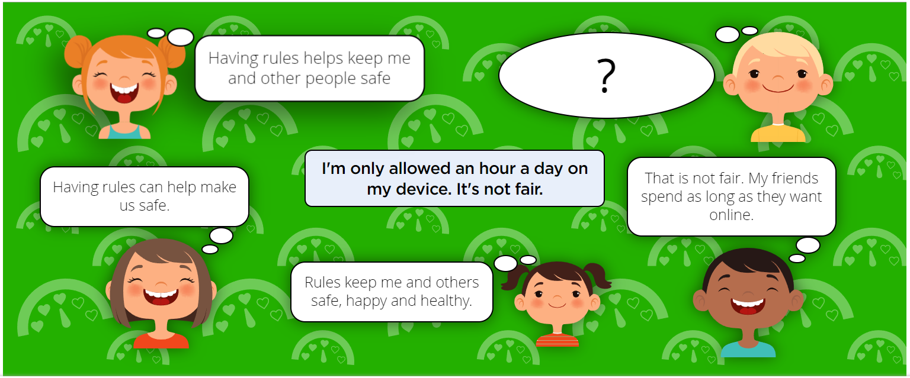

Slide 23
Privacy and Security
I can explain how passwords are used to protect information, accounts and devices.
Questions to ask
What is a password?
When might a password be really important?
Are there things you do online that you don’t need a password for?
What makes a good password?
What makes a bad password?

Slide 24
Privacy and Security
I can recognise more detailed examples of information that is personal to someone (e.g where someone lives and goes to school, family names).
Questions to ask
When is it OK to share personal information?
What is personal information?
Why is this information important?
Why should we not just share this information all the time?
What makes you think those adults are best?
Are some adults better to ask than others? Why?

Slide 25
Privacy and Security
I can explain why it is important to always ask a trusted adult before sharing any personal information online, belonging to myself or others.
Questions to ask
When is it OK to share personal information?
What is personal information?
Why is this information important?
Why should we not just share this information all the time?
What makes you think those adults are best?
Are some adults better to ask than others? Why?

Slide 26
Copyright and ownership
I can explain why work I create using technology belongs to me
Questions to ask
What things ‘belong’ to you at home? (e.g. toys, bedroom, other belongings)
What things ‘belong’ to you at school? (e.g. clothing/uniform, peg, tray, seat/space, etc.)
Do some things belong to more than one person? (e.g. your house, your classroom/school, objects, etc.)
If you draw a picture, who does it belong to? Why? (e.g. ‘because I made it’)
If you draw a picture on the computer/tablet/interactive whiteboard, who does it belong to?
If I give a copy of my digital picture to my friend, do I still own it?
How could we help other people know that things are ours? (e.g. ‘put our name on them’ - clothes as a good example)

Slide 27
Copyright and ownership
I can say why it belongs to me (e.g. ‘I designed it’ or ‘I filmed it’’).
Questions to ask
What things ‘belong’ to you at home? (e.g. toys, bedroom, other belongings)
What things ‘belong’ to you at school? (e.g. clothing/uniform, peg, tray, seat/space, etc.)
Do some things belong to more than one person? (e.g. your house, your classroom/school, objects, etc.)
If you draw a picture, who does it belong to? Why? (e.g. ‘because I made it’)
If you draw a picture on the computer/tablet/interactive whiteboard, who does it belong to?
If I give a copy of my digital picture to my friend, do I still own it?
How could we help other people know that things are ours? (e.g. ‘put our name on them’ - clothes as a good example)

Slide 28
Copyright and ownership
I can save my work under a suitable title or name so that others know it belongs to me (e.g. filename, name on content).
Questions to ask
What do we call each of you so we know who everyone is?
How do you know that your work is yours?
What does your teacher call you when they want your attention?
Why are names important?

Slide 29
Copyright and ownership
I understand that work created by others does not belong to me even if I save a copy
Questions to ask
What do we call each of you so we know who everyone is?
How do you know that your work is yours?
What does your teacher call you when they want your attention?
Why are names important?

Slide 30
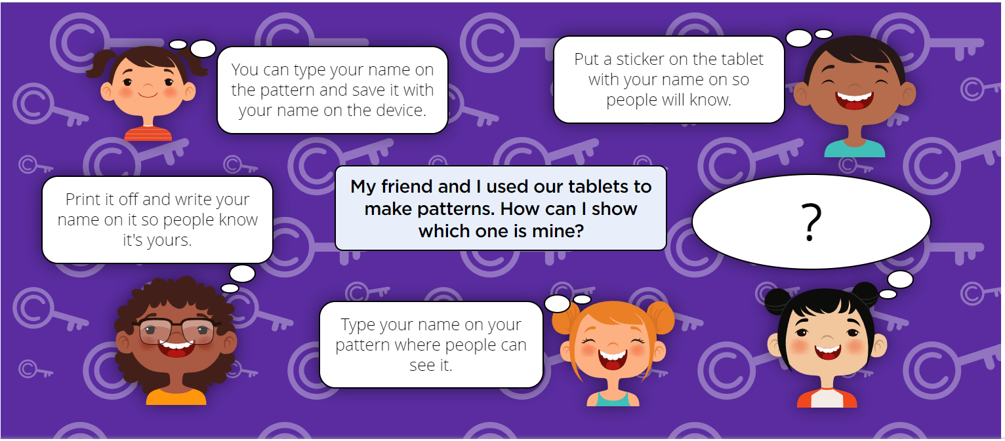

Slide 31
