Slide 1

Online Safety – Starter tasks linked to progression of skills
Project Evolve – Discussion points

Slide 2
YEAR 2
For further resources to enrich these topics please log in to Project Evolve and follow the link below. Full lesson plans are available which are resourced as well.
https://projectevolve.co.uk/toolkit/resources/years/year-two/

Slide 3
Self image and identity
I can explain how other people may look and act differently online and offline.
Questions To Ask
What ways can people be different to us online?
How might someone show they are different to us online?
Physical appearance - How could someone show things about their physical appearance online? Why might someone want to do this? Why might they not? Why would someone want to show a different physical appearance online to how they actually look offline?
What is a profile picture? What might you include in it? What can you change about it?
How can you change your appearance online?
If you hid your face, what questions could your friend ask to determine that you are really you? What is most striking about you? Which bits of our identity do we include online, and which bits do we keep offline?

Slide 4
Self image and identity
I can give examples of issues online that might make someone feel sad, worried, uncomfortable or frightened; I can give examples of how they might get help.
Questions To Ask
What do you like to do online? What do you not like to do?
What can you do if something makes you feel sad/ embarrassed or upset online?
Who can help you if something ever worries or upsets you online?
How can you ask for help? What would you say?

Slide 5
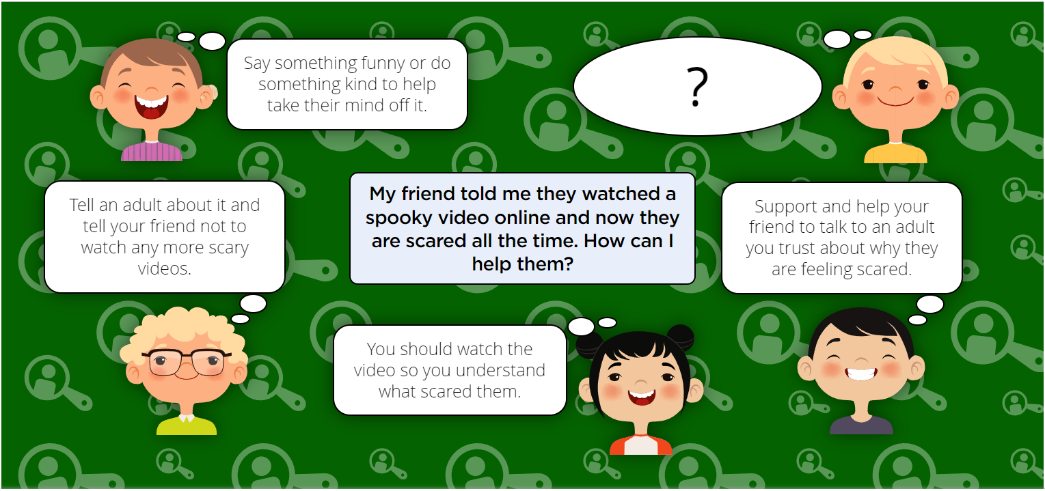

Slide 6
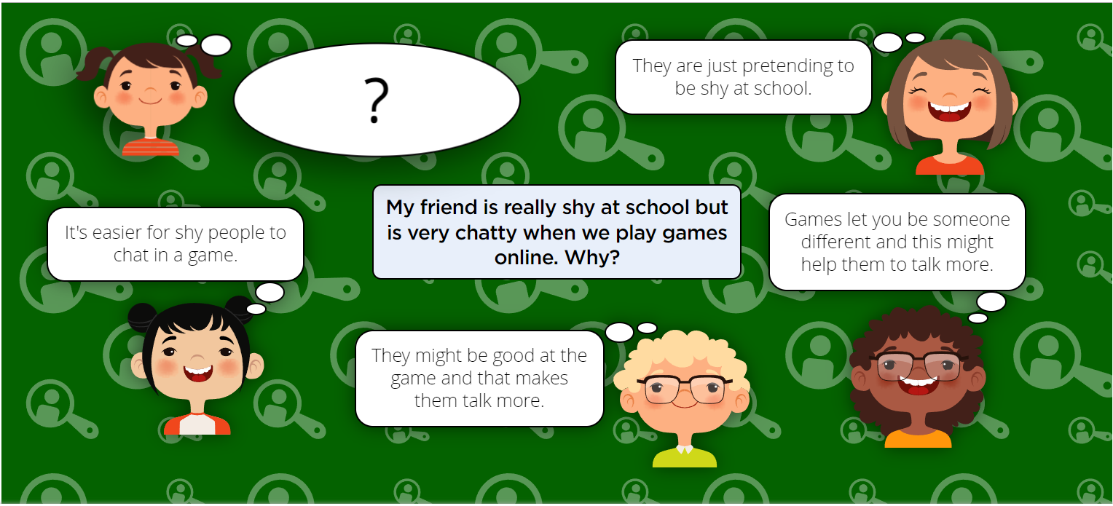

Slide 7
Online Relationships
I can give examples of how someone might use technology to communicate with others they don’t also know offline and explain why this might be risky. (e.g. email, online gaming, a pen-pal in another school / country).
Questions To Ask
What does online mean? What does offline mean?
Why might someone want to communicate online with someone they already know offline?
Why might someone want to do this? What would be good about this?
Can you think of any problems this might cause?
What might they be?
Is it sometimes ok to communicate with people you don’t know online?
How would you check whether it was ok or not?
What are the things you need to think about to stay safe when communicating with people you don’t know well?

Slide 8
Online Relationships
I can explain who I should ask before sharing things about myself or others online.
Questions To Ask
What kinds of things do you share online?
Do you have consent to share these things about yourself?
Do you have consent to share these things about others?
Who do you have to ask permission to do certain things?
Why should you ask permission before you do certain things? What might happen if you don’t?
Can you give examples of when you might have to ask permission before you do something online or when using technology?
What might happen if you do not ask permission before sharing things about others online using technology?
Should people ask for your permission too before they share things about you?
Do you always have to give permission if you are asked?
Can you give examples of when you might not give permission online or before using technology?
How could you deny permission or say ‘no’ politely?
Who is a trusted adult?
Can you identify who could help you in school and at home if something is posted without your consent?

Slide 9
Online Relationships
I can describe different ways to ask for, give, or deny my permission online and can identify who can help me if I am not sure.
Questions To Ask
What kinds of things do you have to ask if you are allowed to do before you do them?
Who do you have to ask permission to do certain things?
Why should you ask permission before you do certain things? What might happen if you don’t?
Can you give examples of when you might have to ask permission before you do something online or when using technology?
What might happen if you do not ask permission before using technology?
Should people ask for your permission too?
Do you always have to give permission if you are asked?
Can you give examples of when you might not give permission online or before using technology?
How could you deny permission or say ‘no’ politely?

Slide 10
Online Relationships
I can explain why I have a right to say ‘no’ or ‘I will have to ask someone’. I can explain who can help me if I feel under pressure to agree to something I am unsure about or don’t want to do.
Questions To Ask
What feelings do you have if someone asks you to do something nice or says something nice about you?
How does it make you feel if someone asks you to do something which you don’t like or don’t want to do?
Do friends sometimes ask you to do things which you might not like to do?
What kinds of things might you be asked to do online or using technology which you might not like to do?
How could you say ‘no’? Are there ways to say ‘no’ politely?
Is it always easy to say no, particularly to friends?
Which adults do you know that you trust and could help you if you didn't know what to do?

Slide 11
Online Relationships
I can identify who can help me if something happens online without my consent
Questions To Ask
What kinds of things do you share online?
Do you have consent to share these things about yourself?
Do you have consent to share these things about others?
Who do you have to ask permission to do certain things?
Why should you ask permission before you do certain things? What might happen if you don’t?
Can you give examples of when you might have to ask permission before you do something online or when using technology?
What might happen if you do not ask permission before sharing things about others online using technology?
Should people ask for your permission too before they share things about you?
Do you always have to give permission if you are asked?
Can you give examples of when you might not give permission online or before using technology?
How could you deny permission or say ‘no’ politely?
Who is a trusted adult?
Can you identify who could help you in school and at home if something is posted without your consent?

Slide 12
Online Relationships
I can explain how it may make others feel if I do not ask their permission or ignore their answers before sharing something about them online.
Questions To Ask
What kinds of things do you have to ask if you are allowed to do before you do them?
Who do you have to ask permission to do certain things?
Why should you ask permission before you do certain things? What might happen if you don’t?
Can you give examples of when you might have to ask permission before you do something online or when using technology?
What sorts of things might you share online about other people?
Why is it sometimes good to share things online?
Does sharing things online, particularly things about other people, always feel good?
What types of things might you or others not want to be shared online? Why?
How would it make you feel if someone shared something about you online without asking?
What if they asked and you said no, but they still shared?
Can you imagine how other people might feel if you shared something about them online without asking them?
Who might you talk to or what might you do if you had any problems about things being shared without permission?

Slide 13
Online Relationships
I can explain why I should always ask a trusted adult before clicking ‘yes’, ‘agree’ or ‘accept’ online
Questions To Ask
What kind of things do we see online?
What do we like to see online?
Do we always see what we want or are other things shown to us (adverts, links etc)
Should you always just click ‘ok/yes/accept’ online?
If yes, why? If not, why not?
Discuss what can happen if we click an advert or permission we shouldn't do, for example in a game? Might it cost us money or we lose security or data?
Which adults do you know that you trust and could help you if you didn't know what to do?

Slide 14
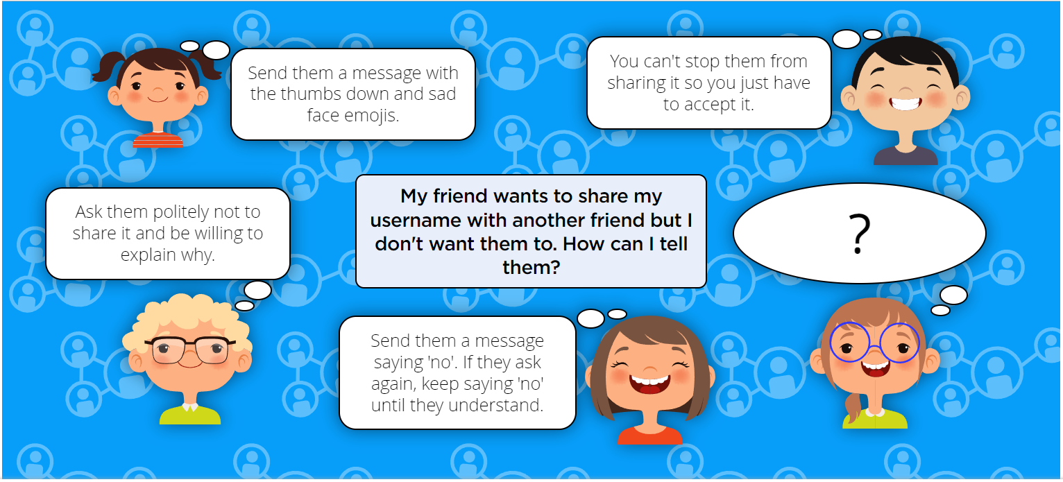

Slide 15
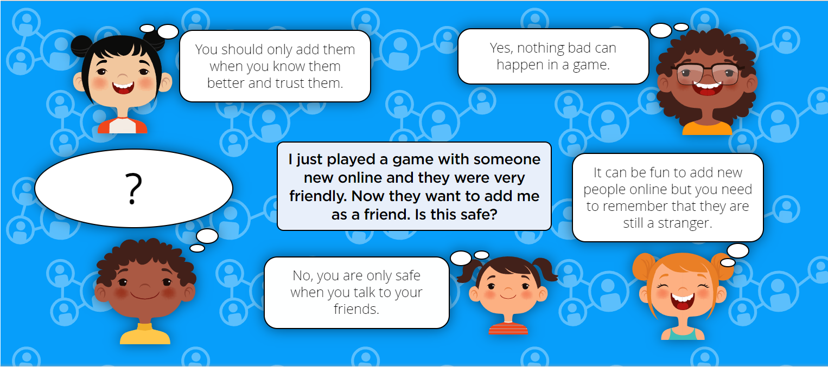

Slide 16
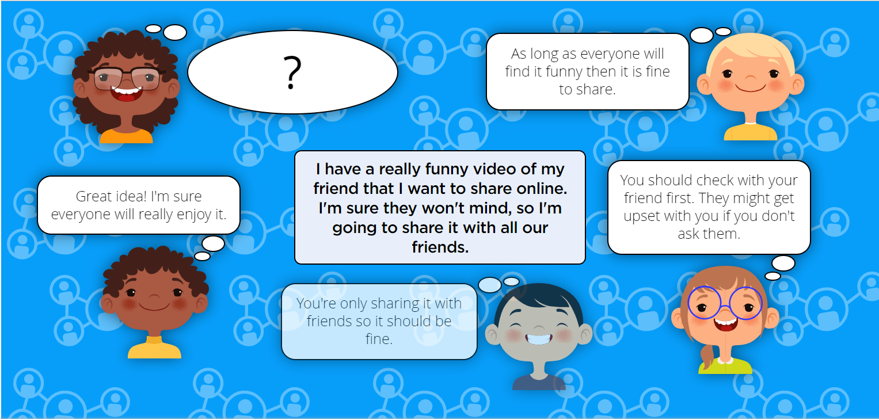

Slide 17
Online Reputation
I can explain how information put online about someone can last for a long time.
Questions To Ask
What kinds of information can be shared online?
Is anyone responsible for taking down old information?
How long do you think information stays online for?
Can people share information about me without my knowledge?
If they do, could it still stay online for a long time?
Have you parents/carers ever shared a picture of you on social media?
have you seen it?
did you like it?
was it funny?
was it cute?
was it embarrassing?
did anyone comment on it?
How/can we tell when something was posted online?
Do you think we can take information down from the internet?

Slide 18
Online Reputation
I can describe how anyone’s online information could be seen by others.
Questions To Ask
What information do you share online?
What information about you do other people share online?
If someone shares something on social media, just for their friends, could anyone else see it?
If someone sends a picture message to a friend, could other people see it?
What could you do to prevent other people seeing your information online?

Slide 19
Online Reputation
I know who to talk to if something has been put online without consent or if it is incorrect.
Questions To Ask
What information might people share online?
Is it ok to share information online?
What kind of information is it ok to share?
What kind of information should we not share?
Why shouldn’t we share some kinds of information?
What should we do if someone shares information online that they shouldn’t?
Could people share private information by accident?
Who could we tell?
What do we mean by ‘trusted adult?
What is a trusted adult?
Can strangers be trusted adults?
Childline
Police

Slide 20
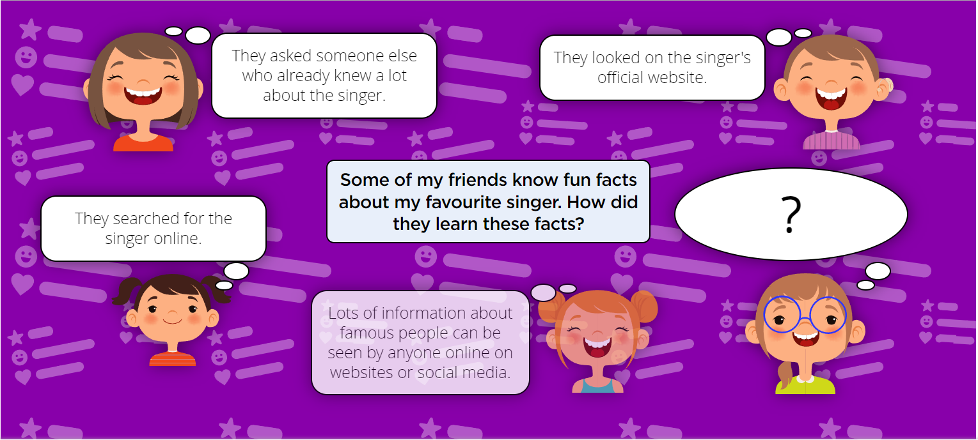

Slide 21
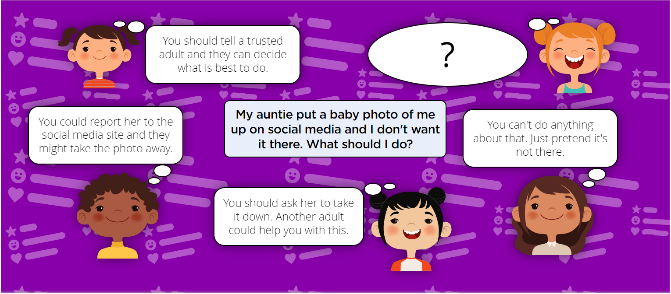

Slide 22
Online Bullying
I can explain what bullying is, how people may bully others and how bullying can make someone feel.
Questions To Ask
How would you define bullying?
What is the difference between bullying and light teasing?
What are the differences between bullying online and offline?
What are the similarities between bullying online and offline?
Why do you think someone might bully others?
How might someone being bullied feel?
How might the person bullying feel?
How might someone witnessing the bullying feel?

Slide 23
Online Bullying
I can explain why anyone who experiences bullying is not to blame
Questions To Ask
What does the word ‘accident’ mean?
Can you give me an example of an accident?
Have you ever been blamed for something you haven't done?
What does the word ‘intentional’ mean?
What sort of things do we do that are intentional, planned or on purpose?
Is bullying accidental or intentional?
Can bullying ever be accidental?
How?
Is there a difference online as opposed to offline?
Who is to blame for bullying behaviour?
Why do you think people bully others, online or offline?

Slide 24
Online Bullying
I can talk about how anyone experiencing bullying can get help.
Questions To Ask
Who can help you if you are worried about something?
At school?
At home?
Online?
Who could you go to if you were being bullied?
At school?
At home?
Online?
Would you go to someone different if the bullying was happening online?
Why/why not?
Would you go to someone different if someone you knew (a friend, someone in your class, etc.) was being bullied?
Why/why not?

Slide 25
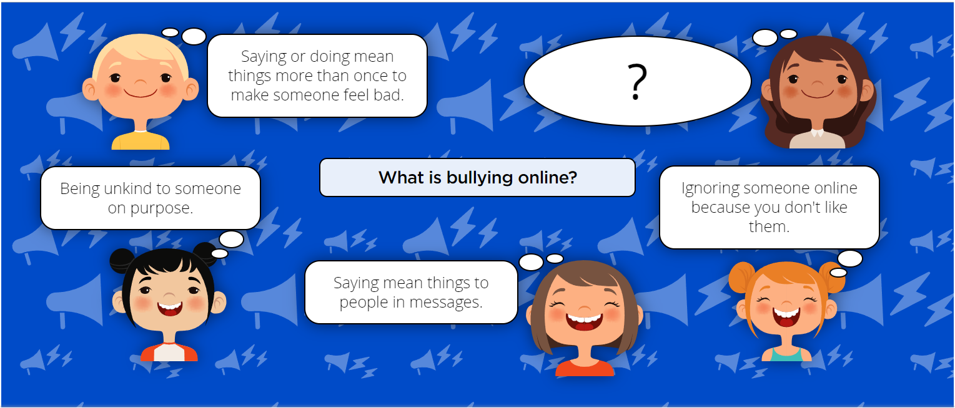

Slide 26
Manging Online Information
I can use simple keywords in search engines
Questions To Ask
Have you ever searched for something online? For example, searched for a video? How easy was it to find what you were looking for?
We need to use the right words when we search, to get the best search results. We can use keywords for this. What is a keyword?
What is a website? What is a webpage?

Slide 27
Manging Online Information
I can demonstrate how to navigate a simple webpage to get to information I need (e.g. home, forward, back buttons; links, tabs and sections).
Questions To Ask
Have you ever searched for something online? For example, searched for a video? How easy was it to find what you were looking for?
We need to use the right words when we search, to get the best search results. We can use keywords for this. What is a keyword?
What is a website? What is a webpage?

Slide 28
Manging Online Information
I can explain what voice activated searching is and how it might be used, and know it is not a real person (e.g. Alexa, Google Now, Siri).
Questions To Ask
What is a smart speaker?
Have you used a smart speaker? Or maybe you've used a 'digital assistant' on a tablet, smartphone or computer (where you talk rather than type or swipe)?
Does a smart speaker or digital assistant know everything? Is there any question it can't answer? Is it always right?
How does a smart speaker answer questions? Is it a real person?
Are there some questions that are better to ask a grownup?

Slide 29
Manging Online Information
I can explain the difference between things that are imaginary, ‘made up’ or ‘make believe’ and things that are ‘true’ or ‘real’
Questions To Ask
What is a smart speaker?
Have you used a smart speaker? Or maybe you've used a 'digital assistant' on a tablet, smartphone or computer (where you talk rather than type or swipe)?
Does a smart speaker or digital assistant know everything? Is there any question it can't answer? Is it always right?
How does a smart speaker answer questions? Is it a real person?
Are there some questions that are better to ask a grownup?

Slide 30
Manging Online Information
I can explain why some information I find online may not be real or true.
Questions To Ask
What is a smart speaker?
Have you used a smart speaker? Or maybe you've used a 'digital assistant' on a tablet, smartphone or computer (where you talk rather than type or swipe)?
Does a smart speaker or digital assistant know everything? Is there any question it can't answer? Is it always right?
How does a smart speaker answer questions? Is it a real person?
Are there some questions that are better to ask a grownup?

Slide 31
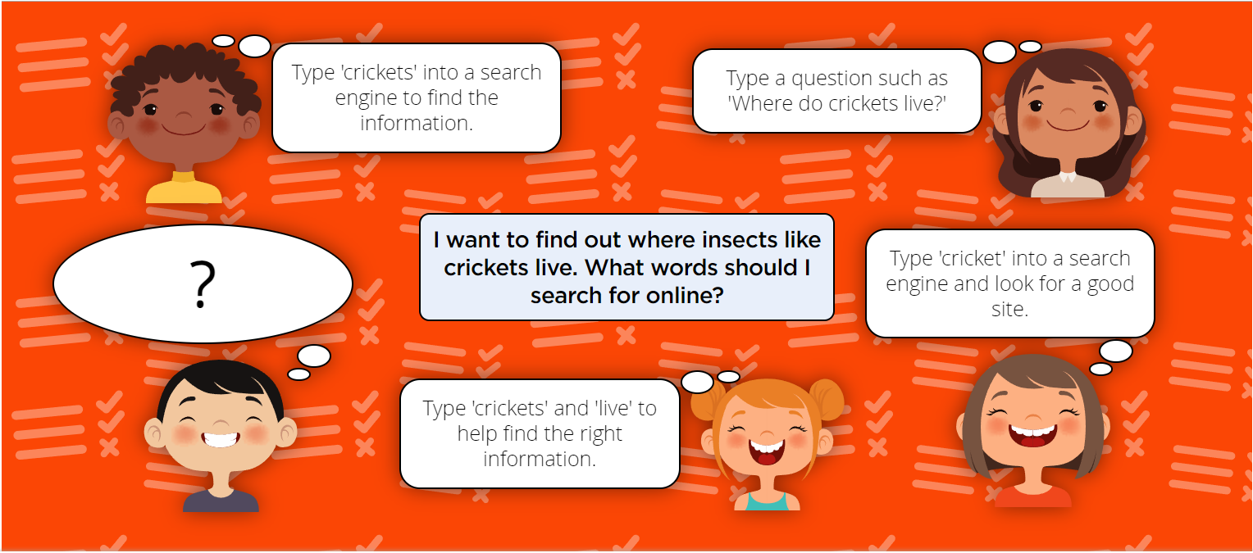

Slide 32
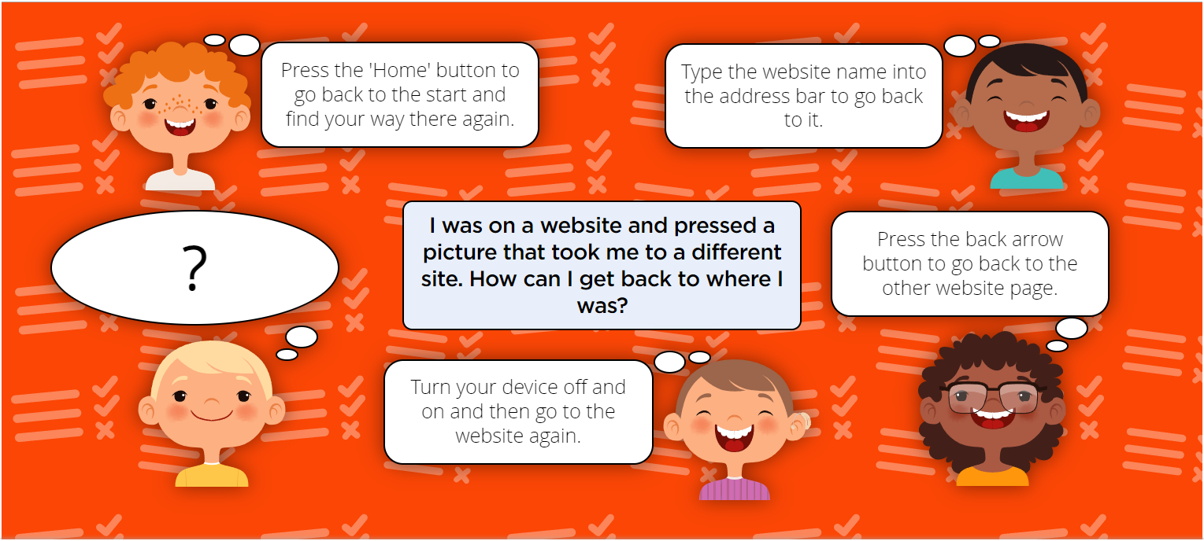

Slide 33
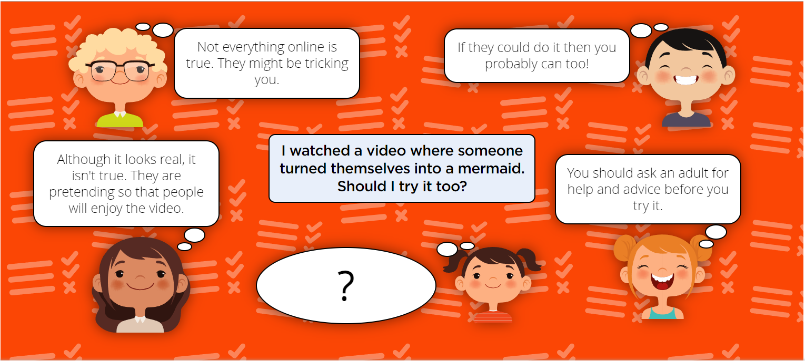

Slide 34
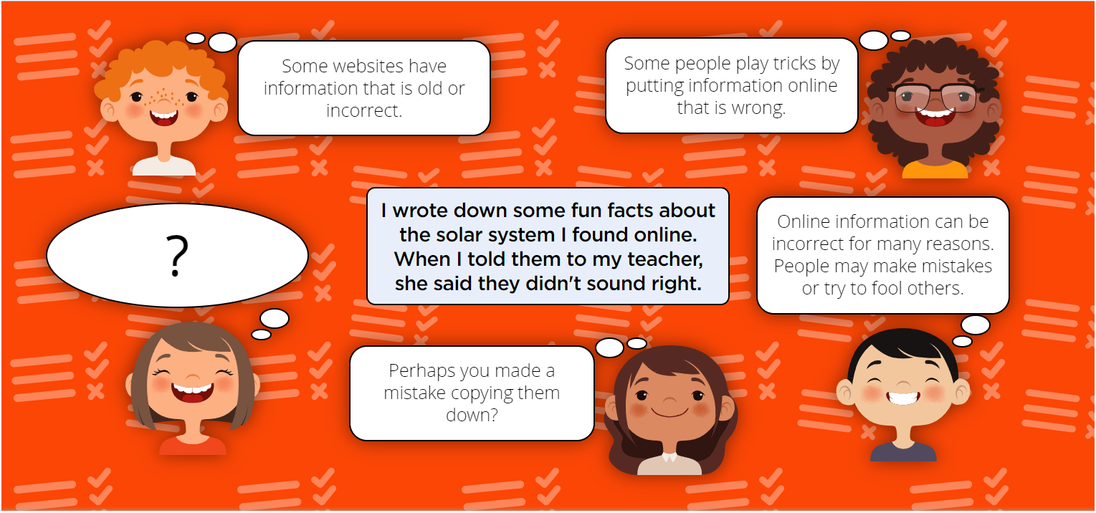

Slide 35
Health, Wellbeing and lifestyle
I can explain simple guidance for using technology in different environments and settings e.g. accessing online technologies in public places and the home environment
Questions To Ask
What things do you do most at home when you are using technology online? Remind me.
What are the good things you use technology for?
What do you enjoy most? Why?
Which things make you lose patience/get sad/angry/annoying?
What happens to you when you’ve used technology for too long?
Last time we talked about some rules that you have at home/ school (or your ideas for rules) when using technology. Let’s just run through some of those again to remind ourselves what they were.
Let’s look at one of those rules (eg timing based rule). Why do you think having that rule in place is important?
What sorts of things might that rule help make better?
Can you explain how that rule might make things better?
Are there certain times (context) when that rule is more important than at other times? (Bedtime? Homework time? Family Meals? Lessons? When someone is talking to you?) Explain

Slide 36
Health, Wellbeing and lifestyle
I can say how those rules / guides can help anyone accessing online technologies
Questions To Ask
What things do you do most at home when you are using technology online? Remind me.
What are the good things you use technology for?
What do you enjoy most? Why?
Which things make you lose patience/get sad/angry/annoying?
What happens to you when you’ve used technology for too long?
Last time we talked about some rules that you have at home/ school (or your ideas for rules) when using technology. Let’s just run through some of those again to remind ourselves what they were.
Let’s look at one of those rules (eg timing based rule). Why do you think having that rule in place is important?
What sorts of things might that rule help make better?
Can you explain how that rule might make things better?
Are there certain times (context) when that rule is more important than at other times? (Bedtime? Homework time? Family Meals? Lessons? When someone is talking to you?) Explain

Slide 37
Privacy and Security
I can explain how passwords can be used to protect information, accounts and devices.
Questions to ask
What is a password?
Where do we use passwords? (games, devices, etc.)
Do you have any passwords? What are they for?
Who knows your passwords? Why?
Why do we need passwords?
Do you know what makes a strong password?
Do you know what makes a poor password?

Slide 38
Privacy and Security
I can explain and give examples of what is meant by ‘private’ and ‘keeping things private’.
Questions to ask
What is personal information?
Who knows your personal information? (e.g. family, friends, teacher/school, doctor, etc.)
Which famous person/people do you like online?
What do you know about them?
How did you learn those things?
Could someone online learn things about you? How?
How can you keep things private online?

Slide 39
Privacy and Security
I can describe and explain some rules for keeping personal information private (e.g. creating and protecting passwords). Questions to ask
What is personal information?
Who knows your personal information? (e.g. family, friends, teacher/school, doctor, etc.)
Which famous person/people do you like online?
What do you know about them?
How did you learn those things?
Could someone online learn things about you? How?
How can you keep things private online?
How can passwords help keep things private?

Slide 40
Privacy and Security
I can explain how some people may have devices in their homes connected to the internet and give examples (e.g. lights, fridges, toys, televisions). Questions to ask
What are the features of a connected device?
Where might you find connected devices…
… at home?
… at school?
… in public?
What are the benefits of using connected devices in their home?
Can you think of any disadvantages to using connected devices?

Slide 41
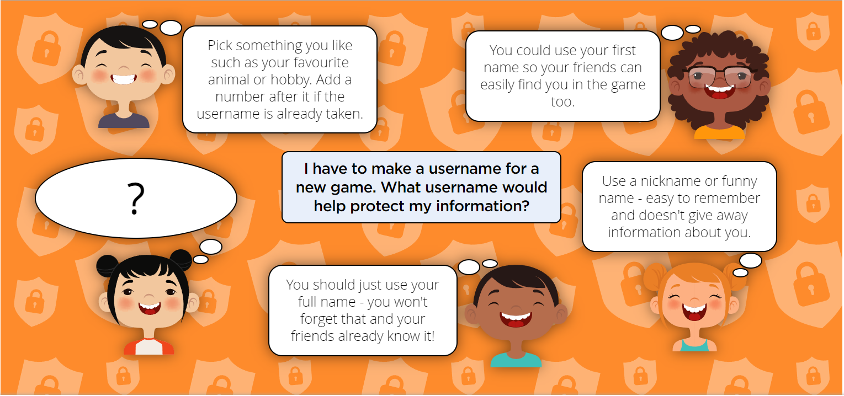

Slide 42
Copyright and ownership
I can recognise that content on the internet may belong to other people.
Questions to ask
How do you show someone that your work belongs to you?
If someone’s work isn’t named, can you claim it as yours? Why/why not?
If I made a copy of your work, would it now be my work?
(Show search engine results) Do these things belong to the search engine? Why/why not?
(Show suitable website) Who owns this website?
How could we find out?
Who made the pictures/photos?
Who wrote the text?
Who owns those elements?
How do we show who things belong to online?
What do you need to do if you want to use someone else’s online content (photos, videos, text, etc.)?
If you can’t see who owns something online, can you use it?

Slide 43
Copyright and ownership
I can describe why other people’s work belongs to them
Questions to ask
How do you show someone that your work belongs to you?
If someone’s work isn’t named, can you claim it as yours? Why/why not?
If I made a copy of your work, would it now be my work?
(Show search engine results) Do these things belong to the search engine? Why/why not?
(Show suitable website) Who owns this website?
How could we find out?
Who made the pictures/photos?
Who wrote the text?
Who owns those elements?
How do we show who things belong to online?
What do you need to do if you want to use someone else’s online content (photos, videos, text, etc.)?
If you can’t see who owns something online, can you use it?

Slide 44
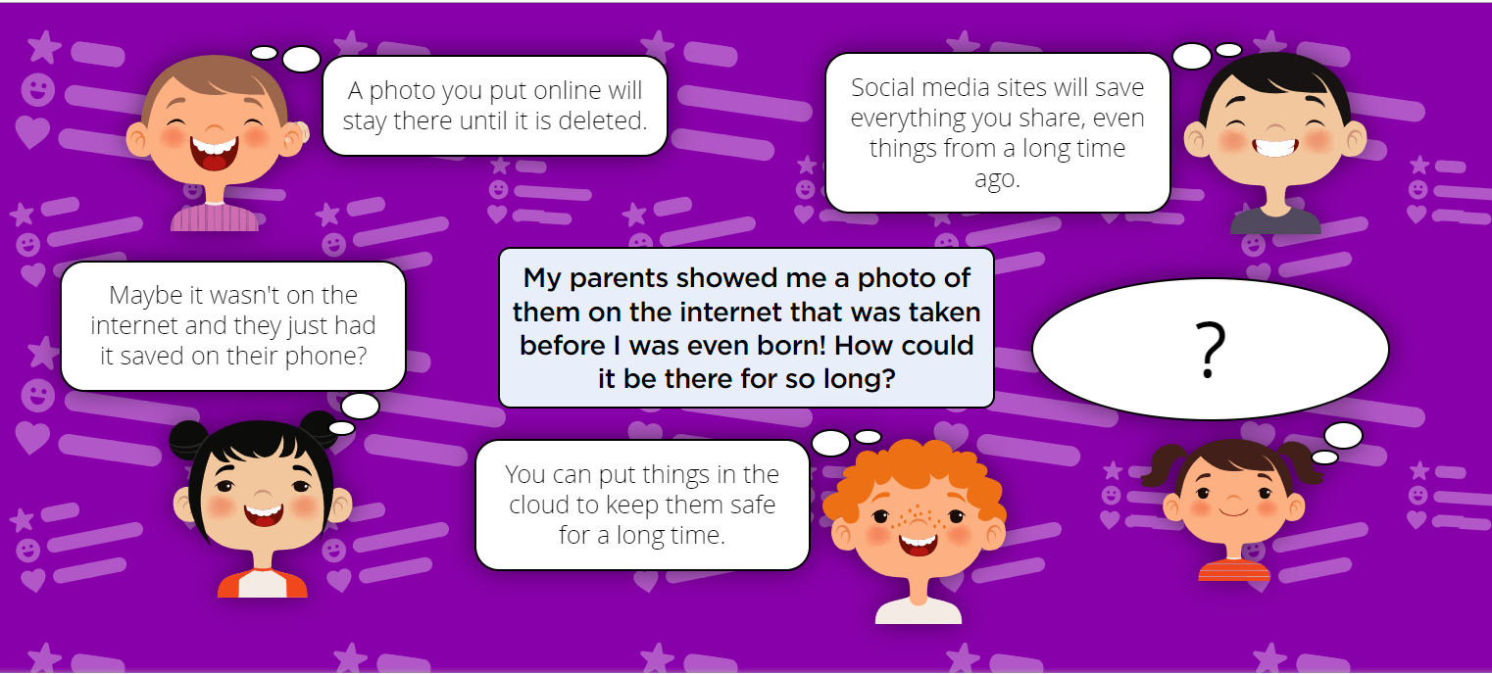

Slide 45
