Slide 1

Online Safety – Starter tasks linked to progression of skills
Project Evolve – Discussion points

Slide 2
YEAR 3
For further resources to enrich these topics please log in to Project Evolve and follow the link below. Full lesson plans are available which are resourced as well.
https://projectevolve.co.uk/toolkit/resources/years/year-three/

Slide 3
Self image and identity
I can explain what is meant by the term ‘identity’.
Questions To Ask
What is an identity? What makes up our identity?
What ways can our identities be similar or different to others?
How might someone show their identity online?
What might someone feel happy to share about themselves online and what might they not want to share? Why?
Why might someone change their identity online for different platforms? e.g. gaming; using an avatar; social media
How can someone change their identity online?

Slide 4
Self image and identity
I can explain how people can represent themselves in different ways online
Questions To Ask
What is an identity? What makes up our identity?
What ways can our identities be similar or different to others?
How might someone show their identity online?
What might someone feel happy to share about themselves online and what might they not want to share? Why?
Why might someone change their identity online for different platforms? e.g. gaming; using an avatar; social media
How can someone change their identity online?

Slide 5
Self image and identity
I can explain ways in which someone might change their identity depending on what they are doing online (e.g. gaming; using an avatar; social media) and why.
Questions To Ask
What is an identity? What makes up our identity?
What ways can our identities be similar or different to others?
How might someone show their identity online?
What might someone feel happy to share about themselves online and what might they not want to share? Why?
Why might someone change their identity online for different platforms? e.g. gaming; using an avatar; social media
How can someone change their identity online?

Slide 6
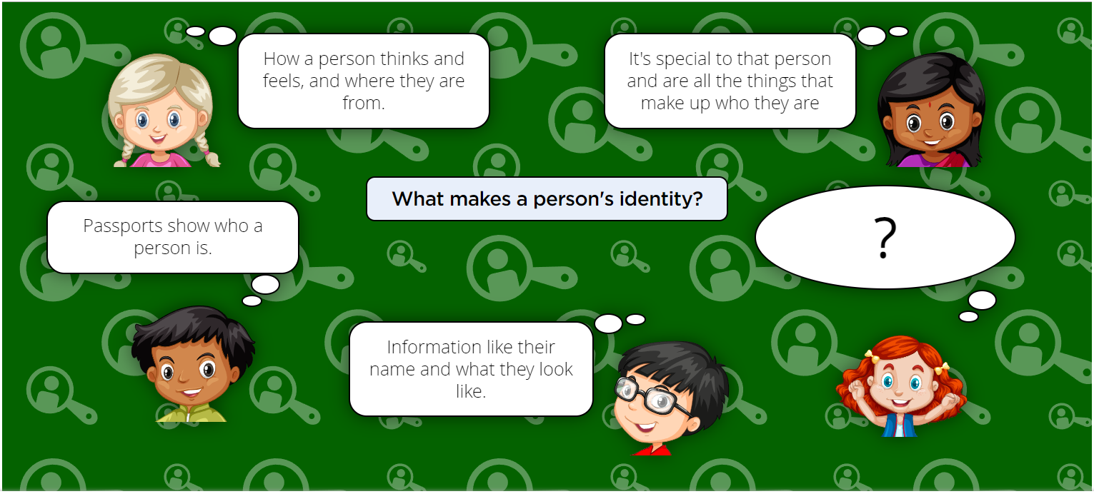

Slide 7
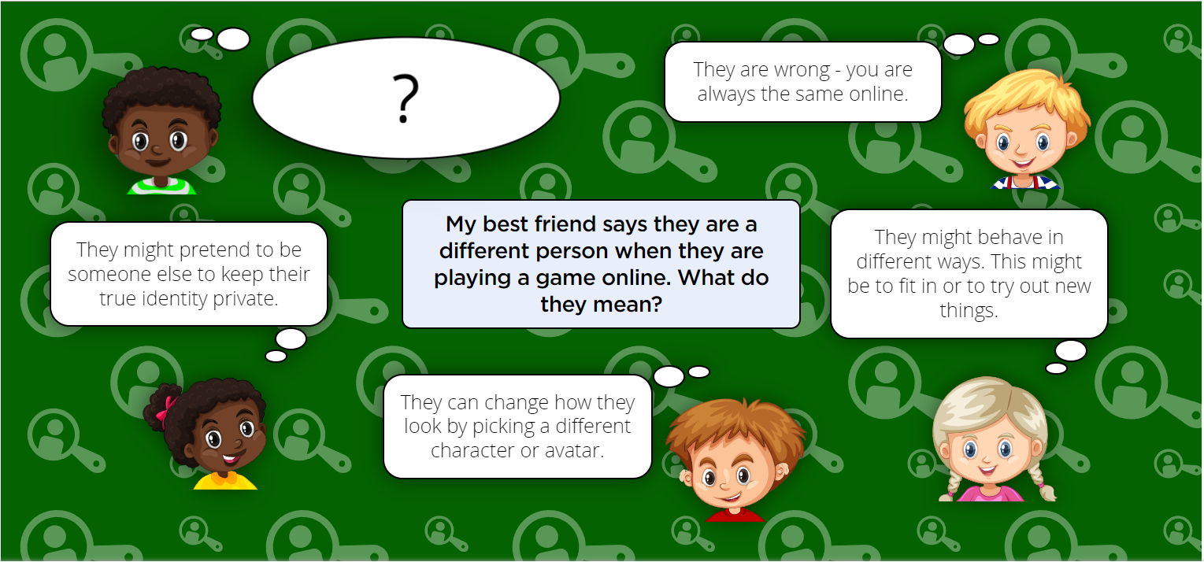

Slide 8
Online Relationships
I can describe ways people who have similar likes and interests can get together online.
Questions To Ask
What does communicate mean?
Who do you know well?
Who do you know but not very well?
What’s the difference between ‘friends’ you know well and not so well?
Why do friends get together?
What sorts of things do friends do together?
When you get together with your friends what do you do with them that is different to being on your own?
How does being together with friends make you feel?
What are some of the things that happen when you are with friends that can cause problems?
Why do friends get together online?
What are the sorts of things friends can do together online?
How is being with friends online different than offline e.g. in school or at home?
If you wanted to get together with other friends online, what are the different ways in which you might do this?
Why might this be a good thing?

Slide 9
Online Relationships
I can explain what it means to ‘know someone’ online and why this might be different from knowing someone offline.
Questions To Ask
What does online mean? What does offline mean?
Who do you know, including online?
How well do you know them?
How do you know when you really know someone?
What kinds of information do you know about different people, including online?
Does the amount of information you know about people make a difference?
Is knowing someone online the same as knowing someone offline?

Slide 10
Online Relationships
I can explain what is meant by ‘trusting someone online’, why this is different from ‘liking someone online’, and why it is important to be careful about who to trust online including what information and content they are trusted with.
Questions To Ask
What is trust?
Why is so important, including online?
Why might you want to trust someone?
How do I earn somebody's trust?
Who do you trust, including online?
Why do you trust them?
What might someone do online to make you break that trust?
What does it mean to like someone?
Who do you like?
Can you like someone you don't trust?
Can you like someone you’ve never met?
Can you trust someone you've never met?
What does liking someone online mean?
How do you show that you like someone online?
Is liking someone online the same as trusting them? Can you do both? Is there a difference?

Slide 11
Online Relationships
I can explain why someone may change their mind about trusting anyone with something if they feel nervous, uncomfortable or worried.
Questions To Ask
What is trust?
Why is trust so important, including online?
Why might you want to trust someone?
How do you earn somebody's trust?
What do others have to do/show to earn your trust?
What things can happen between two people online that can break trust?
If you have trusted someone, can your trust be taken back if they do something to break that trust?
Can they do the same if you break their trust?
What kinds of information might you be particularly careful about sharing with someone online?
What sorts of information would you think it was fine to share with someone you trust?
What might happen to your trust in someone if they have done something which has made you feel nervous, uncomfortable and worried online?

Slide 12
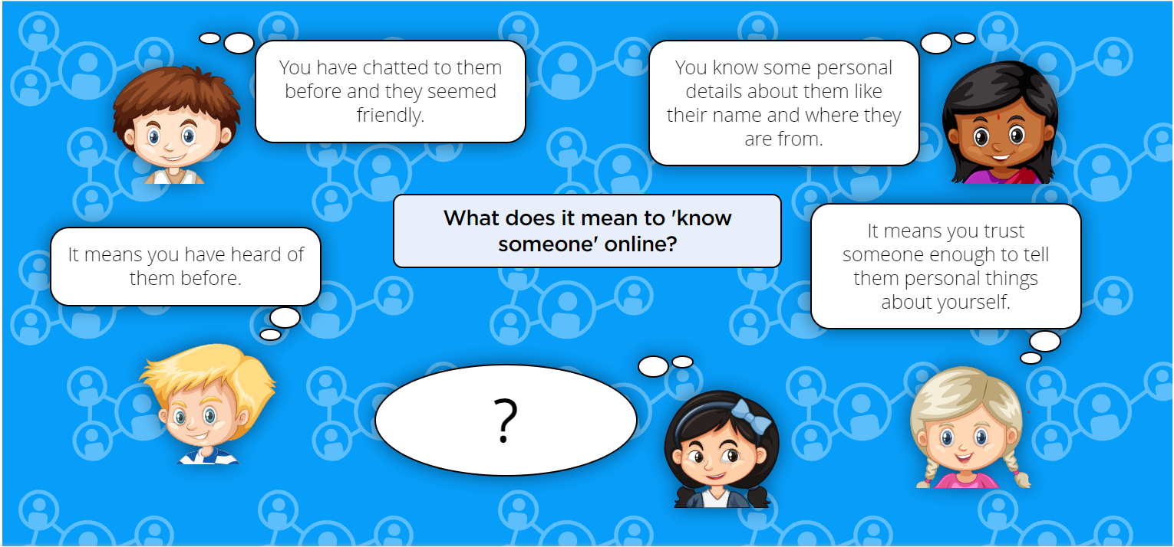

Slide 13
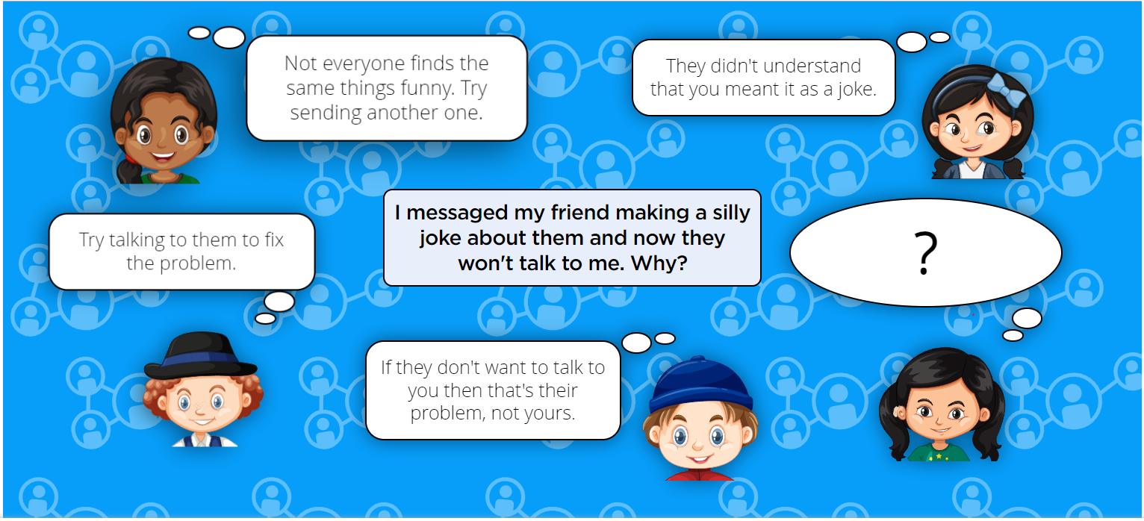

Slide 14
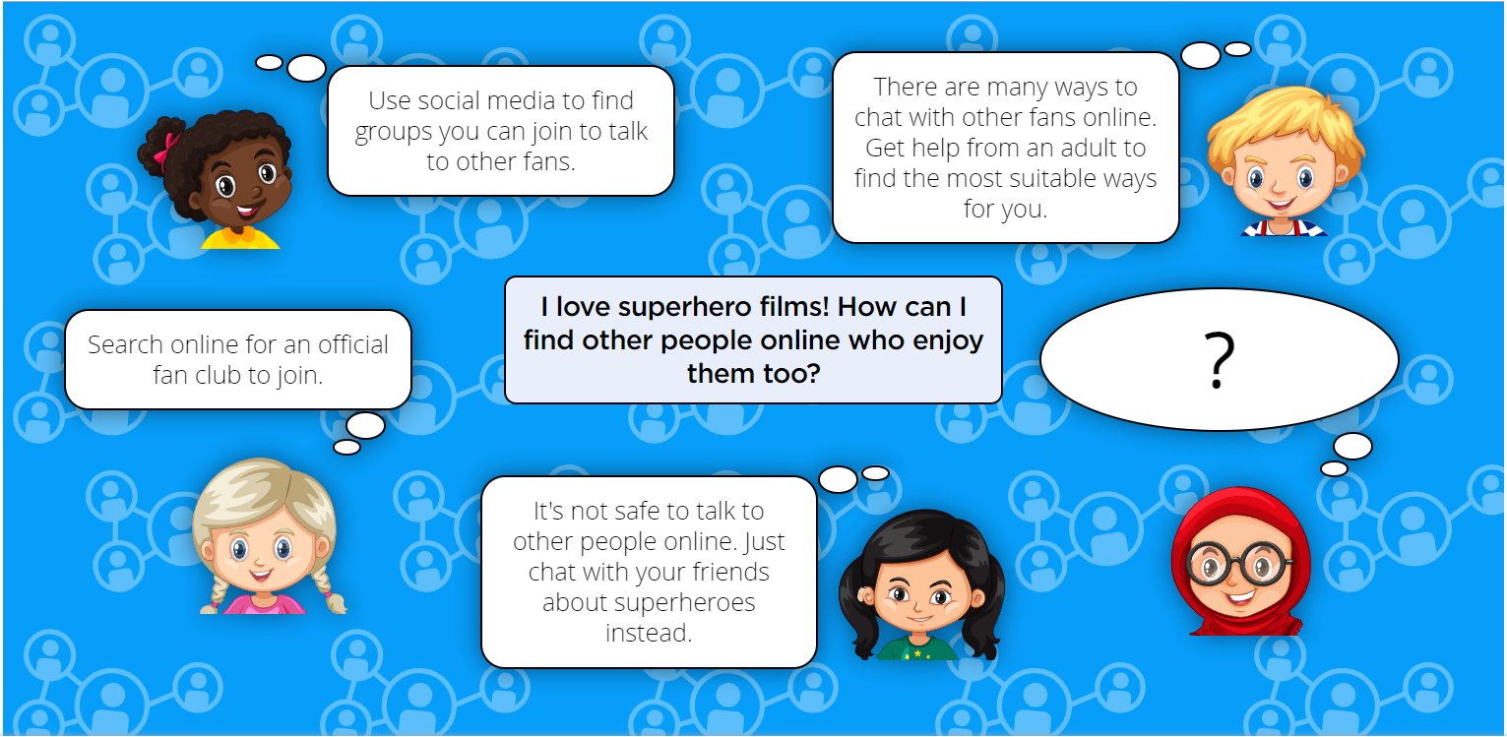

Slide 15
Online Reputation
I can explain how to search for information about others online
Questions To Ask
What do we use to find information online?
What kinds of information can we find? (social media, videos, pictures, news stories)
Is it ok to search for ourselves online?
Who might share information about us online?
Could there be information about us online that we didn't know about?
Who might share information about us? Parents, carers,grandparents, schools, friends, sports clubs
What information would we put in a search engine to find information about ourselves?
What do we mean by ‘keywords’?
If we search for our own name will we only get results about us?

Slide 16
Online Reputation
I can give examples of what anyone may or may not be willing to share about themselves online. I can explain the need to be careful before sharing anything personal.
Questions To Ask
What do we mean by personal information?
Name
location
contact details
birthday
email address
phone number
school
parents/carers/siblings details
Why do we share information about ourselves online?
What do we mean by a ‘trusted adult’
Who might we ask if we don't know if its ok to share information online?
When might we share information about others online?
Birthday pirates
Playdates
Videos
Can we post information about others without asking them first?
Should we ask permission from their parent/carer?
What if they say no? Is it still ok to share
why not?
What might happen if we still share?

Slide 17
Online Reputation
I can explain who someone can ask if they are unsure about putting something online.
Questions To Ask
What do we mean by personal information?
Name
location
contact details
birthday
email address
phone number
school
parents/carers/siblings details
Why do we share information about ourselves online?
What do we mean by a ‘trusted adult’
Who might we ask if we don't know if its ok to share information online?
When might we share information about others online?
Birthday pirates
Playdates
Videos
Can we post information about other without asking them first?
Should we ask permission from their parent/ carer?
What if they say no? Is it still ok to share
why not?

Slide 18
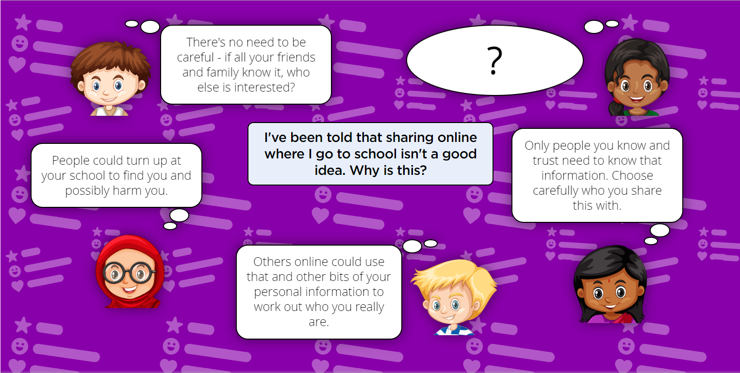

Slide 19
Online Bullying
I can explain what bullying is, how people may bully others and how bullying can make someone feel.
Questions To Ask
What does it mean to ‘be kind’ online?
Why are people sometimes unkind online?
Does it matter if you hurt someone’s feelings online?

Slide 20
Online Bullying
I can give examples of how bullying behaviour could appear online and how someone can get support. Questions To Ask
Could you describe how someone could be unkind online?
How could you tell if someone was being bullied online?
What can you do if you see someone being mean online?

Slide 21
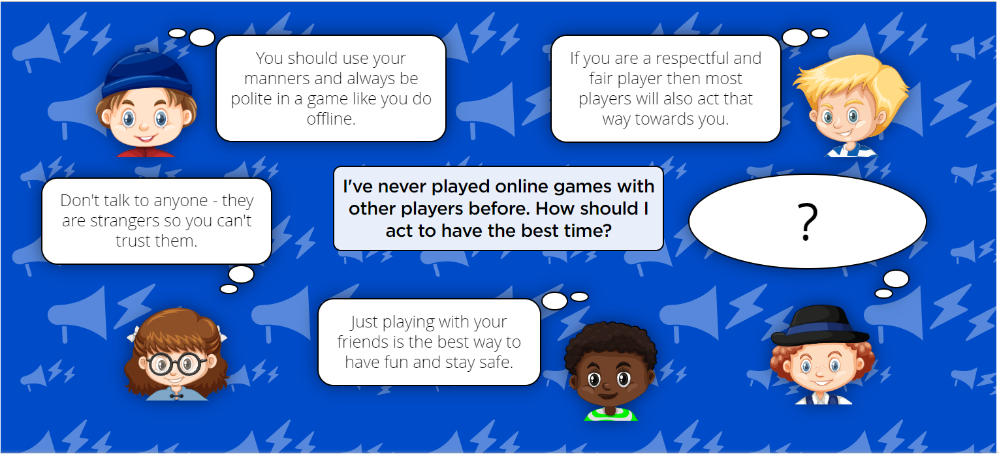

Slide 22
Manging Online Information
I can demonstrate how to use key phrases in search engines to gather accurate information online.
Questions To Ask
What is a search engine?
What is autocomplete?
How does autocomplete work?
Is autocomplete helpful?
How trustworthy is autocomplete?

Slide 23
Manging Online Information
I can explain what autocomplete is and how to choose the best suggestion.
Questions To Ask
What is a search engine?
What is autocomplete?
How does autocomplete work?
Is autocomplete helpful?
How trustworthy is autocomplete?

Slide 24
Manging Online Information
I can explain how the internet can be used to sell and buy things
Questions To Ask
How many different ways are there to spend money online?
Is everything for sale online? Can you think of something you can buy in the physical world which you can't buy online?
And vice versa? What's the difference?
Is virtual currency real money? e.g. Robux
What virtual things can you buy online?
How do you know if what you're buying online is good quality?
Is it possible to buy something online without realising it?

Slide 25
Manging Online Information
I can explain the difference between a ‘belief’, an ‘opinion’ and a ‘fact. and can give examples of how and where they might be shared online, e.g. in videos, memes, posts, news stories etc.
Questions To Ask
What is the difference between a belief, an opinion and a fact?
How do you know if something is a fact?
Can you prove a belief?
How do you know if evidence is credible?
Does it matter if we have different opinions from our family or friends?
Think of something that everyone knows to be true. What evidence would persuade you out of that belief?

Slide 26
Manging Online Information
I can explain that not all opinions shared may be accepted as true or fair by others (e.g. monsters under the bed). Questions To Ask
What is the difference between a belief, an opinion and a fact?
How do you know if something is a fact?
Can you prove a belief?
How do you know if evidence is credible?
Does it matter if we have different opinions from our family or friends?
Think of something that everyone knows to be true. What evidence would persuade you out of that belief?

Slide 27
Manging Online Information
I can describe and demonstrate how we can get help from a trusted adult if we see content that makes us feel sad, uncomfortable, worried or frightened. Questions To Ask
What is the difference between a belief, an opinion and a fact?
How do you know if something is a fact?
Can you prove a belief?
How do you know if evidence is credible?
Does it matter if we have different opinions from our family or friends?
Think of something that everyone knows to be true. What evidence would persuade you out of that belief?

Slide 28
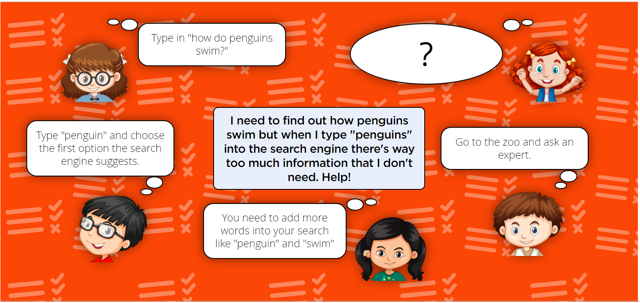

Slide 29
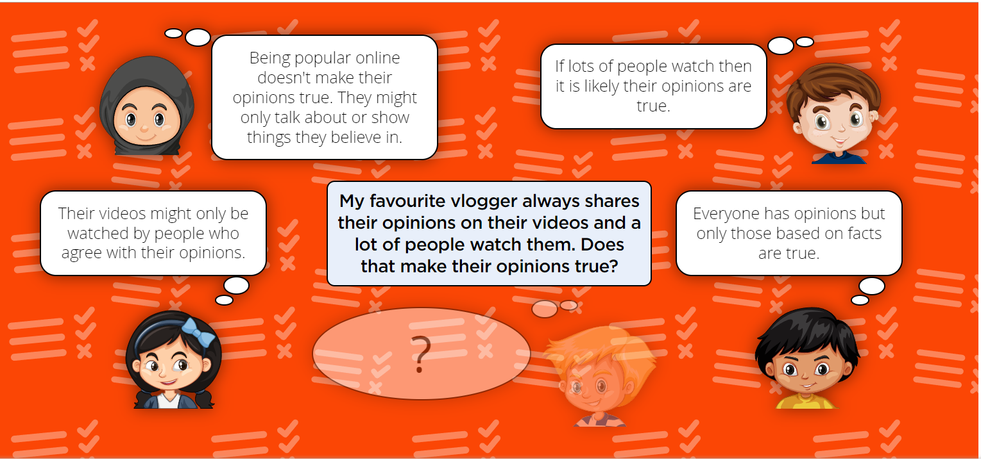

Slide 30
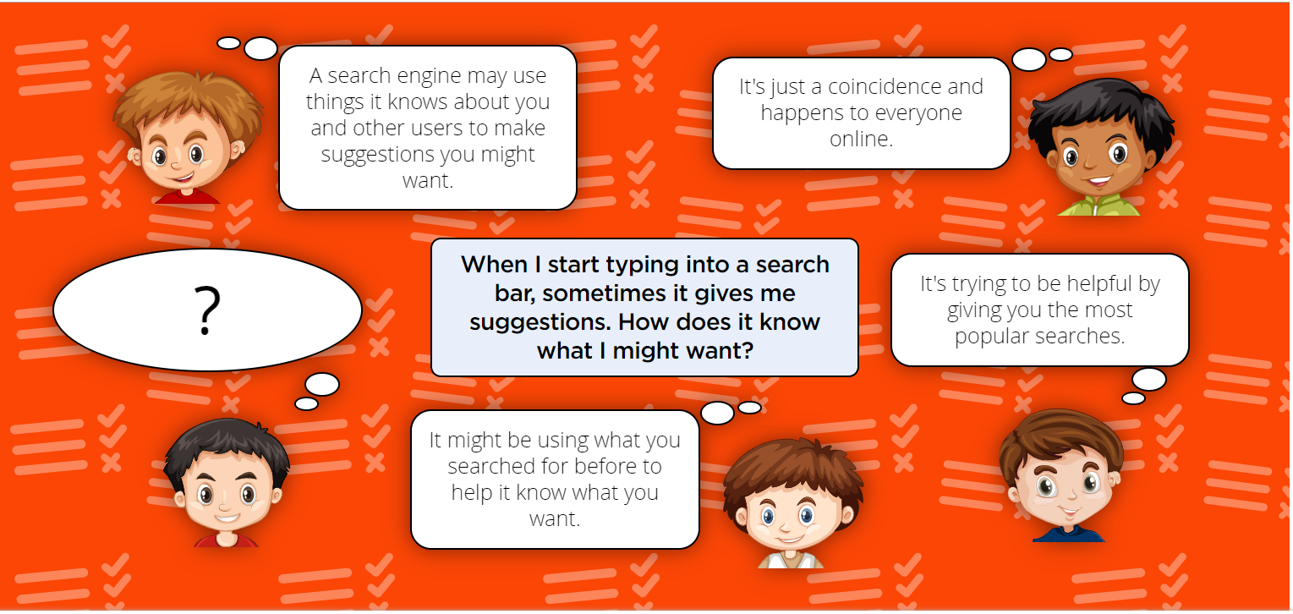

Slide 31
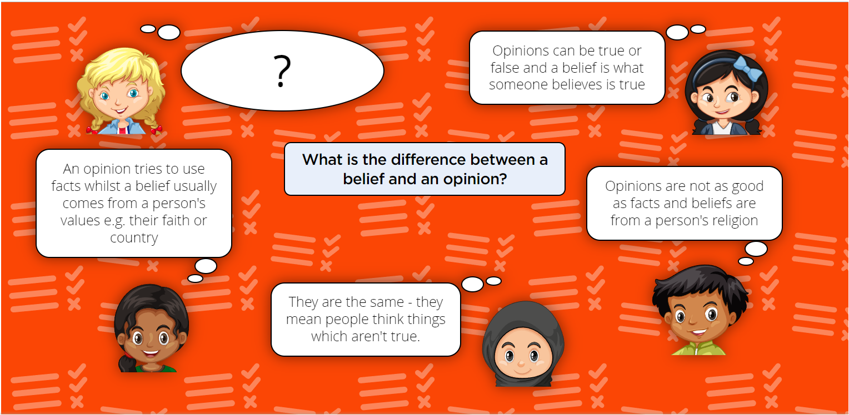

Slide 32
Health, Wellbeing and lifestyle
I can explain why spending too much time using technology can sometimes have a negative impact on anyone; I can give some examples of both positive and negative activities where it is easy to spend a lot of time engaged
Questions To Ask
What are the good things you use technology for? What makes these things good? (e.g. do they make you feel happy, excited, interested, relaxed? Do they make you laugh or feel part of a group?)
How long does it take to do these things? Do some things take longer than others? Which ones?
Which things could you keep doing for a long time without stopping? Would you want to keep doing one thing for a long time?
Can you say how playing a game for a long time can make your body feel?
Do you notice if a lot of time has passed when you play a game, or watch a video?
What sorts of things do you normally do when you’re not at school? (E.g. eat meals, do homework, tidy my room, go to judo lesson, etc.). Does it matter if you do these things or not? If a child spends all their time after school and at the weekend playing an online game, could that affect these other things they normally do? What can a child do about this? (e.g. agree a set time to do the activity; take regular breaks; do homework beforehand etc.)

Slide 33
Health, Wellbeing and lifestyle
I can explain why some online activities have age restrictions, why it is important to follow them and know who I can talk to if others pressure me to watch or do something online that makes me feel uncomfortable (e.g. age restricted gaming or web sites).
Questions To Ask
What are age ratings? Why do games, videos and apps have age ratings?
What sort of content would make a game have a higher age rating?
Why might a child play a game they're underage for?
What tactics could someone use to persuade a child to watch a video they're underage for?
Is a child to blame if they see something upsetting in a game, if they knew they were underage but played anyway?
If we didn't have age ratings, how could we protect children?

Slide 34
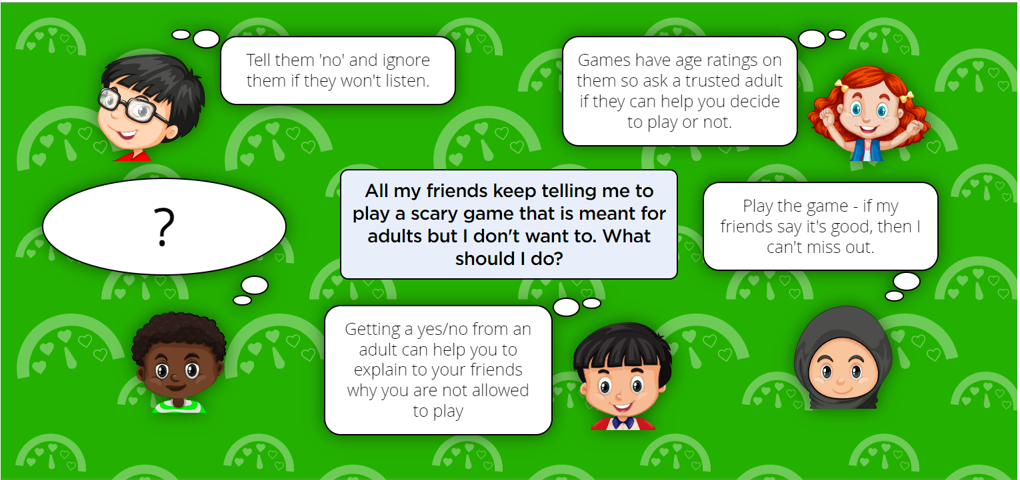

Slide 35
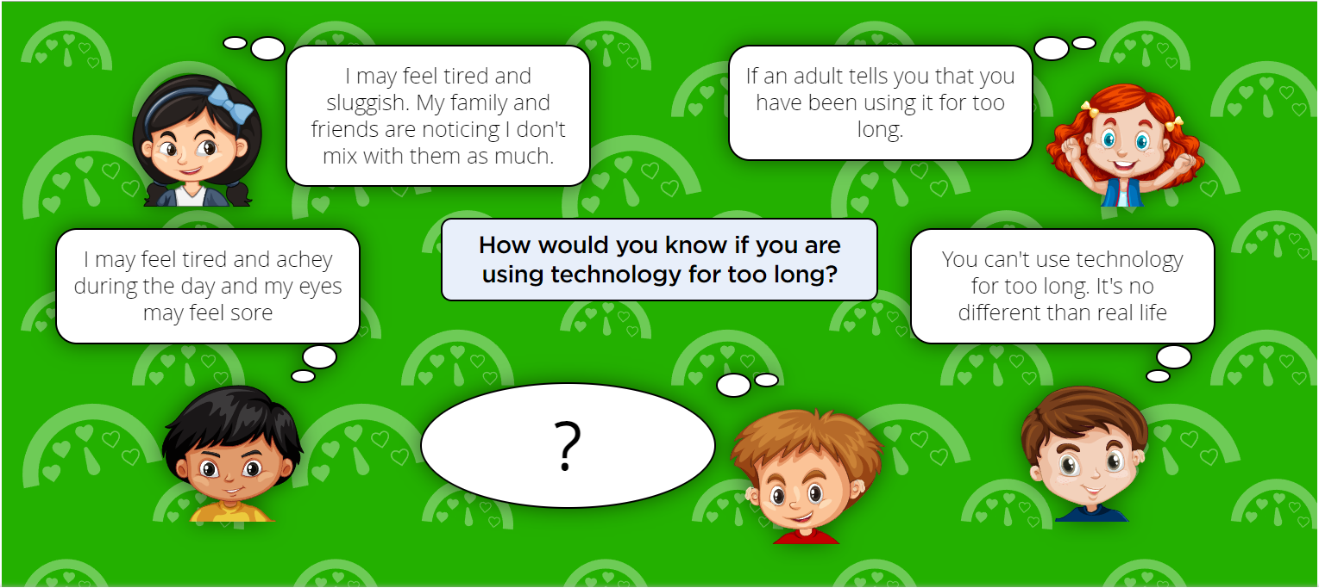

Slide 36
Privacy and Security
I can describe simple strategies for creating and keeping passwords private.
Questions to ask
What would happen if you didn’t have a password?
What is a safe way to remember your password?
How can you store passwords...
...on devices?
...on apps?

Slide 37
Privacy and Security
I can give reasons why someone should only share information with people they choose to and can trust. I can explain that if they are not sure or feel pressured then they should tell a trusted adult. Questions to ask
What makes a company trustworthy?
What makes a person trustworthy?
Ask the children what is information?
Why might we be concerned about sharing information with others?

Slide 38
Privacy and Security
I can describe how connected devices can collect and share anyone’s information with others. Questions to ask
How do you know if your voice is being recorded?
When you’re listening to someone, do you always hear all that they say?
What does the assistant have to do after it’s heard the key word?
Is there a difference between hearing and listening?
How do devices find out the answers to commands asked?

Slide 39
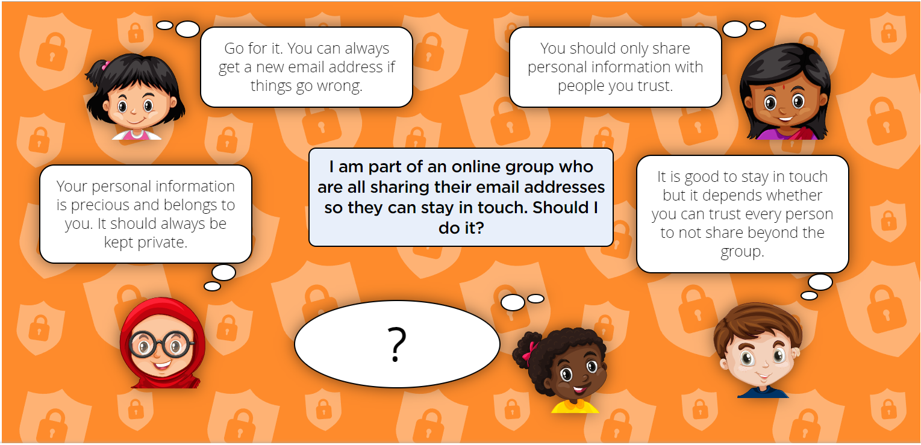

Slide 40
Copyright and ownership
I can explain why copying someone else’s work from the internet without permission isn’t fair and can explain what problems this might cause.
Questions to ask
Where did the Internet come from?
Who made the internet?
How does the Internet get bigger?
Who owns the stuff you see on the Internet?

Slide 41
