Slide 1

Online Safety – Starter tasks linked to progression of skills
Project Evolve – Discussion points

Slide 2
YEAR 4
For further resources to enrich these topics please log in to Project Evolve and follow the link below. Full lesson plans are available which are resourced as well.
https://projectevolve.co.uk/toolkit/resources/years/4/

Slide 3
Self image and identity
I can explain how my online identity can be different to my offline identity.
Questions To Ask
How can we show who we are online?
Do we have to share everything about ourselves online?
What might someone prefer not to share about themselves online?
What are the right choices to make when sharing things about yourself online?
What can we change about our identity online?
What are the reasons for and against choosing a different identity online?
Why might someone hide who they are or present themselves differently when online?

Slide 4
Self image and identity
I can describe positive ways for someone to interact with others online and understand how this will positively impact on how others perceive them.
Questions To Ask
How can we show who we are online?
Do we have to share everything about ourselves online?
What might someone prefer not to share about themselves online?
What are the right choices to make when sharing things about yourself online?
What can we change about our identity online?
What are the reasons for and against choosing a different identity online?
Why might someone hide who they are or present themselves differently when online?

Slide 5
Self image and identity
I can explain that others online can pretend to be someone else, including my friends, and can suggest reasons why they might do this.
Questions To Ask
How do you know if someone is your friend?
How do you know if someone is your friend online?
How do you know that someone is who they say they are online?
Do you have any different personas in your online spaces?
What reasons can you think of when it might be good to have a different persona online?
Why might someone pretend to be someone else online?

Slide 6
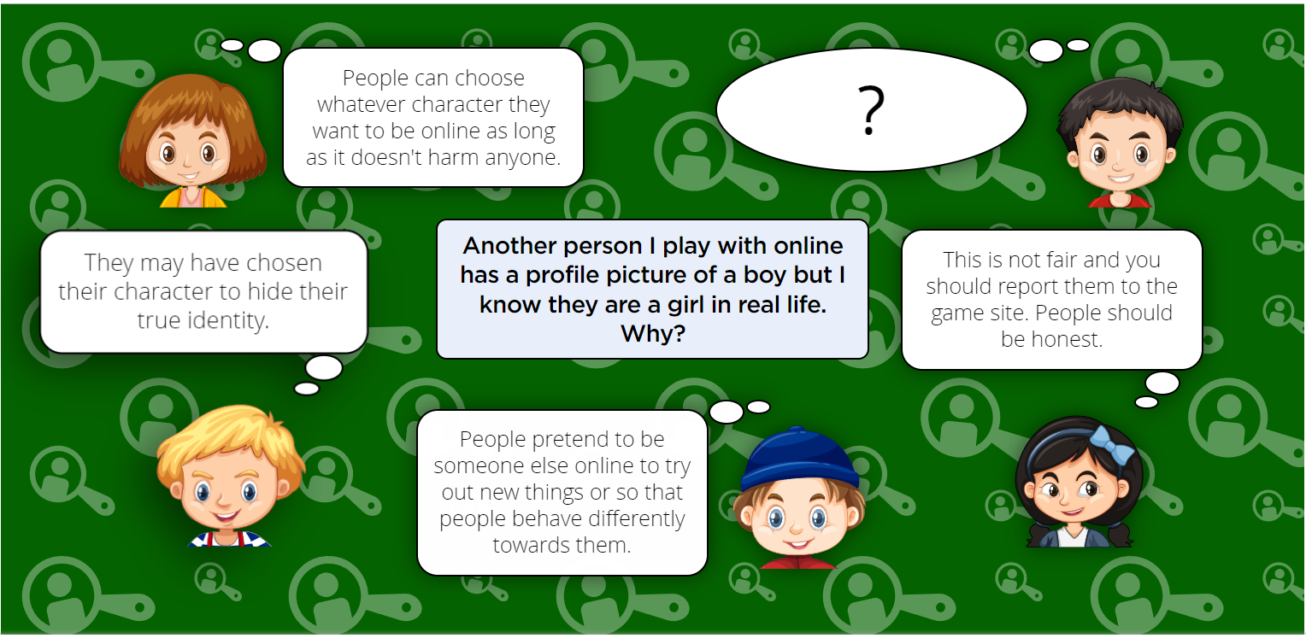

Slide 7
Online Relationships
I can describe strategies for safe and fun experiences in a range of online social environments (e.g. livestreaming, gaming platforms)
Questions To Ask
What kinds of things do you like to do for fun?
What do you like to do with friends for fun?
What about online?
What does feeling safe mean?
How does it feel when you are safe?
How do you feel when you feel unsafe?
What would make you feel unsafe online? Give some examples.
When you feel unsafe online what are the first things you might do?
How could you make sure that you stay as safe as possible online?
Where might you go to get help if things make you feel embarrassed, sad, angry or upset?

Slide 8
Online Relationships
I can give examples of how to be respectful to others online and describe how to recognise healthy and unhealthy online behaviours.
Questions To Ask
What does respect mean?
Can you give examples of how you show people respect eg friends, family, teachers, people you don't know very well?
In what ways might people show respect to you? What might they do or say?
How do you feel when someone shows you respect?
How do you feel when you someone doesn't respect you?
When might it be important to show respect to others?
How can you make sure that you show respect online?
What things might be disrespectful online?

Slide 9
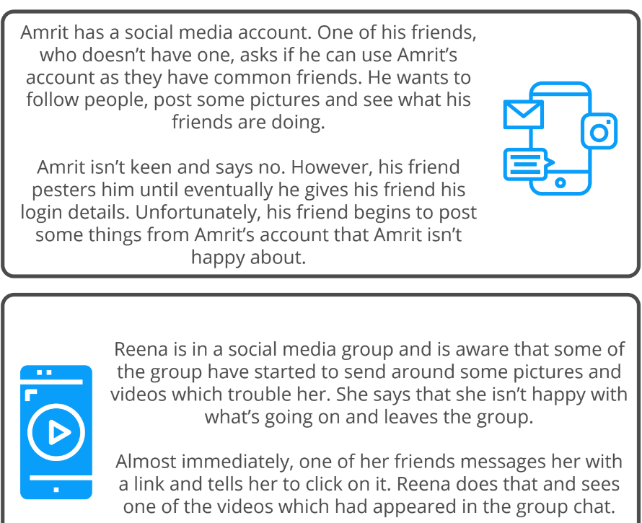
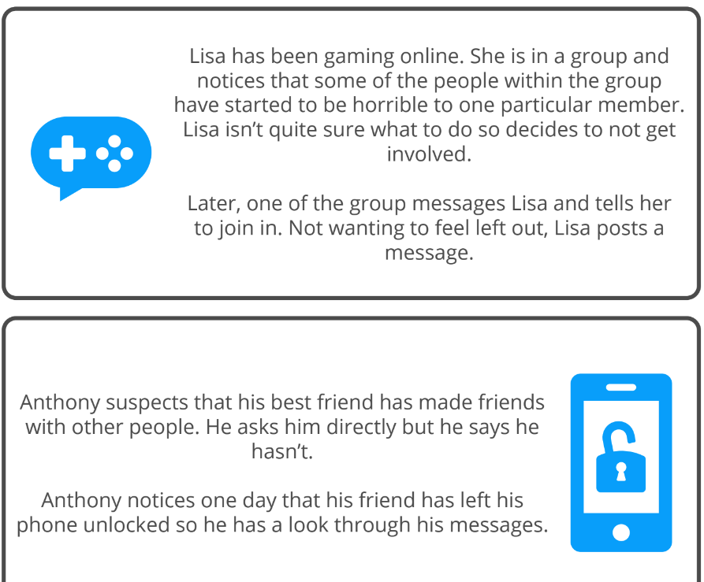
Online Relationships
I can explain how content shared online may feel unimportant to one person but may be important to other people’s thoughts feelings and beliefs.
Questions To Ask

Slide 10
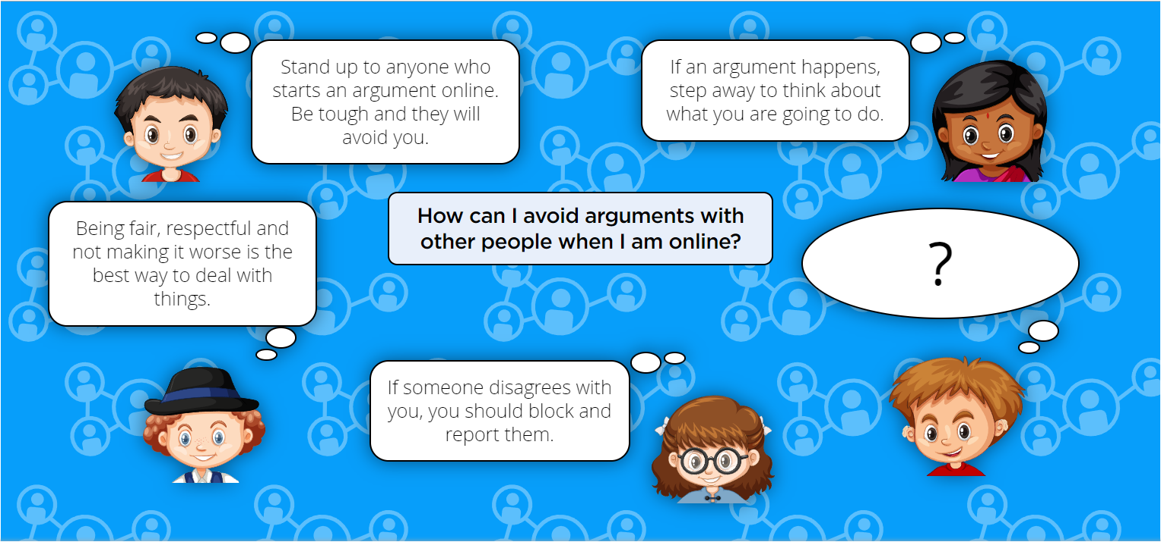

Slide 11
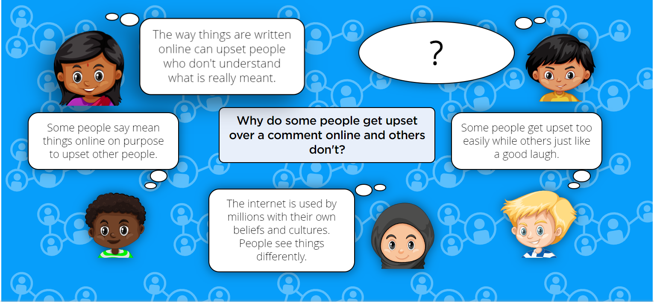

Slide 12
Online Reputation
I can describe how to find out information about others by searching online.
Questions To Ask
Who might search for you online?
Why might people search for you online?
Have you ever searched for information about someone else online? Who was it?
  A friend
  Family member
  Celebrity
  Sportsperson
Can other people put your information online
Can they do this without your consent?
Can other people copy and share your information when you have shared it online?
What information could these people find about you online?
  your family members
  friends
  your school
  what you look like
  what your interests are
What could someone do with the information they find about you online?
  find out more about you
  save your photos
  pass on your information to other people
Can you find information about your friends online?
Do people have to ask you before searching for you online?
Can other people copy or share the information you put online?

Slide 13
Online Reputation
I can explain ways that some of the information about anyone online could have been created, copied or shared by others.
Questions To Ask
Who might search for you online?
Why might people search for you online?
Have you ever searched for information about someone else online? Who was it?
  A friend
  Family member
  Celebrity
  Sportsperson
Can other people put your information online
Can they do this without your consent?
Can other people copy and share your information when you have shared it online?
What information could these people find about you online?
  your family members
  friends
  your school
  what you look like
  what your interests are
What could someone do with the information they find about you online?
  find out more about you
  save your photos
  pass on your information to other people
Can you find information about your friends online?
Do people have to ask you before searching for you online?
Can other people copy or share the information you put online?

Slide 14
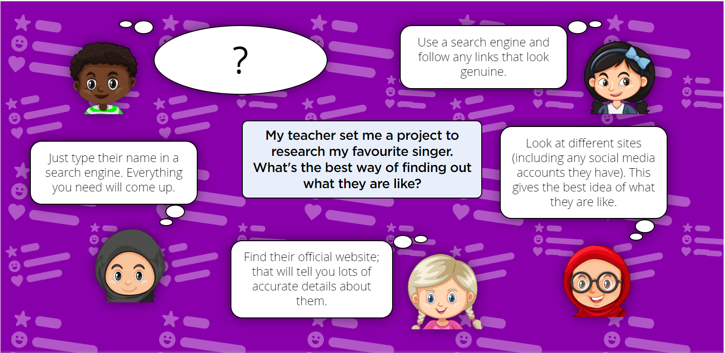

Slide 15
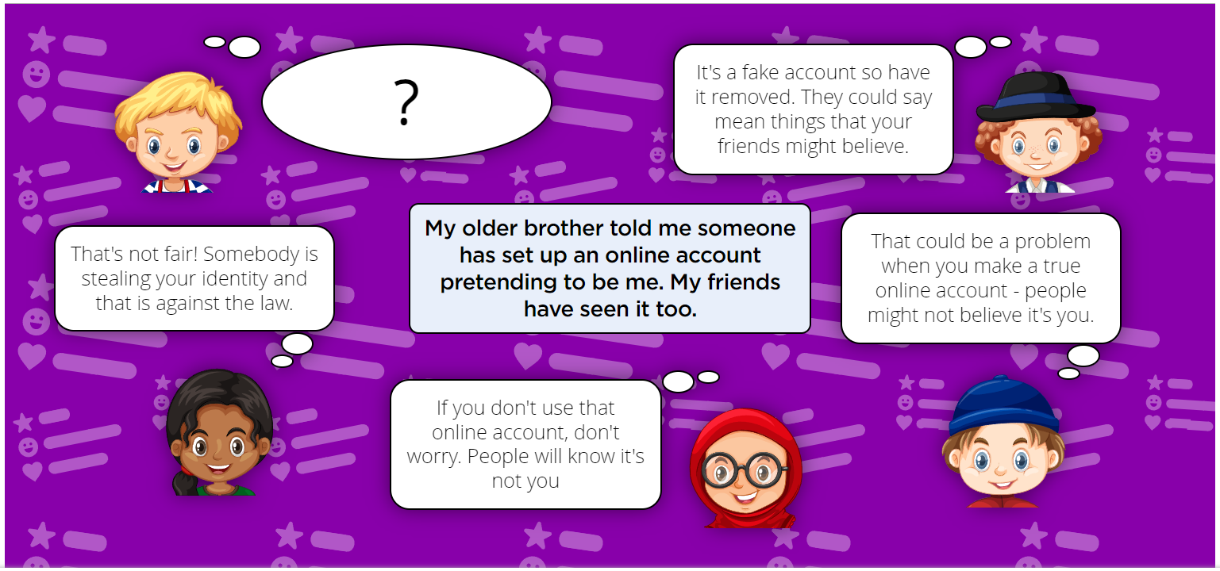

Slide 16
Online Bullying
I can recognise when someone is upset, hurt or angry online.
Questions To Ask
What sort of things do people do when they’re feeling upset, hurt or angry?
If someone is upset, hurt or angry, how can they show their feelings online?
Do you think people show their ‘true’ feelings online?
Can you always tell if someone is feeling upset, hurt or angry online?
What can you do if you think someone is being bullied online?

Slide 17
Online Bullying
I can describe ways people can be bullied through a range of media (e.g. image, video, text, chat).
Questions To Ask
I know what are different types of media online.
I can explain the different features of different media
I can simply describe what bullying online may look like on these different forms of media

Slide 18
Online Bullying
I can explain why people need to think carefully about how content they post might affect others, their feelings and how it may affect how others feel about them (their reputation).
Questions To Ask
Can you predict how others would feel when you do things online, like write a message?
Have you ever found that your posts have been taken well or positively?
Have you ever found that your posts have been taken negatively?
What do you need to think about before doing things online?
Why would someone post something hurtful online?

Slide 19
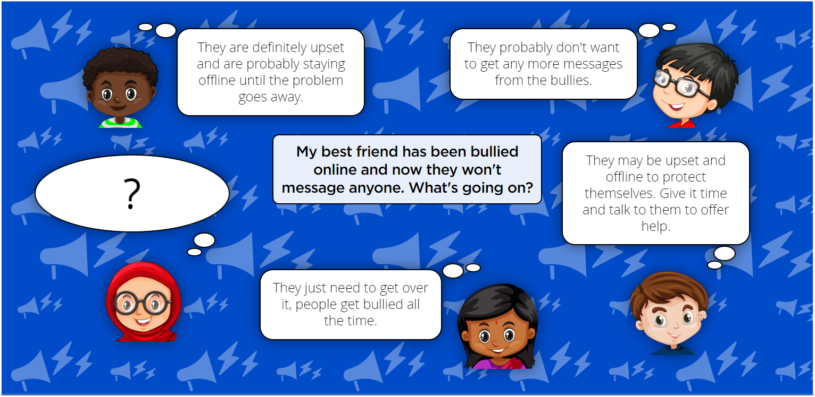

Slide 20
Manging Online Information
I can analyse information to make a judgement about probable accuracy and I understand why it is important to make my own decisions regarding content and that my decisions are respected by others.
Questions To Ask
What is the difference between a belief, an opinion and a fact?
How do you know if something is a fact?
Can you prove a belief?
How do you know if evidence is credible?
Does it matter if we have different opinions from our family or friends?
Think of something that everyone knows to be true. What evidence would persuade you out of that belief?
hat is a search engine?
What is autocomplete?
How does autocomplete work?
Is autocomplete helpful?
How trustworthy is autocomplete?

Slide 21
Manging Online Information
I can describe how to search for information within a wide group of technologies and make a judgement about the probable accuracy (e.g. social media, image sites, video sites).
Questions To Ask
If you want to find out something, what different ways can you search online?
What can we learn from text, images or videos? Is one more believable than another?

Slide 22
Manging Online Information
I can describe some of the methods used to encourage people to buy things online (e.g. advertising offers; in-app purchases, pop-ups) and can recognise some of these when they appear online.
Questions To Ask
Thinking about the things you do online, e.g. the games you play or the apps you use, which ones are free and which ones cost money?
For the ones that are free, why are they free? How do they make money?
What is the purpose of an advert?
Does it matter if you don't realise something is an advert?

Slide 23
Manging Online Information
I can explain why lots of people sharing the same opinions or beliefs online do not make those opinions or beliefs true.
Questions To Ask
I can describe what is a 'bot'.
I can explain how bots are used online (e.g. boost follower/retweet numbers, chat bot for help on a site, or as part of an app or game, impersonation).
I can describe techniques to identify if I'm talking to a bot.
I can explain why lots of people sharing the same opinions or beliefs online does not make those opinions or beliefs true.

Slide 24
Manging Online Information
I can explain that technology can be designed to act like or impersonate living things (e.g. bots) and describe what the benefits and the risks might be.
Questions To Ask
What is a 'bot'?
What are bots used for?
Can bots be helpful?
How do you know if you're talking to a bot? Does it matter if you know?

Slide 25
Manging Online Information
I can explain what is meant by fake news e.g. why some people will create stories or alter photographs and put them online to pretend something is true when it isn’t.
Questions To Ask
Why do people create false information online?
Why do people create disinformation (false information intended to be harmful)?
Why do people share misinformation and disinformation?

Slide 26
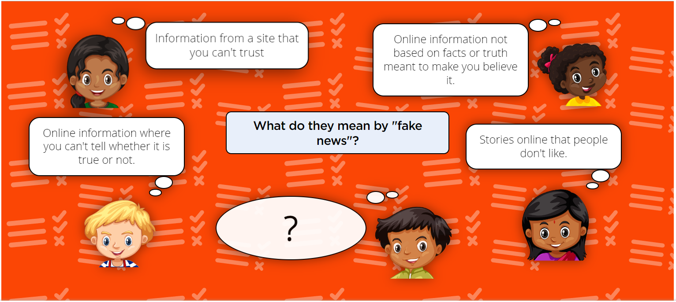

Slide 27
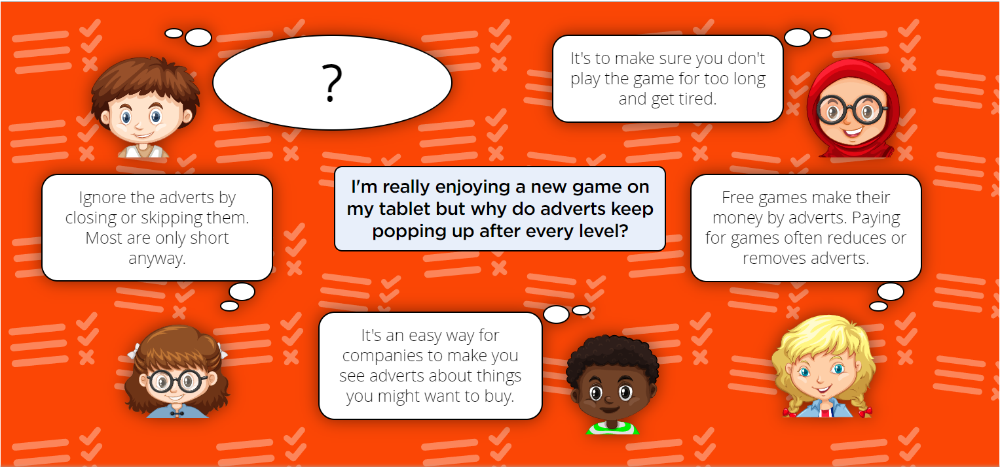

Slide 28
Health, Wellbeing and lifestyle
I can explain how using technology can be a distraction from other things, in both a positive and negative way.
Questions To Ask
Thinking of the things you use technology for, some of them take a lot of concentration. What sort of things do you use technology for, which need you to pay attention? (e.g. playing a game needs me to focus on what I’m doing in the game).
Why do you need to pay attention to it? Are you able to do anything else at the same time? Does that matter?
(Recap) If a child spends all their time after school and at the weekend playing an online game, could that affect other things they normally do?
How you decide between activities to do online/using technology? (e.g. do you pick an activity based on the time available? Based on how you feel at that moment? Do you plan out what to do in advance?)
Do you ever lose track of time when using technology/going online? Why do you think this is?
Are some activities more distracting than others? Why do you think this is?
What are some things you can do at the same time as using a device?
What are some things that you can’t do at the same time as using a device?
How do you decide what is important/not important to do when using technology?

Slide 29
Health, Wellbeing and lifestyle
I can identify times or situations when someone may need to limit the amount of time they use technology e.g. I can suggest strategies to help with limiting this time.
Questions To Ask
What do you use technology for?
How long do you spend using technology each day/ week?
What happens when you’ve been using technology for too long? (to your body? to your mood? to your device?)
What rules do you have at home/ school for when you can use technology and how long for?
Is it easy to set time limits for going online? How do you do this at home/ school?
When might you need to take a break from using technology?
How does it make you feel when you do take a break from technology? Is it easy to do?
How can you limit your time using technology? How can your family help you? How can your device help you?

Slide 30
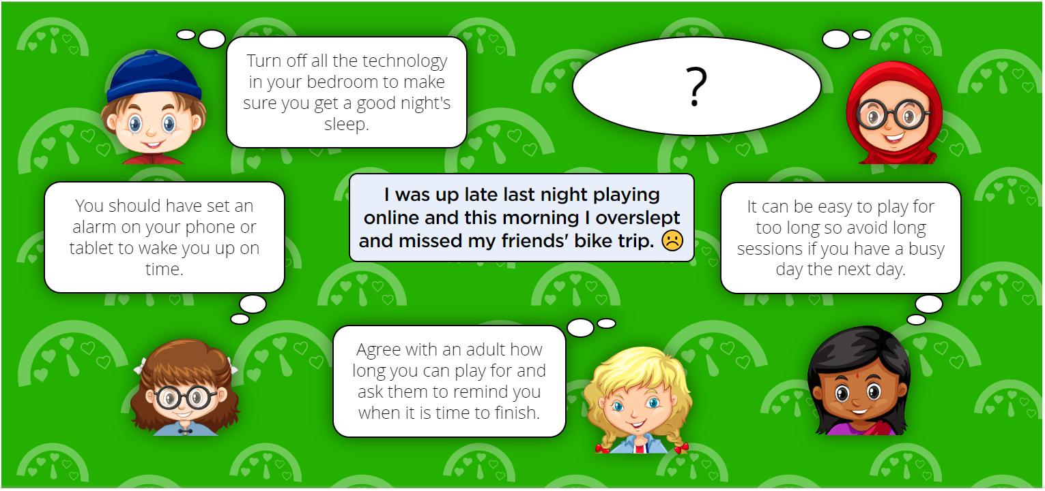

Slide 31
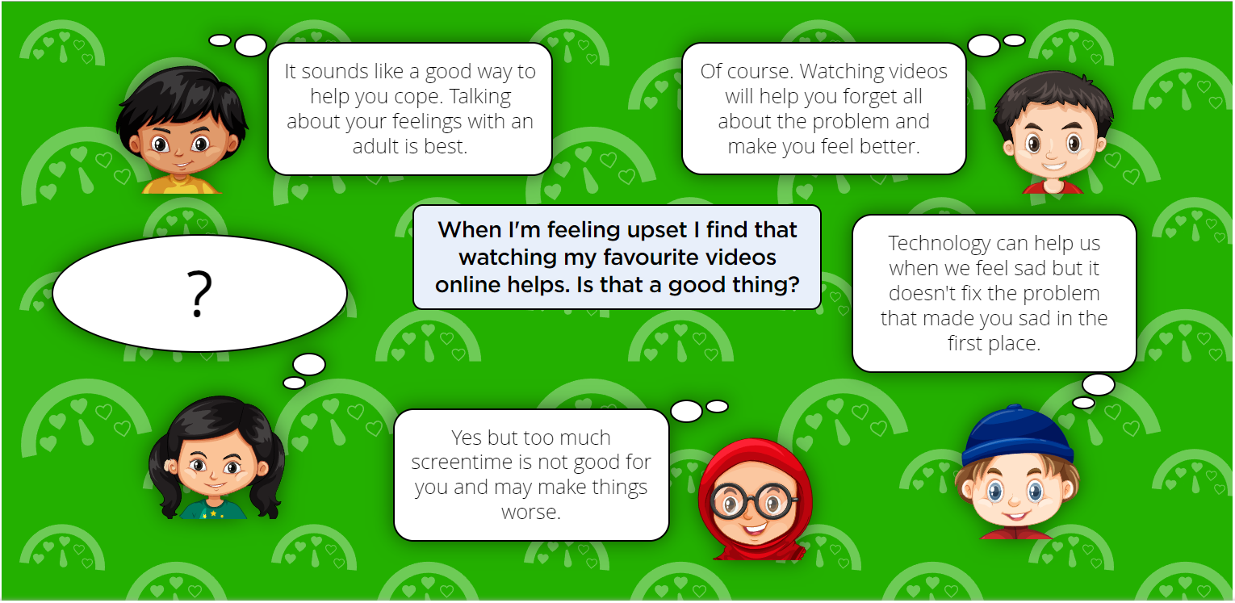

Slide 32
Privacy and Security
I can describe strategies for keeping personal information private, depending on context.
Questions to ask
Why do we use passwords? (What do they keep safe?)
What is a strong password - how would you know?
What might happen if you didn’t have a (strong) password?
Why do we share personal information online? Who might we share it with?
What ways do you know to keep personal information private online?

Slide 33
Privacy and Security
I can explain that internet use is never fully private and is monitored, e.g. adult supervision.
Questions to ask
Should people be able to watch what you’re doing all the time?
Why/why not?
Who watches what you do online?
Why do you think your online actions are monitored…
...at school?
...at home?
...in public?
...on a game/app?

Slide 34
Privacy and Security
I can describe how some online services may seek consent to store information about me; I know how to respond appropriately and who I can ask if I am not sure.
Questions to ask
What sort of personal data do online services collect? Why?
What are 'Terms of Use'?
What is a 'Privacy Policy'?
Why is the minimum age for lots of online services 13?
How is children's personal information protected online?
What can a child do if they want to use an app but don't understand (or agree with) the Terms of Use or Privacy Policy?

Slide 35
Privacy and Security
I know what the digital age of consent is and the impact this has on online services asking for consent.
Questions to ask
What sort of personal data do online services collect? Why?
What are 'Terms of Use'?
What is a 'Privacy Policy'?
Why is the minimum age for lots of online services 13?
How is children's personal information protected online?
What can a child do if they want to use an app but don't understand (or agree with) the Terms of Use or Privacy Policy?

Slide 36
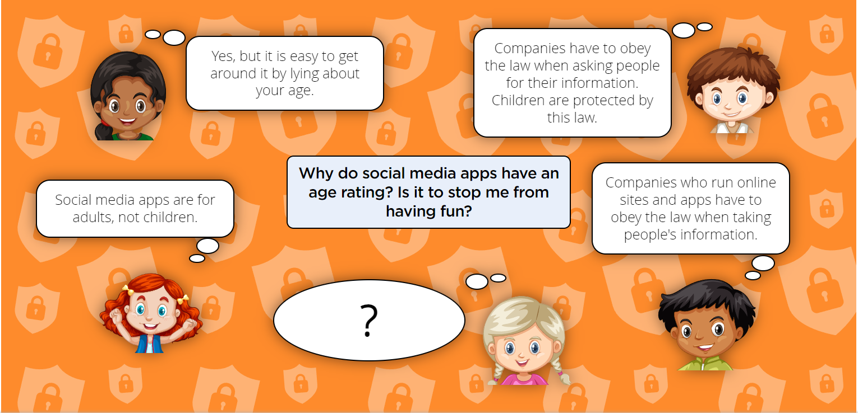

Slide 37
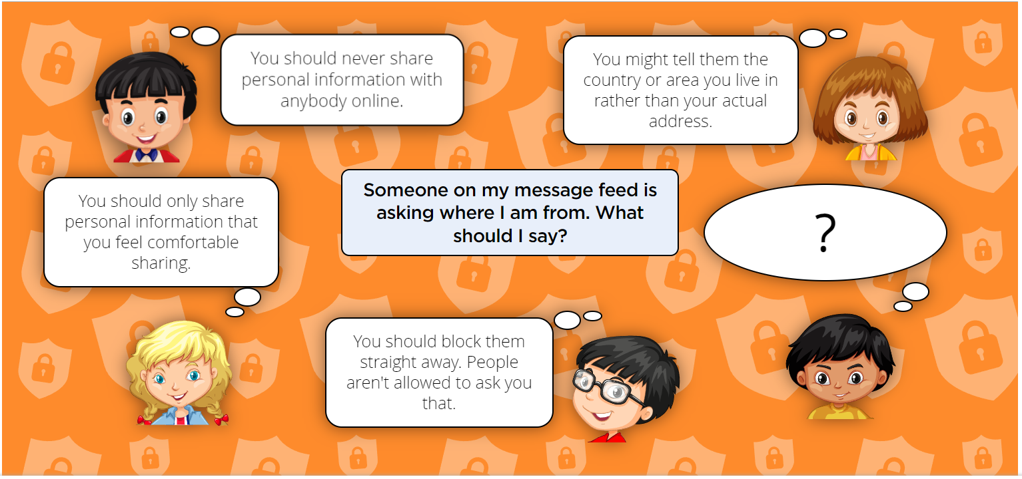

Slide 38
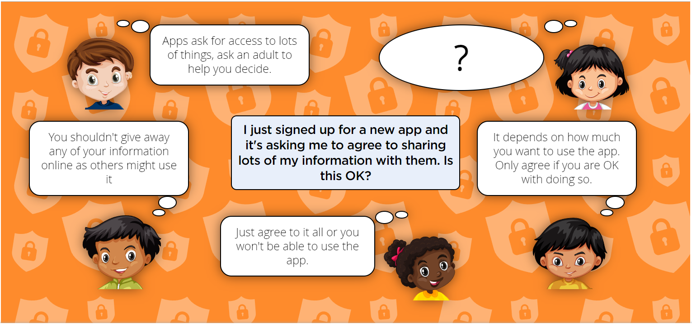

Slide 39
Copyright and ownership
When searching on the internet for content to use, I can explain why I need to consider who owns it and whether I have the right to reuse it.
Questions to ask
When you find things (such as images, videos, music) using a search engine, who owns that content?
  How do you know they own it?
Who owns the content posted on social media?
  How do you know they own it?
What does reusing online content mean?
Have you ever used content that belongs to someone else?
  What did you use it for?
  Did you know it belonged to someone else?
  How did you show others that it belonged to someone else?
How would you know if it is okay to reuse someone else’s content online?

Slide 40
Copyright and ownership
I can give some simple examples of content which I must not use without permission from the owner, e.g. videos, music, images.
Questions to ask
When you find things (such as images, videos, music) using a search engine, who owns that content?
  How do you know they own it?
Who owns the content posted on social media?
  How do you know they own it?
What does reusing online content mean?
Have you ever used content that belongs to someone else?
  What did you use it for?
  Did you know it belonged to someone else?
  How did you show others that it belonged to someone else?
How would you know if it is okay to reuse someone else’s content online?

Slide 41
