Slide 1
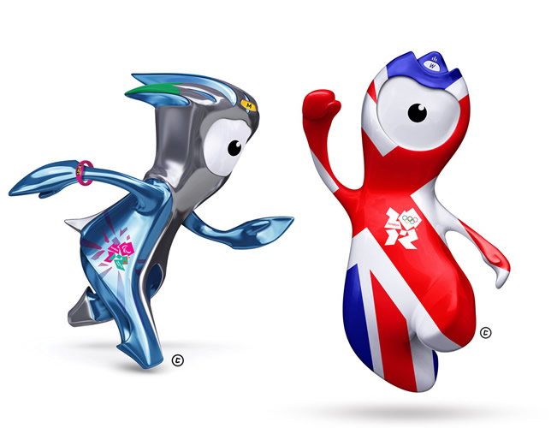
Olympic Mascots

Slide 2
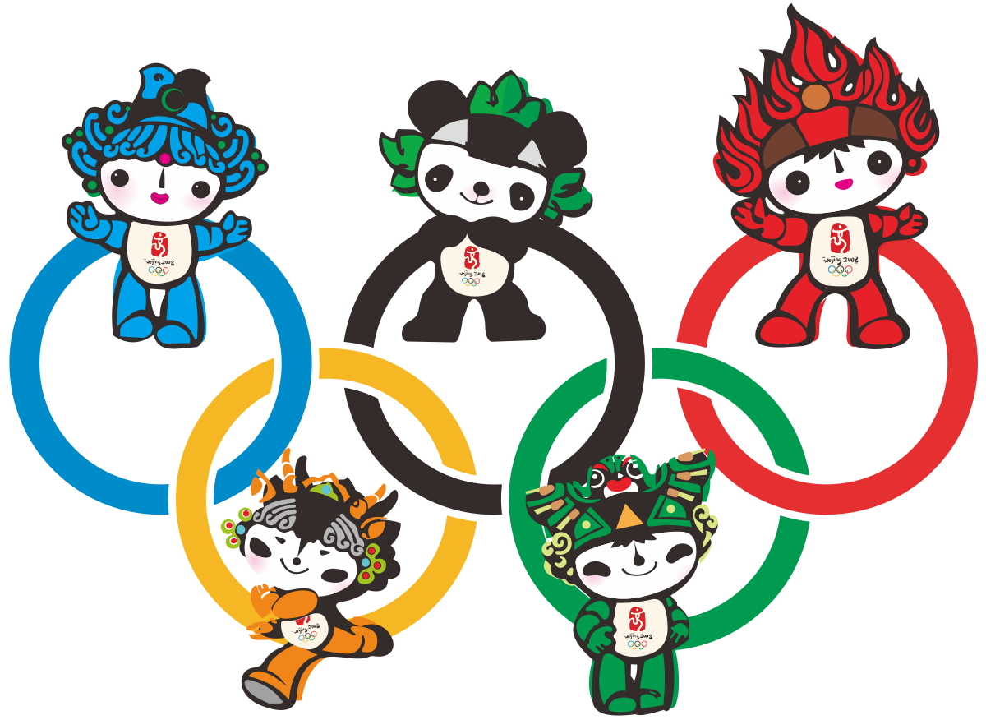
What is a mascot?
A mascot is a person or thing that is supposed to bring good luck, especially one linked to a particular organization or event.

Slide 3
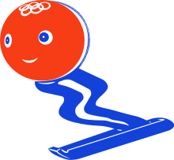
When was the tradition of having mascots for the Olympic Games started?
The first Olympic mascot was born at the Grenoble Olympic Games in 1968. It was named "Schuss" and it was a little man on skis, designed in an abstract form and painted in the colours of France: blue, red and white. However, the first official Olympic mascot appeared in the 1972 Summer Olympics in Munich.

Slide 4
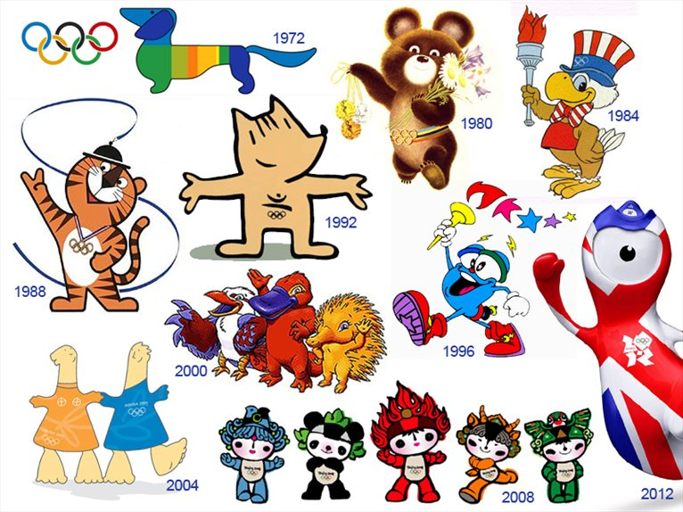
Here are some examples of previous Summer Olympic mascots.
1972 – Munich, Waldi
1980 – Moscow, Misha
1984 – Los Angeles, Sam
1988 – Seoul, Hodori
1992 – Barcelona, Cobi
1996 – Atlanta, Izzy
2000 – Sydney, Olly, Syd and Millie
2004 – Athens, Athena and Phevos
2008 – Beijing, The Fuwa
2012 – London, Wenlock

Slide 5
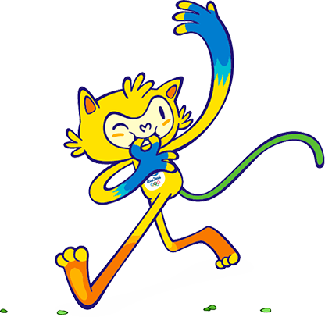
The last Summer Olympics was held in Rio, Brazil in 2016. The mascot was Vinicius, who represented Brazilian wildlife, combining "the agility of cats, sway of monkeys and grace of birds." The character's arms and legs can stretch unlimited distances. Vinicius's mission was "to spread joy throughout the world and celebrate the friendship that flourishes between people from all over the world" at the Olympic Games.

Slide 6
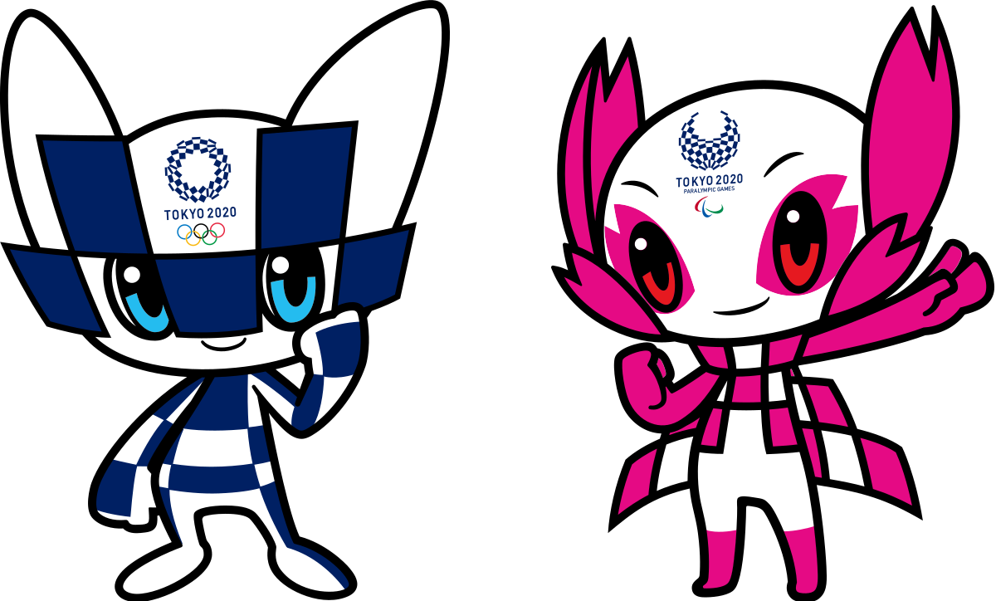
The Olympics was due to take place in Tokyo this Summer but has been postponed until next Summer instead because of the
Coronavirus pandemic. The mascot for the Tokyo Olympics is Miraitowa and Someity is the official mascot of the 2020 Summer Paralympics.

Slide 7

As this year’s Olympics have been postponed, Mrs Martin and I have decided that we are going to hold our own ABC mini-Olympics for our ‘Bubble’ next week – weather permitting!
As you have seen, all Olympics Games need a mascot to help bring our competitors good luck. However, we haven’t got a mascot yet.
Your task this afternoon is to design a mascot for our KS2 Bubble.
You will need to decide what it will look like and give it a name, then draw it on a piece of A3 paper. You need to chose the colours you are going to use to colour it in – remember, brighter colours are more eye-catching.
Then, we would like you to explain why you have chosen your particular design.
Finally, we are going to ask a panel of judges to chose the best design for our mascot for our ABC mini-Olympics!

