Slide 1


Persuasive Writing Unit
Year 6
Working at Greater Depth
Commissioned by The PiXL Club Ltd.
Example 2017
This resource is strictly for the use of member schools for as long as they remain members of The PiXL Club. It may not be copied, sold nor transferred to a third party or used by the school after membership ceases. Until such time it may be freely used within the member school.
All opinions and contributions are those of the authors. The contents of this resource are not connected with nor endorsed by any other company, organisation or institution.
© Copyright The PiXL Club Limited, 2017

Slide 2
Contents
Slide 3: Teacher notes
Slide 4: Skeleton plan
Slides 5-8: Phase 1 – Context, purpose and audience
Slides 9-12: Phase 2 – Immersion
Slides 13-18 Phase 3 – Understanding conventions
Slides 19-22 Phase 4 – Establishing structure
Slides 23-26 Phase 5 – Inserting content
Slides 27-28 Phase 6 – Oral rehearsal
Slides 29-30 Phase 7 – Recording
Slides 31-38 Phase 8 – Editing
Slides 39-40 Evaluation
Slides 41-42 Assessment

Slide 3
Teacher Notes
The following resources are designed to support teachers in structuring a unit of work that results in pupils writing a persuasive text for EOKS2 assessment, ‘Working at Greater Depth’ (see TAFs).
Each phase of the writing process is prefaced with a slide containing information for teachers to consider. Following these are suggestions and considerations that support each phase of the teaching unit. These should be supplemented with specific skills teaching that is applicable to your class or cohort. They are not designed to teach the GPS concepts, but to help pupils shape their own persuasive text. The strategies included are not exhaustive but may be useful in helping children to plan and execute their own work.
Additional materials can be found on Primary Wise, specifically the ‘GDS Concept Models’ which exemplify each of the statements from the TAFs for GDS.

Slide 4
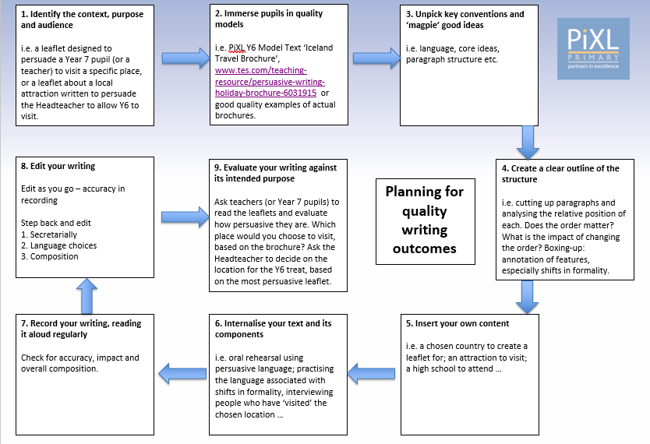
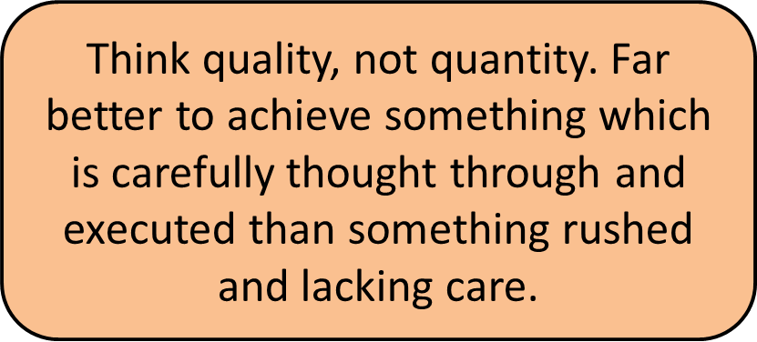
Skeleton plan (see Model Writing units –’Iceland Travel Brochure’ on Primary Wise)
Work through each section of the skeleton plan, identifying which activities you intend to complete for each phase of the writing process. Consider the needs and strengths of your class.
The following slides give teaching ideas for each phase.
Maintain flexibility in your plan. It is crucial that pupils have sufficient time to complete each phase and really internalise what they are going to write about before they start recording.

Slide 5
Phase 1 – Context, purpose, audience
It is vital to establish the stimulus or context for their writing, as this will help pupils to make links between their learning.
Establishing a purpose for their writing gives pupils a reason to write and a reason to make an effort – the children’s familiarity with a location and giving them a vested interest in the outcome of their brochures, will motivate them with this text type.
Where possible, the best outcomes usually have a real audience who can offer real feedback – as this unit targets pupils working at GDS, using Year 7 pupils, or members of staff, would provide an audience who can critically evaluate the more challenging concepts.
Discuss the key questions on Slide 7 with pupils before beginning any work on what they are actually going to write. They can respond to these questions in writing and refer back to them as part of the evaluation phase.

Slide 6
Phase 1 – Context, purpose, audience
Some possible contexts for writing a persuasive leaflet are:
Create a leaflet to persuade someone to go to a specific country/place on holiday.
Create a leaflet about a local attraction to persuade the Headteacher to allow Y6 to visit as a treat (for working hard towards SATs)!
Create a leaflet to persuade someone to visit a particular attraction e.g. a theme park, museum, a zoo etc.
Create a leaflet to persuade someone to attend a particular educational institution e.g. their school, a local high school or a college/university.
Create a leaflet to persuade someone to attend a local sports club.

Slide 7
What is a persuasive text?
Purpose: a persuasive text seeks to sway the audience to the writer’s point of view, or convince them about something. For example, writing to persuade someone to visit a museum.
Audience: The audience would be the people who are likely to read the chosen text. For example, a leaflet to persuade someone to attend a specific university would be directed at young adults (who are the likeliest group to want to attend).
Context: this can vary from persuading your Headteacher to extend the lunch break to persuading adults to visit a particular holiday resort.
For discussion
with pupils

Slide 8
Context, purpose and audience – over to you!
Context: Why have you chosen this place to persuade someone to visit or attend? Is it somewhere you have visited or would like to visit? Is it linked to somewhere you have studied in history or geography?
Purpose: Why are you writing the leaflet? Is it to persuade someone to visit or attend a certain place? Is it to persuade someone to allow you to attend somewhere?
Audience: Who are you writing this for? Is it for older children or adults? Is it for your headteacher or someone in a role of authority? Who is actually going to read it once it is finished?
For discussion
with pupils

Slide 9
Phase 2 - Immersion
Immersing pupils in examples of high quality models is crucial in helping them to shape their own ideas. The best authors use their reading experiences to feed their own work. It is important that children don’t see this as cheating, but instead as a crucial part of the writing process.
Make sure your models are indicative of what you would like pupils to produce themselves. There is a good quality model of a persuasive leaflet in the Model Texts folder on Primary Wise. This can be used alongside other examples that may fit well with the context for your writing. Ultimately, the content of the model texts matters less than the structure for this phase, as children can use an existing structure and insert their own content.
Give children time and opportunity to look closely at a range of texts. Suggested activities for this phase follow this slide.

Slide 10
Phase 2 – Immersion in the text
Paired/Guided reading: Use your chosen persuasive leaflets as texts for paired or guided reading. This is a very time efficient way to get pupils to engage with and internalise a text model.
Reorganising – cut up the model text. Does the order of paragraphs matter? Do you agree with the priority given to specific information? How would you sequence the paragraphs?
Compare and contrast – what makes a good front page or opening for a leaflet? What is the ‘hook’ for the reader?
Look at two leaflets – which one ‘hooks’ you in more? Give reasons for your choice. Which one would you choose to read? What is the balance between factual information and language used to persuade?
Suggested activities

Slide 11
Phase 2 – Immersion in the language
Finding favourites: read the persuasive leaflet and pick out your favourite…and explain your reasons:
Expanded noun phrase
Sentence opener
Alliteration
Formal or informal – read each paragraph and highlight examples of formal and informal phrases or features (such as contractions and the first person register ‘you’). What is the overall tone of each paragraph? Are there shifts in formality within the text? How do you know?
Conjunctions
How are conjunctions used to link ideas within and between paragraphs? Try reading the text without them. What effect does this have?
Suggested activities

Slide 12
Phase 2 – Immersion in the sentence structure
Switch it.
Provide pupils with a series of phrases, written either formally or informally. Can they rewrite them in the opposite register?
Have you ever wanted to visit Iceland?
Want to go to Iceland?
Experiment with the contracted form for an informal register.
Identify relative clauses which add extra information in the sentence. Why is this needed? Give pupils sentences where they have to create a relative clause using brackets, dashes or commas.
What is the effect of the relative clause?
Long or short? Can pupils identify where short sentences are used? What is the effect on the reader? Look at multi-clause sentences: why have they been used? How is punctuation used to separate clauses? Highlight sentences where the colon and/or semi-colon are used. What job do they do? How else could the sentence be written?
Suggested activities

Slide 13
Phase 3 – Understanding conventions
Pupils should have the opportunity to unpick different elements of the persuasive leaflet models that they have read. This should only happen once they have had a good opportunity to read and understand the text type, as it is vital that children have a clear view of the whole text before they break it down. The teacher should gather checklists for the features that are generated as a whole class and display them prominently to allow pupils to add to them during the unit of work and to familiarise themselves with them in preparation for writing.
Key conventions that should be covered include:
Format and structure – a ‘title page’ to entice or hook the reader; an introduction; thematic paragraphs; sub-headings; a balance of factual information and persuasive language; illustrations and a conclusion/ back page.
Language features – emotive language, expanded noun phrases, superlatives, hyperbole, alliteration and rhetorical questions.
Language features – shifts in formality by varying language and grammatical forms (e.g. first person address v passive voice; contractions v complete words).
Sentence composition – multi-clause sentences to provide detail and shorter sentences for impact.

Slide 14

Phase 3 – Understanding conventions
Format and structure
How is the persuasive leaflet structured?
How does the text hook the reader from the outset?
How are paragraphs organised? How are sub-headings used to inform or persuade the reader?
How is the leaflet concluded?
How are facts incorporated into the text?
How are other features, such as illustrations, used to persuade the reader?
Use your chosen model/s here

Slide 15
Phase 3 – Understanding conventions
Language conventions
Can you identify the use of alliteration in your leaflet? What effect does it have?
Replace one of the alliterative phrases with an expanded noun phrase? Compare the two phrases. Which one has more impact on the reader?
Why do you think the author has begun the text with a metaphor?
What other examples of figurative language are used in your leaflets?
Iceland is a force of nature. Shaped by hundreds of volcanos, including around 30 that are still active, it has giant glaciers, wonderful waterfalls, bizarre beaches of black sand and eerie fields of living lava. No wonder it has been called the land of fire and ice!
See ‘Language Conventions’ support sheet
Use your chosen model/s here

Slide 16
Phase 3 – Understanding conventions
Language conventions – formality
Can you identify a shift in formality within or between paragraphs? How do you know?
Rewrite a paragraph, which has been written in an informal style, in a formal one (or vice versa).
Why does the author switch between formal and informal styles?
Can you identify the use of the passive voice? Rewrite the sentence to change it to the active form. How does this affect the tone and formality?
Extract 1
There is so much to do in Iceland. The lively tourist has many ways to enjoy the unique, thrilling and largely unspoilt scenery. Naturally, there is plenty to challenge the serious cyclist, hiker or even rock-climber. Fancy something a bit different? Then why not try exploring some of the island’s many caves and marvel at the stunning rock structures.
Extract 2
Despite being so close to the Arctic, it has a mild climate in summer, where the cold winds of the north are calmed by the warmer waters of the Gulf Stream, flowing straight from the West Indies.
See ‘Language Conventions’ support sheet
Use your chosen model/s here

Slide 17
Phase 3 – Understanding conventions
Sentence composition
How does the length of sentences vary? What impact do shorter sentences have?
How does the clause structure vary? Can you identify examples where the subordinate clause begins the sentence?
What is the effect of swapping the main and subordinate clauses?
How are relative clauses used to add extra information? Why is this important for the reader?
Experiment with using different types of parentheses to mark relative clauses.
Iceland is a land of surprises. A land of experiences. A land of adventure. Located in the North Atlantic Ocean, just outside the Arctic Circle, it boasts a dramatic landscape capped by active volcanos and fringed with rugged coastlines. For those who love the outdoors, it’s got everything from spectacular views to specialist sports.
Use your chosen model/s here

Slide 18
Phase 3 – Understanding conventions
Punctuation
What is the purpose of the colon in the sentence in bold?
Can you identify a variety of punctuation in your leaflets? What ‘job’ is it doing? What is the effect of removing or replacing the punctuation?
Where have hyphens been used? Can you identify an example where it has been used to avoid ambiguity? For example, what would be the effect of removing the hyphens in this phrase: ‘carrying-on the age-old tradition’?
But this amazing country is not just about craggy landscapes: the surrounding seas have a lot to offer too. In the past, Iceland relied on the life-rich waters to provide food for its people, but now tourists are discovering its other treasures. Not only is there a wild and raw coastline of fjords (steep-sided, ice-carved inlets) and volcanic beaches, but also there is plenty to see for lovers of wildlife.
Use your chosen model/s here

Slide 19
Phase 4 – Establishing structure
If pupils have a clear view of the structure of a text, they will be able to emulate and manipulate this to ensure that their own is clearly and effectively structured. Comparing the structure of different persuasive leaflets that they have read will help them to choose the type of structure they would like to use in their own writing.
Pupils working at ‘Greater Depth’ should be able to demonstrate a shift in formality by consciously manipulating grammar and vocabulary. This could be achieved either by structuring an entire paragraph in a formal way and contrasting this with an informal paragraph. Equally, pupils may be able to shift formality within paragraphs (see the Y6 Model Text ‘Iceland’).
The following techniques can be used to help establish the structure of a persuasive leaflet but also as planning tools for pupils’ own texts.

Slide 20
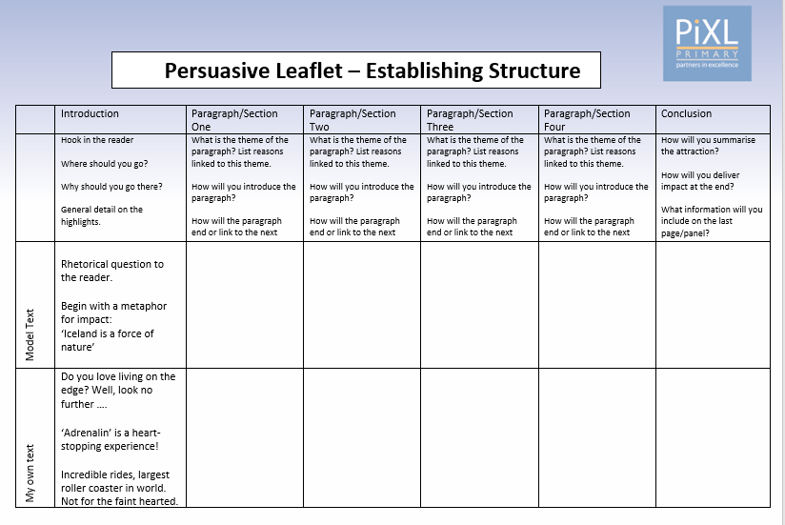
Phase 4 – Establishing structure
Boxing up
‘Box up’ the key components of the model text that you have read.
Add further detail once you have a basic summary.
See ‘Establishing Structure: Persuasion’

Slide 21
Phase 4 – Establishing structure
‘Flesh it out’
Gather information about your chosen place.
Research ‘real’ information (e.g. prices, opening hours, average temperatures etc).
Plan rhetorical question stems e.g. Why not…?Have you ever wondered …?
Add details such as expanded noun phrases, alliteration etc.
Plan the formal/informal shifts. How will you show this?
What headings, sub-headings, callouts etc will you include to engage the reader?
Use your chosen stimulus here

Slide 22
Phase 4 – Establishing structure
Test it out
Rehearse the ideas aloud, putting them into full sentences with some of the language that you have gathered.
Experiment with formal and informal devices (e.g. contractions, the first person address, use of the passive voice).
Practise moving clauses around. Try them out on a partner. Which is most effective?
How persuasive is the language used?
Use your chosen stimulus here

Slide 23
Phase 5 – Inserting content
Once pupils have been immersed in quality text models and are able to confidently discuss the structure of a persuasive leaflet, they can use these experiences to help them begin planning their own work.
Stimulus – what are the pupils writing about? Where possible, make this something that sparks their interest and that they have some prior knowledge of so that they can concentrate on the structure and the finer details of the language.
Innovation – use the text models they have explored and innovate the persuasive elements.
Structure – use the ‘Boxing Up’ technique to identify key themes for each paragraph.
Overview – map out the text and orally rehearse it until pupils can talk confidently.

Slide 24
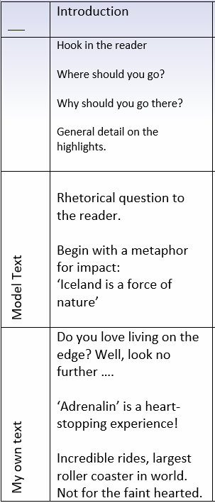

Phase 5 – Inserting content
Substitutions
Now you have seen examples of some persuasive leaflets, you can use them to substitute your own ideas. It might look like this:

Slide 25
Phase 5 – Inserting content
Innovation
Now you have seen examples of some persuasive texts, you can use them to plan your own ideas using the same structure.
Use the contents of each section identified from the model text and then change them to incorporate your own ideas.
See ‘Establishing Structure: Persuasive Leaflet’

Slide 26
Phase 5 – Inserting content
Substitutions
You can also use some of the sentence constructions that you have found in the model texts and substitute your own language into them.
Original text (formal phrase)
On the other hand, you could try ice-climbing on one of the huge glaciers…
Substituted text (formal phrase)
On the other hand, you could have a go on the wonderful log flumes.
Original text (informal phrase)
Fancy something a bit different? Then why not try exploring some of the island’s many caves…
Substituted text (in formal phrase)
Fancy something truly spectacular? Then why not try the heart-stopping ‘Death Drop’.

Slide 27
Phase 6 – Oral rehearsal
Giving pupils time to internalise their text and really ‘know’ it before they begin writing will ensure that once they begin their recording, they can concentrate on the language and grammar elements, rather than trying to remember what content should be included and what the structure should be.
Oral rehearsal can come in many forms, but the most useful tool to support this is the boxed up plan. This should be used as a working document and is a great stimulus to help pupils feel confident in talking their text and allows them to add/ change details as they rehearse.
The following techniques may be useful in supporting this part of the planning process.

Slide 28
Phase 6 – Oral rehearsal
Techniques for helping pupils to internalise their planned leaflets:
Role play Imagine they had to create a radio advertisement for their place? Select a paragraph and rehearse saying it using the planned content, vocabulary and persuasive devices.
Recording Practise telling someone about the various attractions, making use of the suggested language features. Record themselves and play it back. Was it persuasive? What could be improved?
Flip it! One child practises a sentence which they may include, using a formal register. The other child ‘flips’ it to say the sentence in an informal way. Which was most effective?

Slide 29
Phase 7 – Recording
The recording process should be the easy part if pupils have a well-planned and structured persuasive leaflet. Once they know their text really well, they can focus on adding the details using the suggested language and persuasive features.
Take this opportunity to exploit the GPS links between what they have read and what they are going to write. Refer to the GDS TAFs and challenge the pupils to incorporate the relevant ones into their writing. Notably, shifts in formality and a full range of punctuation should be demonstrated.
Encourage pupils to view their first draft as a starting point. Once they have this on paper, they can embellish and improve it until they are happy with the finished product.
Build in mini-plenaries so that pupils can read their paragraphs aloud to a partner, or to the class, to give them the opportunity to revise their ideas and language as they write. At the same time, they can evaluate their writing against the key language features.

Slide 30
Phase 7 – Recording
The following list of considerations for recording should be discussed and, where relevant, modelled for pupils, so that they are aware of your expectation. You may want to focus on one or two of these during each writing session. This should be an opportunity to apply previously learnt skills.
Presentation and handwriting
Precise language choices (including figurative language)
Accurate and ambitious punctuation
Spelling
Sentence structure and text composition
Using a range of verb forms, including use of the passive voice for formality
Controlling the level of formality through manipulating grammar and vocabulary

Slide 31
Phase 8 – Editing
Editing can take many forms and is the most important part of the writing process. However, this is often the phase that pupils find the most challenging.
Pupils need to understand that editing should be a layered process, which eventually results in the finished outcome. It is impossible to edit everything all at once, so breaking the process down usually gives the best results.
The following slides suggest stages of editing that you may want to work through with your pupils. Modelling these stages is vital, if editing is to result in meaningful improvements in pupils’ own work.

Slide 32
Phase 8 – Editing
Editing as you write
Read, check, choose, change …
At the end of a group of sentences or after 5 minutes writing:
read what you have written.
check it for sense, grammatical accuracy and spelling.
choose at least one element of the section of text that could be improved.
make a change which enhances the writing in relation to the ‘toolkit’ of features.
Suggested activity

Slide 33
Phase 8 – Editing
Editing for meaning
Sometimes when we write, we get so caught up in getting our ideas down that we make mistakes which result in our work not making sense.
Handy hint: when you check your writing, run your fingers along the line to avoid confusing what you think you have written with what is actually there.
Common errors include:
omissions – look out for missing determiners.
repetitions – look out for repeated words and use pronouns or synonyms to avoid repeating nouns e.g. for ‘tourists’, use ‘visitors’.
over-long or unclear sentences.
missing punctuation.
For discussion with pupils

Slide 34
Phase 8 – Editing
Editing for meaning – read these paragraphs and identify what needs improving.
To cap a perfect day you might even lucky enough to glimpse the stunning northern lights also known as the aurora borealis and marvel at the ghostly colours crossing sky.
Iceland is a beautiful country. Iceland is full of natural wonders including; wonderful volcanoes, stunning glaciers and bubbling thermal spas.
If you ain’t ever been to Iceland you are in for a right treat. The local geezers are very friendly and enjoy trying out their English on the visitors. However, it would be a good idea to learn a few Icelandic phrases to show willing.
Suggested activity

Slide 35
Phase 8 – Editing
Editing for meaning – how did you do?
To cap a perfect day, you might even be lucky enough to glimpse the stunning northern lights (also known as the aurora borealis) and marvel at the ghostly colours crossing the sky. omission and punctuation
Iceland is a beautiful country which is full of natural wonders including: wonderful volcanoes, stunning glaciers and bubbling thermal spas. conjunction needed, incorrectly used semi-colon
If you have never been to Iceland you are in for a real treat. The local people are very friendly and enjoy trying out their English on the visitors. However, it would be a good idea to learn a few Icelandic phrases to show willing. inappropriate colloquialisms and slang more associated with spoken language
Suggested activity

Slide 36
Phase 8 – Editing
Secretarial editing
This includes anything that is not related to the composition of the text or the effect on the audience. Check the following, one at a time. Remember to look for what is actually on the page.
Handy hint: with these kinds of errors, it can help to read backwards so that you don’t get caught up with the content of the writing.
handwriting
punctuation
spelling
grammatically correct English
format and presentation
For discussion with pupils

Slide 37
Phase 8 – Editing
Editing language and composition choices
When you write a text, you must always consider the effect you want to have on the audience or reader. Language and composition choices should be carefully thought through, but it can sometimes be difficult to do this when you are writing your first draft.
Where could the language choices in this passage be improved?
Is there a more convincing alternative? How could it be more emotive and persuasive?
When you visit ‘Adrenalin’ you will have a good time on the great rides. Why not try the ‘Zoob Spinner? This will make you really dizzy but you will still want another go!
Suggested activity

Slide 38
Phase 8 – Editing
Editing language and composition choices
Now spend some time identifying the key language in your writing which describes the place and aims to persuade your reader to visit.
Also consider and make improvements for each of the following:
sentence openers – is there a range of fronted adverbials and conjunctions?
sentence lengths – are they varied with short sentences for impact and multi-clause sentences to add detail and clarity?
vocabulary – are expanded noun phrases and figurative language used to describe?
persuasive devices – have you used alliteration, superlatives and rhetorical questions?
verb forms – is there a variety? How have you used them to reflect the chosen level of formality?
Suggested activity

Slide 39
Phase 9 – Evaluation
Quality evaluation should give pupils an opportunity to comment on how effective their work was in fulfilling the original brief. Where possible, the best evaluation process includes comment from the intended audience. Organise for the target audience (for example, the Headteacher or a group of Year 7 pupils) to read the leaflets and evaluate them.
Pupils can, of course, comment on the writing skills and literary strategies that they have included in their work, but this should not be a substitute for identifying whether their writing had the desired effect on the audience.
A ‘toolkit’ of conventions gathered from all the model texts provides a useful prompt for pupils to evaluate the success of their own writing.

Slide 40
Evaluating the impact of your writing
Is my title/strap line attention-grabbing?
Do my paragraphs contain a balance of facts and persuasive language?
Have I used a hook to engage my reader from the start?
Does my summary communicate the main attractions and deliver impact.
Does my reader want to visit?
Have I used expanded noun phrases and precise vocabulary choices to describe the attractions?
Have I varied my sentence lengths and clause structures?
Have I used a range of punctuation to clarify meaning?
Have I used persuasive devices e.g. rhetorical questions.
Have I demonstrated a shift of formality either within or between paragraphs?
For discussion with pupils – See evaluating writing sheet

Slide 41
Assessment
On the next two slides are the strands from the Teacher Assessment Framework (TAF) for working at greater depth standard which can be evidenced through this writing.
Write effectively for a range of purposes and audiences, selecting the appropriate form and drawing independently on what they have read as models for their own writing e.g. literary language. For example, pupils write an engaging leaflet which incorporates a range of persuasive devices to tempt the reader. The leaflet is organised into clear sections using sub-headings and illustrations. Factual information is supported with detailed descriptions using precise vocabulary choices.
Distinguish between the language of speech and writing and choose the appropriate register. For example, pupils recognise that long sentences with many conjunctions are suitable for speech but not writing. So, multi-clause sentences should still be punctuated appropriately e.g. Despite being so close to the Arctic, it has a mild climate in summer, where the cold winds of the north are calmed by the warmer waters of the Gulf Stream, flowing straight from the West Indies.
Exercise an assured and conscious control over levels of formality, particularly through manipulating grammar and vocabulary to achieve this. For example, within the leaflet, pupils demonstrate shifts in formality. Whilst they may select some informal devices associated with speech (e.g. contractions) this is a conscious decision to achieve informality within the text. The first person address ‘Are you wondering where to go on holiday this year?’ is intended to convey informality but this may contrast with the more formal use of the passive voice ‘Gaze at the wonderful waterfall which is surrounded by the dense foliage of the Amazon.’

Slide 42
Assessment
On the next two slides are the strands from the TAF for working at greater depth standard which can be evidenced through this writing.
.
Use the range of punctuation taught at Key Stage 2 correctly:
Semi-colons: pupils use this accurately to separate main clauses. For example, to add more detail about an attraction ‘The wonderful log flume is ideal for all the family; they will scream with delight as they plunge headlong towards the water!’
Dashes: pupils employ this as a form of parenthesis or to hold the reader’s attention. For example, ‘The enormous roller coaster – the biggest in Europe – is a must!’ or ‘Perhaps the best known and most spectacular is the Blue Lagoon – regarded by some as one of the wonders of the world.’
Colons: pupils demonstrate the use of the colon to mark the boundary between an independent clause and an explanation. For example, ‘But this amazing country is not just about craggy landscapes: the surrounding seas have a lot to offer too.’
Hyphens: pupils may use this as part of an expanded noun phrases. For example, ‘the ice-cold glaciers’ or to avoid ambiguity ‘Take a terrific trip on the twice-weekly cruise.’
All of the above should be used to enhance meaning or avoid ambiguity.

