Slide 1
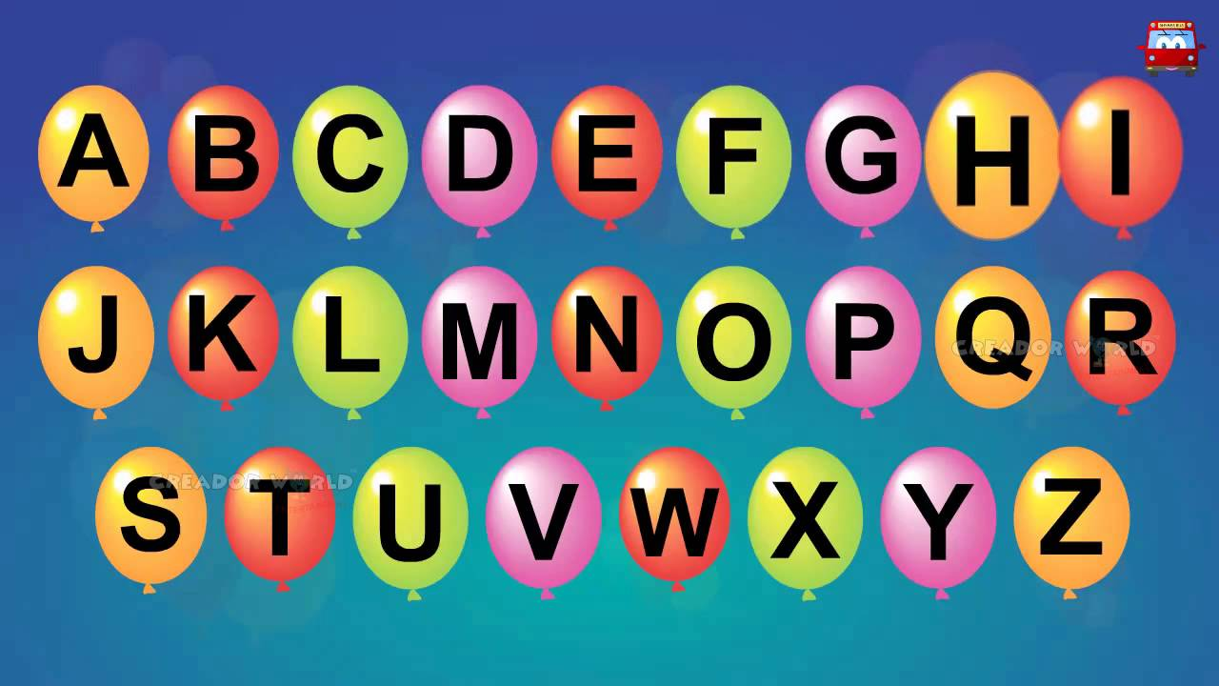
https://www.youtube.com/watch?v=ioBg5RBmyWY

Slide 2
New tricky word
was

Slide 3
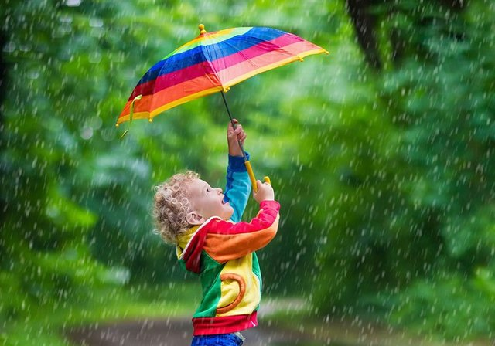
It was raining.

Slide 4
air

Slide 5

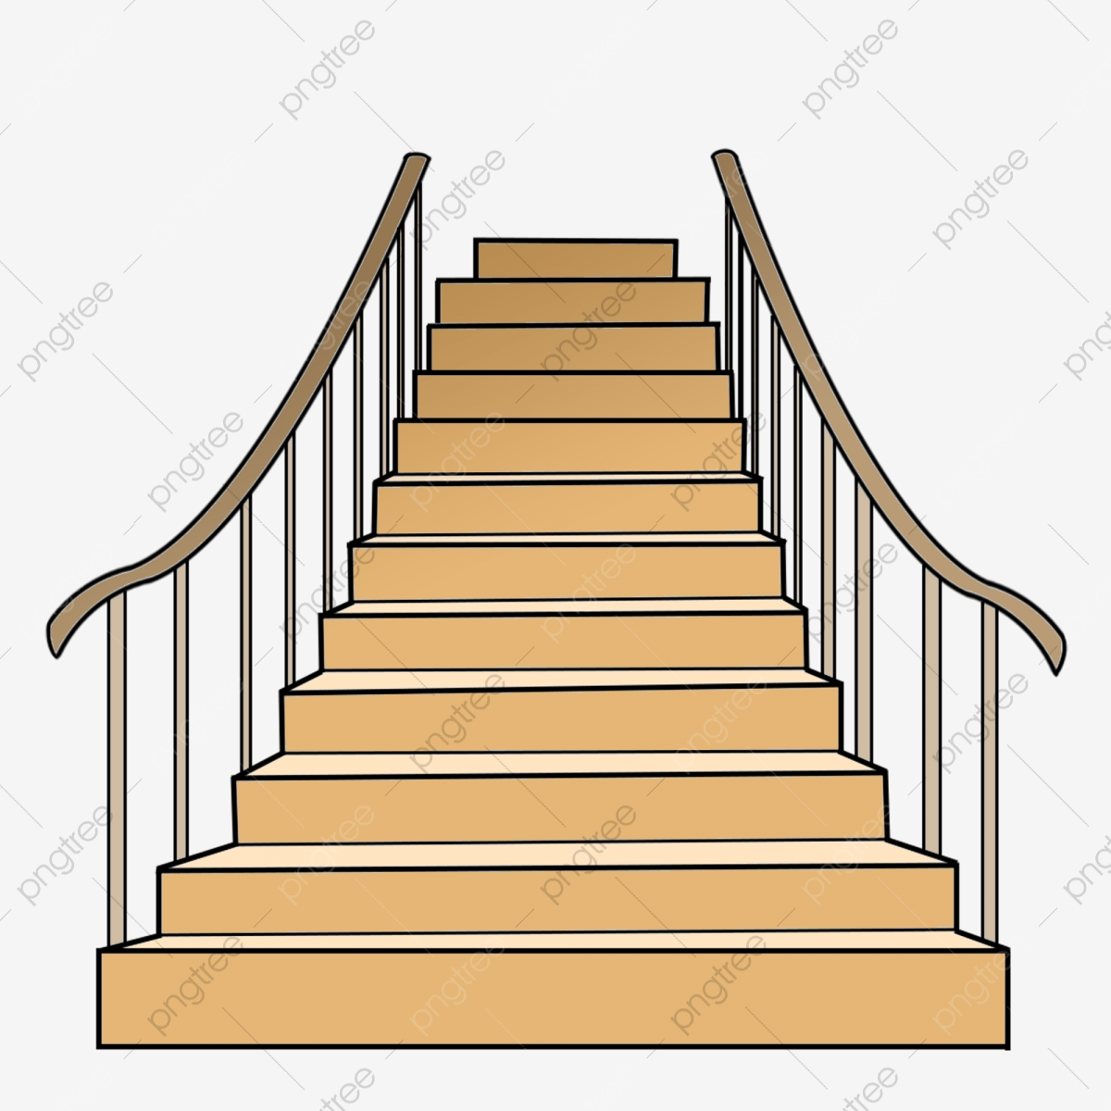



stair
airport
chair
hair
pair

Slide 6
She has a pink chair.

Slide 7
A chair at the top of the stair.

Slide 8
We went as a pair to the funfair.

