Slide 1
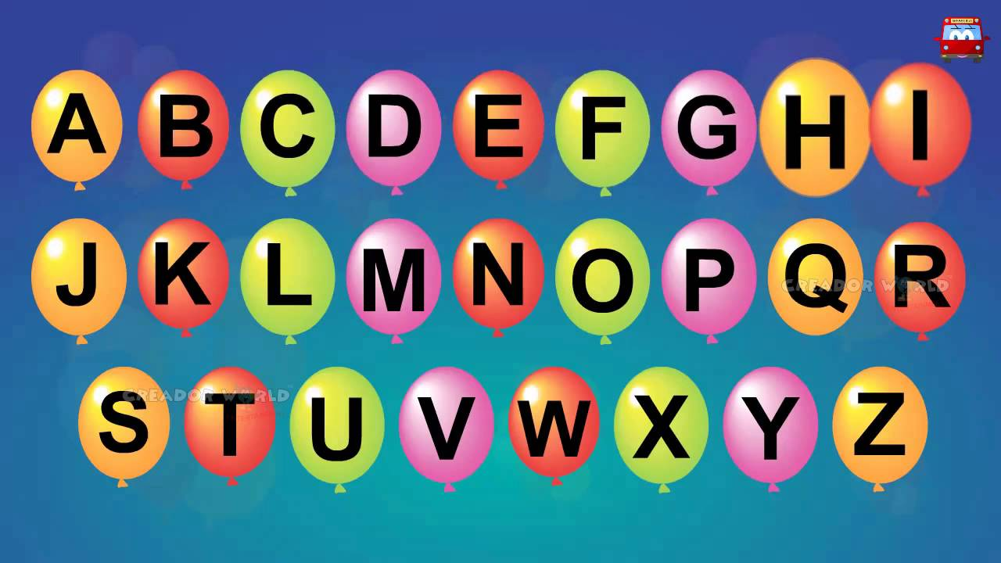
https://www.youtube.com/watch?v=ioBg5RBmyWY

Slide 2
New tricky word
her

Slide 3
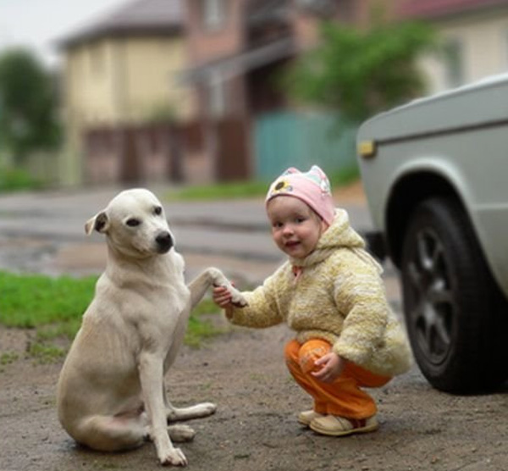
This is her dog.

Slide 4
er

Slide 5


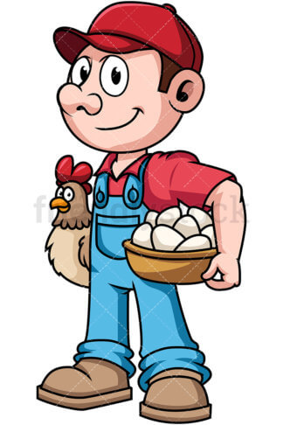


farmer
ladder
hammer
dinner
letter

Slide 6
I got a letter from a farmer.

Slide 7
My ladder is longer.

Slide 8
Get a hammer and bang a nail.

