Slide 1
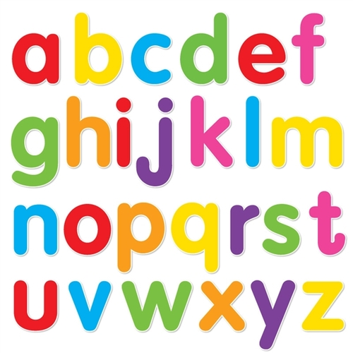
https://www.youtube.com/watch?v=ioBg5RBmyWY

Slide 2
New tricky word
he

Slide 3
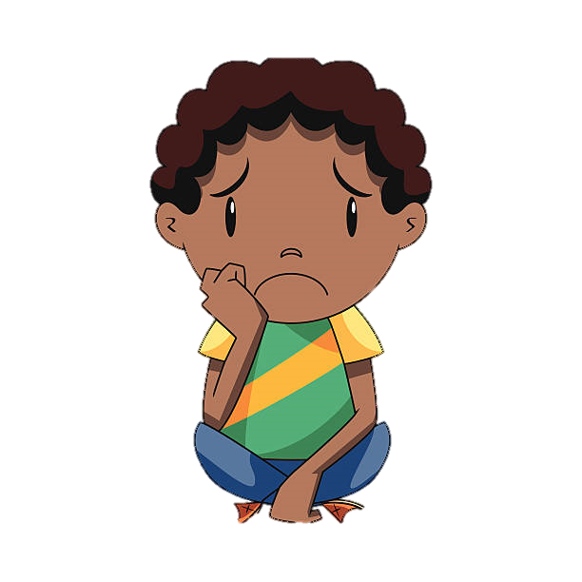
He is sad

Slide 4
j

Slide 5
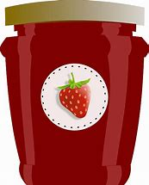

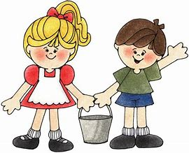


jug
Jack and
Jill
jam
jet
jog

Slide 6
jam

Slide 7
jet

Slide 8
Jack

Slide 9
Jill

Slide 10
jug

Slide 11
jog

Slide 12
Jack and Jill went up the hill.

Slide 13
He has the jug.

Slide 14
The jet is fast.

