Slide 1

https://www.youtube.com/watch?v=ioBg5RBmyWY

Slide 2
New tricky word
you

Slide 3

Can you jump up and down?

Slide 4
oi

Slide 5
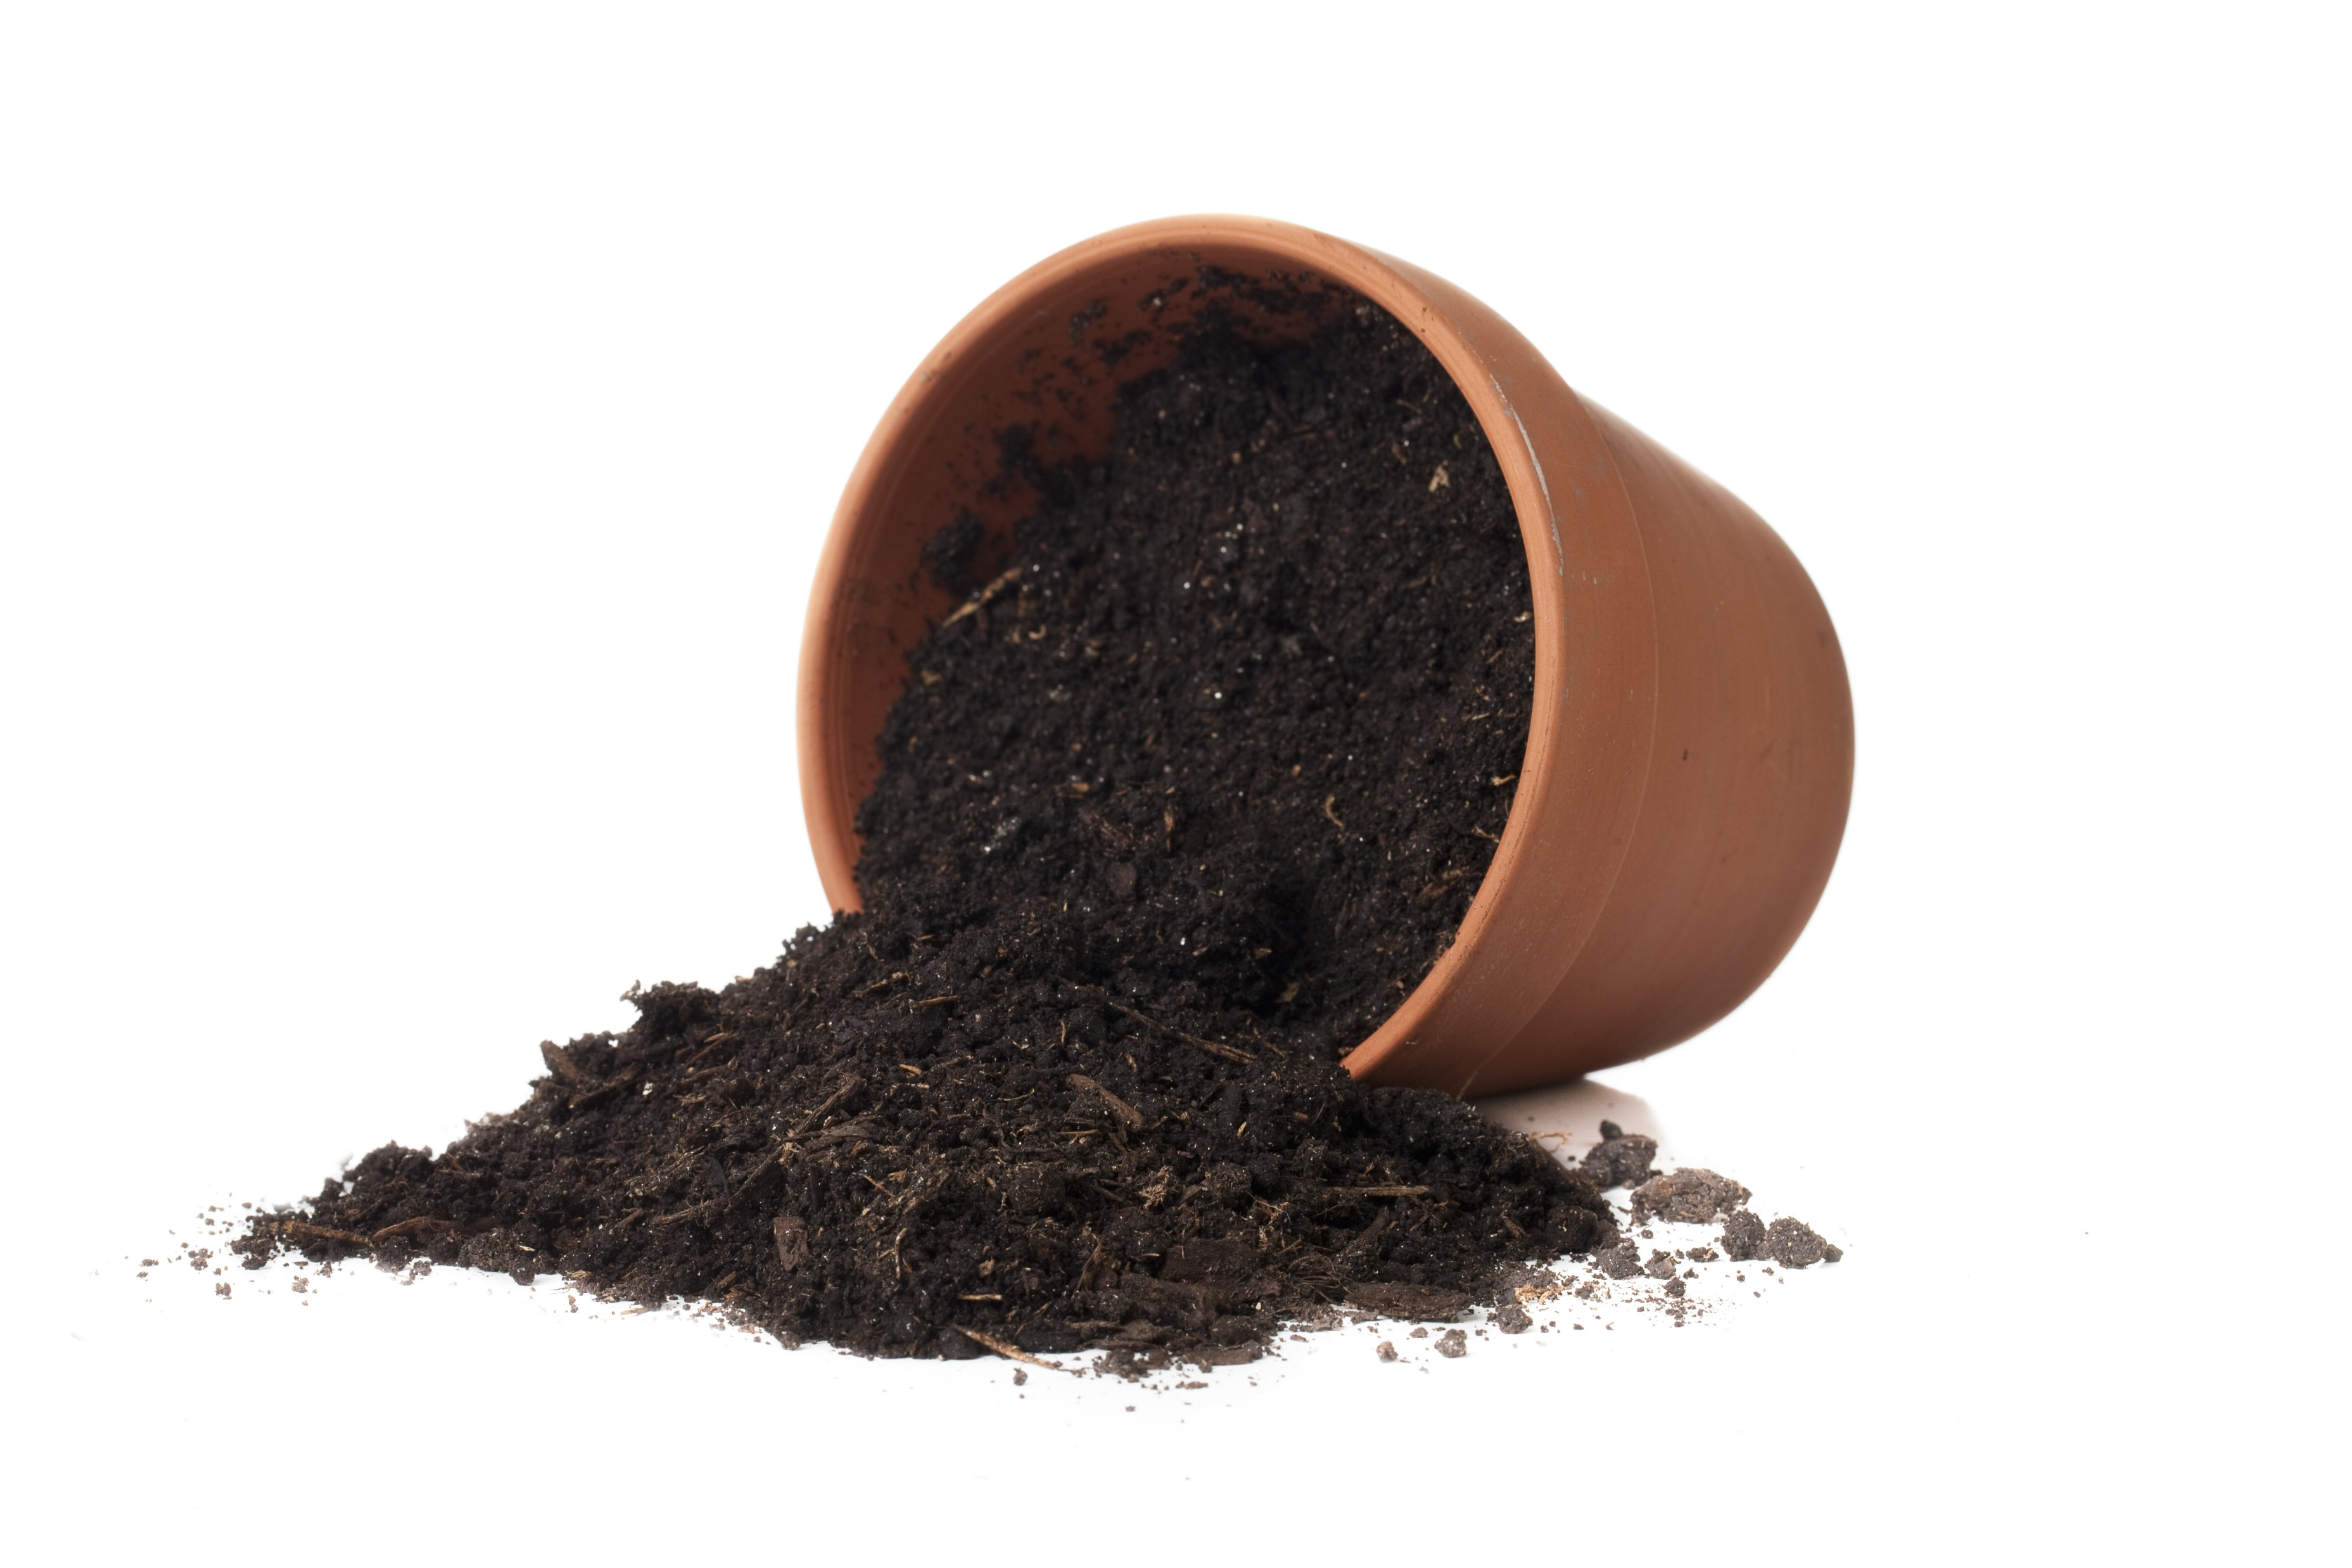
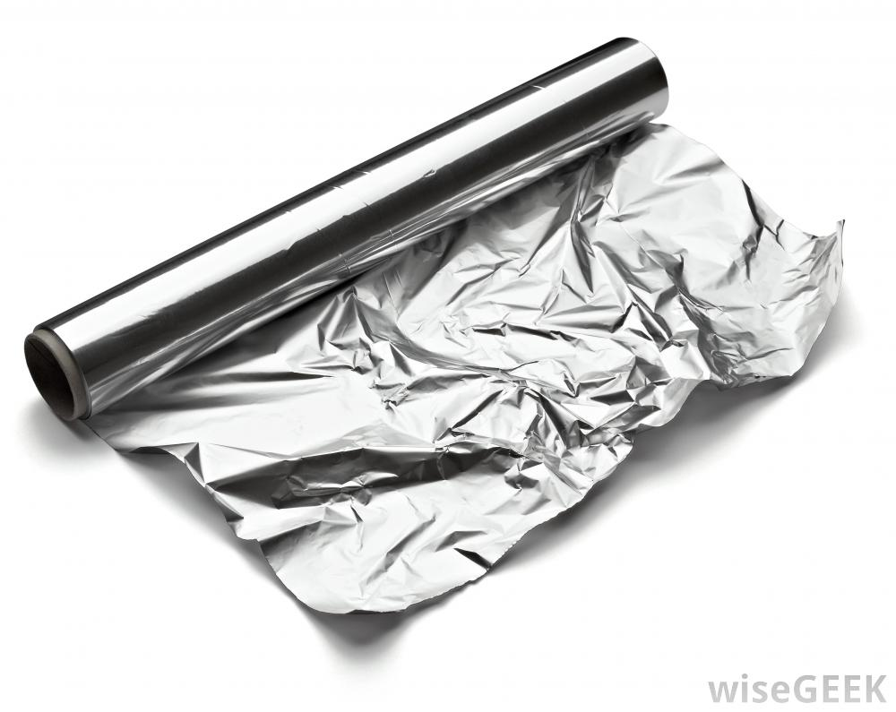
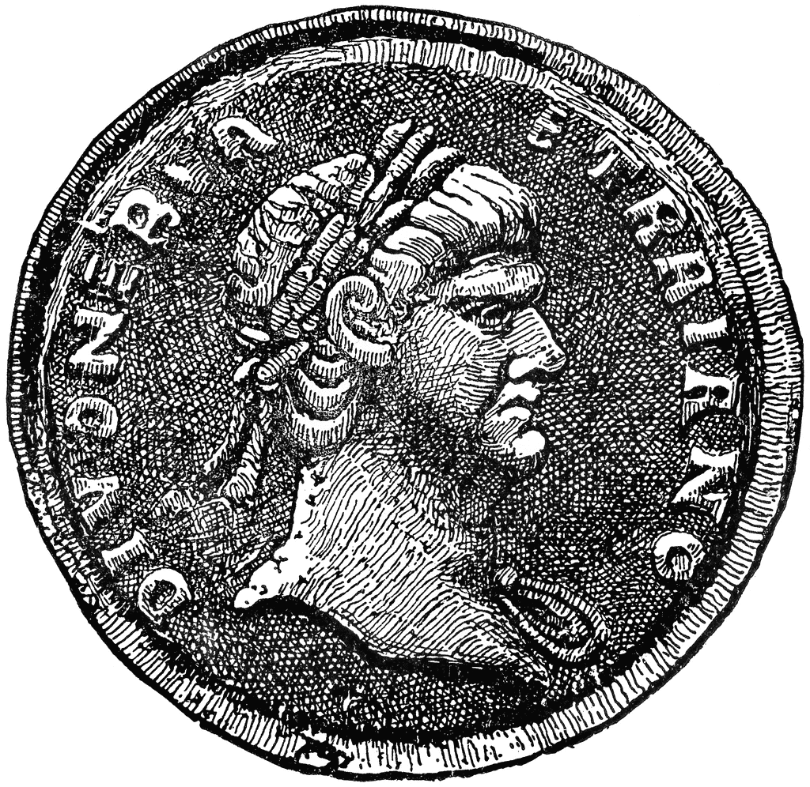


foil
coin
soil
boil
oil

Slide 6
soil

Slide 7
foil

Slide 8
boil

Slide 9
coin

Slide 10
oil

Slide 11
He has a coin.

Slide 12
I need the foil.

Slide 13
We need to boil the eggs.

