Slide 1
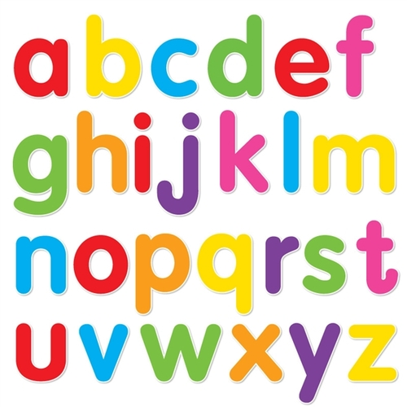
https://www.youtube.com/watch?v=ioBg5RBmyWY

Slide 2
New tricky word
be

Slide 3
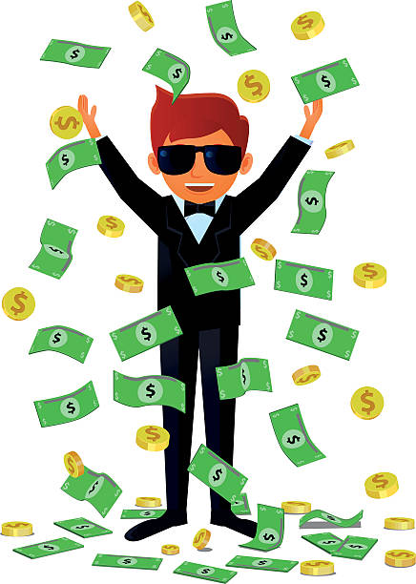
We can be rich.

Slide 4
or

Slide 5
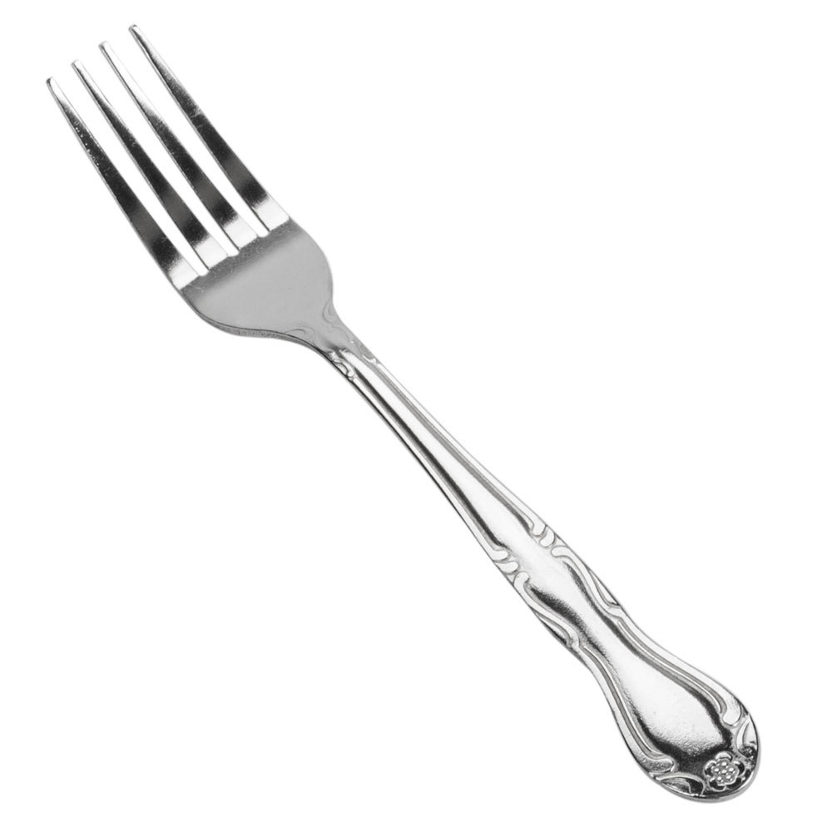
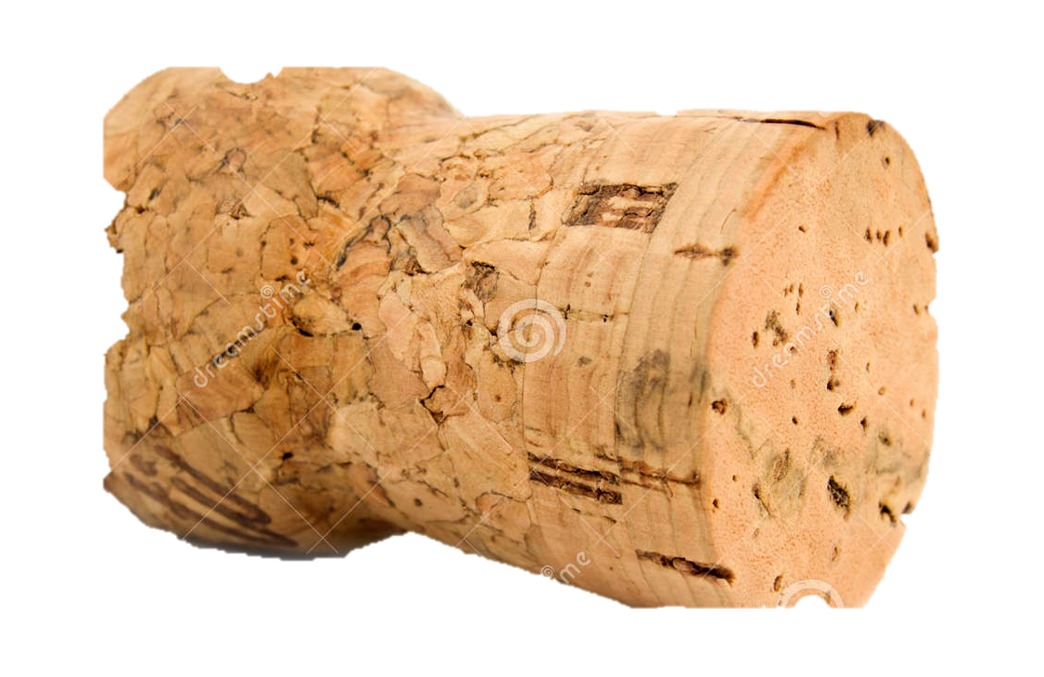



thorn
cork
fork
corn
horn

Slide 6
fork

Slide 7
corn

Slide 8
cork

Slide 9
thorn

Slide 10
horn

Slide 11
The thorn is sharp.

Slide 12
Is corn red?

Slide 13
You need a cup and fork.

