Slide 1
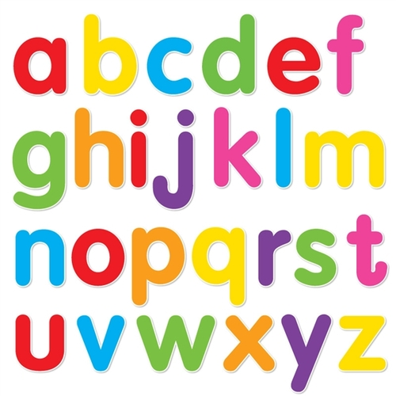
https://www.youtube.com/watch?v=ioBg5RBmyWY

Slide 2
New tricky word
my

Slide 3
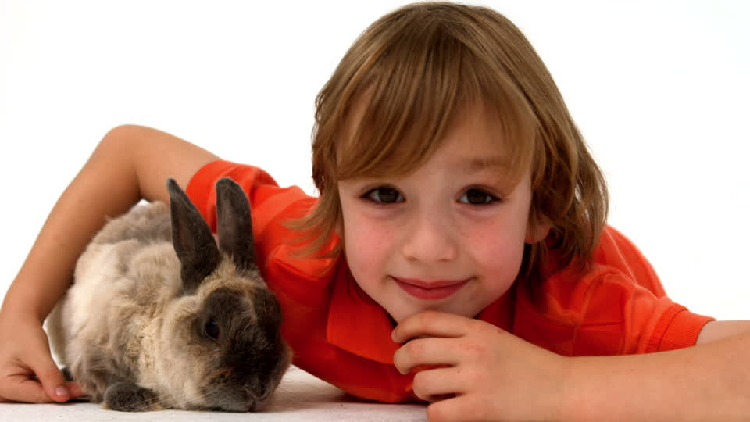
This is my rabbit.

Slide 4
ow

Slide 5
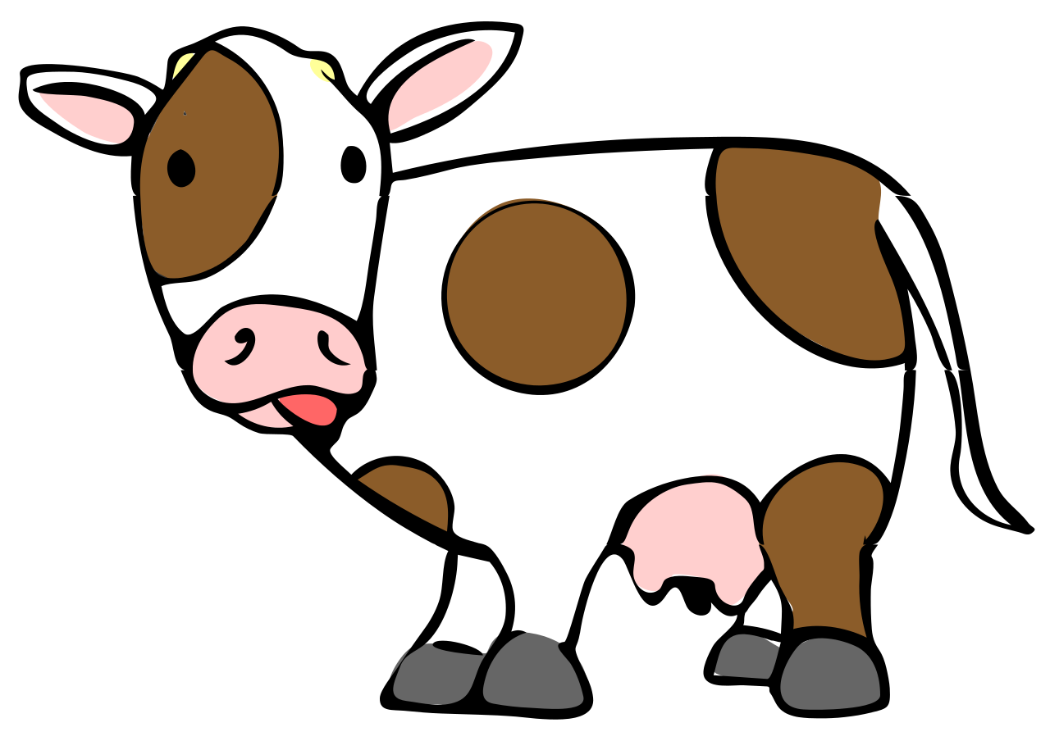


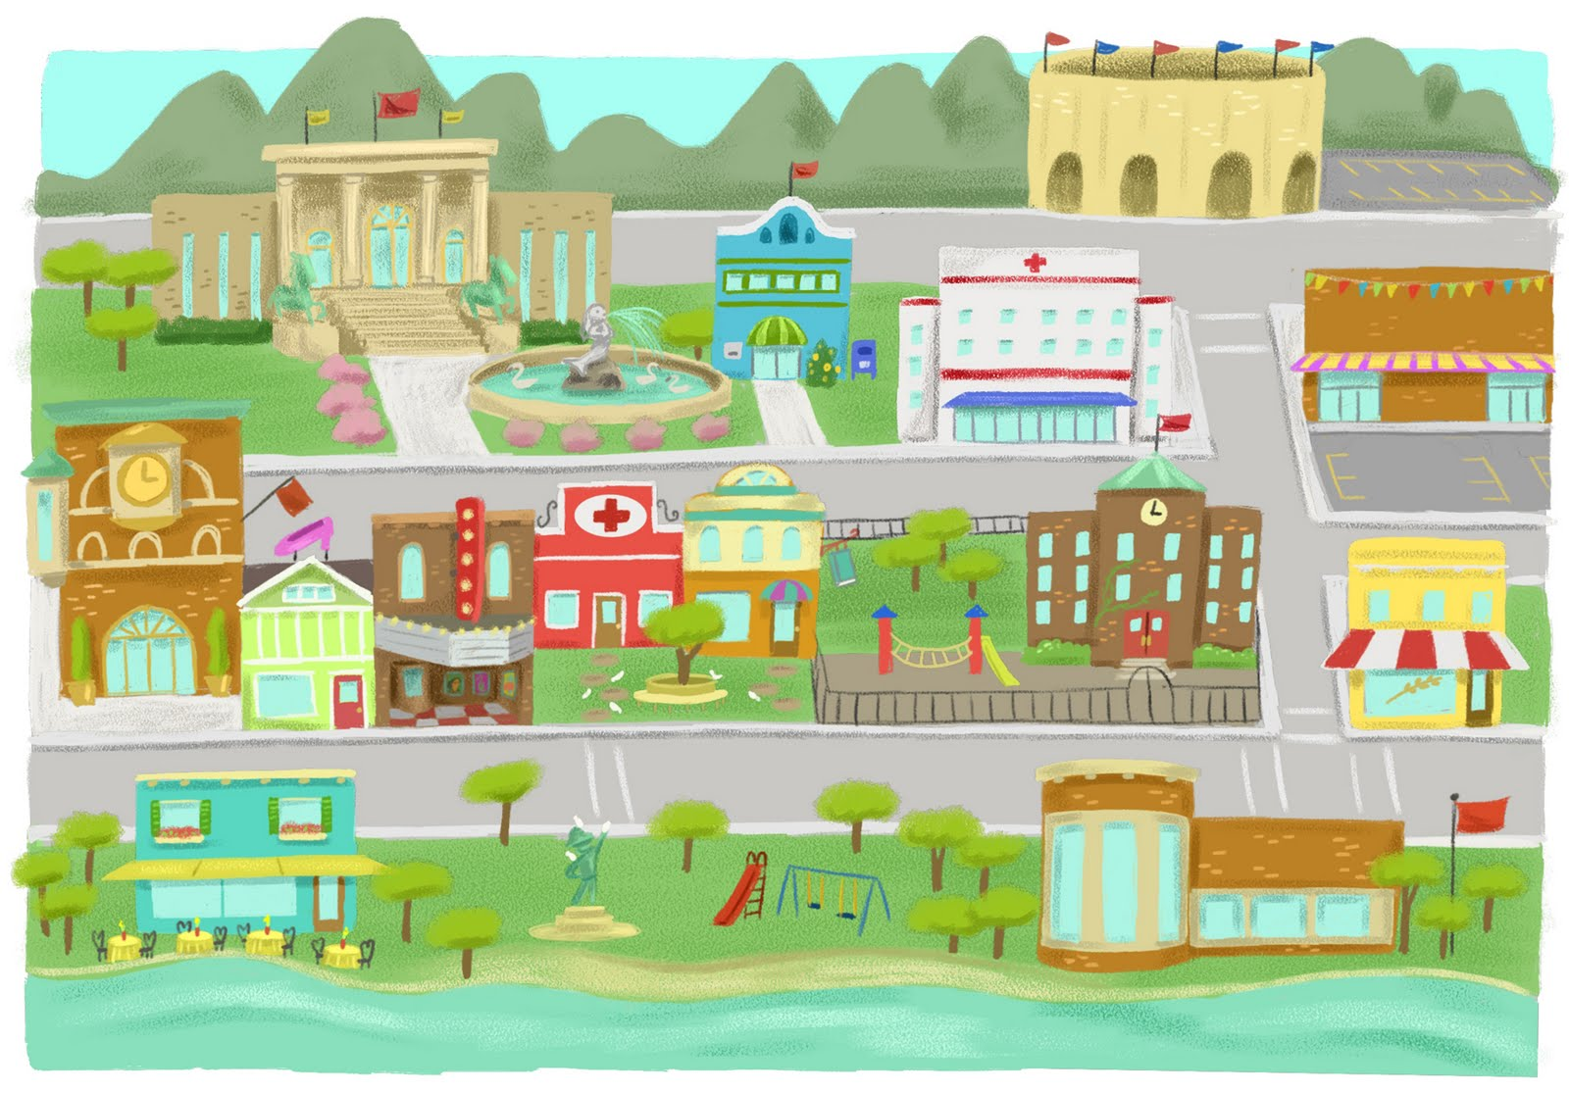
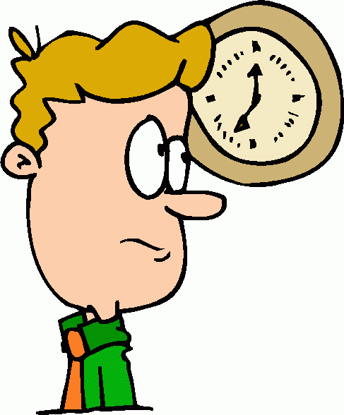
down
owl
cow
town
now

Slide 6
cow

Slide 7
town

Slide 8
owl

Slide 9
down

Slide 10
now

Slide 11
The owl looks sad.

Slide 12
I park my car in the town.

Slide 13
We need to feed the brown cow.

