Slide 1
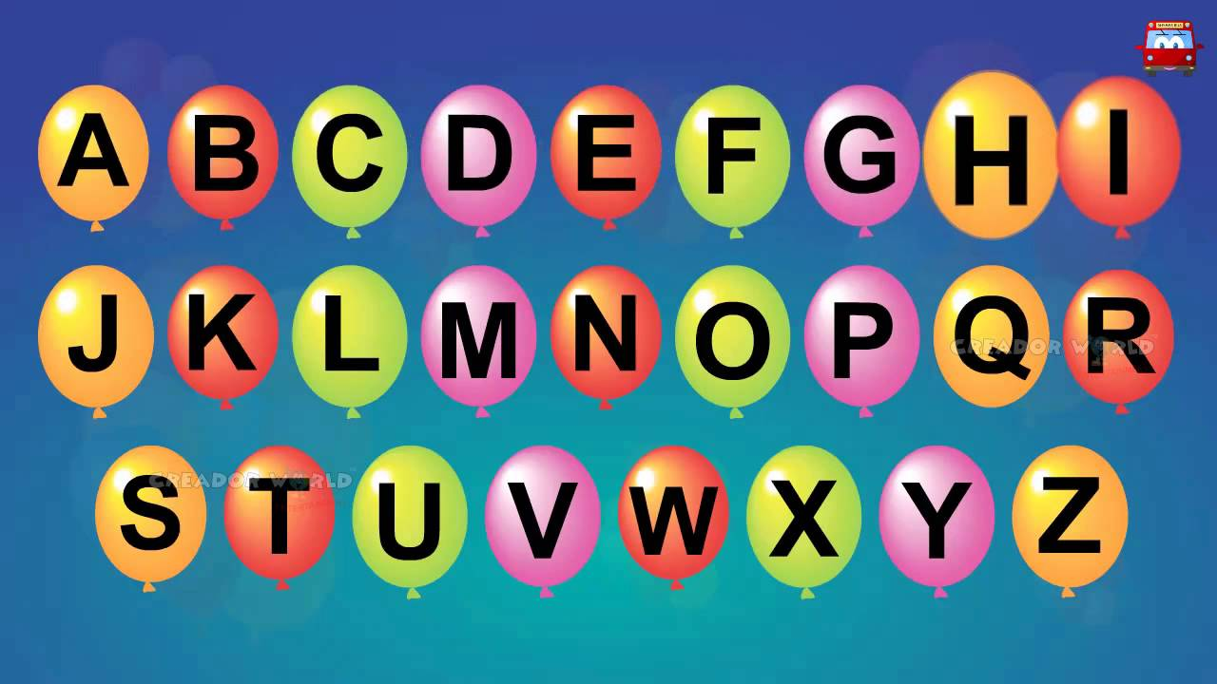
https://www.youtube.com/watch?v=ioBg5RBmyWY

Slide 2
New tricky word
her

Slide 3
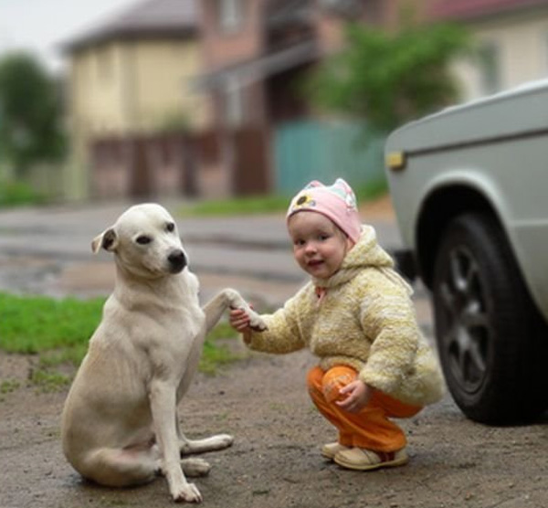
This is her dog.

Slide 4
sh

Slide 5
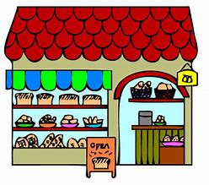




fish
cash
shop
ship
shell

Slide 6
shop

Slide 7
ship

Slide 8
cash

Slide 9
fish

Slide 10
shell

Slide 11
We got a big shell.

Slide 12
The fish has a red fin.

Slide 13
The shop has no cash.

