Slide 1
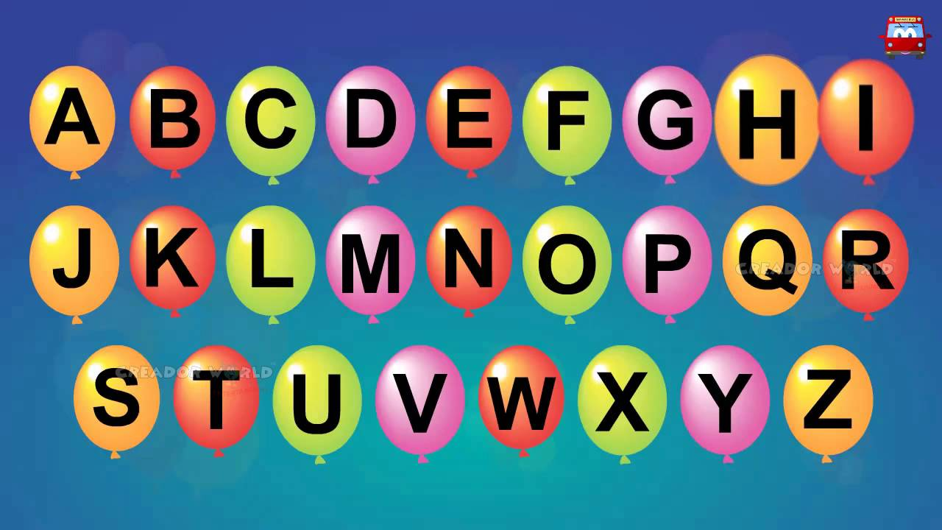
https://www.youtube.com/watch?v=ioBg5RBmyWY

Slide 2
New tricky word
her

Slide 3
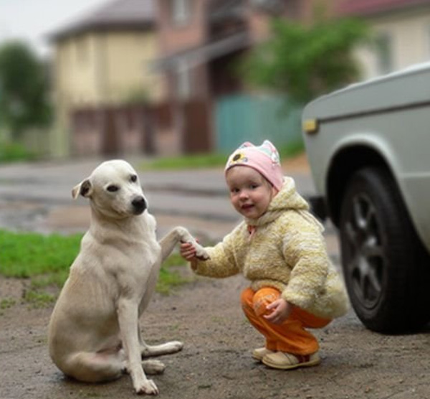
This is her dog.

Slide 4
th

Slide 5
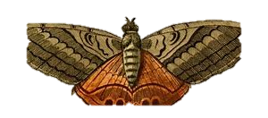

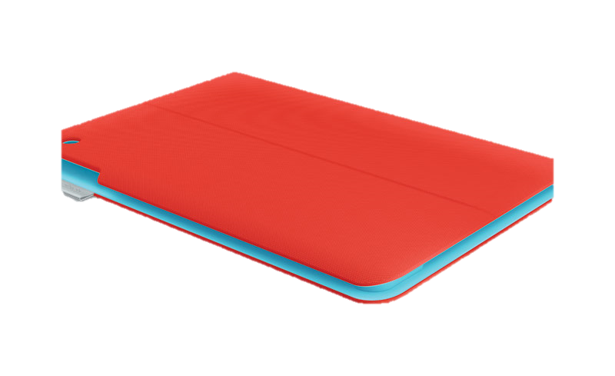


thorn
thin
moth
thick
teeth

Slide 6
moth

Slide 7
thin

Slide 8
thick

Slide 9
thorn

Slide 10
teeth

Slide 11
He has a thick book.

Slide 12
They brush the dogs teeth.

Slide 13
The thorn is sharp.

