Slide 1

https://www.youtube.com/watch?v=ioBg5RBmyWY

Slide 2
New tricky word
she

Slide 3
She has a rabbit.

Slide 4
w

Slide 5



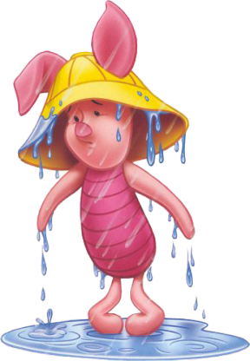
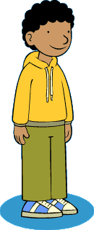
wig
wax
web
wet
Wilf

Slide 6
web

Slide 7
wet

Slide 8
wax

Slide 9
wig

Slide 10
Wilf

Slide 11
The wax is hot.

Slide 12
The bug is in the web.

Slide 13
The wig is black.

