Slide 1
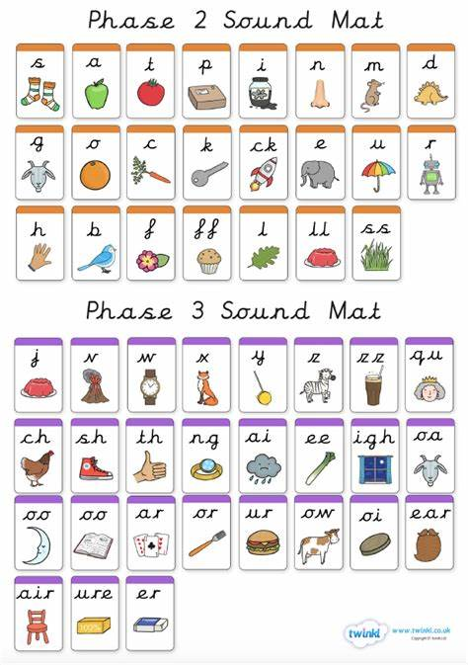
Can you the name the following:

Slide 2
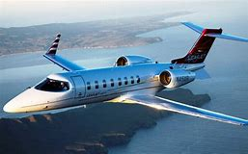
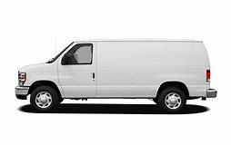
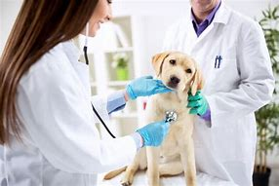
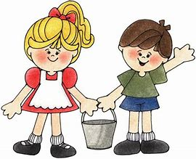
Can you read these words?
van
jet
vet
Jack

Slide 3
New tricky word
so

Slide 4
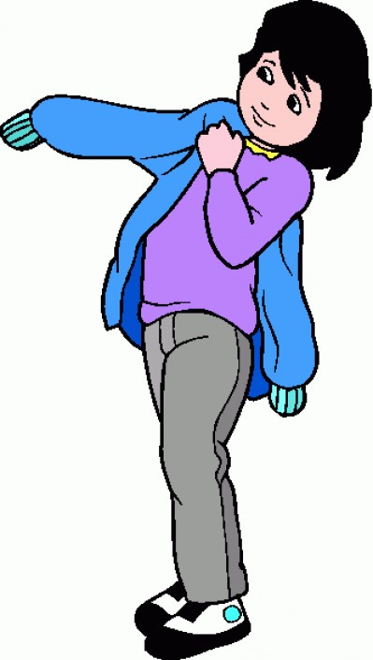
It is cold so I need my coat.

Slide 5
Can you read these words?

Slide 6
pin

Slide 7
sin

Slide 8
ban

Slide 9
tan

Slide 10
win

Slide 11
Now we are going to add a letter to a 3 letter word (CVC).

Slide 12

pink

Slide 13
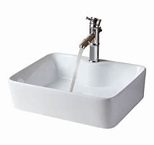
sink

Slide 14
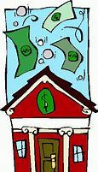
bank

Slide 15
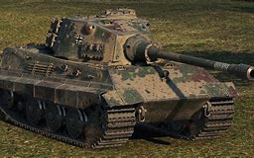
tank

Slide 16

wink

Slide 17
Now we are going to read some sentences.

Slide 18
It is damp in the pink tent.

Slide 19
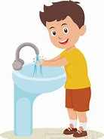
Can you write a sentence for this picture?

Slide 20
Practise some reading here https://www.youtube.com/watch?v=MOskhln9X3s

