Slide 1
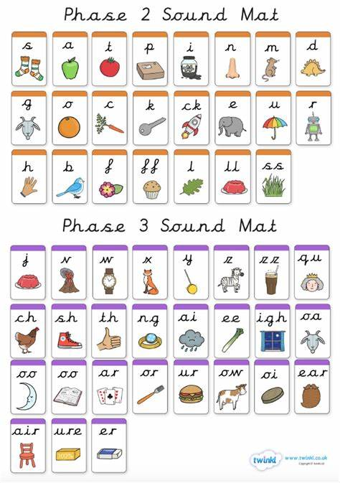
Can you the name the following:

Slide 2

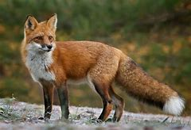



Can you read these words?
fox
zip
tax
mix
zag

Slide 3
New tricky word
she

Slide 4

She is in the car.

Slide 5
Can you read these words?

Slide 6
rip

Slide 7
can

Slide 8
pin

Slide 9
top

Slide 10
and

Slide 11
ink

Slide 12
Now we are going to add a letter to the start of each word.

Slide 13

trip

Slide 14

scan

Slide 15

spin

Slide 16

stop

Slide 17

land

Slide 18
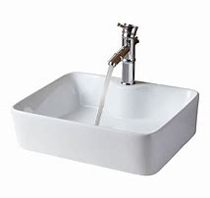
sink

Slide 19
Now we are going to read some sentences.

Slide 20
It was dark when the lamp went out.

Slide 21
Sam cannot see now.

