Slide 1
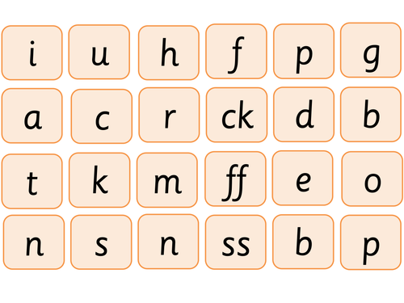
Say these sounds as quickly as you can.

Slide 2
New tricky word
like

Slide 3

I like to cook.

Slide 4
Can you read these words?

Slide 5
soap

Slide 6
goat

Slide 7
coat

Slide 8
boat

Slide 9
loaf

Slide 10
Now we are going to add a sound. You need to read 4 sounds.

Slide 11

lamp

Slide 12

pink

Slide 13

nest

Slide 14

hunt

Slide 15
Now we are going to read some sentences.

Slide 16
The gift was lost.

Slide 17
I have a pink coat.

Slide 18
Wash with the soap.

