Slide 1
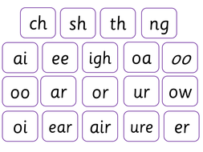
Say these sounds as quickly as you can.

Slide 2
New tricky word
was

Slide 3
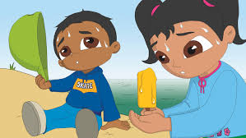
It was a hot day.

Slide 4
Can you read these words?

Slide 5
bar

Slide 6
jar

Slide 7
far

Slide 8
card

Slide 9
park

Slide 10
Now we are going to add a sound. You need to read 4 sounds.

Slide 11

stop

Slide 12

flag

Slide 13
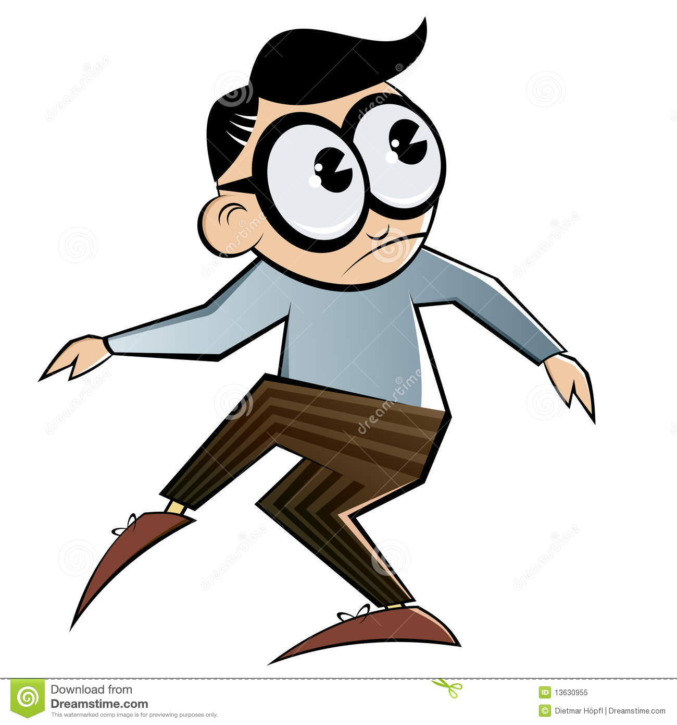
creep

Slide 14

grip

Slide 15
Now we are going to read some sentences.

Slide 16
She lost the glass spoon .

Slide 17
Can you brush the step?

Slide 18
The flag says stop.

