Slide 1
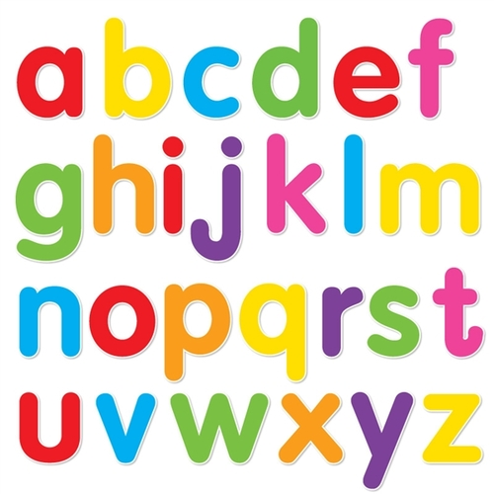
https://www.youtube.com/watch?v=ioBg5RBmyWY

Slide 2
New tricky word
you

Slide 3
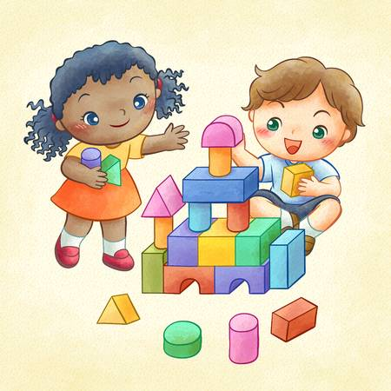
I am going to play with you .

Slide 4
Can you read these words?

Slide 5
light

Slide 6
fight

Slide 7
tight

Slide 8
right

Slide 9
might

Slide 10
high

Slide 11
Now we are going to add a sound. You need to read 4 sounds.

Slide 12

flat

Slide 13

spin

Slide 14
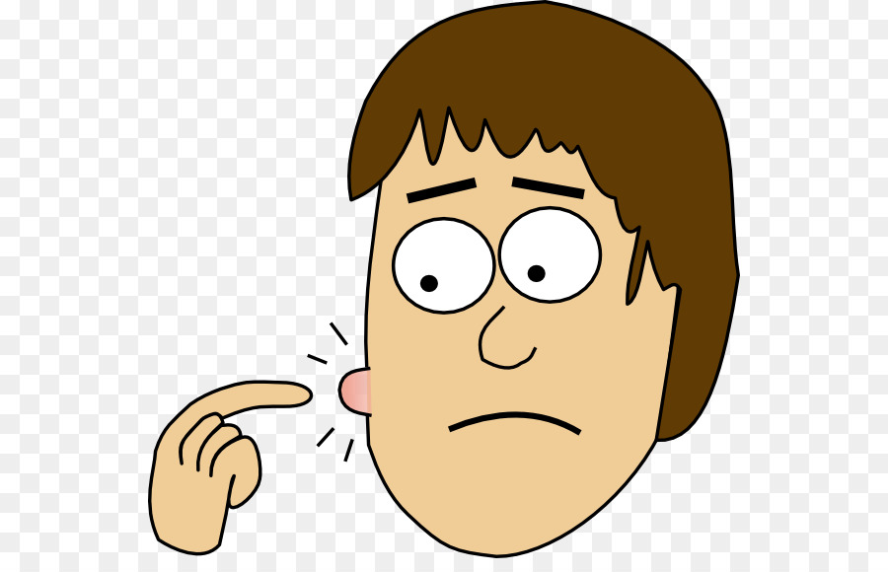
spot

Slide 15
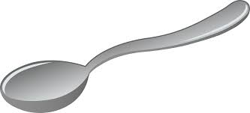
spoon

Slide 16
Now we are going to read some sentences.

Slide 17
Step on the flat green grass.

Slide 18
Can you spot the dog?

Slide 19
Have you got a spoon?

