Slide 1

Can you write the grapheme you hear?
https://youtu.be/TTe5_Em0BHQ

Slide 2
New tricky word
there

Slide 3

There is a fish in the pond.

Slide 4
Can you read these words?

Slide 5
box

Slide 6
top

Slide 7
pit

Slide 8
sand

Slide 9
desk

Slide 10
lunch

Slide 11
We are now going to put two words together to read them.

Slide 12
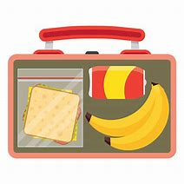
lunchbox

Slide 13
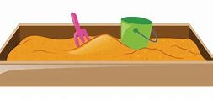
sandpit

Slide 14

deskt[op

Slide 15
Can you think of any words?

Slide 16
Now we are going to read some sentences.

Slide 17
Milk is good for children’s teeth.

