Slide 1
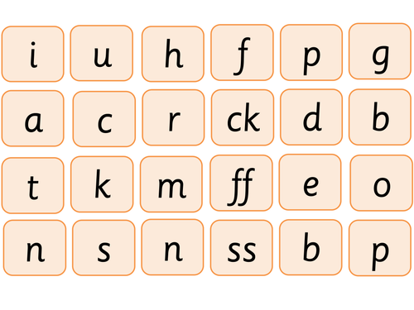
Say these sounds as quickly as you can.

Slide 2
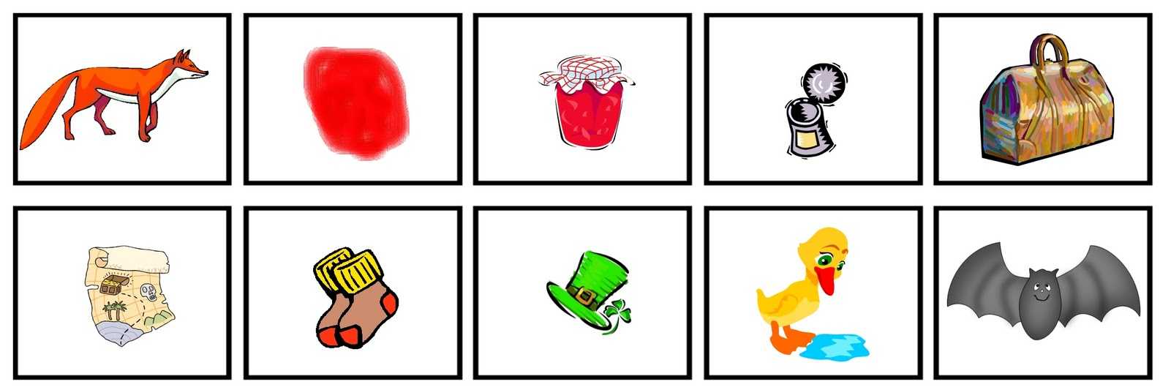
Can you write the words for these pictures?

Slide 3
New tricky word
there

Slide 4
There is a bird in a nest.

Slide 5
New tricky word
little

Slide 6
This is a little cup .

Slide 7
Now we are going to practise all the tricky words from this week.

Slide 8
were

Slide 9
one

Slide 10
they

Slide 11
all

Slide 12
are

Slide 13
Now we are going to read a sentence.

Slide 14
The windmill has seven sails.

