Slide 1
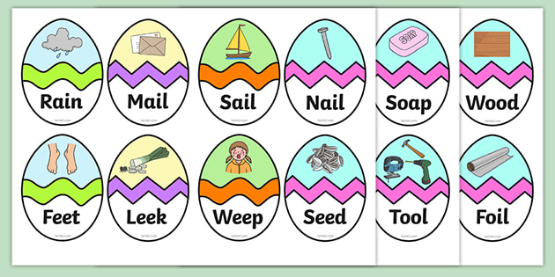
Read these phase 3 CVC words as fast as you can.

Slide 2
New tricky word
out

Slide 3
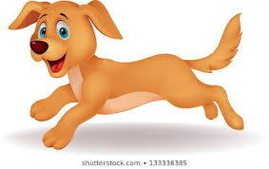
The dog ran out of the house.

Slide 4
Can you read these high frequency words?

Slide 5
little

Slide 6
there

Slide 7
one

Slide 8
out

Slide 9
Now we are going to read some sentences.

Slide 10

The chick is very little.

Slide 11

There is a red car.

Slide 12

I have one sweet left.

