Slide 1
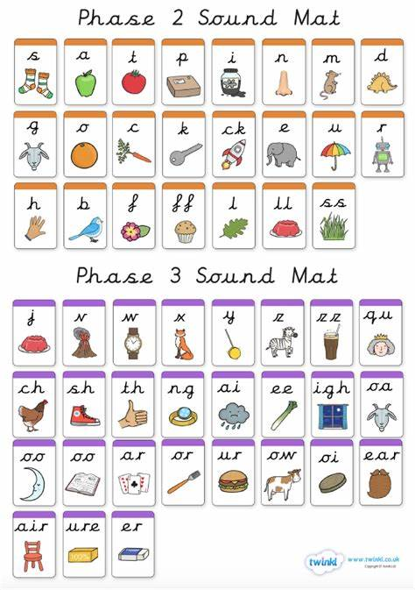
Can you the name the following:

Slide 2
Can you read these words?
yes
yet
yell
yap
box
six

Slide 3
New tricky word
he

Slide 4

He has brown hair.

Slide 5
Can you read these words?

Slide 6
and

Slide 7
rip

Slide 8
pan

Slide 9
rap

Slide 10
cot

Slide 11
lip

Slide 12
Now we are going to add a letter to the start of each word.

Slide 13
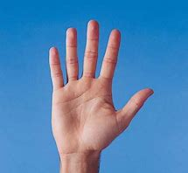
hand

Slide 14
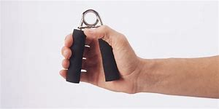
grip

Slide 15
span

Slide 16
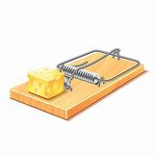
trap

Slide 17

flip

Slide 18
scot

Slide 19
Now we are going to read some sentences.

Slide 20
Ben and Sam jump over the pond.

