Slide 1

https://www.youtube.com/watch?v=ioBg5RBmyWY

Slide 2
New tricky word
have

Slide 3

I have red boots .

Slide 4
Can you read these words?

Slide 5
see

Slide 6
fee

Slide 7
tree

Slide 8
root

Slide 9
zoom

Slide 10
look

Slide 11
Now we are going to add a sound. You need to read 4 sounds.

Slide 12
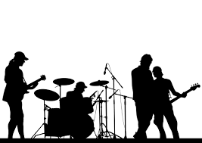
band

Slide 13
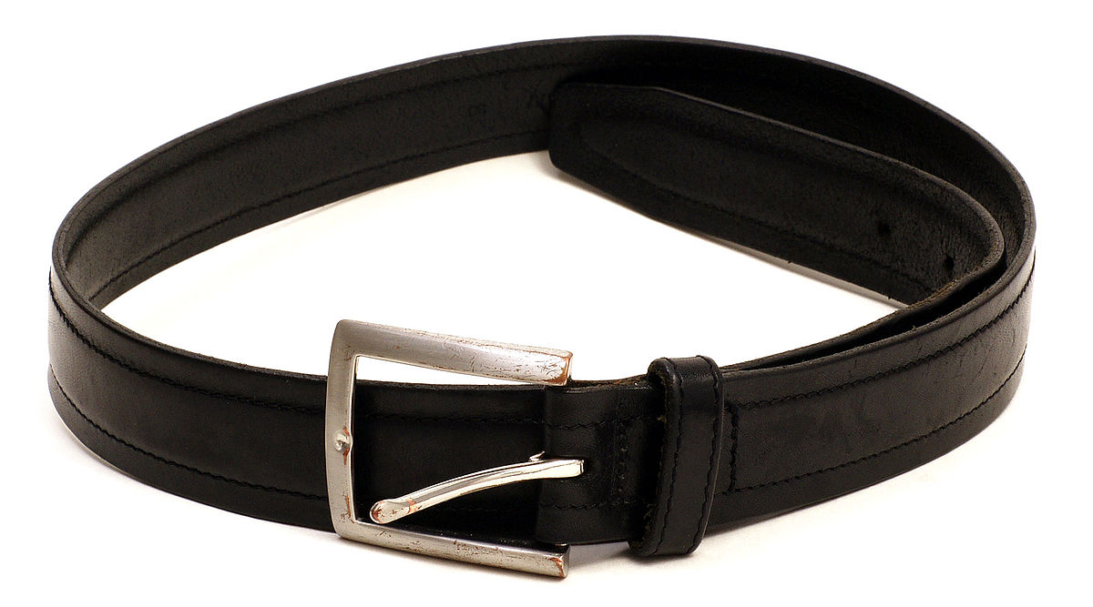
belt

Slide 14

camp

Slide 15
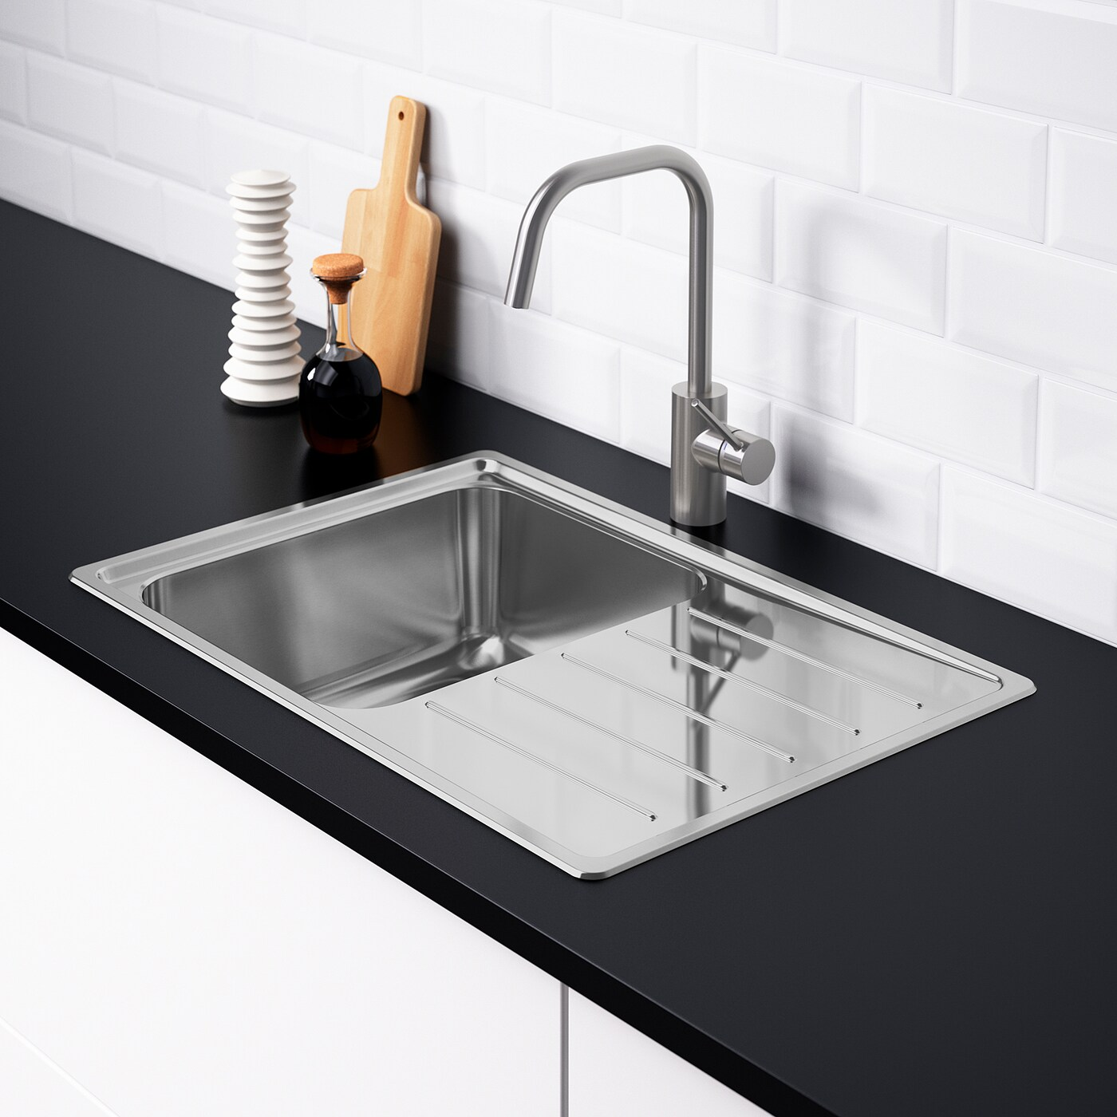
sink

Slide 16
Now we are going to read some sentences.

Slide 17
The cash was put in the bank.

Slide 18
Put the cup in the sink.

Slide 19
I went to see a cool band.

