Slide 1
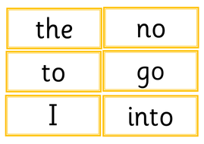
Read these tricky words as quickly as you can.

Slide 2
New tricky word
Some

Slide 3
Can I have some sweets?

Slide 4
New tricky word
Come

Slide 5
Come over to play at my house.

Slide 6
Now we are going to practise all the tricky words from this week.

Slide 7
have

Slide 8
Like

Slide 9
was

Slide 10
you

Slide 11
Now we are going to read some sentences.

Slide 12
have you been to the park?

Slide 13
When was it Monday?

Slide 14
Do you like cats?

