Slide 1

Can you write the grapheme you hear?
https://youtu.be/TTe5_Em0BHQ

Slide 2
New tricky word
were

Slide 3
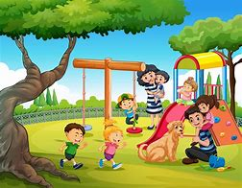
They were at the park.

Slide 4
Can you read these words?

Slide 5
lip

Slide 6
man

Slide 7
post

Slide 8
milk

Slide 9
stick

Slide 10
chop

Slide 11
We are now going to put two words together to read them.

Slide 12
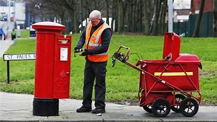
postman

Slide 13
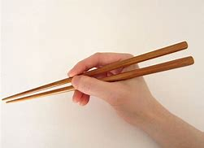
chopstick

Slide 14
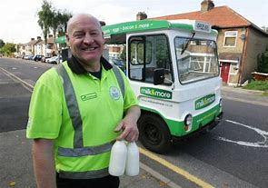
milkman

Slide 15

lipstick

Slide 16
Now we are going to read some sentences.

Slide 17
Fred and Brett spent a week in Spain.
.

