Slide 1

Can you write the grapheme you hear?
https://youtu.be/TTe5_Em0BHQ

Slide 2
New tricky word
one

Slide 3

I can see one bee.

Slide 4
Can you read these words?

Slide 5

handbag

Slide 6

teapot

Slide 7
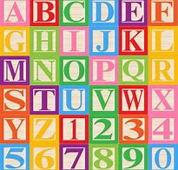
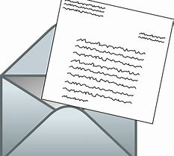
letter

Slide 8


tablet

Slide 9
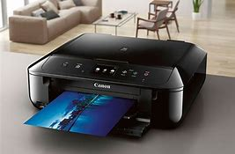
printer

Slide 10
Can you write the words for these pictures?

Slide 11


Slide 12
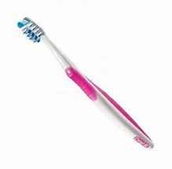

Slide 13
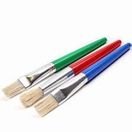

Slide 14
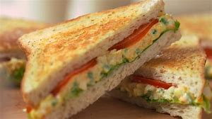

Slide 15
Now we are going to read some sentences.

Slide 16
A drip from the tap drops in the sink.

