Slide 1
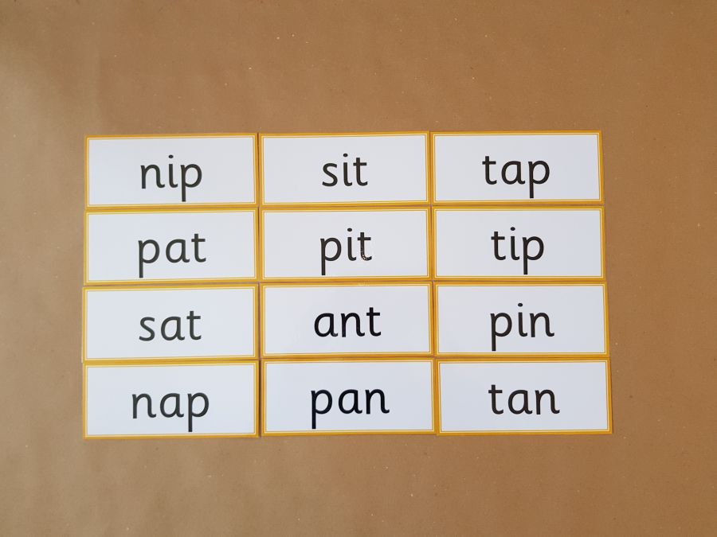
Read these phase 2 CVC words as fast as you can.

Slide 2
New tricky word
do

Slide 3

I like to do gardening.

Slide 4
Can you read these words?

Slide 5
hand

Slide 6
stick

Slide 7
ball

Slide 8
foot

Slide 9
Now we are going to read words with two syllables.

Slide 10
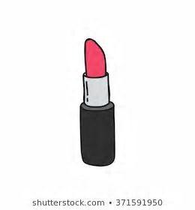
lipstick

Slide 11
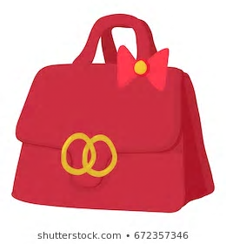
Handbag

Slide 12
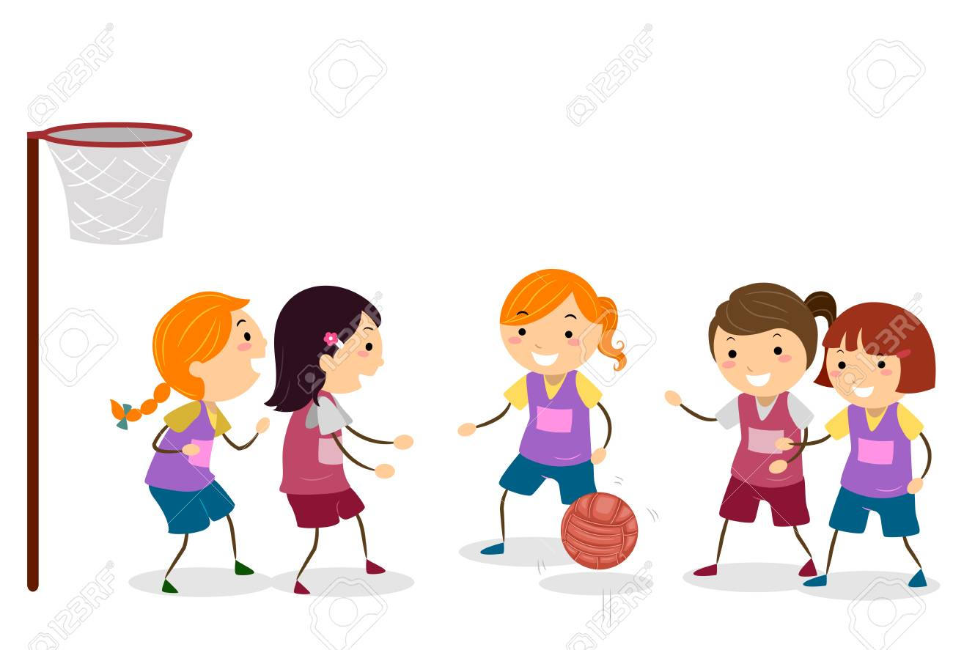
Netball

Slide 13

Teapot

Slide 14
Now we are going to read some sentences.

Slide 15
I have a lipstick in my handbag.

Slide 16
Put the water in the teapot.

Slide 17
I like to play netball.

