Slide 1
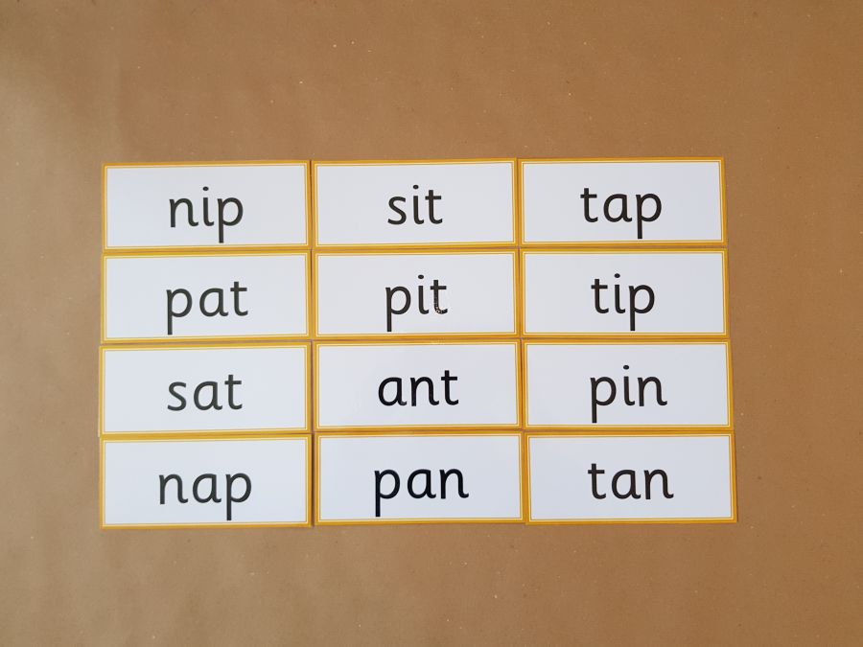
Read these phase 2 CVC words as fast as you can.

Slide 2
New tricky word
when

Slide 3

When do you go to bed?.

Slide 4
Can you read these high frequency words?

Slide 5
went

Slide 6
It’s

Slide 7
from

Slide 8
children

Slide 9
just

Slide 10
Now we are going to read some sentences.

Slide 11

I have just been shopping.

Slide 12

The children are singing.

Slide 13

It’s a card from my sister.

