Slide 1
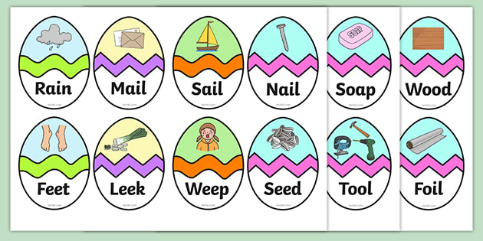
Read these phase 3 CVC words as fast as you can.

Slide 2
Practising reading sentences

Slide 3
To read sentences we must break down each word as we go along.

Slide 4
We must return to read from the beginning of the sentence so it makes sense.

Slide 5
Have a go at reading the following sentences and decide if the answer is yes or no? .

Slide 6

Can a clock get cross?

Slide 7
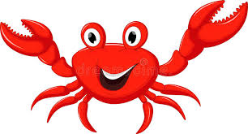
Can a crab clap hands?
.

Slide 8
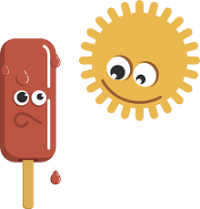
Can a lolly melt?
.

Slide 9
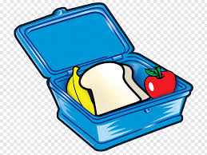
Do you have a lunchbox?
.

