Slide 1
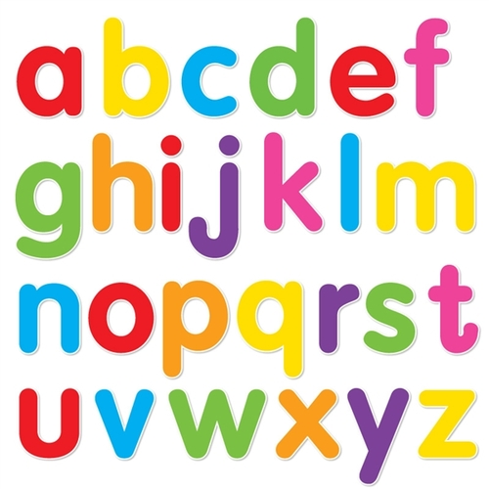
https://www.youtube.com/watch?v=ioBg5RBmyWY

Slide 2
New tricky word
said

Slide 3
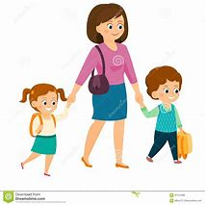
Mum said we need to go to the shop.

Slide 4
Can you read these words?

Slide 5
ten

Slide 6
ben

Slide 7
dam

Slide 8
pan

Slide 9
Now we are going to add a letter to a 3 letter word (CVC).

Slide 10
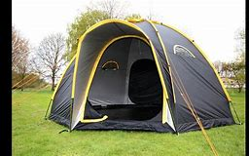
tent

Slide 11
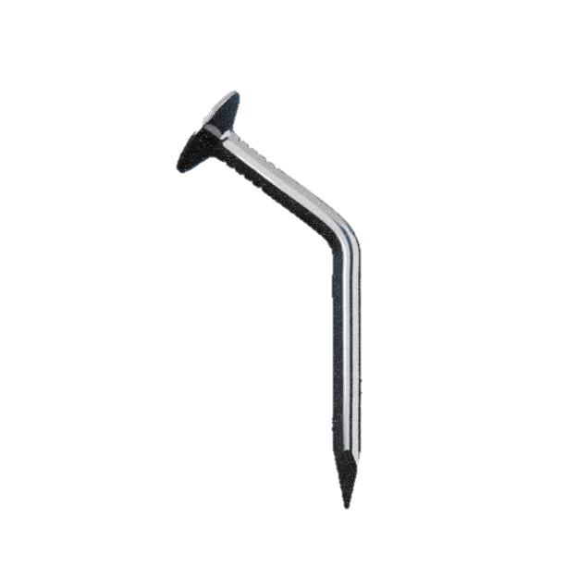
bent

Slide 12
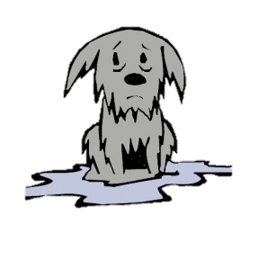
damp

Slide 13
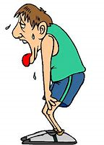
pant

Slide 14
Now we are going to read some sentences.

Slide 15
It can be fun to camp in a tent.

Slide 16
The man bent the nail.

Slide 17
The dog got damp in the rain.

