Slide 1
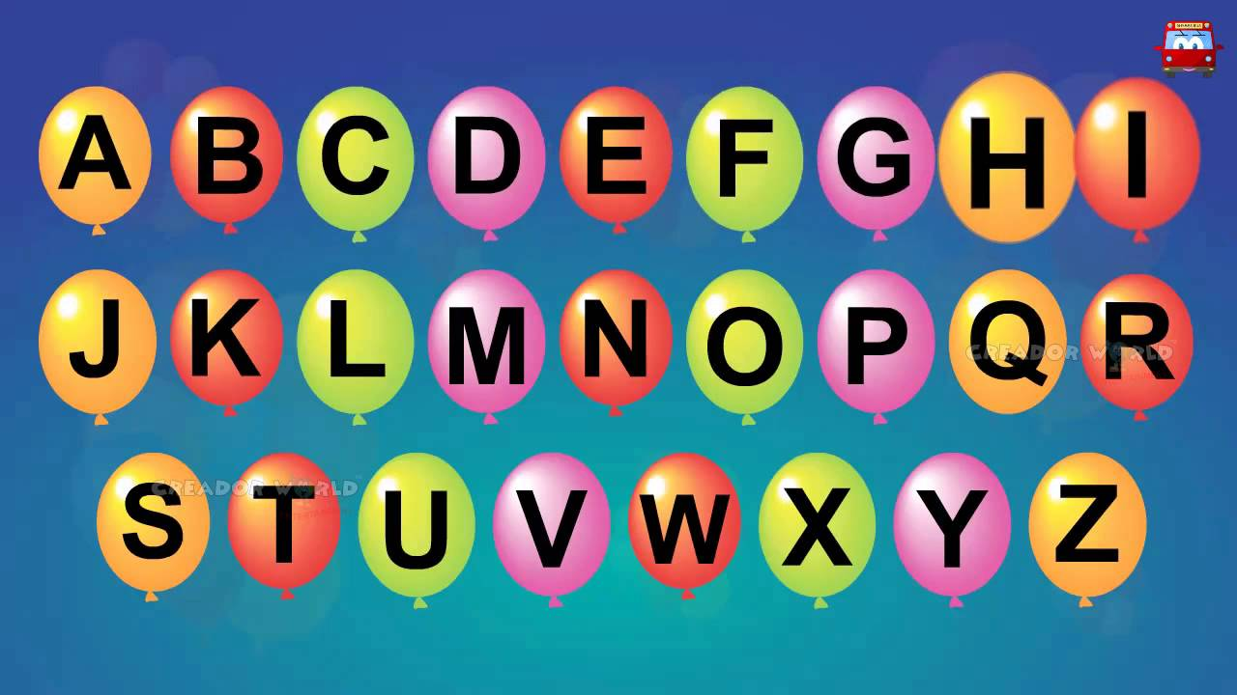
https://www.youtube.com/watch?v=Q8JmK5z6QD4

Slide 2
New tricky word
they

Slide 3
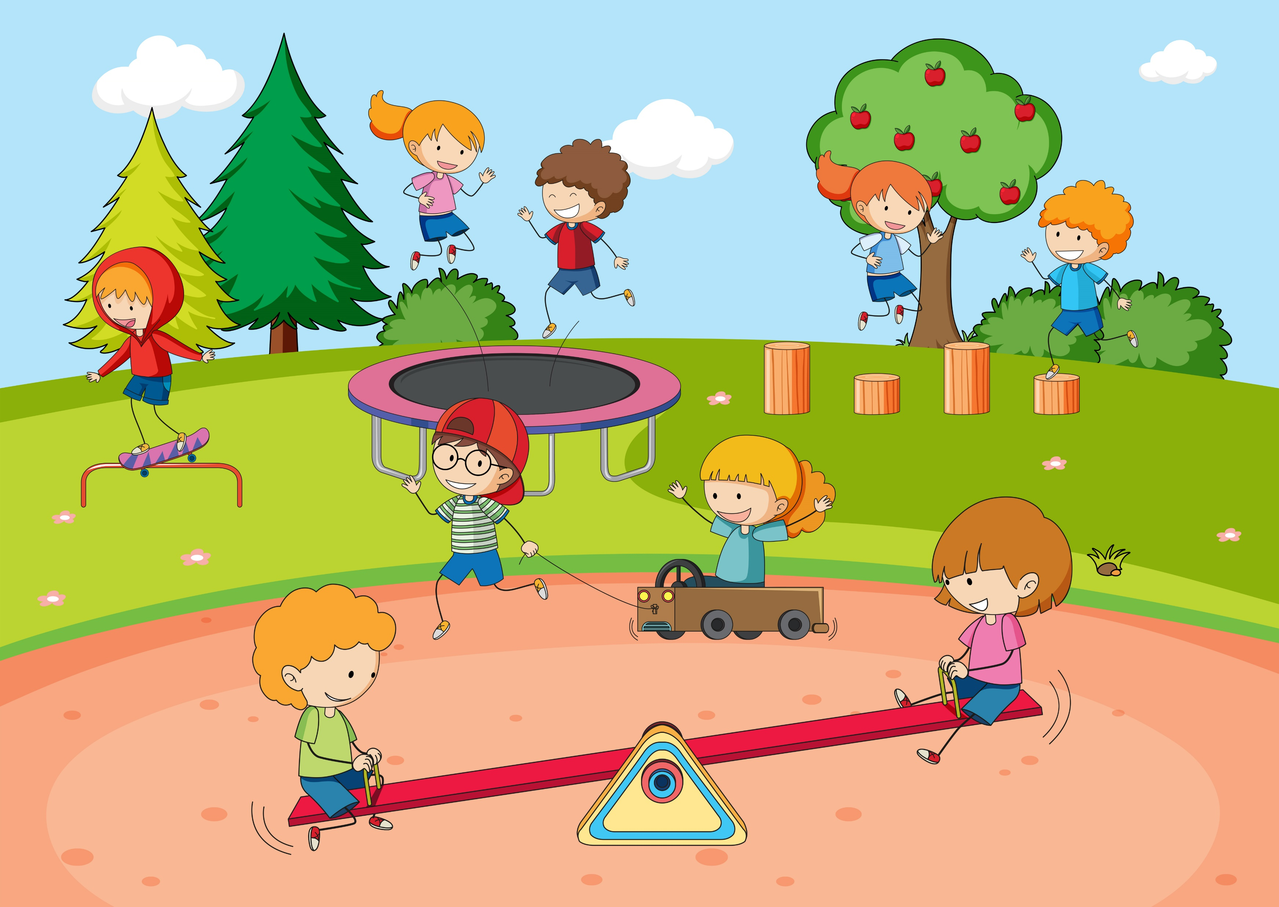
They went to the park.

Slide 4
igh

Slide 5


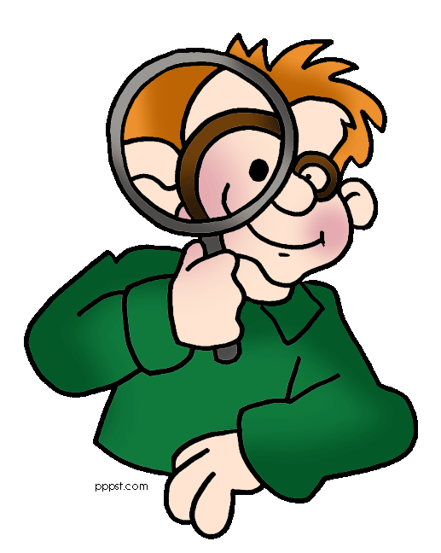

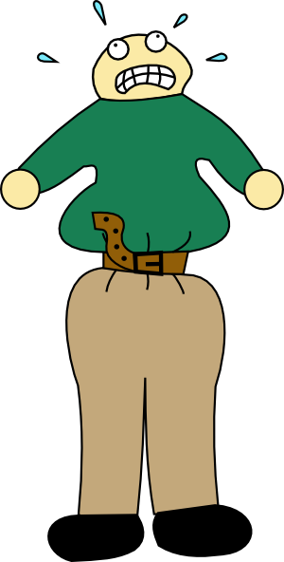

right
sight
light
night
tight

Slide 6
light

Slide 7
night

Slide 8
sight

Slide 9
right

Slide 10
tight

Slide 11
Is it light at night?

Slide 12
They had a fight.

Slide 13
We can all sleep tonight.

