Slide 1
Phonics Workshop
October 2019

Slide 2
Phonics at Archbishop Courtenay
We use letters and sounds.
Fluent readers by the end of KS1.
Building reading and writing skills.

Slide 3
Terminology
Phoneme- the sound a letter makes https://www.youtube.com/watch?v=BqhXUW_v-1s
Graphemes- the written letter
Segmenting- ‘chopping up’ the word to spell it
Blending- putting sounds together to read a word
Digraph – 2 graphemes together that make 1 sound
Trigraph – 3 graphemes together that make a sound
Split digraph – a vowel sound that has been split (‘magic e’)

Slide 4
A phonics lesson:
Revisit/review | Practice phonemes learnt so far. (flashcards)
Teach | Teach new phoneme.
Practice | Play a game to practice blending/segmenting.
Apply | Read/write captions. Learn tricky words.

Slide 5
Phase 1
Introduced in nursery and continued throughout school.
It involves rhyme, rhythm and oral blending.
Skills developed by sharing nursery rhymes, and rhyming games.
Oral blending and segmenting

Slide 6
Phase 2
Set 1: s, a, t, p
Set 2: i, n, m, d
Set 3: g, o, c, k
Set 4: ck, e, u, r
Set 5: h, b, f, ff, l, ll, ss
Tricky words: I, the, to, no, go

Slide 7
Phase 3
Set 6: j, v, w, x
Set 7: y, z, zz, qu
Consonant digraphs: ch, sh, th, ng
Vowel digraphs: ai, ee, igh, oa, oo, ar, or, ur, ow, oi, ear, air, ure, er
Tricky words: he, she, we, me, be, was, my, you, her, they, all, are

Slide 8
Phase 4
CVC to CVCC words eg. From ten to tent
This phase consolidates all the children have learnt in the previous phases.

Slide 9
Phase 5
Children will be taught new graphemes and alternative pronunciations for these graphemes.
Vowel digraphs: wh, ph, ay, ou, ie, ea, oy, ir, ue, aw, ew, oe, au
Split digraphs: a_e, e_e, i_e, o_e, u_e

Slide 10
Phase 6
The focus is on learning spelling rules for suffixes.
-s -es -ing -ed
-er -est -y -en
-ful -ly -ment -ness

Slide 11
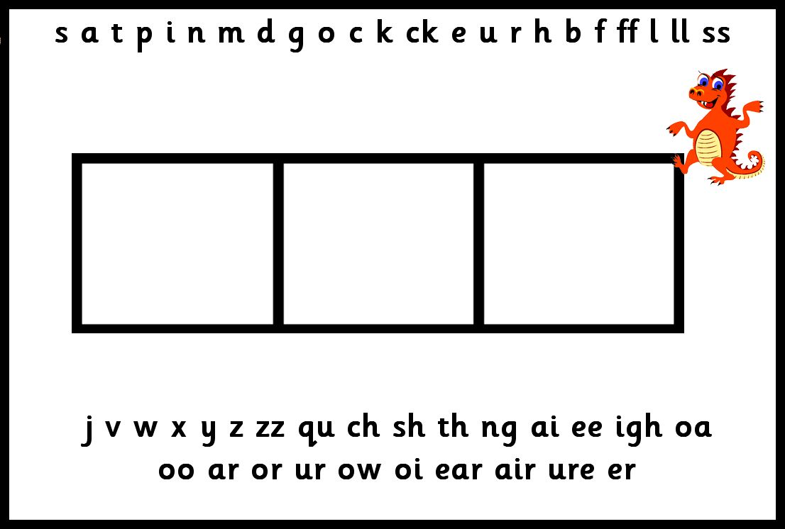
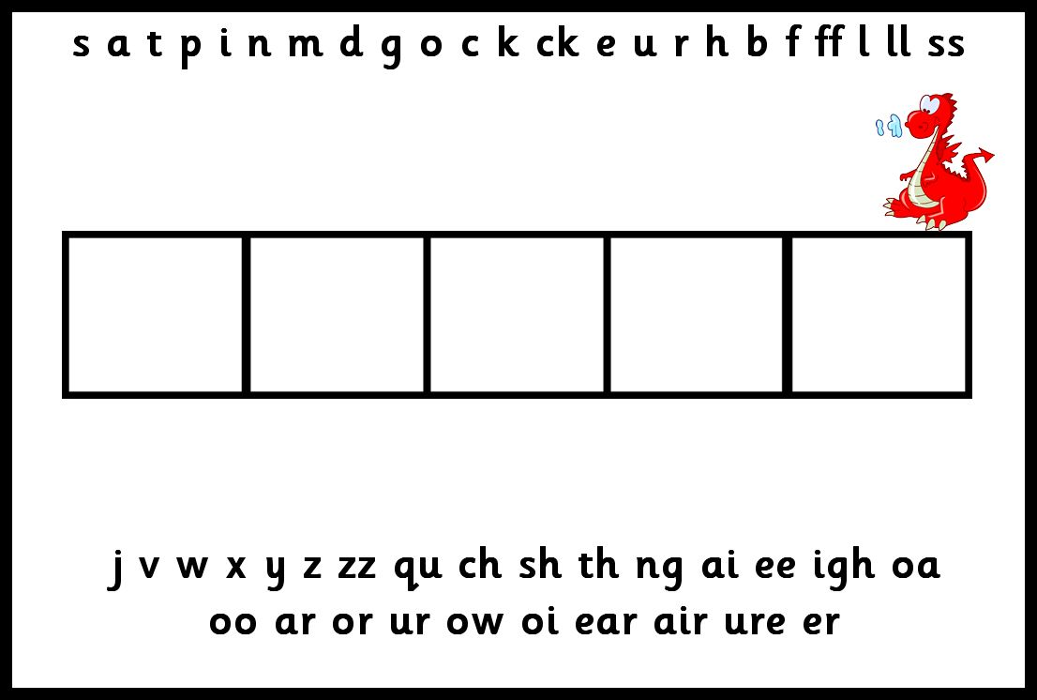
Segmenting
We use a phoneme frame to help children work out how many sounds there are in words

Slide 12
Blending
Building words from phonemes to read.
c a t
cat

Slide 13

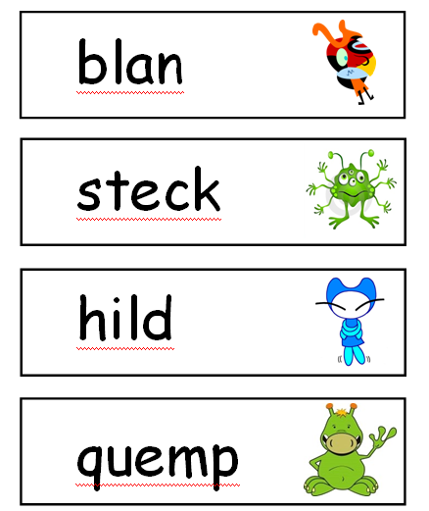
Phonics screening

Slide 14
HOW CAN I HELP?
Play ‘I-spy’
Use the action words to play games
Play phonic games
Continue to share books with your child each night and encourage them to;
Sound out simple words
Re-read to check it makes sense.
Use pictures for clues.
Ask questions about the book.
Phonic flashcards

Slide 15
Useful Phonics Websites for Parents
http://www.letters-and-sounds.com/
printable resources for each of the Letters and Sounds phonic phases, also links to games aligned with each phase.
http://www.oxfordowl.co.uk/question/index/3
lots of information and guidance for parents/carers
http://www.phonicsplay.co.uk/ParentsMenu.htm
a selection of interactive games for all phonic phases. Mostly simple games.
www.ictgames.com/literacy.html
a great selection of games that link well with games in Letters and Sounds.
https://www.bbc.co.uk/cbeebies/grownups/the-alphablocks-guide-to-phonics
Interactive videos and detailed guide to teaching children phonics at home.
http://www.bigbrownbear.co.uk/magneticletters/
Make any words with this useful game.
http://www.bbc.co.uk/schools/wordsandpictures/index.shtml
Activities for all phases

Slide 16

Thank you
Are there any questions?

