Slide 2
To the Teacher
These activities require no preparation, but children will need writing equipment for some activities.
Success Criteria
Slides are editable as for some of the activities you may wish to change the wording. For example, depending upon whether parents are involved or children are working independently, if you wish an activity to be a talk activity or you would prefer children to record their answers.

Slide 3
Select an Activity
wordsearch
write a sentence about a photo
read the sentence and draw a picture
can you read the words?
can you help Pirate Pete?
can you spot the words?
read the words
roll the dice and read the words
can you find the missing letters?
unscramble the letters
match the picture to the sentence
write a sentence about a picture
add the -est or -y
can you read the sentence?
can you read the words?

Slide 4
Select an Activity 2
can you help Pirate Pete?
read the words
roll the dice and read the words
can you find the missing letters?
unscramble the letters
match a word to the sentence
write a sentence about a picture
change the words to –ment and -ness
‘wa’ and ‘qua’ missing letters
read the words that have ‘s’
can you read the ‘ful’ words
roll the dice ‘tion’ words
match the homophones
add the ‘dis’ to these words

Slide 5
Can you find the words using a ‘y’ to say /igh/?
Select another activity
Can you hunt the words in this word search? How many can you find?
Write them on your whiteboard. They will only be down and across.
c | r | r | h | l |  |  |  | k | b | k | m
e | l | i | a | l | t | z | v | i | q | k | m
a |  | c | t | e | f | c |  |  |  | r | y
u |  | c | r | r | h | i | q | y | j |  | m
g |  | y | w | e | u | m | r | i | j |  | r
h |  | u | l | j | y |  |  |  | q |  | m
i |  | t | d | e | l | g | h | l | j | h | m
e | k |  |  |  | a | g | a | o | j | f | j
h | l | n | d | w | m | n | h | i | p | k | m
l | r | t | w | l | o | n | t |  |  |  | t
o | b | q | d | r | b | k |  |  | j | j | m
q | u | j | d | e | o | g | p | t | j | k | m
f l y
reply
s l y
by
fly
sky
Oops, Try Again.
try
sly
t r y
dry
spy
d r y
sky
reply
s p y
b y

Slide 6
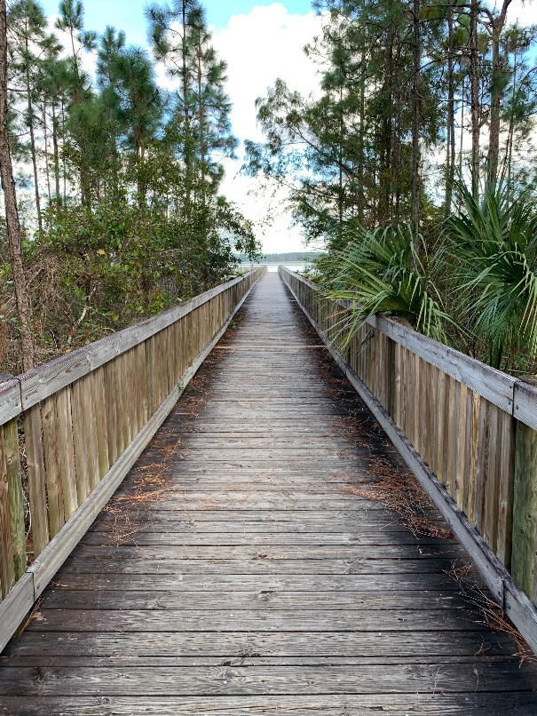
Can you write a sentence about this picture?
Select another activity
Can you write a sentence using words that use ‘dge’ and ‘ge’ to say /j/?
You could use some of these words:
edge
hedge
bridge
large
challenge

Slide 7
Can you read the sentences and draw pictures?
Select another activity
The gnome wanted to design a sign.
The angry wolf started to gnash his teeth as an annoying gnat flew past him.

Slide 8
Can you read the words?
Select another activity
flies
fly
cry
spies
cries
spy
teddies
babies
teddy
baby
Now change the words to add -es to words ending in ‘y’.
Remember to change the y to an i.
dry
dries

Slide 9

Can you help Pirate Pete find the treasure?
Select another activity
The real treasure has words using ‘kn’ to say /n/ on them.
The fake treasure has incorrect words.
Can you find the real treasure?
knight
nee
know
knife
knee
knowledge
knot
nife
nock
tonk
answers

Slide 10
Can you spot the words adding ‘er’ and ‘est’ to words ending in ‘y’ in this story?
Select another activity
On your whiteboard, write down the common exception words you read, in order.
I was happier than a bug on a rug. I feel like I am the happiest I have ever been. I must be luckier than I was yesterday, after I picked a four-leaf clover. I feel like the luckiest girl in the world. It was when my friend and I were laying on the grass telling jokes. Each joke she told was funnier than the last but the final joke was the funniest.
I was happier than a bug on a rug. I feel like I am the happiest I have ever been. I must be luckier than I was yesterday, after I picked a four-leaf clover. I feel like the luckiest girl in the world. It was when my friend and I were laying on the grass telling jokes. Each joke she told was funnier than the last but the final joke was the funniest.

Slide 11
Can you read the words that have ‘el’ to say /l/?
Select another activity
camels
travel
squirrel
funnel
Now write some sentences using the words.
I will use a funnel to fill the bottle up with liquid.
We are going to travel to France in the car this year.
A chestnut coloured squirrel sat on my shoulder at lunch today.
In Egypt they use camels as transport.

Slide 12


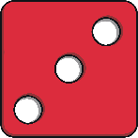
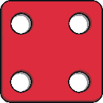
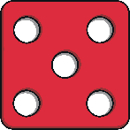
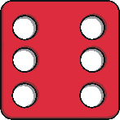
Can you roll your dice and read the words that use ‘wr’ to say /r/?
Select another activity
Roll your dice and read the words.
 | wrong | wren | wrist | wrap | write
 | wrote | wring | wreck | wrong | wren
 | wrist | wrap | write | wrote | wring
 | wreck | wrong | wren | wrist | wrap
 | write | wrote | wring | wreck | wreck
 | wrong | wren | wrist | wrap | write

Slide 13
Can you add ‘al’ or ‘il to say /l/ for these words with missing letters?
Select another activity
These words are missing a letter. See if you can work out the missing letter and write the word.
festiv_
med_
tot_
loc_
pup_
penc_
Apr_
nostr_
answers

Slide 14
Can you add ‘al’ or ‘il to say /l/ for these words with missing letters?
Select another activity
These words are missing a letter. See if you can work out the missing letter and write the word.
festival
medal
total
local
pupil
pencil
April
nostril
answers

Slide 15
Can you unscramble the letters in the words with ‘le’ to say /l/?
Select another activity
The letters have been scrambled. Can you unscramble the words and write the correct word?
bbleub
dduple
bleta
dducle
ppale
answers

Slide 16
Can you unscramble the letters in the words with ‘le’ to say /l/?
Select another activity
The letters have been scrambled. Can you unscramble the words and write the correct word?
bubble
puddle
table
cuddle
apple
answers

Slide 17
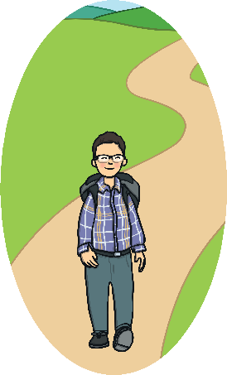
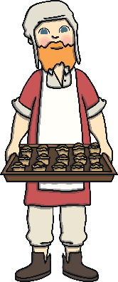


Can you match the picture to the sentence using -ed and -er to words ending in ‘e’?
Select another activity
Match the pictures to the right sentence.
1. The man at the end of the street is a great baker.
a)
b)
1. The man at the end of the street is a great baker.
2. For the last year every Sunday he has hiked up a huge mountain.
2. For the last year every Sunday he has hiked up a huge mountain.
3. It was a cold winters day, but I braved the weather and went to the shop.
3. It was a cold winters day, but I braved the weather and went to the shop.
c)
d)
4. To record how fast I could run a 100m race, I used a timer.
4. To record how fast I could run a 100m race, I used a timer.

Slide 18
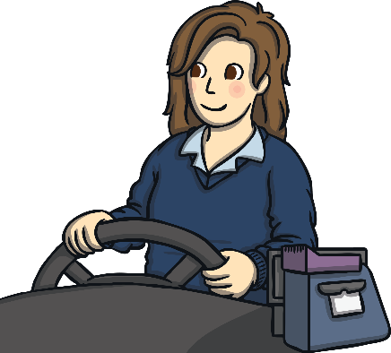

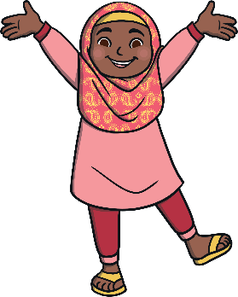
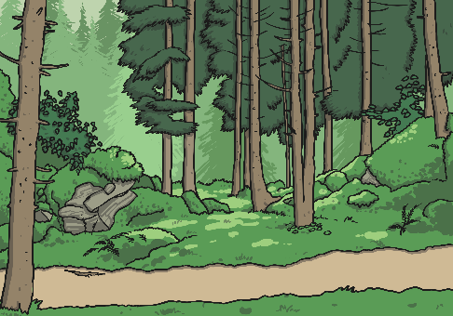
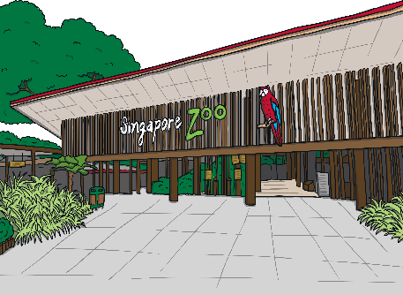
Can you write a sentence about one of these pictures?
Select another activity
Can you write a sentence using words that use ‘eer’ to say /ear/?
You could use some of these words:
steer cheer deer meerkat

Slide 19
Can you add the -est or -y to these words that end in ‘e’?
Select another activity
Can you change these words to add -est or -y? Can you think of any other words?
nice
shine
slime
large
fine
Challenge: You could have a go at putting these into a sentence.

Slide 20
Can you read the sentences and draw pictures?
Select another activity
The boy looked into the sculpture and could see the future.
Sid the Vulture went on a mysterious adventure.
The scientist has to find a way to capture the creature.

Slide 21
Can you read the words?
Select another activity
pat
hum
drop
patting and patted
humming and hummed
dropping and dropped
jog
clap
jogging and jogged
clapping and clapped
Now change the words to add -ing and -ed.

Slide 22
Can you help Pirate Pete find the treasure?
Select another activity
The real treasure has words using ‘mb’ to say /m/ on them.
The fake treasure has incorrect words.
Can you find the real treasure?
lam
numb
clim
lamb
bom
crumb
thumb
comb
bomb
answers

Slide 23
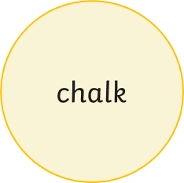
Can you read the words that have ‘al’ to say /or/?
Select another activity
call
small
almost
walk
Now write some sentences using the words.
Every Sunday night I call my mother.
We did a survey in school to record how many people walk to school.
It is almost time for dinner.
We have a new pet dog, because he is a puppy he is very small.
I drew a huge picture on the playground using chalk.

Slide 24
Can you roll your dice and read the words that use ‘o’ to say /u/?
Select another activity
Roll your dice and read the words.
 | brother | son | above | wonder | worry
 | glove | cover | month | brother | son
 | above | wonder | worry | glove | cover
 | month | brother | son | above | wonder
 | worry | glove | cover | month | brother
 | son | above | wonder | worry | cover

Slide 25
Can you add -er, -est or -y these words with missing letters?
Select another activity
These words are missing -er, -est or -y. See if you can work out the missing letters and write the word.
long_ or long_
warm_ or warm_
hott_ or hott_
cold_ or cold_
funn_
wind_
sunn_
answers

Slide 26
Can you add -er, -est or -y these words with missing letters?
Select another activity
These words are missing -er, -est or -y. See if you can work out the missing letters and write the word.
longer or longest
warmer or warmest
hotter or hottest
colder or coldest
funny
windy
sunny
answers

Slide 27
Can you unscramble the letters in the words with ‘ey’ to say /ee/?
Select another activity
The letters have been scrambled. Can you unscramble the words and write the correct word?
eyk
eymnich
eydnko
eymno
eykmon
eykurt
answers

Slide 28
Can you unscramble the letters in the words with ‘ey’ to say /ee/?
Select another activity
The letters have been scrambled. Can you unscramble the words and write the correct word?
key
chimney
donkey
money
monkey
turkey

Slide 29
Can you match the words to the sentence using the correct contractions?
Select another activity
Match the words to the right sentence.
1. I think you should’ve said sorry to your friend.
1. I think you should’ve said sorry to your friend.
a) can not
b) I will
2. I can’t believe it is Friday already.
2. I can’t believe it is Friday already.
c) should have
d) we would
3. We can carry more boxes, but that would mean we’d be slower.
3. We can carry more boxes, but that would mean we’d be slower.
4. I think I’ll burst if I don’t tell you.
4. I think I’ll burst if I don’t tell you.

Slide 30
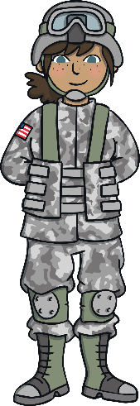

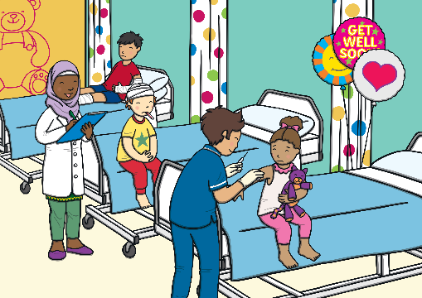
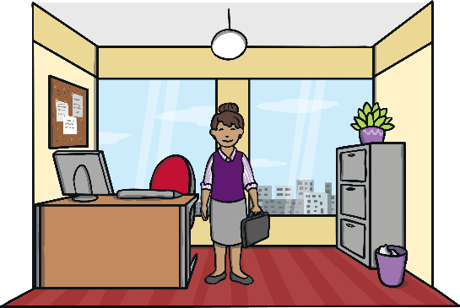
Can you write a sentence about one of these pictures?
Select another activity
Can you write a sentence using words that use ‘war’ to say /wor/ and ‘wor’ to say /wur/?
You could use some of these words:
war ward world work

Slide 31
Can you read the words?
Select another activity
enjoy
excite
enjoyment
excitement
kind
kindness
tidy
happy
tidiness
happiness
Now change the words to use -ment and -ness.

Slide 32
Can you add ‘wa’ to say /wo/ or ‘qua’ to say /quo/ for these words with missing letters?
Select another activity
These words are missing ‘wa’ to say /wo/ or ‘qua’ to say /quo/. See if you can work out the missing letters and write the word.
_nt
_lity
_tch
s_sh
_sh
s_bble
s_p
_ntity
answers

Slide 33
Can you add ‘wa’ to say /wo/ or ‘qua’ to say /quo/ for these words with missing letters?
Select another activity
These words are missing ‘wa’ to say /wo/ or ‘qua’ to say /quo/. See if you can work out the missing letters and write the word.
want
quality
watch
squash
wash
squabble
swap
quantity
answers

Slide 34
Can you read the words that have ‘s’ to say /zh/?
Select another activity
usual
treasure
measure
visual
Asia
Now write some sentences using the words.
I have a fantastic visual memory.
It is quite usual for people to wear fancy hats at wedding.
Pirate Joe loved to find lots of treasure on undiscovered islands.
What can I use to measure how long it is?

Slide 35
Can you read the words?
Select another activity
grace
graceful
wonder
wonderful
breath
breathless
happy
happily
lucky
luckily
Now change the words to add -ful, -less or -ly.

Slide 36
Can you roll your dice and read the words that use ‘tion’ to say /shun/?
Select another activity
Roll your dice and read the words.
 | action | motion | description | station | section
 | adoption | portion | fiction | action | motion
 | description | station | section | adoption | portion
 | fiction | action | motion | description | station
 | section | adoption | portion | fiction | action
 | motion | description | station | section | adoption

Slide 37
Can you match the homophones and near homophones?
Select another activity
Read the words below and match the pairs together.
hear
bare
there
quiet
bear
here
quite
their
Have a go at writing a sentence using each word.
answers

Slide 38
Can you add the dis- to these words?
Select another activity
Can you change these words to add dis-? Can you think of any other words?
like
appear
agree
connected
obey
Challenge: You could have a go at putting these into a sentence

