Slide 1


M1b: Can read, write and order numbers up to 3 decimal places
Commissioned by The PiXL Club Ltd.
July 2018
This resource is strictly for the use of member schools for as long as they remain members of The PiXL Club. It may not be copied, sold nor transferred to a third party or used by the school after membership ceases. Until such time it may be freely used within the member school.
All opinions and contributions are those of the authors. The contents of this resource are not connected with nor endorsed by any other company, organisation or institution.
PiXL Club Ltd endeavour to trace and contact copyright owners. If there are any inadvertent omissions or errors in the acknowledgements or usage, this is unintended and PiXL will remedy these on written notification
© Copyright The PiXL Club Limited, 2018

Slide 2
Vocabulary:
Reading, writing and ordering numbers
decimal
decimal point
compare
ascending
descending
Teacher’s Note:
See ‘Vocabulary Shorts’ resource below for ideas and games to develop and embed vocabulary.
Vocabulary Shorts
Notes:
To locate Vocabulary Shorts resource click on:
Currency
Whole School Materials
English
Writing
PiXL Vocabulary
Vocabulary Shorts PP

Slide 3
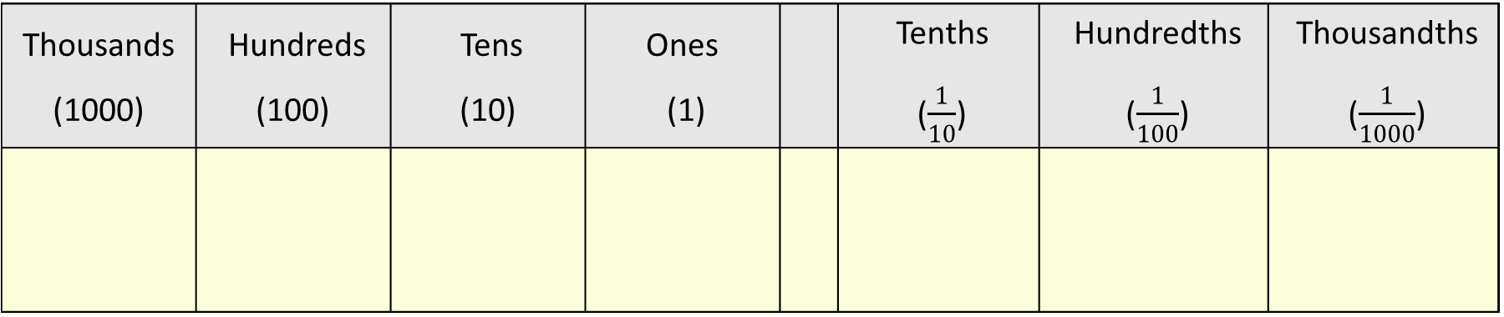
Reading and writing decimals
Can read, write and order numbers up to 3 decimal places
You should be able to read and write decimal numbers with up to 3 places.
Remember: When working with decimals, it is very important that you know and understand the place value of numbers.
Thousands (1000) | Hundreds (100) | Tens (10) | Ones (1) |  | Tenths ($\frac{1}{10}$) | Hundredths ($\frac{1}{100}$) | Thousandths ($\frac{1}{1000}$)

Slide 4
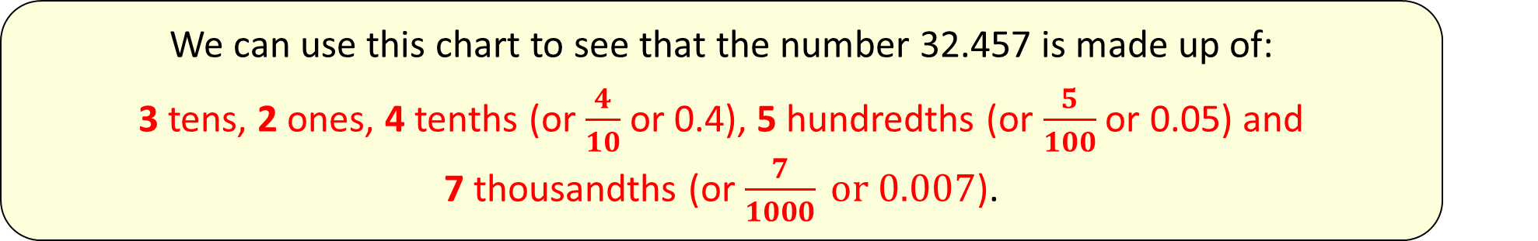
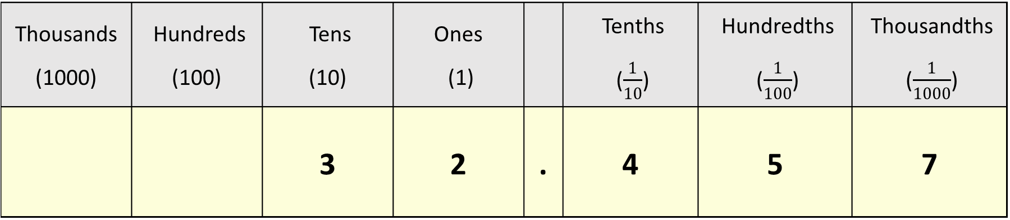
Can read, write and order numbers up to 3 decimal places
We can use this chart to see that the number 32.457 is made up of:
3 tens, 2 ones, 4 tenths (or $\frac{4}{10}$ or 0.4), 5 hundredths (or $\frac{5}{100}$ or 0.05) and 7 thousandths (or $\frac{7}{1000} or 0.007$).
Thousands (1000) | Hundreds (100) | Tens (10) | Ones (1) |  | Tenths ($\frac{1}{10}$) | Hundredths ($\frac{1}{100}$) | Thousandths ($\frac{1}{1000}$)
 |  | 3 | 2 | . | 4 | 5 | 7
This number is read or written in words as thirty two point four five seven.

Slide 5

Reading and writing decimals
Can read, write and order numbers up to 3 decimal places
We are sometimes given decimal numbers written in words and we have to read, understand the number and write it in figures.
Read
21.098
This number is read or written in words as twenty one point zero nine eight.

Slide 6

Can read, write and order numbers up to 3 decimal places
Reading and writing decimals
Your turn
Write the following numbers in figures:
sixty two point three six five
thirty point two zero eight
eighty eight point two zero seven

Slide 7
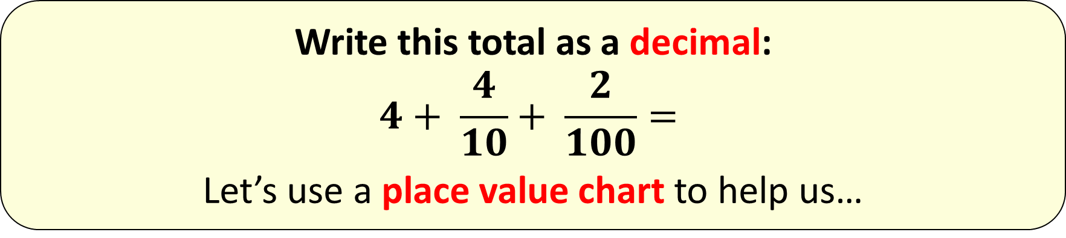
Reading and writing decimals
Can read, write and order numbers up to 3 decimal places
We will sometimes be asked questions to show that we understand place value. Let’s look at an example:
Write this total as a decimal:
$$4+ \frac{4}{10}+ \frac{2}{100}=$$
Let’s use a place value chart to help us…

Slide 8
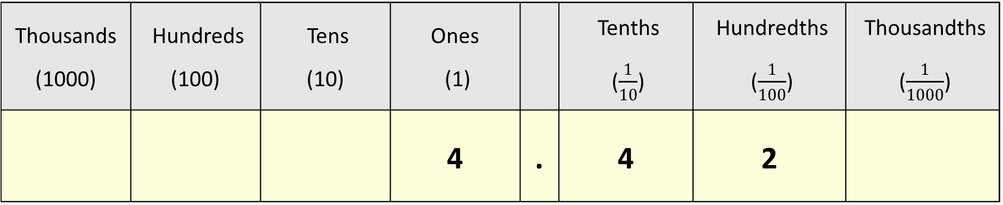
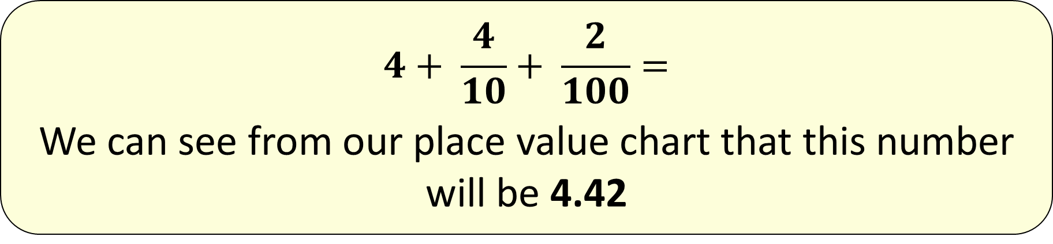
Can read, write and order numbers up to 3 decimal places
$$4+ \frac{4}{10}+ \frac{2}{100}=$$
We can see from our place value chart that this number will be 4.42
Thousands (1000) | Hundreds (100) | Tens (10) | Ones (1) |  | Tenths ($\frac{1}{10}$) | Hundredths ($\frac{1}{100}$) | Thousandths ($\frac{1}{1000}$)
 |  |  | 4 | . | 4 | 2

Slide 9
Reading and writing decimals
Can read, write and order numbers up to 3 decimal places
Write a number in the box to make this correct:
7.645 = 7 + 0.6 + □ + 0.005
We know that the number 7.645 is 7 ones, 6 tenths,
4 hundredths and 5 thousandths or:
7.645 = 7 + 0.6 + 0.04 + 0.005
Therefore the missing number is 0.04.

Slide 10
Your turn
Can read, write and order numbers up to 3 decimal places
Write a number in the box to make these correct:
2.136 = 2 + 0.1 + □ + 0.006
4.25 = 4 + 0.2 + □
5.555 = 5 + □ + 0.05 = 0.005

Slide 11
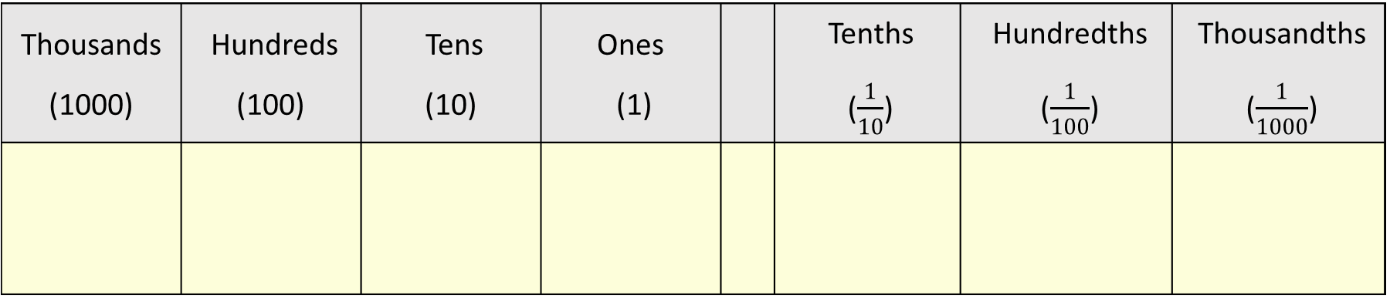
Ordering decimals
Can read, write and order numbers up to 3 decimal places
We can also use our place value chart to help us order decimals...
Thousands (1000) | Hundreds (100) | Tens (10) | Ones (1) |  | Tenths ($\frac{1}{10}$) | Hundredths ($\frac{1}{100}$) | Thousandths ($\frac{1}{1000}$)
Notes:
Not needed

Slide 12
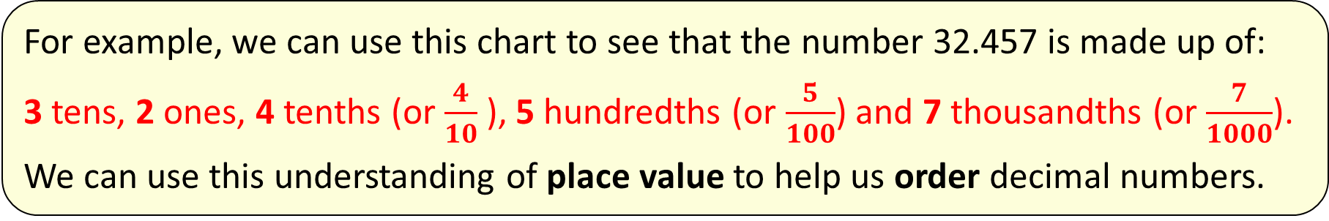
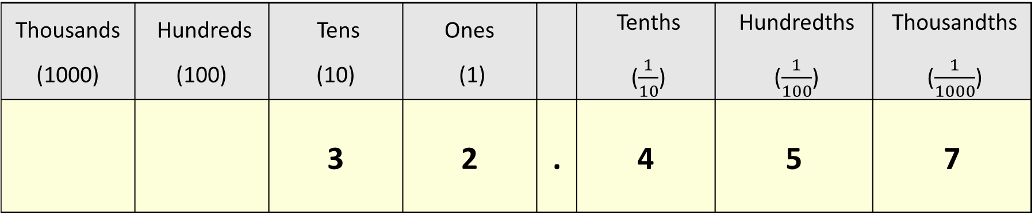
Ordering decimals
Can read, write and order numbers up to 3 decimal places
For example, we can use this chart to see that the number 32.457 is made up of:
3 tens, 2 ones, 4 tenths (or $\frac{4}{10}$ ), 5 hundredths (or $\frac{5}{100}$) and 7 thousandths (or $\frac{7}{1000}$).
We can use this understanding of place value to help us order decimal numbers.
Thousands (1000) | Hundreds (100) | Tens (10) | Ones (1) |  | Tenths ($\frac{1}{10}$) | Hundredths ($\frac{1}{100}$) | Thousandths ($\frac{1}{1000}$)
 |  | 3 | 2 | . | 4 | 5 | 7

Slide 13
Ordering decimals
Can read, write and order numbers up to 3 decimal places
Put these numbers in order from smallest to largest:
5.51 3.75 7.35 5.73 3.77
Let’s work on this question together…

Slide 14
Ordering decimals
Can read, write and order numbers up to 3 decimal places
Put these numbers in order from smallest to largest:
5.51 3.75 7.35 5.73 3.77
To answer this question, let’s start by looking at the ones. There are two numbers which have the smallest number of ones: 3.75 and 3.77
Let’s first look at 3.75:
3.77 also has 3 ones and 7 tenths but has 7 hundredths.
Therefore 3.75 is smaller than 3.77
3.75
5 hundredths
7 tenths
3 ones

Slide 15
Ordering decimals
Can read, write and order numbers up to 3 decimal places
Put these numbers in order from smallest to largest:
5.51 3.75 7.35 5.73 3.77
If we now compare 5.51 and 5.73 in the same way, we can immediately see that 5.51 is smaller. Both numbers have 5 ones but 5.51 has 5 tenths and 5.73 has 7 tenths. Therefore, 5.51 is smaller.
The decimal numbers in order from smallest to largest will be:
3.75 3.77 5.51 5.73 7.35

Slide 16
Your turn
Can read, write and order numbers up to 3 decimal places
Put these decimal numbers in order from smallest to largest:
4.28 4.23 4.26 4.19
7.21 5.02 2.10 3.67 2.01
Put these decimal numbers in order from largest to smallest:
2.01 0.99 2.10 3.09 0.93
5.21 7.98 5.11 7.89 6.09

Slide 17
Ordering decimals
Can read, write and order numbers up to 3 decimal places
Hint
When you are comparing decimals with tenths and hundredths such as in this question, it may be easier to think of them in terms of money.
When answering questions such as this, make sure your final list has all the numbers and none have been left out.

Slide 18
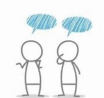
Reasoning
Tell me a number that lies between 3.12 and 3.13. Which number is it closer to?
How do you know?

Slide 19
Ordering decimals
Can read, write and order numbers up to 3 decimal places
Let’s now try to order decimal numbers which include thousandths digits.
Put the numbers below in order from largest to smallest:
7.6 7.675 7.67 7.556 6.776
Let’s work on this question together.
To order these decimals, let’s first put them all in the correct column in the place value table…
Notes:
.

Slide 20
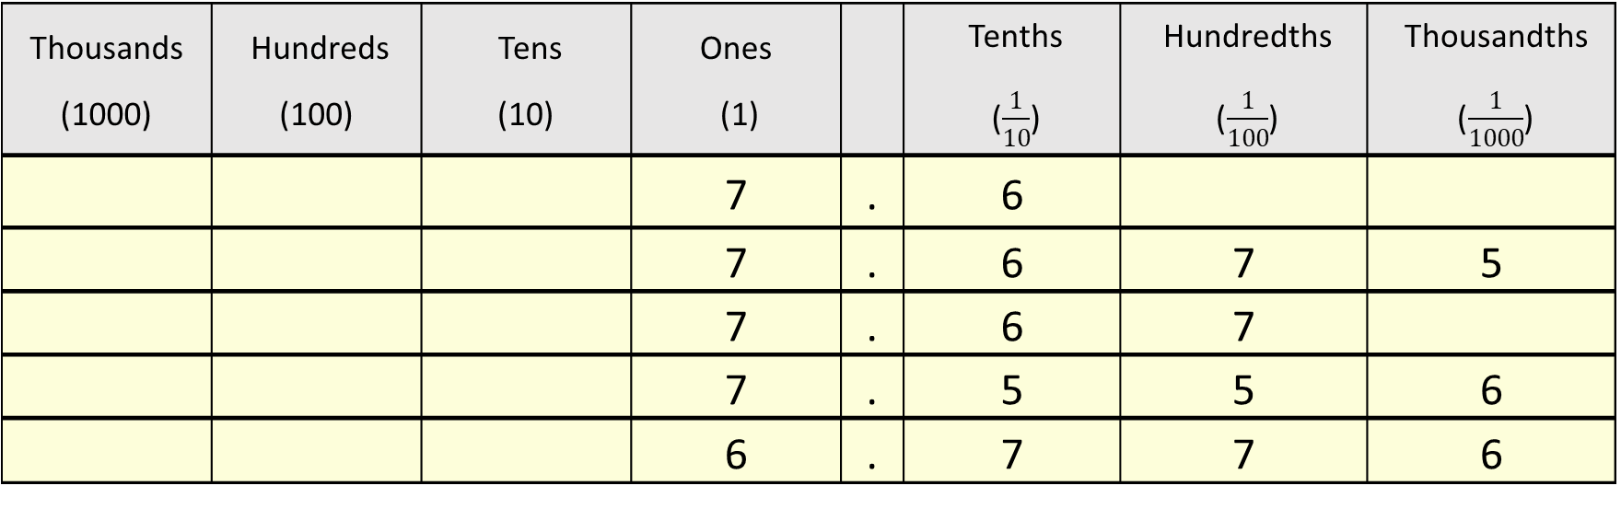
First, let’s put all the numbers into the correct column on our place value chart.
7.6 7.675 7.67 7.556 6.776
Writing them in the correct columns will help us compare the size of the numbers.
Thousands (1000) | Hundreds (100) | Tens (10) | Ones (1) |  | Tenths ($\frac{1}{10}$) | Hundredths ($\frac{1}{100}$) | Thousandths ($\frac{1}{1000}$)
 |  |  | 7 | . | 6
 |  |  | 7 | . | 6 | 7 | 5
 |  |  | 7 | . | 6 | 7
 |  |  | 7 | . | 5 | 5 | 6
 |  |  | 6 | . | 7 | 7 | 6
Now we are ready to put them in order…

Slide 21
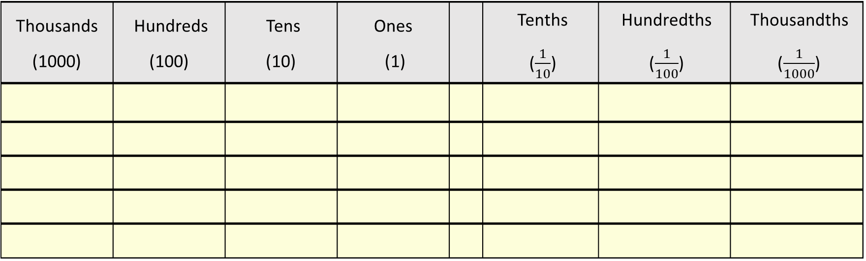
Put the numbers below in order from largest to smallest:
7.6 7.675 7.67 7.556 6.776
Remember, the question asks us to order from largest to smallest. Sometimes, it is easier to start with the smallest numbers and then write the numbers in reverse. So, starting with comparing the ones, it is clear that 6.776 will be the smallest number as that is the only number which hasn’t got 7 ones. We know therefore that 6.776 will come last on our list.
Thousands (1000) | Hundreds (100) | Tens (10) | Ones (1) |  | Tenths ($\frac{1}{10}$) | Hundredths ($\frac{1}{100}$) | Thousandths ($\frac{1}{1000}$)
6
.
7
7
6

Slide 22
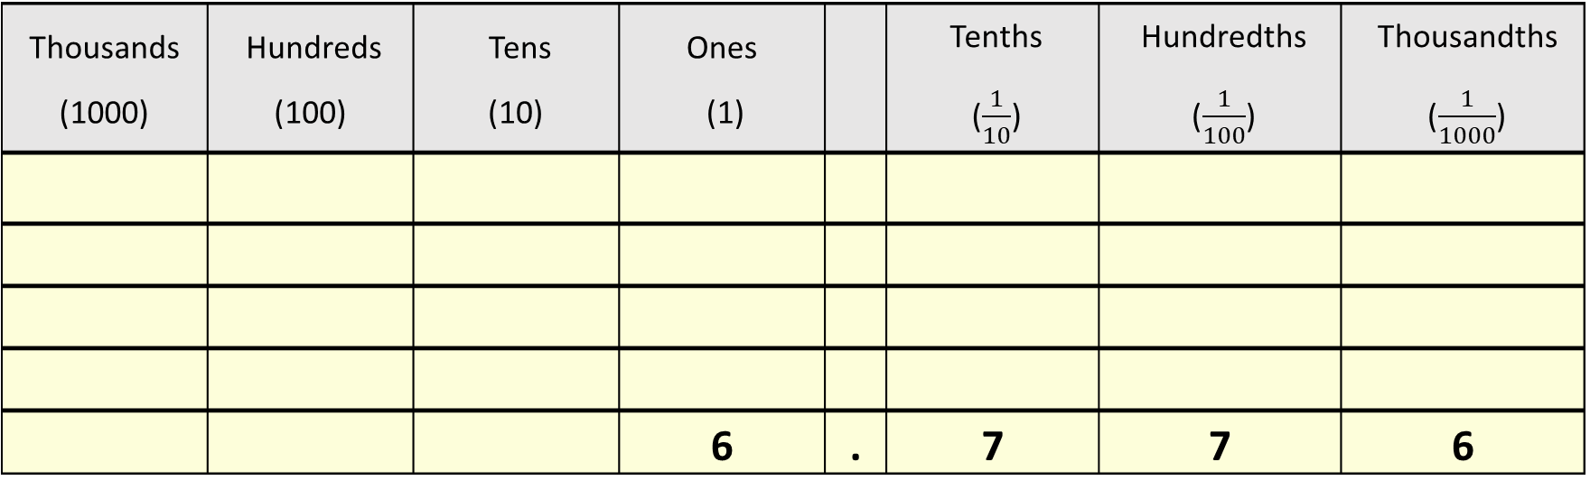
Put the numbers below in order from largest to smallest:
7.6 7.675 7.67 7.556 6.776
To find the largest of the remaining numbers, let’s first look down the tenths column. The top three numbers have 6 in the tenths column but 7.556 only has 5 in the tenths column. Therefore, 7.556 is smaller and will be the next smallest number on our list.
Thousands (1000) | Hundreds (100) | Tens (10) | Ones (1) |  | Tenths ($\frac{1}{10}$) | Hundredths ($\frac{1}{100}$) | Thousandths ($\frac{1}{1000}$)
 |  |  | 6 | . | 7 | 7 | 6
7
.
5
5
6

Slide 23
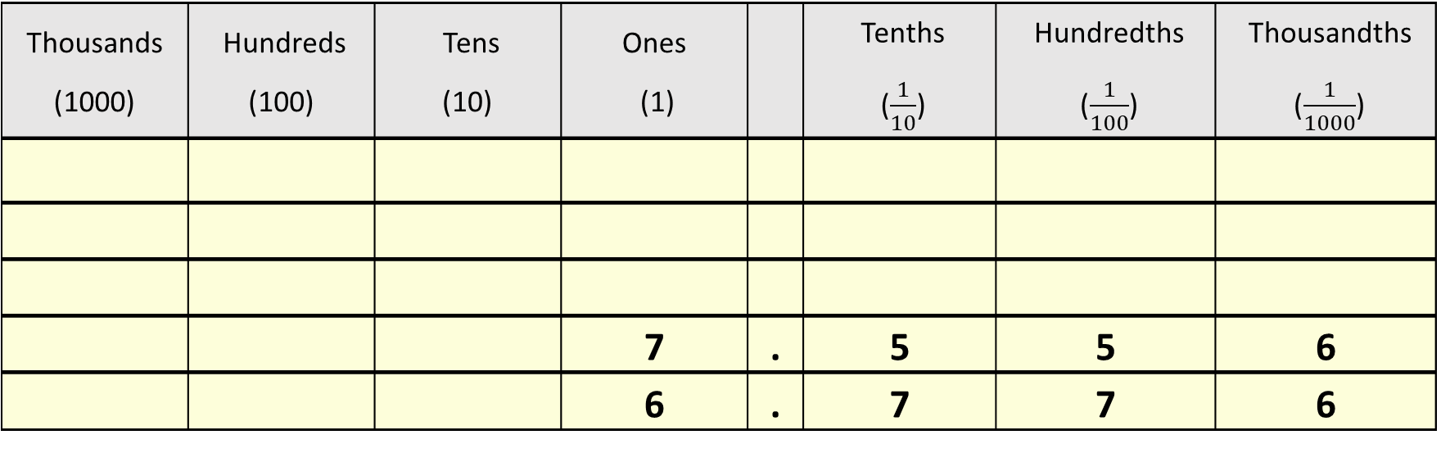
Put the numbers below in order from largest to smallest:
7.6 7.675 7.67 7.556 6.776
We now need to compare the remaining numbers: 7.6, 7.675 and 7.67
We have already seen that the three numbers have 7 ones and 6 tenths. We therefore now need to look at the hundredths column. 7.675 and 7.67 both have 7 in the hundredths column but 7.6 has nothing in the hundredths column. In other words, 7.6 has 0 hundredths and is smaller than 7.675 and 7.67.
Thousands (1000) | Hundreds (100) | Tens (10) | Ones (1) |  | Tenths ($\frac{1}{10}$) | Hundredths ($\frac{1}{100}$) | Thousandths ($\frac{1}{1000}$)
 |  |  | 7 | . | 5 | 5 | 6
 |  |  | 6 | . | 7 | 7 | 6
7
.
6

Slide 24
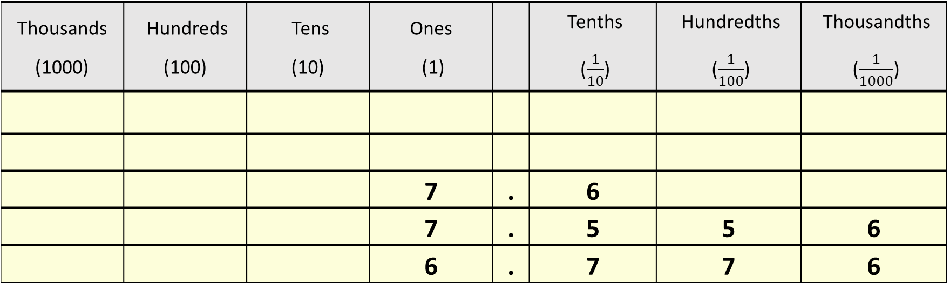
Put the numbers below in order from largest to smallest:
7.6 7.675 7.67 7.556 6.776
Lastly, if we compare 7.675 and 7.67, we can see that 7.675 is larger because 7.675 has 5 thousandths but 7.67 has 0 thousandths.
Thousands (1000) | Hundreds (100) | Tens (10) | Ones (1) |  | Tenths ($\frac{1}{10}$) | Hundredths ($\frac{1}{100}$) | Thousandths ($\frac{1}{1000}$)
 |  |  | 7 | . | 6
 |  |  | 7 | . | 5 | 5 | 6
 |  |  | 6 | . | 7 | 7 | 6
7
.
6
7
5
7
.
6
7

Slide 25
Can read, write and order numbers up to 3 decimal places
The list of decimals in order from largest to smallest is:
7.675 7.67 7.6 7.556 6.776
Another method is to write each of the numbers out with the same number of decimal places to show that there is nothing in these place value columns:
7.675 7.670 7.600 7.556 6.776
(You may find it easier to write the list from smallest to largest first and then reverse the order of the numbers.)

Slide 26
Your turn
Can read, write and order numbers up to 3 decimal places
Put these decimal numbers in order from smallest to largest:
3.867 3.857 2.604 1.989
0.89 1.099 0.829 1.09
Put these decimal numbers in order from largest to smallest:
0.076 0.70 0.607 0.067
9.80 8.901 0.18 8.109

Slide 27
Problem solving
Kyle runs the 200m in 25.7 seconds.
Harry runs 12 seconds slower than Kyle.
What time did Harry run the 200m in?

Slide 28
Problem solving
Ben completed the 100m sprint in 17.58 seconds.
Levi completed it in 17.409 seconds.
Robert completed it in 17.582 seconds.
Who came first, second and third?

