Slide 1


.
Writing
Y5 W4c. Uses own planning strategies to compose and rehearse whole texts before writing
Commissioned by The PiXL Club Ltd.
October 2019
This resource is strictly for the use of member schools for as long as they remain members of The PiXL Club. It may not be copied, sold nor transferred to a third party or used by the school after membership ceases. Until such time it may be freely used within the member school.
All opinions and contributions are those of the authors. The contents of this resource are not connected with nor endorsed by any other company, organisation or institution.
PiXL Club Ltd endeavour to trace and contact copyright owners. If there are any inadvertent omissions or errors in the acknowledgements or usage, this is unintended and PiXL will remedy these on written notification.
© Copyright The PiXL Club Limited, 2019

Slide 2
Teachers’ Notes
The PiXL therapies can be taught to a whole class or a target group. Each therapy is editable so that it can be adapted or extended.
Each therapy begins with a LORIC activity to develop relevant character attributes.
This is followed by a vocabulary task, which uses the PiXL 5-phase approach to teach key vocabulary. Further resources to develop vocabulary can be found in the Whole School area under the PiXL Unlock strategy.
Each therapy adopts the ‘Teach, model and apply’ process with plenty of opportunities for pupils to demonstrate the taught skill.
A range of question types is included to promote pupils’ developing security by testing the same skill in different ways.

Slide 3
Progress across amber – the 4-stage model
The three therapy tests which accompany this resource can be used to revisit the taught skill to check that the pupil is able to perform it independently and consistently.
A
A child has successfully completed a therapy test independently, following a set of therapy sessions.
A child has successfully completed a therapy test independently, a period after the relevant therapy sessions – we would advise about 2 weeks.
A child has successfully applied their knowledge or skill in an unfamiliar context. This may be application across the curriculum or in a problem.
A pupil has successfully re-visited the skills at a later point, and applies these in an unfamiliar context or problem, or across the curriculum.
A
DA
G

Slide 4

LORIC Task
Our Primary Edge attributes help us to become better learners and today is no exception. Before you start this activity, here are some ideas for how you will need your Ollie Organisation skills today:
Breaking information down into organised steps
Following a plan
Reaching the conclusion
Command Words: organise plan
prepare

Slide 5


With a partner, plan the sequence of instructions that you would need to teach an alien to do a forward roll. Remember to break the information down into small steps until you have reached the conclusion of the process. Then, join with another pair and give them your instructions to see if they can complete the task correctly.
LORIC Task
Were your instructions broken down into small, clear steps?

Slide 6
Read it:
compose
Define it
Use it
Link it
synonym:
Deconstruct it
Vocabulary activity

Slide 7
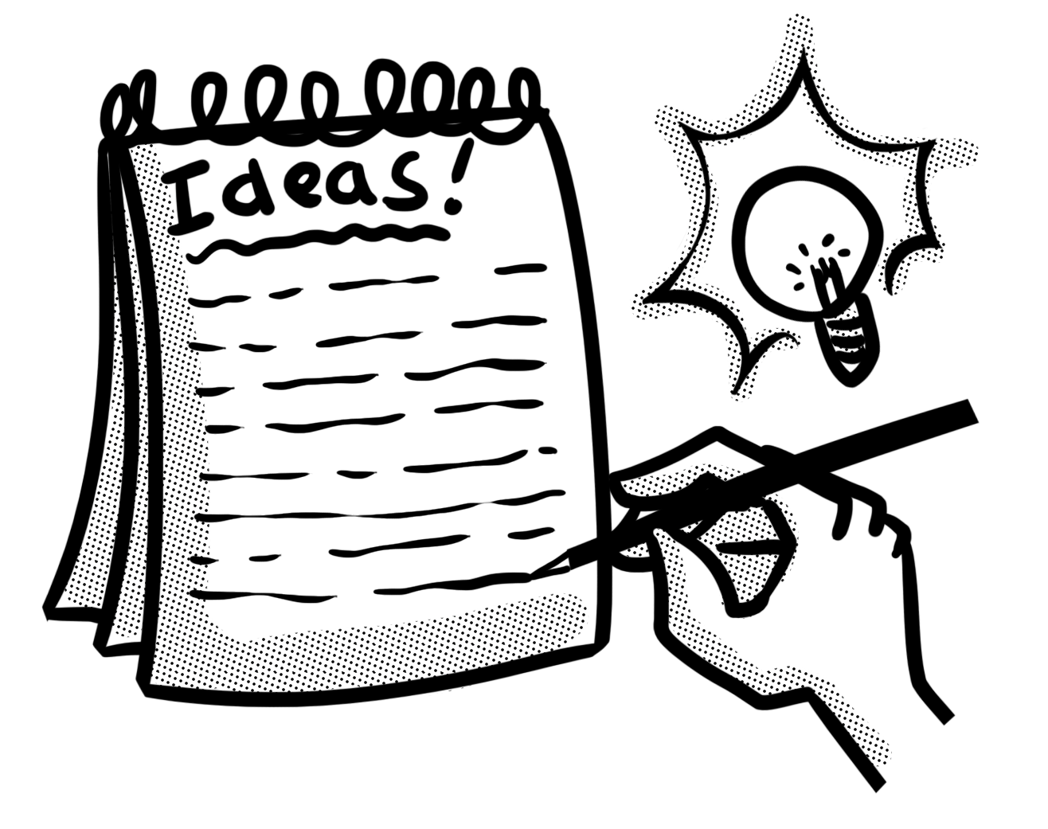
Planning is essential
When we compose texts, we need to organise our ideas into a plan so that our writing flows cohesively for the reader.
There are many different ways of planning texts. Which one we choose will depend upon the purpose or genre of our writing but the essential elements to include are the beginning, middle, end and any key points or sections it will contain. Once we have a plan, we can use it to rehearse our text before we write. We can also refer to it as we write to make sure that we include everything and reach the conclusion.

Slide 8
The sections of a plan
Although there are a variety of different planning formats that we can use, our plan should enable us to prepare each paragraph of our writing. Sometimes, planning frames are organised vertically so that we can follow our ideas down – this can be particularly useful if our writing can be ordered chronologically e.g. a recount, instructions or a story. Sometimes, planning frames allow us to gather similar information together so that we can decide on the order when we come to write e.g. non-chronological reports.

Slide 9
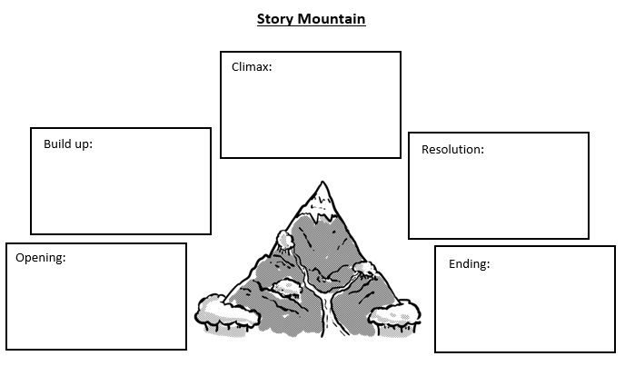
Planning frames
Story mountains can be useful to help us organise narrative texts so that we remember that the action should build to a climax. They can also help us to plan a strong conclusion.

Slide 10
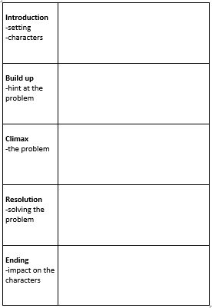
Planning frames
Some of us prefer to use a similar idea to a story mountain but in a vertical format. It can still help to organise a narrative into paragraphs which build to the climax and reach a conclusion.

Slide 11
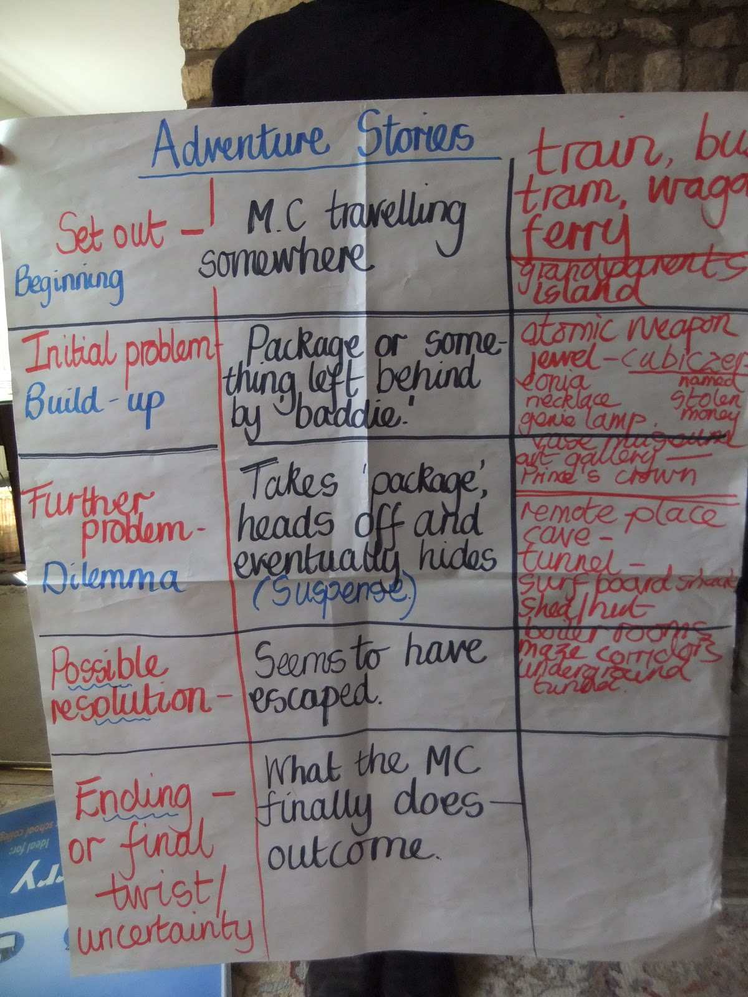
Planning frames
A ‘boxing up’ plan is another popular form of planning which allows us to match our ideas to a text that we have been using as a model.

Slide 12
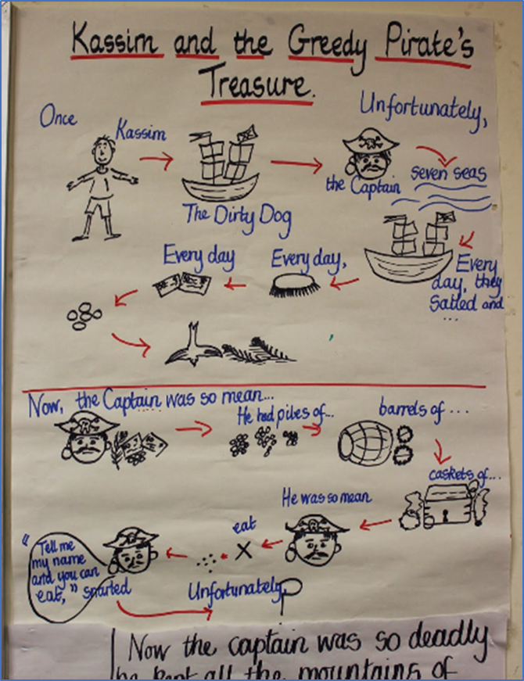
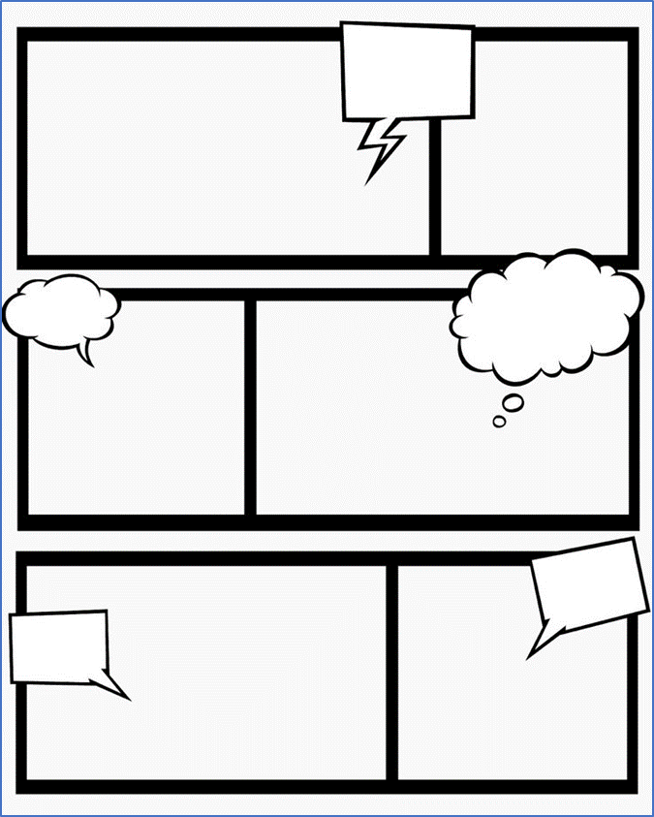
Planning frames
If we are more visual, a story map or a cartoon strip with briefly drawn illustrations and key words can also help to organise events and ideas.

Slide 13
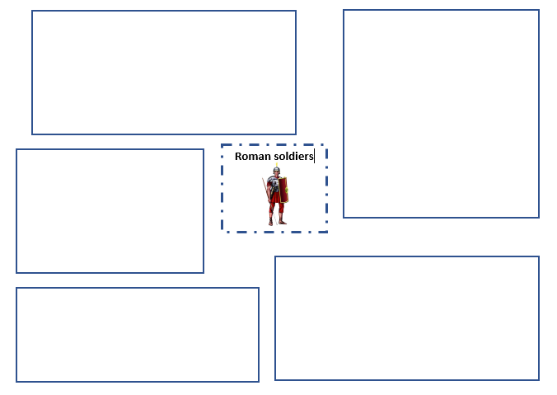
Planning frames
This type of planning frame is useful for texts where similar information needs to be gathered together ahead of writing. We can think about the most logical order for our paragraphs once we have all the ideas.

Slide 14
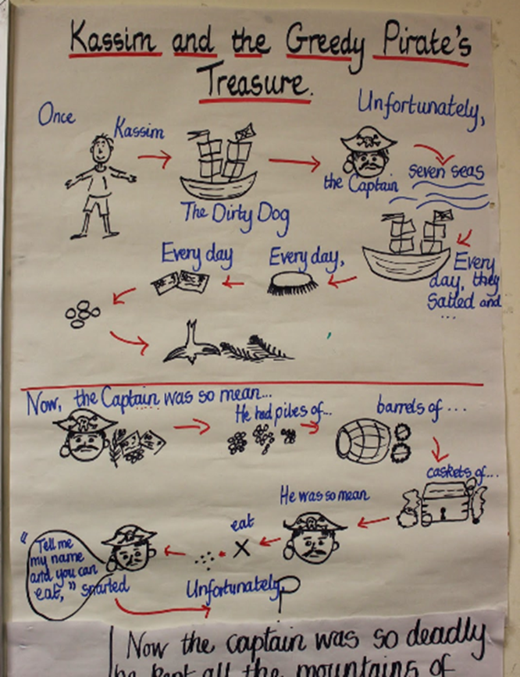
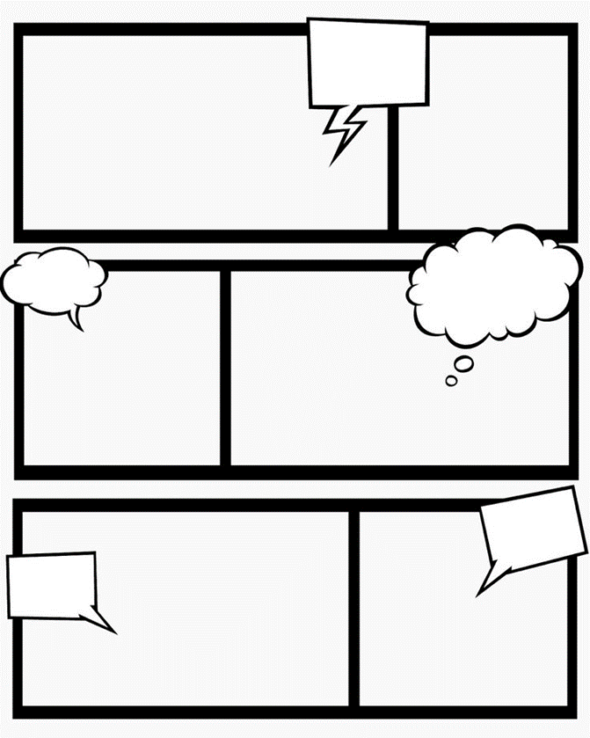
Practise
Imagine that your teacher has asked you to write a short piece of writing to describe a setting using the senses. Which planning frame would you choose and why?

Slide 15
How did you do? (Here is an example)
I would choose this planning frame so that I can gather all my ideas and language relating to each sense in a different box. Then, I will consider how to organise those ideas before I write the paragraph.

Slide 16
Practise
Imagine that your teacher has given you a story starter and asked you to continue the narrative. Which planning frame would you choose and why?

Slide 17
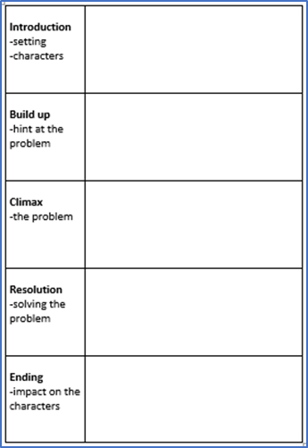
How did you do? (Here is an example)
I would choose either of these planning frames so that I can put the story starter that I have been given into the first box and then consider how my narrative will build to a climax. These frames will help me to structure my ideas so that they reach a conclusion.

Slide 18
Practise
Imagine that you have been using a model persuasive text in your class and then your teacher asks you to plan your own version. Which planning frame would you choose? Why?

Slide 19
How did you do? (Here is an example)
I would choose to ‘box up’ my ideas because then I can put the focus of each paragraph from the model text into my frame before using it to help me plan my own version.

Slide 20
Practise
Imagine that your teacher has asked you to write an information text about the Amazon rainforest. Which planning frame would you use? Why?

Slide 21
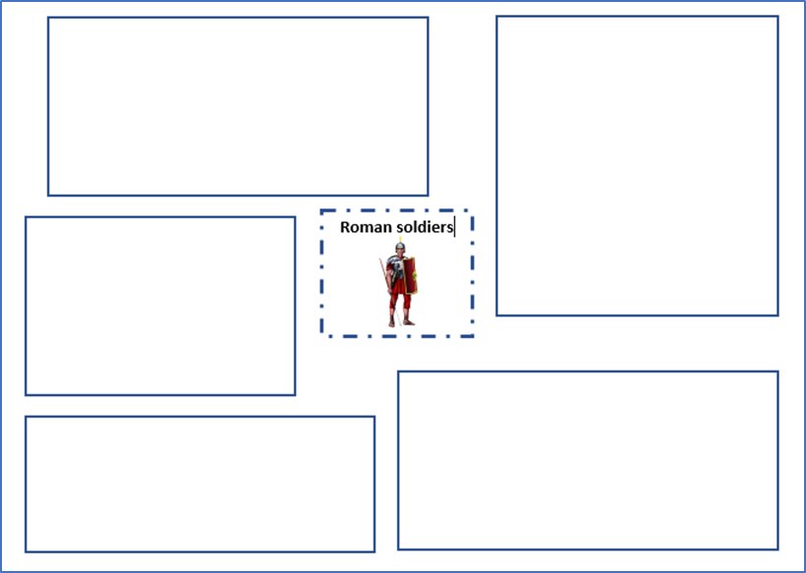
How did you do? (Here is an example)
I would use this frame to organise all my information about the Amazon rainforest into different sections e.g. trees, animals, indigenous people, deforestation. Then, I can consider which is the most logical order for my paragraphs before I write.

Slide 22

Notes on a plan
Planning frames are not intended for us to write whole sentences. Instead, we might:
make notes of the detail that we want to include
jot down any key language that we might want to use
include any features that we are know are central to the toolkit for writing which we do not want to forget
include a linking word or phrase to remind us that each new paragraph needs a link to the one before.

Slide 23
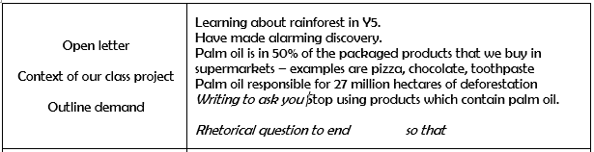
Notes on a plan
Look at the section below from a ‘boxing up’ planning frame for a persuasive letter about reducing the amount of palm oil used in the school kitchen.
detail to include
technical language
key features
conjunction to include

Slide 24

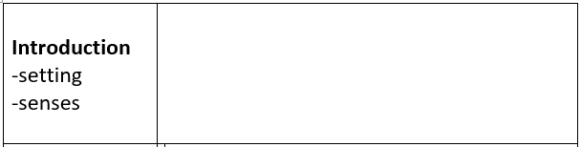
Your turn
Imagine that you have been asked to write a paragraph about this setting. What details would you include on a plan where your teacher has asked you to focus on the senses?

Slide 25
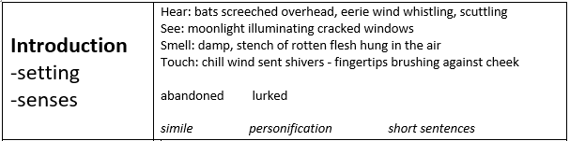
How did you do?
Yours might have looked a little like this.
senses
detail to include
key features
language for effect

Slide 26
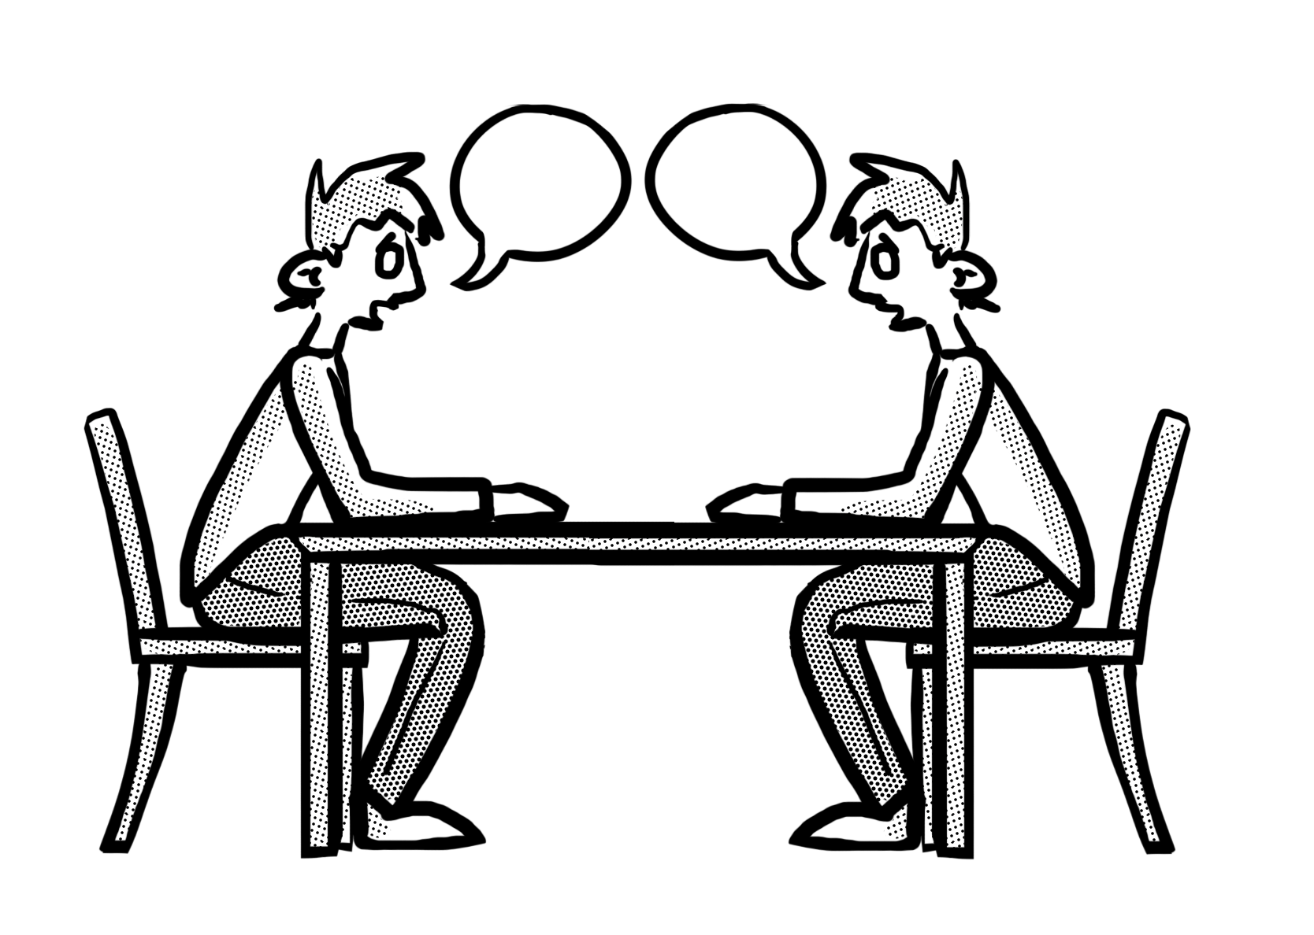
Rehearse
Although planning frames are useful to help us organise our ideas before we write, we can also use them to rehearse our texts. This means that we can follow our plan through, saying our ideas aloud to ensure that they are in a sensible order and that we know how we will link them. We can rehearse with a planning frame in two ways – either summarising the events as they will be written if we are writing a longer text or practising each sentence in turn if we are writing a shorter piece.

Slide 27

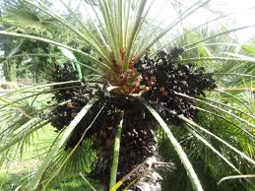
Your turn
Below is the section from the ‘boxing up’ planning frame for a persuasive letter about reducing the amount of palm oil used in the school kitchen that we saw on slide 23. With a partner, use it to rehearse the paragraph that you would write.

Slide 28
How did you do?
Did your paragraph sound something like this?
Dear Cook,
This term, we have been learning about the Amazon rainforest in Year 5 but, unfortunately, we have made an alarming discovery. Palm oil, which is in 50% of the products that we find in supermarkets, is responsible for approximately twenty-seven million hectares of deforestation in the Amazon. Farmers are burning down the trees so that they can grow palm oil plants which provide them with more money. As a result of this, I am writing to ask you to consider using sustainable palm oil in the school kitchen or, even better, no palm oil at all. Don’t you think that you have a responsibility to provide food for future generations without damaging the planet they depend on?

Slide 29
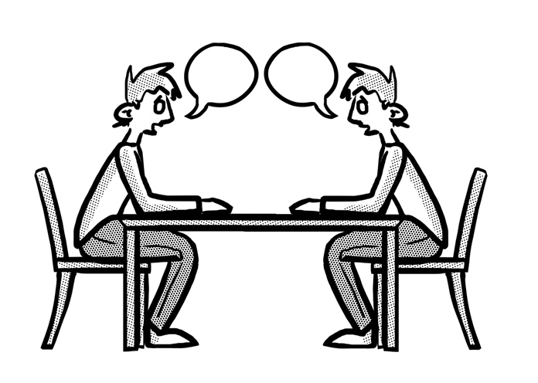
Practise
Use a planning frame that you have completed recently and rehearse your text aloud with a partner.
For a longer text, summarise the information in the correct order and rehearse how you will link it.
For a shorter text, rehearse how you will put the ideas in your plan into complete sentences which link clearly.

Slide 30

Review
Planning a whole text is essential so that we can organise our ideas in a way which helps them flow for the reader.
Planning helps us to ensure that our text reaches a conclusion.
There are a range of different planning strategies that we can choose from – this usually depends on the genre of text that we have been asked to write.
Using our planning frame, we can rehearse our whole text aloud so that we can be sure that we have the ideas organised in our head before we write.

