Slide 1


Y4 M3g Can solve problems involving multiplication and division
Commissioned by The PiXL Club Ltd.
June 2019
This resource is strictly for the use of member schools for as long as they remain members of The PiXL Club. It may not be copied, sold nor transferred to a third party or used by the school after membership ceases. Until such time it may be freely used within the member school.
All opinions and contributions are those of the authors. The contents of this resource are not connected with nor endorsed by any other company, organisation or institution.
PiXL Club Ltd endeavour to trace and contact copyright owners. If there are any inadvertent omissions or errors in the acknowledgements or usage, this is unintended and PiXL will remedy these on written notification.
© Copyright The PiXL Club Limited, 2019

Slide 2
Teacher Guidance
Typically, pupils lack confidence tackling word problems, mainly because they involve several steps and a large amount of information to process. Barriers to successfully answering these may, of course, be the mathematical concepts being assessed, but the amount of reading, the challenging vocabulary, as well as identifying the correct operation/s to perform, is not to be underestimated.
This therapy begins by explaining a suggested teaching strategy for these question types. The intention of this strategy is to develop pupil confidence in tackling such questions through the use of high-quality modelling. Using the teach, model and apply format, it will take pupils through this strategy with two modelled questions. Pupils will then have the opportunity to apply this independently.
The guidance notes under each slide explain each stage. It is assumed that Stage One, the teaching of the mathematical skill/concept involved, has been already taught.

Slide 3

The PiXL approach to solving word problems
Unlock the language
Unlock the numbers
Embed vocabulary
Number-free zones
Answer-free zones
Full problem
Teach the mathematical concept/skill being tested within the question
Stage 1 | Stage 2 | Stage 3 | Stage 4 | Stage 5
Notes:
Stage 1: Clearly, the first step to success will be teaching and ensuring security in the mathematical concept within the word problem i.e. if the question involves finding fractions of a number, this will need to be have been taught out of context first.
Stage 2: Use a word problem with the numbers deleted so that the focus is on the language and the process, rather than calculation. This stage is, technically, a reading task and could be part of a guided reading session. Read the question, explore and explicitly teach the mathematical vocabulary (PiXL Unlock vocabulary resources and templates are recommended).
Stage 3: Using the Number-free problem, read the question and discuss which operation/s are needed and how the problem could be solved. Model how to use ‘Thinking Talk’ and summarise what the steps are. Pupils practise this in pairs/individually, until confident.
Stage 4: Put in the numbers and the answers (use the Answer-free zone questions for this). Model how to answer the question: having the answer provided will maintain focus on the process rather than the answer. This additionally removes the anxiety for pupils. Once this is modelled, simply give pupils the same question with different numbers (ideally simple ones initially, then increase the challenge). Having seen the process modelled, pupils should become more confident to tackle these independently.
Stage 5: Once pupils are secure in the previous stages, give similar examples for them to complete independently.

Slide 4
Progress across amber – the 4-stage model
The three therapy tests which accompany this resource can be used to revisit the taught skill to check that the pupil is able to perform it independently and consistently.
A
A child has successfully completed a therapy test independently, following a set of therapy sessions.
A child has successfully completed a therapy test independently, a period after the relevant therapy sessions – we would advise about 2 weeks.
A child has successfully applied their knowledge or skill in an unfamiliar context. This may be application across the curriculum or in a problem.
A pupil has successfully re-visited the skills at a later point, and applies these in an unfamiliar context or problem, or across the curriculum.
A
DA
G

Slide 5


LORIC task
Today the LORIC task will focus on your Laura Leadership skills:
This means you will have to be:
reflective about your progress
honest about your achievements
responsible for your own learning

Slide 6
LORIC task
Think about all you have learned this year.
What have you made the most progress in?
What do you still need to improve?
Think about how you can improve in this area. Set yourself a target or challenge.
Share your target with a partner. Discuss how you know you will have achieved it. What will success look like for you?

Slide 7
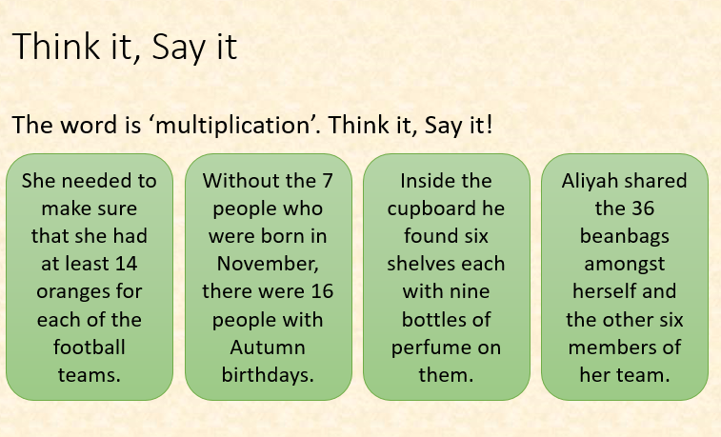
Vocabulary activity
multiplication
multiply
division
divide
inverse
USE IT
Notes:
This activity will test pupils’ deep understanding of new vocabulary. Teach pupils a new word, for example ‘valiant’. Give pupils scenarios and ask them to say the word loudly if it would apply to the scenario. Ask pupils to explain their reasoning. This is excellent for using with mathematical word problems, where pupils would have to decide whether a scenario fitted the mathematical concept. It can also be used with ambitious and challenging adjectives to help pupils understand how they might be used.

Slide 8
Model Question 1

Slide 9
Stage 2 – Vocabulary
7 children each buy 6 packs of rare football stickers. Each pack contains 8 stickers. How many stickers are there in total?
Notes:
Read the question to the pupils and identify any key mathematical or generic vocabulary which may be a challenge.

Slide 10
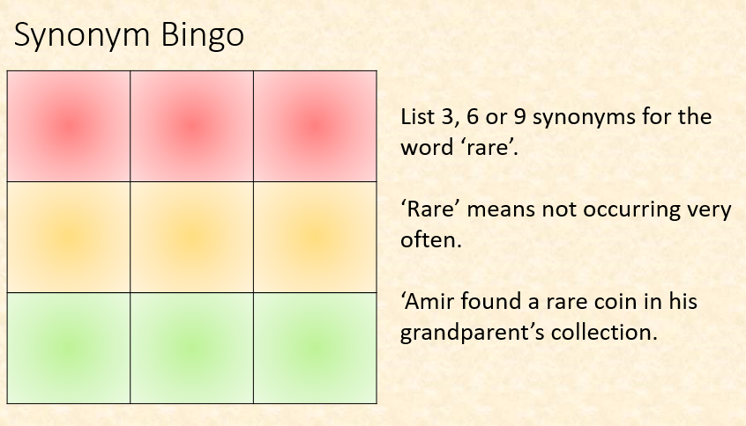
Stage 2 – Vocabulary
LINK IT
rare
contains
Notes:
Give pupils a new and challenging word. Discuss the meaning in isolation then give examples of the word in context. Ask pupils to list 3, 6 or 9 synonyms or near synonyms (depending on the level of challenge you want to give). Read out your own list of synonyms and near synonyms, asking pupils to tick them off as you go. First to tick them all off shouts ‘Bingo’!

Slide 11
Stage 3 – Number-free zone
7 children each buy 6 packs of rare football stickers. Each pack contains 8 stickers. How many stickers are there in total?
1. Vocabulary: write a definition for the following words:
a) rare b) contains
2. Retrieval – which sport are the stickers related to?
3. Inference – what is the question asking you to do? Summarise the problem.
Notes:
Ask 3 questions: a vocabulary one, a retrieval one and, finally, the inference one which is basically asking pupils to summarise what they are being asked to do. Without the numbers, they can focus on the process and identifying the number of steps. Model this if needed.

Slide 12
Stage 4 – Answer-free zone
7 children each buy 6 packs of rare football stickers. Each pack contains 8 stickers. How many stickers are there in total?
Answer: 336 stickers
Notes:
Return to the problem and show the numbers, along with the answer. The next stage requires explicit modelling by the adult to show pupils how they would solve this. Exemplify accurate vocabulary and use appropriate calculations and models to support pupils in understanding.

Slide 13
Stage 4 – Thinking Talk
7 children each buy 6 packs of rare football stickers. Each pack contains 8 stickers. How many stickers are there in total?
Firstly, I know I need to multiply 7 children by 6 packs by 8 stickers.
I know I can complete this calculation in any order so I could do 7 x 6 x 8 or work it out in a different order, e.g. 8 x 6 x 7.
I know that 7 x 6 = 42.
That means I then need to work out 42 x 8. I know I can use short multiplication to work this out.
Answer: 336 stickers
Notes:
This is one suggested approach. Can pupils think of an alternative method for solving it?

Slide 14
Stage 4 – Thinking Talk
7 children each buy 6 packs of rare football stickers. Each pack contains 8 stickers. How many stickers are there in total?
This means that the answer is 336.
I know that 7 x 6 = 42.
That means I then need to work out 42 x 8. I know I can use short multiplication to work this out.
4
2
x
8
3
3
6
3
1
Answer: 336 stickers
Notes:
This is one suggested approach. Can pupils think of an alternative method for solving it?

Slide 15
Stage 5 – Your Turn
4 children each buy 9 packs of rare football stickers. Each pack contains 5 stickers. How many stickers are there in total?
Answer: 180 stickers
Notes:
Give pupils the same question with different numbers. Can they solve this independently? Do they their times table to help? Do they use short multiplication to help?

Slide 16
Model Question 2

Slide 17
Stage 2 – Vocabulary
Katie made £144 at the summer fete selling portions of fruit salad to help buy new computers. She sold them for £4 each. How many portions did she sell in total?
Notes:
Read the question to the pupils and identify any key mathematical or generic vocabulary which may be a challenge.

Slide 18

Stage 2 – Vocabulary
DEFINE IT
Synonym: _____________________
Antonym: _____________________
My definition: ____________________
_________________________________
_________________________________
Used in context: ___________________
_________________________________
______________________________
Word:
portion
Picture:
Notes:
Select one or two words to embed using the PiXL Unlock 5-phase approach. This example is from the PiXL Vocabulary Shorts. Once the vocabulary has been explored, return to the problem.

Slide 19
Stage 3 – Number-free zone
Katie made £144 at the summer fete selling portions of fruit salad to help buy new computers. She sold them for £4 each. How many portions did she sell in total?
1. Vocabulary: write a definition for the following words:
a) portion b) fete
2. Retrieval – why was Katie raising money?
3. Inference – what is the question asking you to do? Summarise the problem.
Notes:
Ask 3 questions: a vocabulary one, a retrieval one and, finally, the inference one, which is basically asking pupils to summarise what they are being asked to do. Without the numbers, they can focus on the process and identifying the number of steps. Model this if needed.

Slide 20
Stage 4 – Answer-free zone
Katie made £144 at the summer fete selling portions of fruit salad to help buy new computers. She sold them for £4 each. How many portions did she sell in total?
Answer: 36
Notes:
Return to the problem and show the numbers, along with the answer. The next stage requires explicit modelling by the adult to show pupils how they would solve this. Exemplify accurate vocabulary and use appropriate calculations and models to support pupils in understanding.

Slide 21
Stage 4 – Thinking Talk
Katie made £144 at the summer fete selling portions of fruit salad to help buy new computers. She sold them for £4 each. How many portions did she sell in total?
So, my calculation will be £144 ÷ £4
Firstly, I need to identify the key facts of the problem, including important numbers.
I know I can use a short division method to work this out:
I know the total made was £144 and she sold each portion for £4 so I need to use those numbers to solve the problem.
Answer: 36 portions
?
?
?
4
1
4
4
Notes:
This is one suggested approach. Can pupils think of an alternative method for solving it?

Slide 22
Stage 4 – Thinking Talk
Katie made £144 at the summer fete selling portions of fruit salad to help buy new computers. She sold them for £4 each. How many portions did she sell in total?
0
3
6
1 2
4
1
4
4
I have used my knowledge of the 4 times table to help me.
So, there were 36 portions of fruit salad sold at the fete.
Answer: 36 portions
Notes:
Where relevant, incorporate visual models to support understanding.

Slide 23
Stage 5 – Your Turn
Archie made £252 at the summer fete selling portions of fruit salad to help buy new computers. He sold them for £6 each. How many portions did he sell in total?
Answer: 42
Notes:
Give pupils the same question with different numbers. Can they solve this independently? Do they use the short division method to support them?

Slide 24
Apply – Problem Solving
3 children each have 4 bags of toys. Each bag contains 9 toys.
How many toys are there in total?
?
x
?
x
?
=

Slide 25
Apply – Problem Solving
Remember to use your times table knowledge to help solve each problem.
There are 184 pens in a tray. They are shared equally between 8 friends. How many pens do they each get?
?
?
?
?
?
?
?

Slide 26
Apply – Reasoning Problem
224 ÷ 7 = 22
2 1
Spot the error in this calculation. Explain how you know.
Challenge – work out the correct answer and explain to a partner.
0
2
2
7
2
2
4

Slide 27
Next steps
To consolidate the language aspects of these problems, a suggestion is that the number-free zone questions could form part of a guided reading session. Use Slide 7 as a model. A template can also be found in the Whole School Reading resources on inference (Slide 3).
Once pupils have developed greater confidence in tackling these word problems, they will then need to develop strategies when working independently. A suggestion is on the following slides.

Slide 28

Solving word problems – steps to success
Take Two – read the question twice, once to get a general idea of context and vocabulary; the second to understand exactly what is being asked.
Underline/highlight key information (or eliminate information from your enquiries – like a detective!)
Give us a clue – look for key words to guide you to the operation needed, e.g. altogether suggests addition, share suggests division etc.
Summarise – in your head, summarise the question back to yourself, e.g. So, I’ve got to add the cost of 3 adults to the cost of a child, then subtract that from £50.00.

Slide 29

Solving word problems – steps to success
5. Estimate – round the numbers to give a rough idea of what the answer should be and jot it down.
6. Calculate – make sure you align digits carefully.
8. Read the question back – have you answered it?
9. Look at your original estimate – does your answer seem reasonable?

Slide 30
Apply
Further Number-free and Answer-free zone questions can be found on PrimaryWise in the relevant year-group areas. These can be used to provide continued support in developing both the confidence to tackle, and strategies to solve, these problems.

