Slide 1


Y5 M3n. Can solve problems using a mixture of all four operations, including missing number problems.
Commissioned by The PiXL Club Ltd.
July 2018
This resource is strictly for the use of member schools for as long as they remain members of The PiXL Club. It may not be copied, sold nor transferred to a third party or used by the school after membership ceases. Until such time it may be freely used within the member school.
All opinions and contributions are those of the authors. The contents of this resource are not connected with nor endorsed by any other company, organisation or institution.
PiXL Club Ltd endeavour to trace and contact copyright owners. If there are any inadvertent omissions or errors in the acknowledgements or usage, this is unintended and PiXL will remedy these on written notification.
© Copyright The PiXL Club Limited, 2018

Slide 2
Vocabulary: Problem Solving
inverse
strategy
solve
check
Teacher’s Note:
See ‘Vocabulary Shorts’ resource below for ideas and games to develop and embed vocabulary.
Vocabulary Shorts

Slide 3

Match it up
Put these words into pairs according to their meaning. Explain the connections that you made.
inverse work out plan
strategy check reverse
review solve

Slide 4
Can solve problems using a mixture of all four operations, including missing number problems.
Solving problems
When we are solving problems, the first step is to work out what we have to do.
Reading the whole question through before we begin is really important.
Remember: Sometimes it takes two or more steps to solve a mathematical problem - we often need to work something out before we can work out the answer. We call these problems multi-step problems.

Slide 5

Problem 1
Can solve problems using a mixture of all four operations, including missing number problems.
Item | Cost
Cod | £3.85
Chips | £1.35
What is the question asking you to do?
How many steps will it take to answer this question?
Sarah buys one piece of cod
and four portions of chips.
What is the total cost of her order?

Slide 6
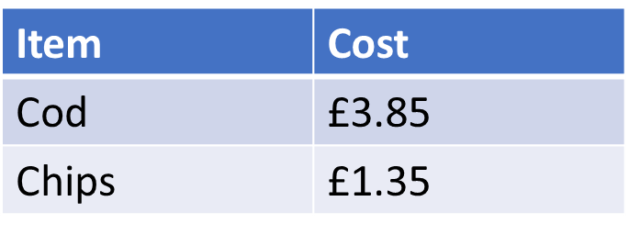
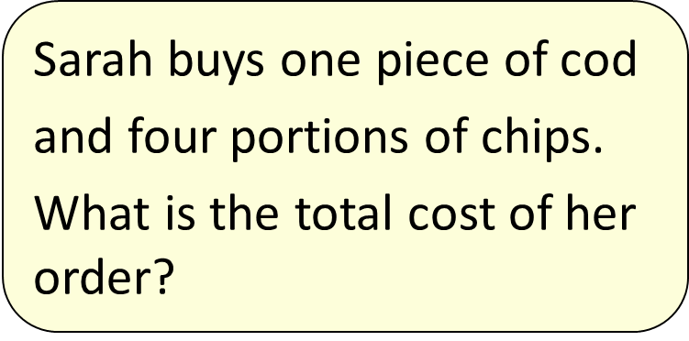
Can solve problems using a mixture of all four operations, including missing number problems.
There are two steps to this problem.
Step 1: We need to find the cost of four portions of chips.
Step 2: We then need to add on the cost of the piece of cod.
The calculation we need to do is:
(4 x £1.35) + £3.85

Slide 7
Estimating
Can solve problems using a mixture of all four operations, including missing number problems.
Let’s first estimate by rounding so we know what will be a reasonable answer.
£3.85 can be rounded up to £4 and £1.35 can be rounded down to £1 so:
(4 x £1) + £4 = £8
Notes:
Ensure children understand the term ‘reasonable’ or ‘approximate’

Slide 8

Calculating the answer
Can solve problems using a mixture of all four operations, including missing number problems.
We could use a mental strategy but some of the numbers might be a bit tricky to calculate, so we’ll need to use an appropriate written strategy.
Let’s remind ourselves of the written strategies we could use…

Slide 9

Can solve problems using a mixture of all four operations, including missing number problems.
The first calculation we need to do is: 4 x £1.35
We could use repeated addition:
1 . 3 5
1 . 3 5
1 . 3 5
+ 1 . 3 5
5 . 4 0
1
2
Notes:
Explain that repeated addition is not normally an efficient method but as we are only multiplying by 4, it is ok in this instance.

Slide 10
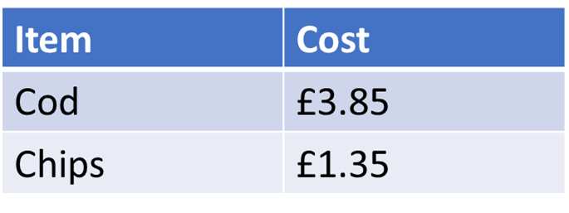
Can solve problems using a mixture of all four operations, including missing number problems.
:
The first calculation we need to do is: 4 x £1.35
Or we could use the grid method:
4
1 . 2
+ 0 . 2 0
__5 . 4 0
X | 1 | 0.3 | 0.05
4 | 4 | 1.2 | 0.2
We’re not finished yet…
1
Notes:
You could also demonstrate the short method for multiplication if this is relevant to your calculation policy.
Remind children that the answer is in terms of money, so the answer cannot be £5.4 it has to be £5.40.

Slide 11
What’s our second step?
Can solve problems using a mixture of all four operations, including missing number problems.
:
Remember, our original calculation was:
(4 x £1.35) + £3.85
Therefore, we now need to add £5.40 and £3.25.
We could choose to use either a mental or written method for this calculation.

Slide 12

Can solve problems using a mixture of all four operations, including missing number problems.
:
Our final step is: £5.40 + £3.85
Written method
5 . 4 0
+ 3 . 8 5
9 . 2 5
1
Answer: The total cost of the meal is £9.25

Slide 13

Final check
Can solve problems using a mixture of all four operations, including missing number problems.
:
Now go back and read the question again. Is our answer reasonable and have we answered the question?
Answer: The total cost of the meal is £9.25.

Slide 14

Your turn
Can solve problems using a mixture of all four operations, including missing number problems.
Louise takes her three children to the zoo.
What is the total cost of their tickets?
What is the question asking you to do?
How many different operations will you need to carry out?
Adults | £9.25
Children | £6.85

Slide 15
Problem 2
Can solve problems using a mixture of all four operations, including missing number problems.
Sam has 37 trading cards, Lucy has 62 and Joe has 39.
They put their cards together and then share them equally.
How many cards do they each now have?
What is the question asking you to do?
How many different operations will you need to carry out?

Slide 16
Can solve problems using a mixture of all four operations, including missing number problems.
What’s our first step?
Sam has 37 trading cards, Lucy has 62 and Joe has 39.
They put their cards together and then share them equally.
How many cards do they each now have?
Step 1: Find out the total number of cards
37 + 62 + 39 = 138

Slide 17
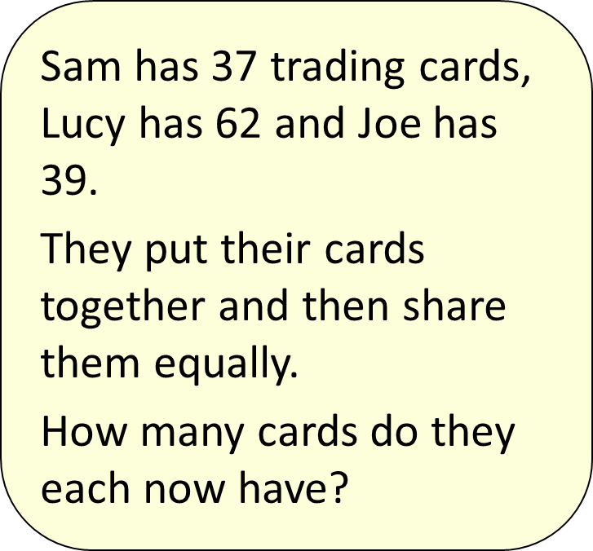
Can solve problems using a mixture of all four operations, including missing number problems.
What’s our second step?
Step 2: Divide the total number of cards by 3.
The calculation we need to do is:
138 ÷ 3 =
A written method will be best for us to solve this.

Slide 18

Can solve problems using a mixture of all four operations, including missing number problems.
What’s our second step?
Short Division (bus stop)
Sam has 37 trading cards, Lucy has 62 and Joe has 39.
They put their cards together and then share them equally.
How many cards do they each now have?
0 4 6
3 1 3 8
1
They will have 46 cards each.

Slide 19
Final check
Can solve problems using a mixture of all four operations, including missing number problems.
:
Now go back and read the question again. Does our answer make sense and have we answered the question?
Answer: They have 46 cards each.

Slide 20
Your turn
Can solve problems using a mixture of all four operations, including missing number problems.
Susan has collected 18 conkers, Jane has collected 21, Maddie has 9 and Cole has 16.
They put their collections together and then share them equally.
How many does each person get?
What is the question asking you to do?
How many different operations will you need to carry out?

Slide 21
Problem 3
Can solve problems using a mixture of all four operations, including missing number problems.
Work out the missing numbers:
3 5 7
+ 0 9
5 5 4 2 9
What is the question asking you to do?

Slide 22
Can solve problems using a mixture of all four operations, including missing number problems.
Step 1: We need to start with our ones column.
7 + ___ = 9
7 + 2 = 9

Slide 23
Can solve problems using a mixture of all four operations, including missing number problems.
Step 2: Now we move to our tens column.
I can’t make this column add to 2. This tells me I am going to have to exchange. The number I need to make is 12.
2
__ + 9 = 12
3 + 9 = 12
Notes:
If the addition contained more numbers, the total of this column could be 22 or 32 etc. but as we can only use one digit in this column, the total can only be 12.

Slide 24
Can solve problems using a mixture of all four operations, including missing number problems.
Step 3: Now we move to our hundreds column.
Again, I can’t make 4 with these numbers without an exchange. So this column must total 14. I must remember the 1 that I have already exchanged.
3
2
5 + __ + 1 = 14
5 + 8 + 1 = 14
1
Notes:
Ensure you focus on the ‘1’ that has been exchanged.

Slide 25
Can solve problems using a mixture of all four operations, including missing number problems.
Step 4: Now we move to our thousands column.
This time I can make my numbers total 5. I must remember the 1 that I have exchanged.
3
8
2
__ + 0 + 1 = 5
4 + 0 + 1 = 5
1
1

Slide 26
Can solve problems using a mixture of all four operations, including missing number problems.
Step 5: Now we move to our ten thousands column.
Again, I can make my numbers total 5 and this time I have no exchanges to remember.
4
3
2
8
2
3 + __ = 5
3 + 2 = 5
1
1

Slide 27
Can solve problems using a mixture of all four operations, including missing number problems.
Now I am going to redo my calculation, this time with the answer missing so I can check that these two numbers total
55,429
Step 6: Checking
4
3
2
8
2
I could have also used the inverse operation to check this:
55,429 – 20,892 = 34,537

Slide 28
Your turn question 1
Can solve problems using a mixture of all four operations, including missing number problems.
Work out the missing numbers:
2 7 1
+ 1 8
6 5 7 4 5
Work through the columns.
Ensure you complete any exchanging that is needed.
Check your calculation by redoing the addition calculation or using the inverse.

Slide 29
Your turn question 2
Can solve problems using a mixture of all four operations, including missing number problems.
Work out the missing numbers:
6 4 9
+ 8 2 1
9 5 8 6 1
Work through the columns.
Ensure you complete any exchanging that is needed.
Check your calculation by redoing the addition calculation or using the inverse.

Slide 30
Can solve problems using a mixture of all four operations, including missing number problems.
Links:
Number – addition and subtraction (mental and written)
Number – multiplication and division (mental and written)

