Slide 1
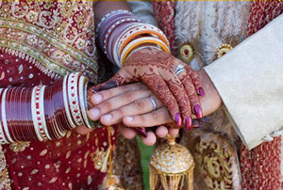
Sikh Weddings

Slide 2
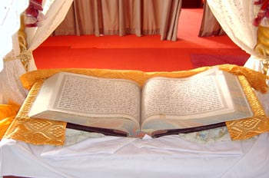
The Guru Granth Sahib gives guidance on how Sikhs should live their life.

Slide 3
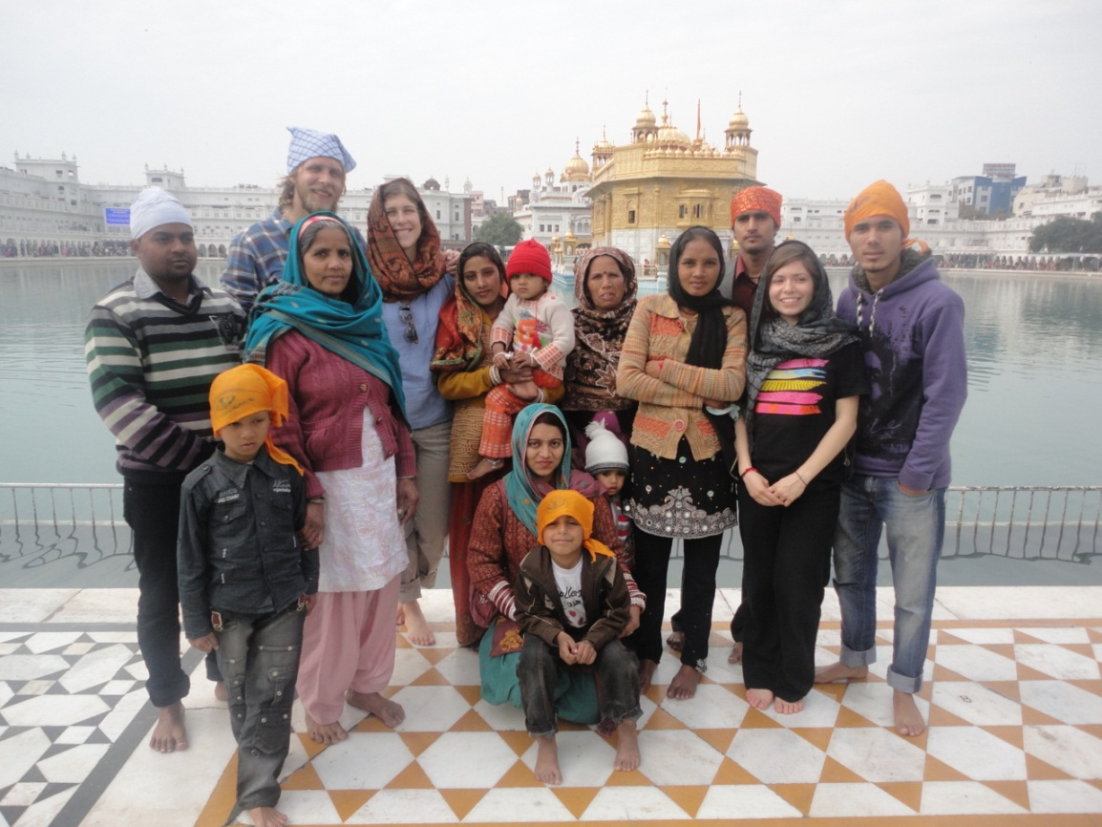
Grown-up Sikh boys and girls get married when they are fully able to take on the responsibilities of married life.
What do you think the responsibilities of marriage are?

Slide 4
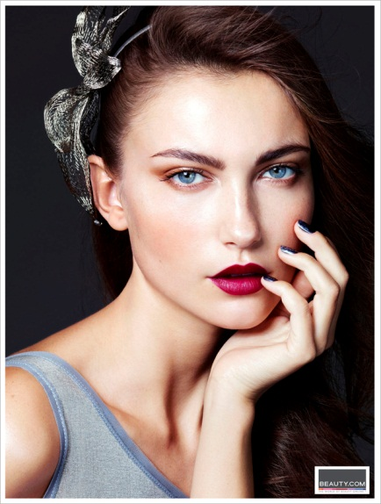

Parents and family may help to ‘arrange’ a wedding but it doesn’t always happen.
You don’t choose a husband/wife based on how rich they are, what they look like or what race they are.

Slide 5
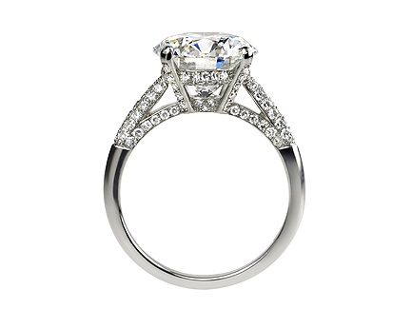
An engagement may be done before the wedding but not always.
Sikhs aren’t allowed to choose a date based on any superstitions e.g “my star sign says it is a good date for us to get married on June 21st because then we will have a long happy marriage.”

Slide 6
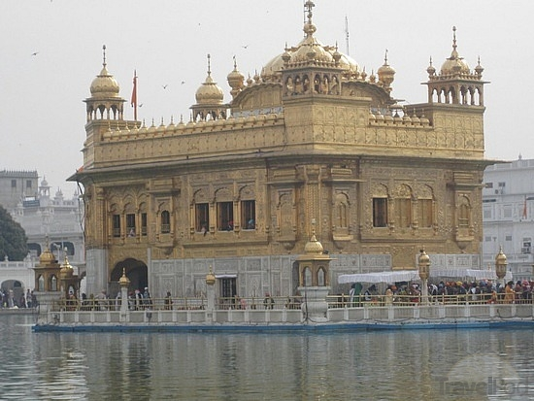
The Wedding
The couple get married in the presence of the Guru Granth Sahib.
Where might they get married?

Slide 7
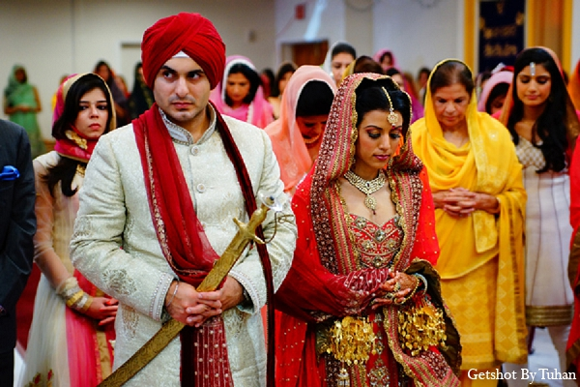
Shabads (Sikh hymns) are sung and the boy and the girl sit side by side facing Guru Granth Sahib.
The girl sits on the left side of the boy.
The couple and their parents (or guardians) stand up and an Ardaas (prayer) is offered, seeking the Blessing of Waheguru (the Wondrous Giver of Knowledge) for the commencement of the Anand marriage

Slide 8
Any Amritdhari Sikh (man or woman who has practices the prescribed Sikh code in daily life) can perform a marriage ceremony.
This person tells the couple of the duties of married life according to the Guru's teachings.

Slide 9
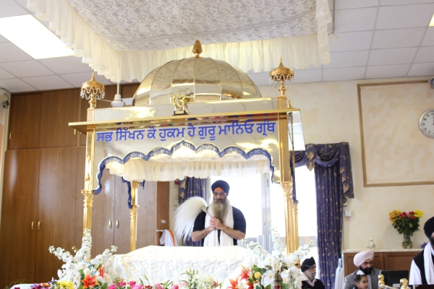
He explains what it is like to be husband and wife.

Slide 10
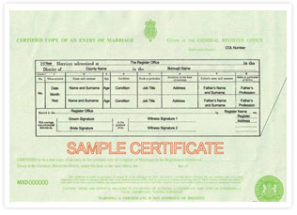
They accept their obligations by bowing before Guru Granth Sahib.
The Anand marriage is a sacrament and no document is necessary.
In the UK we complete a marriage certificate.

Slide 11
The main ceremony is very simple.
The bridegroom wears a sash over his shoulder.
The officiating person reads the four lavan (stanzas) from Guru Granth Sahib.

Slide 12
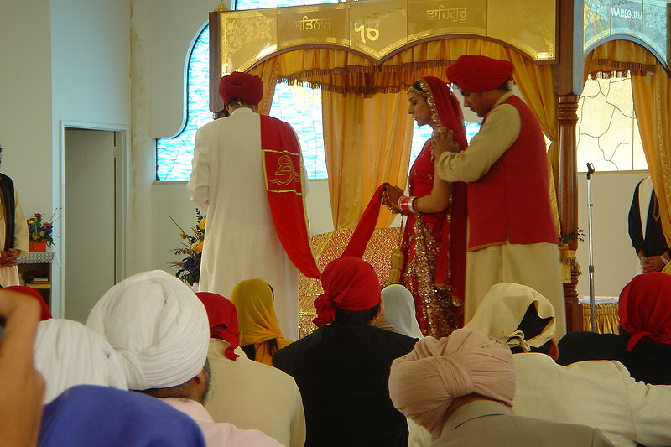
The end of this is placed (by the bride's father, guardian or any other responsible person) in the hands of the bride.

Slide 13
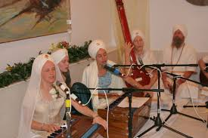
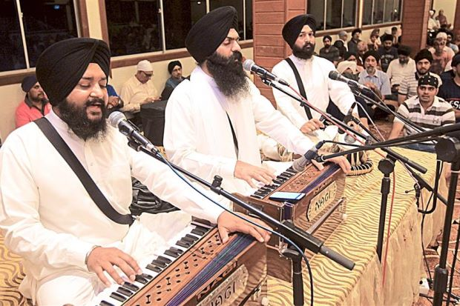
Music is played.
Hymns are sung.
The couple walk slowly around the Guru Granth Sahib with the husband leading the bride.

Slide 14
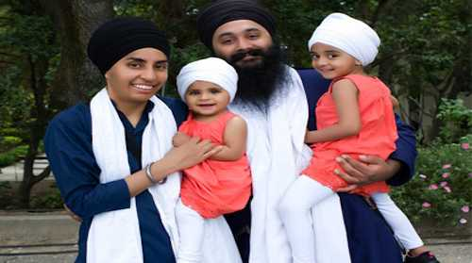
Men and women are seen as equal.

