Slide 1
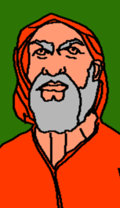
RE: People of God
BIG QUESTION: What is it like to follow God?
LI: To understand Abraham’s faith in God
The Old Testament story of Abraham Genesis 12: 1-9

Slide 2
PROMISES
Have you ever made someone a promise?
What did you promise?
Did you keep the promise?
How did it make the other person feel?
Have you ever broken a promise or had one broken?

Slide 3
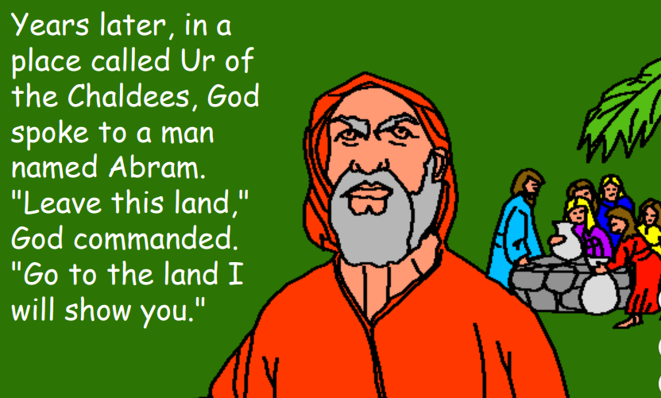
AFTER THE FLOOD,

Slide 4
What do you think?
What problems might there be for Abraham in the new country?
Should Abraham go to a new country he doesn’t know just because God says so?
Why?

Slide 5
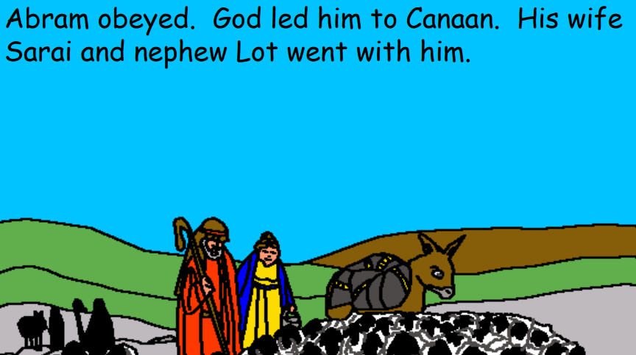

Slide 6
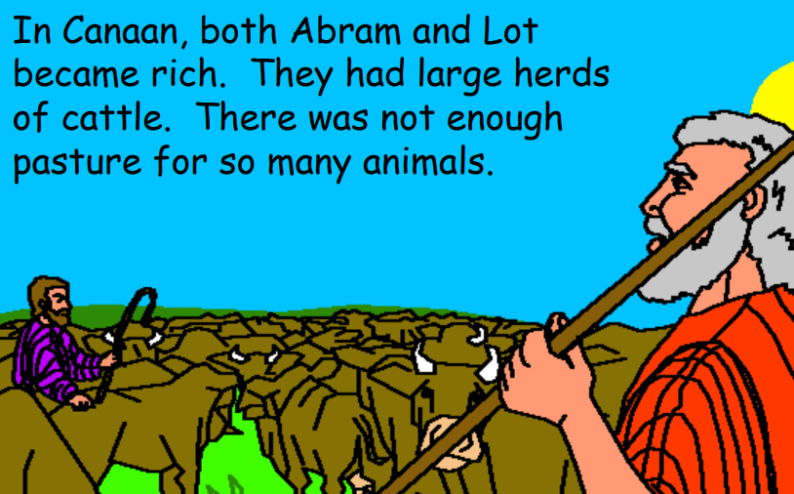

Slide 7
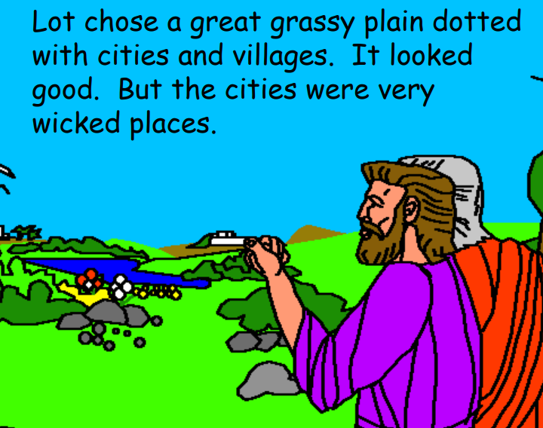

Slide 8
What do you know so far?
Who did Abraham take with him to the new country?
What happened to them in the new country?

Slide 9
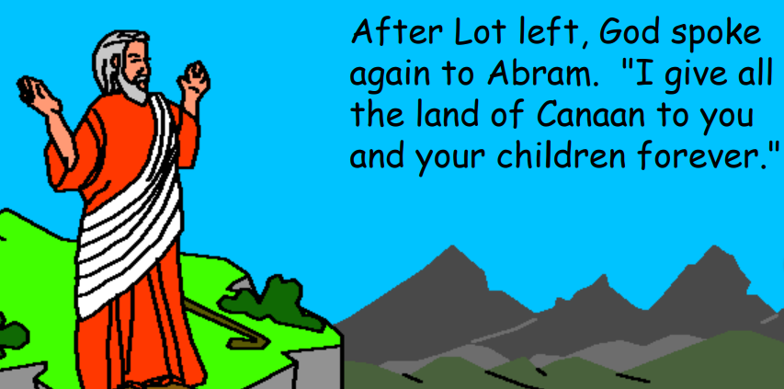

Slide 10
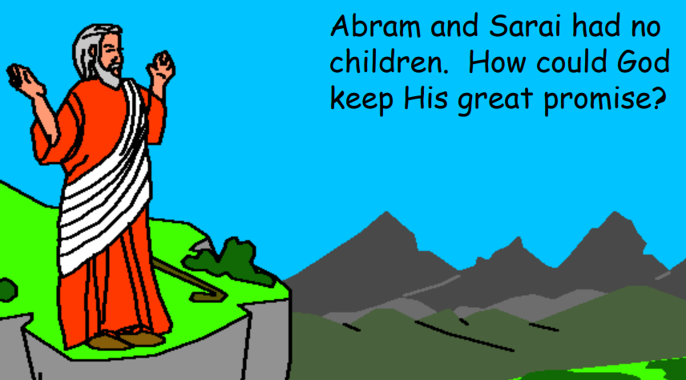

Slide 11
What do you know so far?
What did God promise Abraham?
Why does Abraham think this will be a difficult promise to keep?

Slide 12
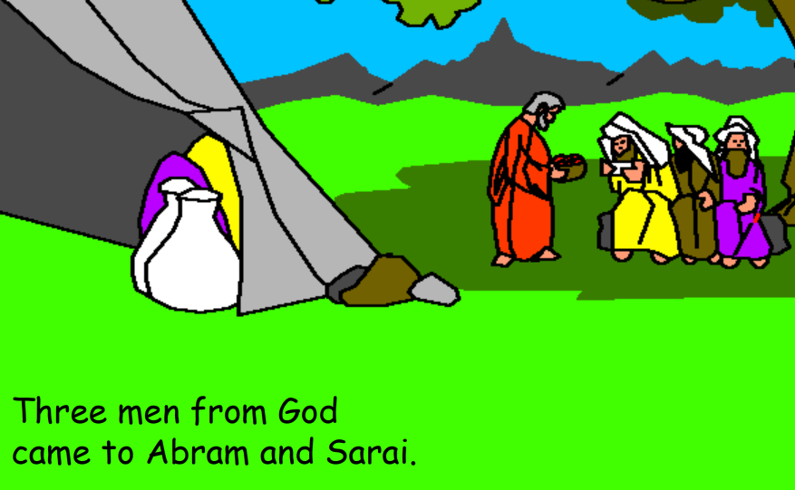

Slide 13
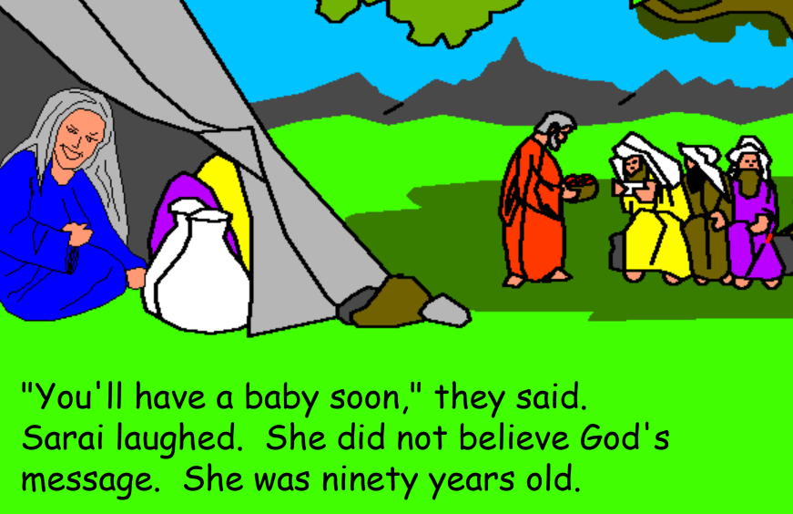

Slide 14
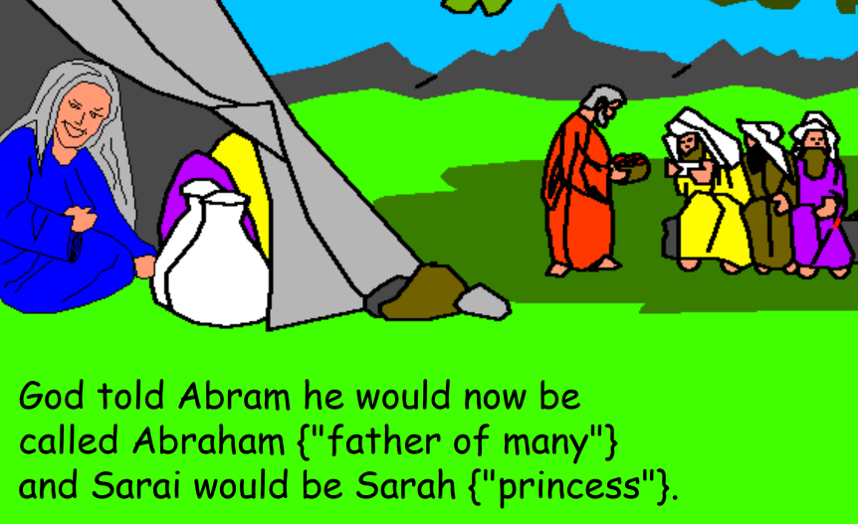

Slide 15
What do you know so far?
Why did Abraham’s wife laugh?

Slide 16
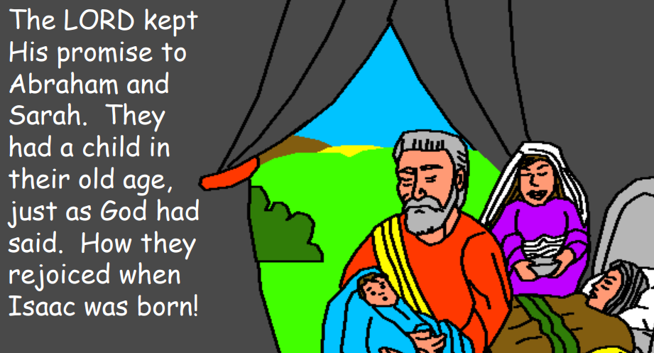

Slide 17
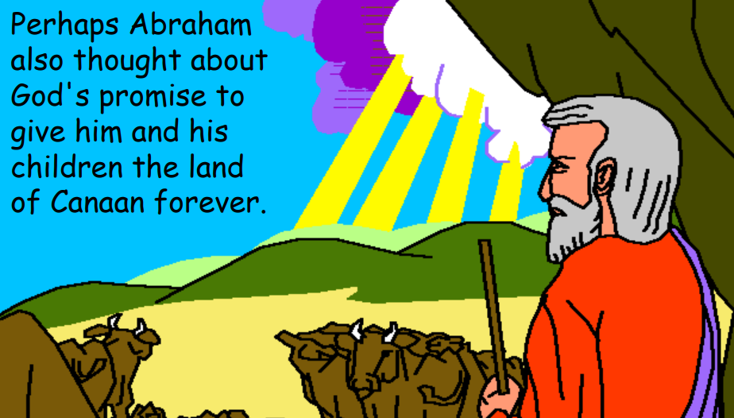

Slide 18
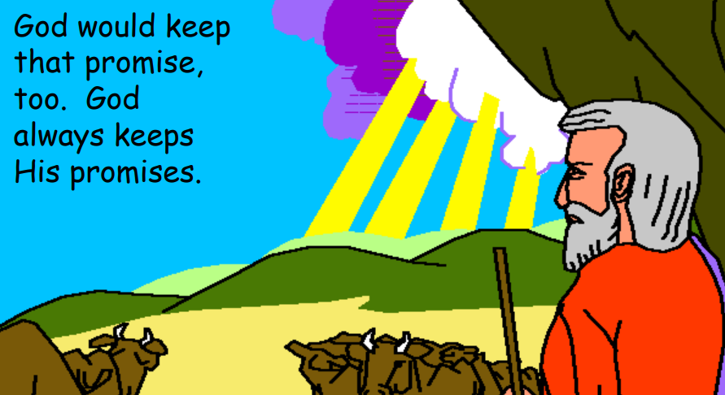

Slide 19
What do you know so far?
How do we know from the story that God kept his promise to Abraham?

Slide 20
YOUR TASK
Create a poster or story board about Abraham’s faith in God.
Show how Abraham trusted God and God’s promises to Abraham.
Use pictures, words or sentences in your poster.
Look at the example on the next slide to give you some ideas!

Slide 21
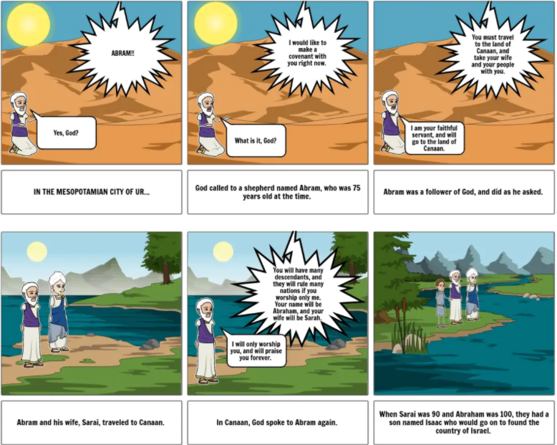

Slide 22
Deep Question:
Why do you think Abraham followed God’s command to leave his own country?

