Slide 1
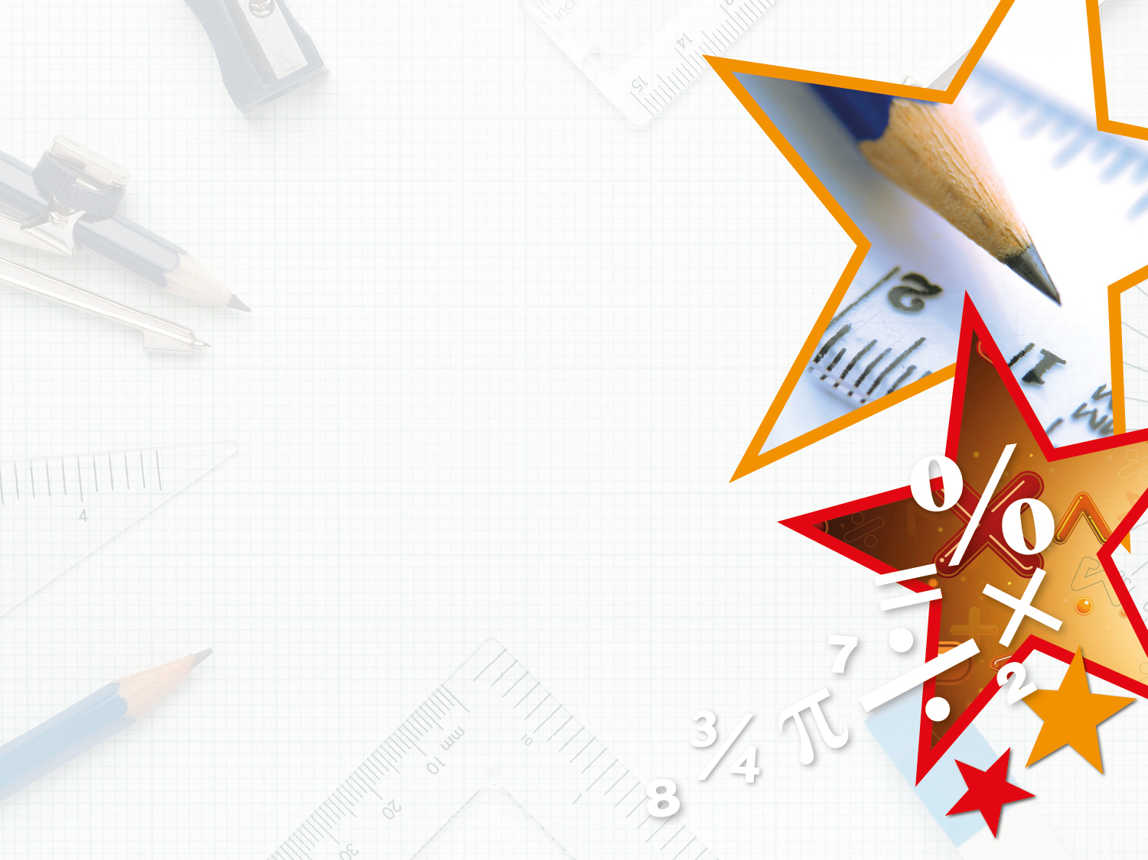

Year 2 – Summer Block 3 – Time – O’clock and Half Past
About This Resource:
This PowerPoint has been designed to support your teaching of this small step. It includes a starter activity and an example of each question from the Varied Fluency and Reasoning and Problem Solving resources also provided in this pack. You can choose to work through all examples provided or a selection of them depending on the needs of your class.
National Curriculum Objectives:
Mathematics Year 2: (2M4a) Tell and write the time to five minutes, including quarter past/to the hour and draw the hands on a clock face to show these times
Mathematics Year 2: (2M4b) Compare and sequence intervals of time
More Year 2 Time resources.
Did you like this resource? Don’t forget to review it on our website.
© Classroom Secrets Limited 2018

Slide 2
Year 2 – Summer Block 3 – Time
Step 1: O’clock and Half Past
© Classroom Secrets Limited 2018

Slide 3
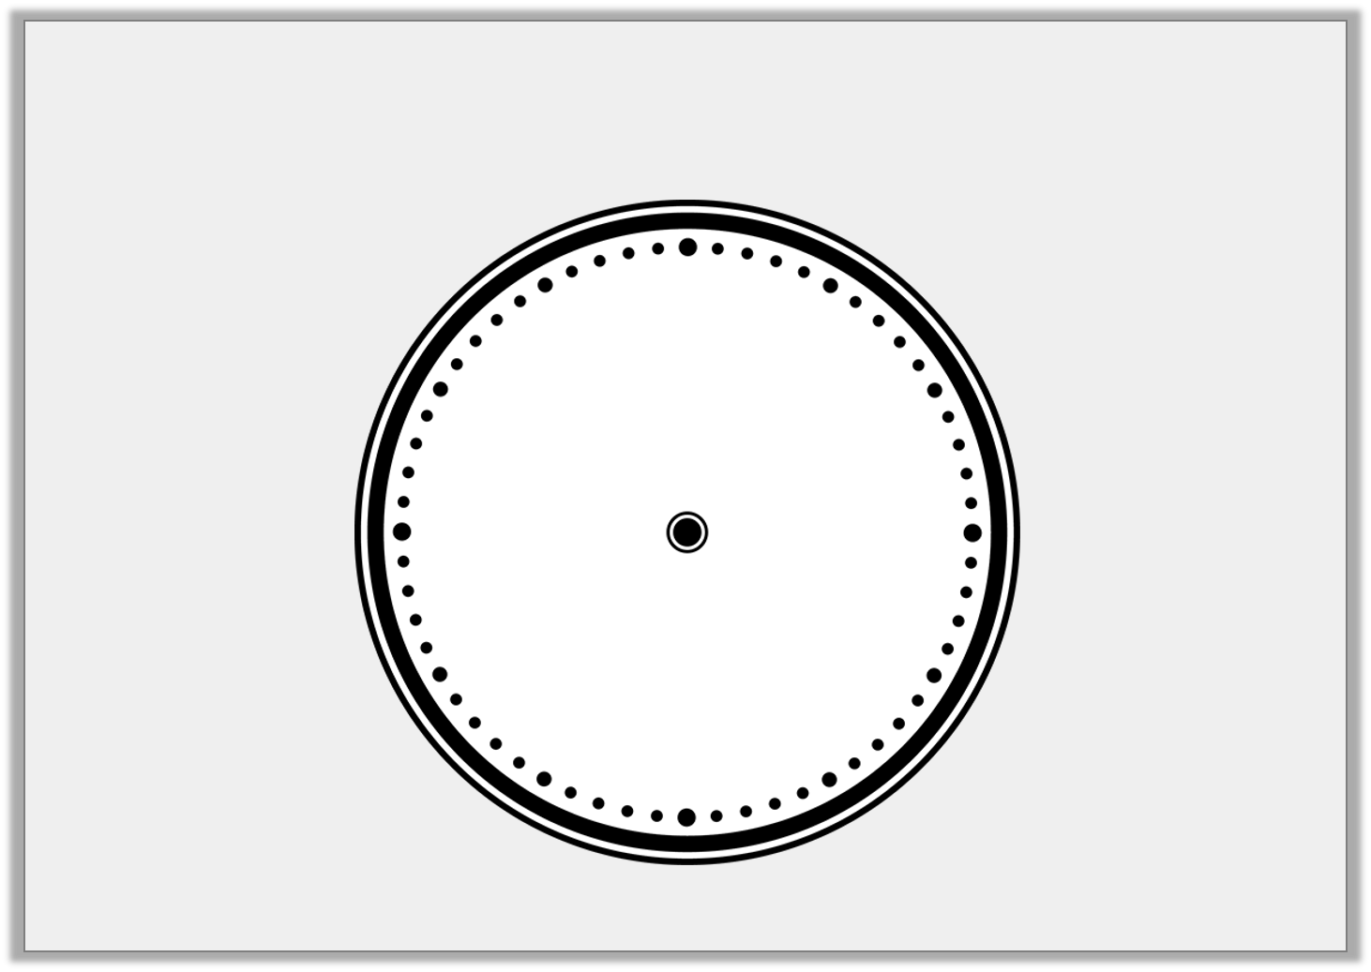

Introduction
Label the clock.
10
4
3
6
2
7
1
11
5
9
12
8
Minute hand
Hour hand
© Classroom Secrets Limited 2018

Slide 4
Introduction
Label the clock.
12
11
1
10
2
Minute hand
9
3
Hour hand
8
4
7
5
6
© Classroom Secrets Limited 2018

Slide 5
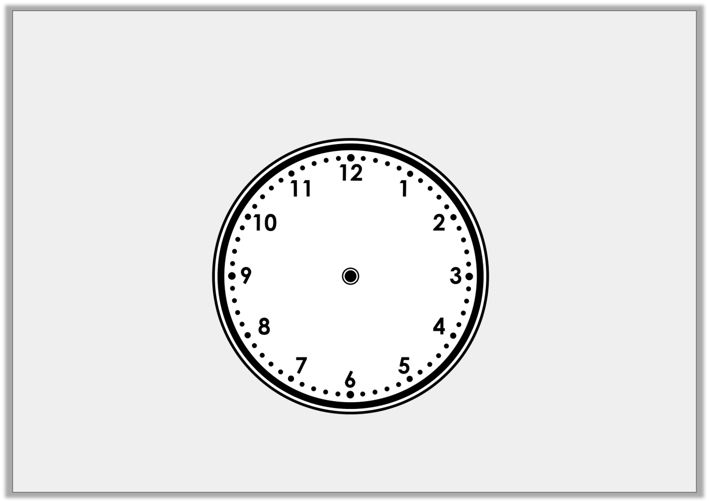
Varied Fluency 1
Write the time shown on this clock.
© Classroom Secrets Limited 2018

Slide 6
Varied Fluency 1
Write the time shown on this clock.
Half past 12
© Classroom Secrets Limited 2018

Slide 7
Varied Fluency 2
Draw the missing hands on the clock so that it shows the correct time written beneath it.
Half past 6
© Classroom Secrets Limited 2018

Slide 8
Varied Fluency 2
Draw the missing hands on the clock so that it shows the correct time written beneath it.
Half past 6
© Classroom Secrets Limited 2018

Slide 9
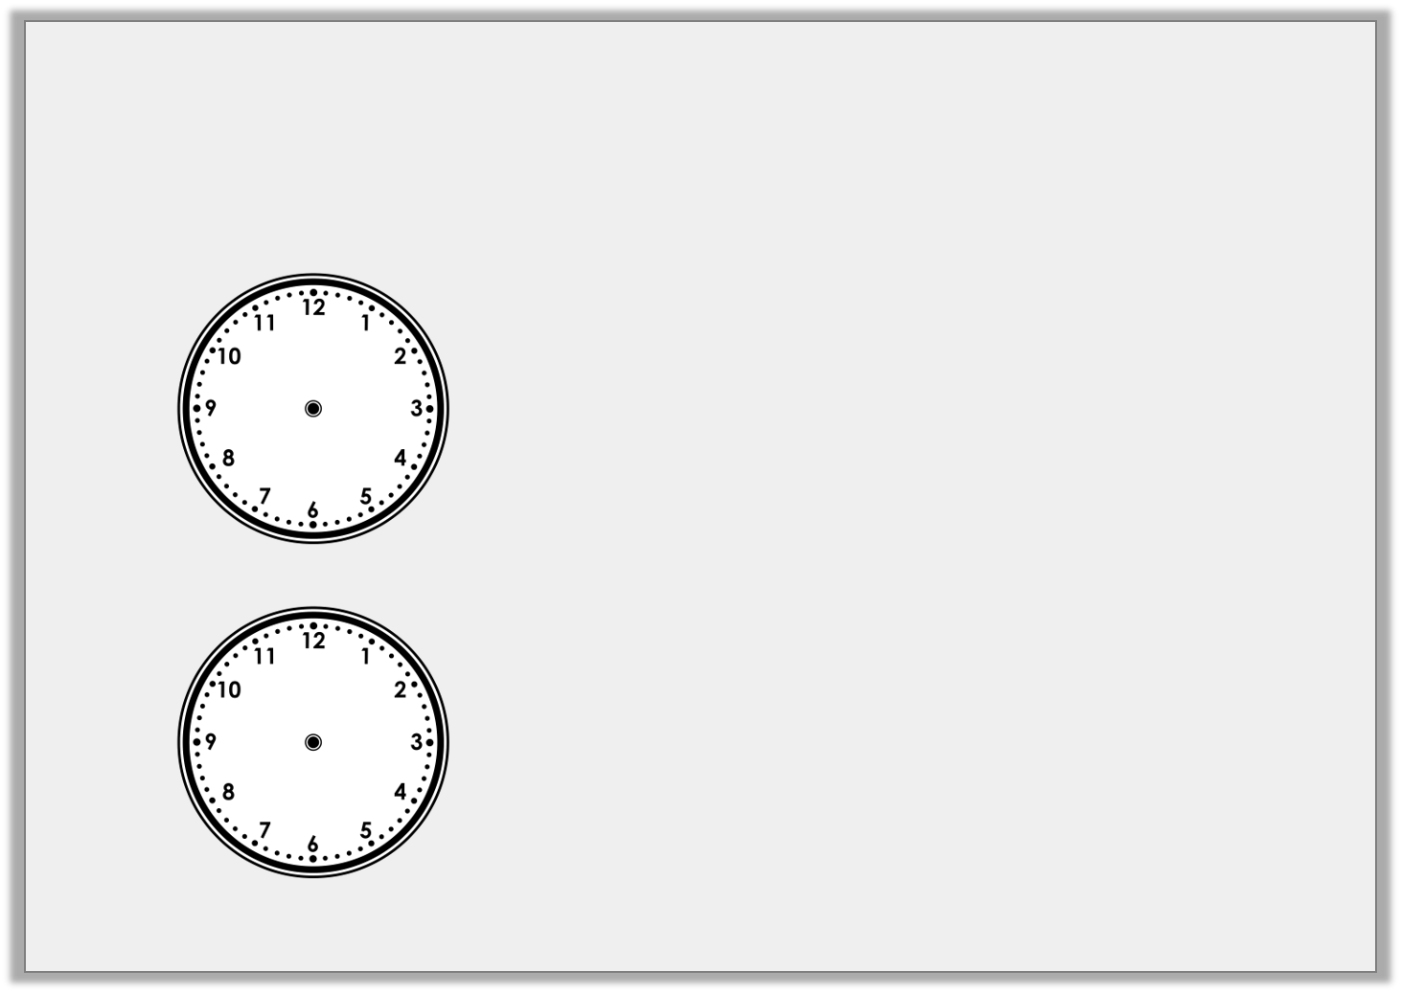
Varied Fluency 3
Draw a line to match the clocks to the correct
written time.
Half past12
3 o’clock
Half past 6
Half past 12
3 o’clock
Half past 6
© Classroom Secrets Limited 2018

Slide 10
Varied Fluency 3
Draw a line to match the clocks to the correct
written time.
Half past12
3 o’clock
Half past 6
Half past 12
3 o’clock
Half past 6
© Classroom Secrets Limited 2018

Slide 11
Varied Fluency 4
Draw a line to match the clocks to the correct
written time.
Eat lunch
Go home
Go to school
© Classroom Secrets Limited 2018

Slide 12
Varied Fluency 4
Draw a line to match the clocks to the correct
written time.
Eat lunch
Go home
Go to school
© Classroom Secrets Limited 2018

Slide 13
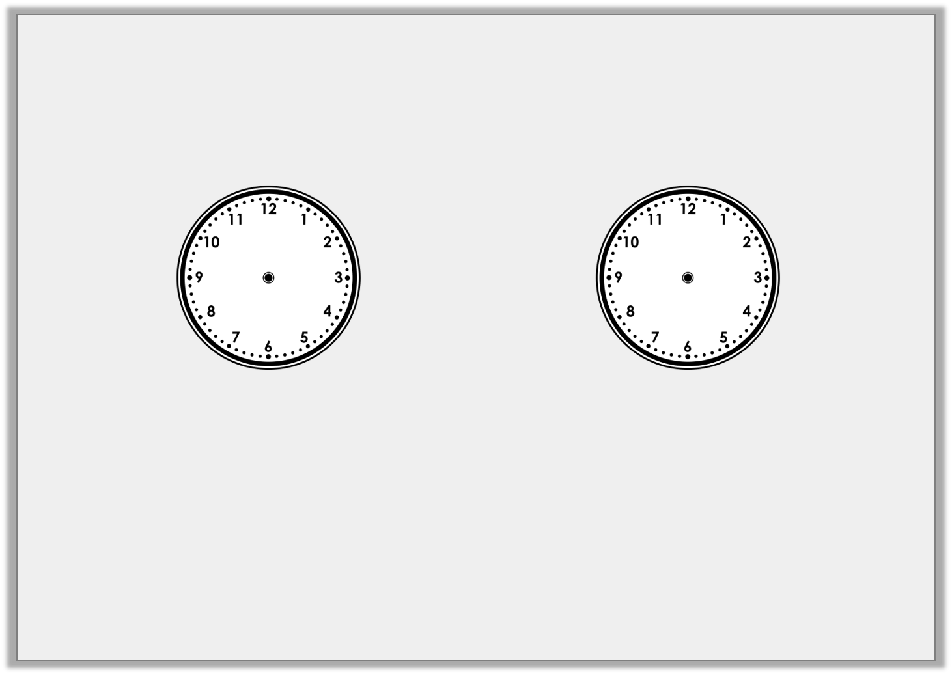
Problem Solving 1
Match the clocks to the time
and the most likely event.
Half past 8 |  | Half past 3 |  | 12 o’clock
Having lunch |  | Going to school |  | Going home
© Classroom Secrets Limited 2018

Slide 14
Problem Solving 1
Match the clocks to the time
and the most likely event.
Half past 8 |  | Half past 3 |  | 12 o’clock
Having lunch |  | Going to school |  | Going home
© Classroom Secrets Limited 2018

Slide 15
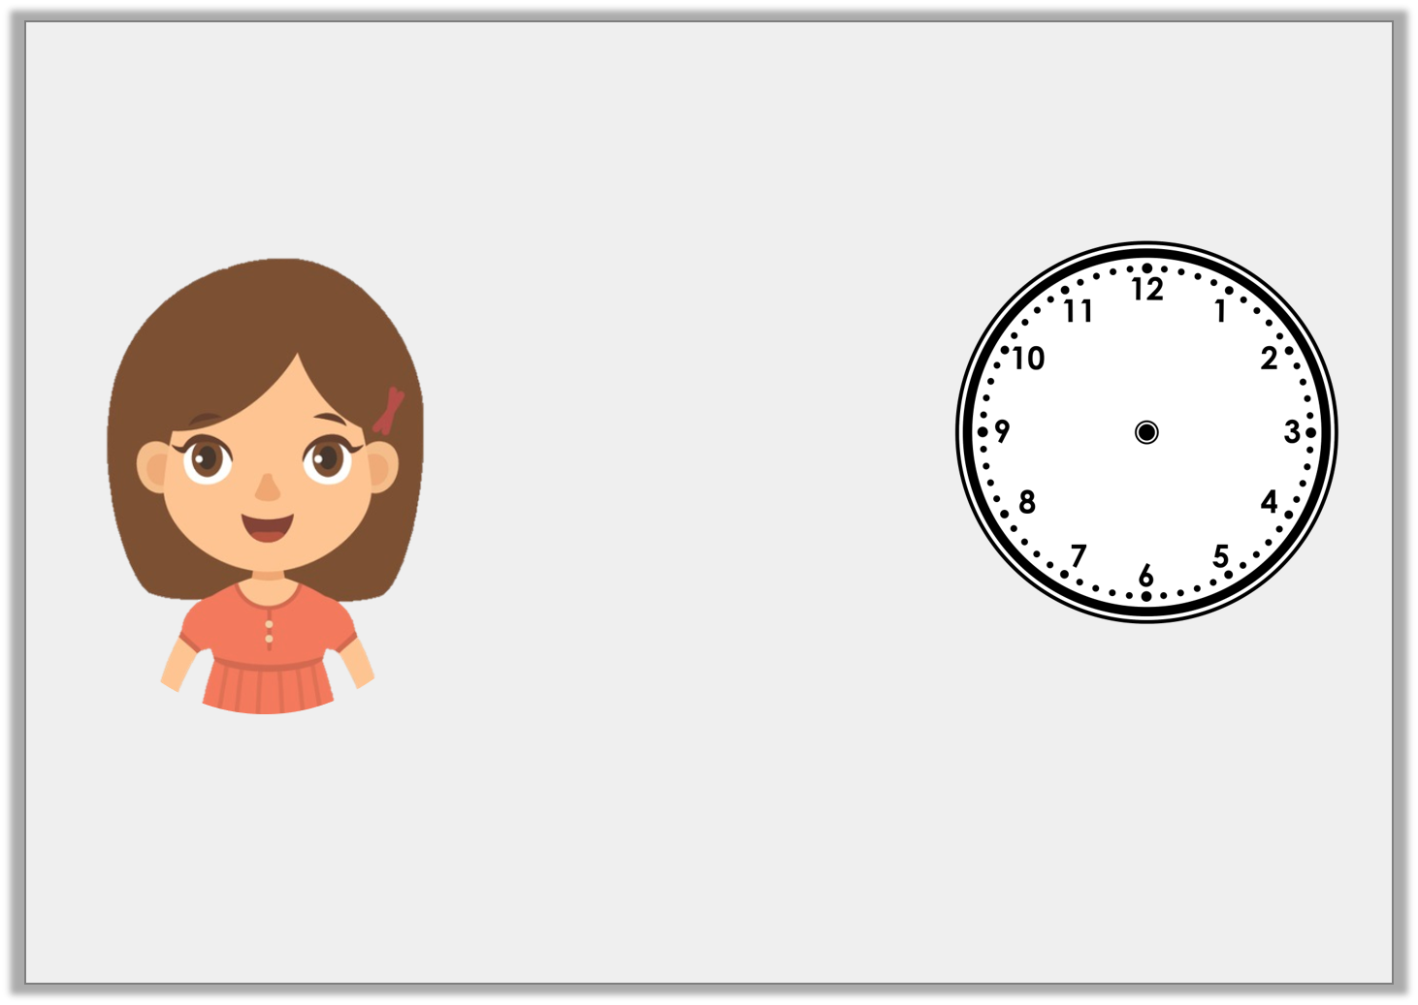
Reasoning 1
Jen is trying to tell the time.
Is Jen right? How do you know?
It’s 5 past 6.
© Classroom Secrets Limited 2018

Slide 16
Reasoning 1
Jen is trying to tell the time.
Is Jen right? How do you know?
Jen is wrong because…
It’s 5 past 6.
© Classroom Secrets Limited 2018

Slide 17
Reasoning 1
Jen is trying to tell the time.
Is Jen right? How do you know?
Jen is wrong because she has mixed up the hour hand and the minute hand. It is half past 5.
It’s 5 past 6.
© Classroom Secrets Limited 2018

Slide 18
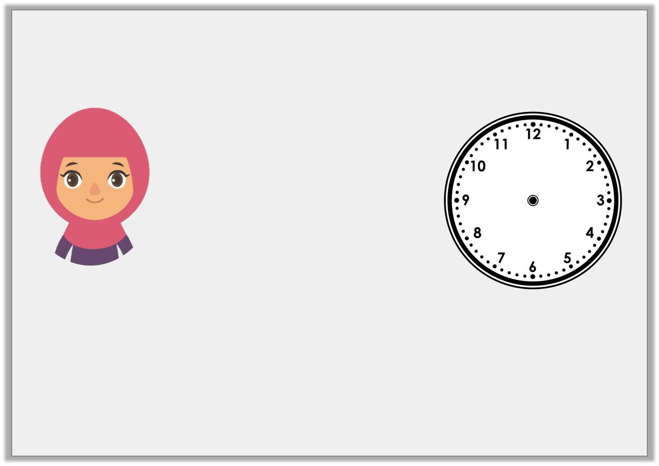
Reasoning 2
The hands have fallen off this clock. Aisha says:
Is Aisha right? How do you know?
Aisha is right about… but wrong about…
It’s half past 4 so the minute hand should be pointing down and the hour hand should be at 4.
© Classroom Secrets Limited 2018

Slide 19
Reasoning 2
The hands have fallen off this clock. Aisha says:
Is Aisha right? How do you know?
Aisha is right about the minute hand but wrong about the hour hand. If it is half past then then the hour hand should be between 4 and 5.
It’s half past 4 so the minute hand should be pointing down and the hour hand should be at 4.
© Classroom Secrets Limited 2018

