Slide 1


.
Y4 M2e. Can solve two-step problems involving addition and subtraction, deciding which operation to use.
Commissioned by The PiXL Club Ltd.
June 2019
This resource is strictly for the use of member schools for as long as they remain members of The PiXL Club. It may not be copied, sold nor transferred to a third party or used by the school after membership ceases. Until such time it may be freely used within the member school.
All opinions and contributions are those of the authors. The contents of this resource are not connected with nor endorsed by any other company, organisation or institution.
PiXL Club Ltd endeavour to trace and contact copyright owners. If there are any inadvertent omissions or errors in the acknowledgements or usage, this is unintended and PiXL will remedy these on written notification.
© Copyright The PiXL Club Limited, 2019

Slide 2
Teachers’ Notes
The PiXL therapies can be taught to a whole class or a target group. Year 3-5 therapies are designed to take approximately 30-40 minutes. However, this is flexible: it may be that only part of the therapy is taught or it could, of course, be adapted or extended.
Each therapy begins with a LORIC activity to develop relevant learning behaviours.
This is followed by a vocabulary task, which uses the PiXL 5-phase approach to teach key mathematical vocabulary. Further resources to develop vocabulary can be found in the Whole School area.
Each therapy adopts the ‘Teach, model and apply’ process with opportunities for pupils to demonstrate the taught skill independently.
Problem solving and reasoning activities are an integral part of each therapy.

Slide 3
Progress across amber – the 4-stage model
The three therapy tests which accompany this resource can be used to revisit the taught skill to check that the pupil is able to perform it independently and consistently.
A
A child has successfully completed a therapy test independently, following a set of therapy sessions.
A child has successfully completed a therapy test independently, a period after the relevant therapy sessions – we would advise about 2 weeks.
A child has successfully applied their knowledge or skill in an unfamiliar context. This may be application across the curriculum or in a problem.
A pupil has successfully re-visited the skills at a later point, and applies these in an unfamiliar context or problem, or across the curriculum.
A
DA
G

Slide 4
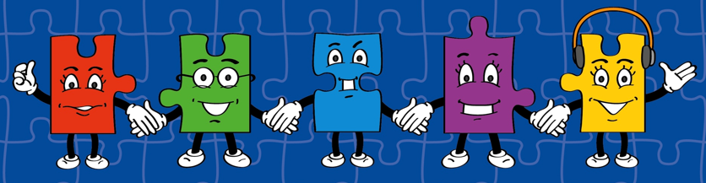
Our Primary Edge attributes help us to become better learners and today is no exception. Before you start this activity, here are some ideas for how you will need your Raj Resilience skills today:
LORIC Task
Command Words:
Persevere Complete
Overcome Achieve Sustain Undertake
Learn over time
Trying hard even when it is challenging
Learn from your mistakes
Asking for help if you need it

Slide 5

Which two numbers can you subtract to give an odd number?
Explain how you chose your numbers.
15
25
14
16
13
LORIC Task
7
18
12

Slide 6
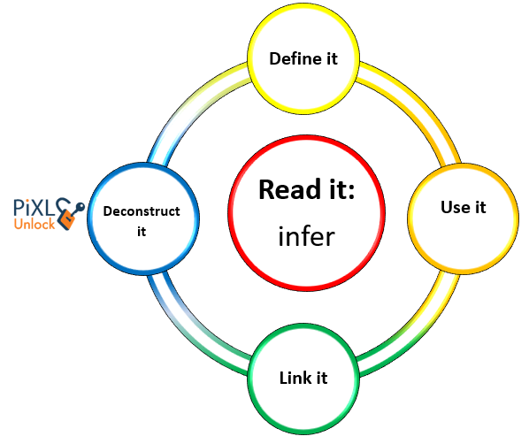

Vocabulary
multiplication
division
addition
subtraction
Use the words in the box opposite to define ‘operation’.
operation

Slide 7

Can solve two-step problems involving addition and subtraction, deciding which operation to use.
Mathematical language is really important when trying to solve any problem.
It helps you understand what the question is asking you to do and understand which operation is best to use to find the answer.
Lets think of some different words/phrases that are used for add and subtract. Talk to the person next to you.

Slide 8
Can solve two-step problems involving addition and subtraction, deciding which operation to use.
What words or phrases did you think of?
add
difference
altogether
take
how many more?
less than
subtract
double
sum
score
fewer
plus
decrease
increase
half/halve
combined
more than
how much less?
how many left?

Slide 9

Can solve two-step problems involving addition and subtraction, deciding which operation to use.
For example:
how many more than 18 is 54?
We could use a subtraction calculation to work this out.
Be careful with the word ‘more’ as it sometimes can be used to refer to a subtraction problem.

Slide 10


Can solve two-step problems involving addition and subtraction, deciding which operation to use.
Let’s look at some problems together and decide whether we would need to use addition or subtraction to solve them.
One ribbon is 17cm long and
another ribbon is 53cm long.
How much ribbon is there altogether?
I thought it would take me
60 minutes to do my homework but it actually only took 37 minutes.
How much time did I save?

Slide 11
Can solve two-step problems involving addition and subtraction, deciding which operation to use.
What language in the question helped you decide which operation you needed to use?
One ribbon is 17cm long and the other ribbon is 53cm long. How much ribbon is there altogether?
I thought it would take me 60 minutes to do my homework but it actually only took 37 minutes. How much time did I save?

Slide 12
Can solve two-step problems involving addition and subtraction, deciding which operation to use.
Sometimes you will come across a problem in which you will need to use two operations.
These are called ‘two-step problems’ because you are required to make two steps in order to solve them.

Slide 13

Can solve two-step problems involving addition and subtraction, deciding which operation to use.
I poured two 250ml glasses of orange juice from a 900ml bottle. How much orange juice is left in the bottle?
Talk to the person next to you.
What do you think we need to do to solve this problem?

Slide 14
Can solve two-step problems involving addition and subtraction, deciding which operation to use.
We know that there are two 250ml glasses of orange juice. So the first operation we will need to use is…
I poured two 250ml glasses of orange juice from a 900ml bottle. How much orange juice is left in the bottle?
First, let’s highlight the important information that tells us what we need to do.
addition.

Slide 15
Can solve two-step problems involving addition and subtraction, deciding which operation to use.
To do this quickly in our heads, we could use doubling as we know there are two 250ml glasses.
We need to use addition because we need to know how much two 250ml glasses of orange juice makes altogether.
To make doubling even quicker we can partition those two numbers.

Slide 16
Can solve two-step problems involving addition and subtraction, deciding which operation to use.
Partitioning 250 twice would look like this:
200 + 50
200 + 50
Then we could add these numbers in our heads to find the total.

Slide 17
Can solve two-step problems involving addition and subtraction, deciding which operation to use.
200ml + 200ml = 400ml
50ml + 50ml = 100ml
400ml + 100ml = 500ml
To begin to add these quickly in our heads, we only really have to add the numbers in the hundreds for 200 + 200 and we only need to add the numbers in the tens for 50 + 50.

Slide 18
Can solve two-step problems involving addition and subtraction, deciding which operation to use.
400ml + 100ml = 500ml
The final stage is adding the two answers together. We know
4 + 1 = 5 so
400 + 100 = 500
So now we know the total amount of orange juice taken from the bottle was 500ml.

Slide 19
Can solve two-step problems involving addition and subtraction, deciding which operation to use.
Have we answered the question yet? What else do we need to do? Talk to the person next to you.
I poured two 250ml glasses of orange juice from a 900ml bottle. How much orange juice is left in the bottle?

Slide 20
Can solve two-step problems involving addition and subtraction, deciding which operation to use.
We have worked out this part...
I poured two 250ml glasses of orange juice from a 900ml bottle. How much orange juice is left in the bottle?
However, we still need to work out the second part in order to solve the word problem.

Slide 21
Can solve two-step problems involving addition and subtraction, deciding which operation to use.
We know there was 900ml of orange juice in the bottle. We also know that 500ml of orange was poured in to the glasses.
What operation do we need to use to solve the final part of this problem?
I poured two 250ml glasses of orange juice from a 900ml bottle. How much orange juice is left in the bottle?

Slide 22
Can solve two-step problems involving addition and subtraction, deciding which operation to use.
The problem is asking us to work out how much juice is left in the 900ml bottle after 500ml of it was poured out.
The operation we now need to use is…
I poured two 250ml glasses of orange juice from a 900ml bottle. How much orange juice is left in the bottle?
subtraction.

Slide 23
Can solve two-step problems involving addition and subtraction, deciding which operation to use.
We need to subtract 500ml from 900ml to find out how much juice is left in the bottle.
This subtraction is fairly simple as we only really need to subtract 5 from 9!
-
In the same way as before, we know that 9 – 5 = 4 so 900 – 500 = 400.

Slide 24
Can solve two-step problems involving addition and subtraction, deciding which operation to use.
Have we answered the question yet?
I poured two 250ml glasses of orange juice from a 900ml bottle. How much orange juice is left in the bottle?
Yes! We added two 250ml glasses together to give us 500ml.
Then we subtracted 500ml from 900ml to give the answer 400ml.

Slide 25

Can solve two-step problems involving addition and subtraction, deciding which operation to use.
I poured two 250ml glasses of orange juice from a 900ml bottle. How much orange juice is left in the bottle?
400ml

Slide 26
Your turn
I have two pieces of rope. One is 170cm long and the other is 220cm long. I tie them together and then cut 35cm off to make it the right length. What length of rope do I have now?
355cm

Slide 27
Your turn
Kie has two 50 pence pieces. He goes to the shop and buys an apple for 24 pence. How much money does Kie have left?
76 pence

